Slide 1
Lesson 5
Learning Objectives:
To explore the importance of friends and the role they play in our lives.
To identify key friendship qualities and create our class list of the Top 5.

Slide 2
Private Reading – 10 Mins

Slide 3
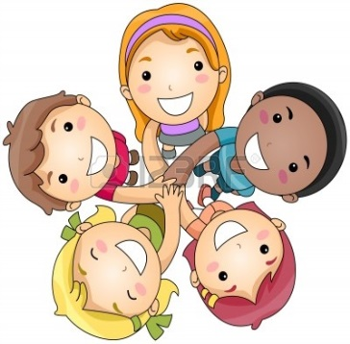
Starter - Friendship
Friends are a key part of growing up. You make friends, you fall out, you’re friends again. They make life fun!
Think about your friends carefully – create a list of what you love about them.
Share your ideas with your partner.
Share your ideas with the class.

Slide 4
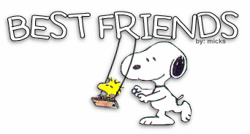
Qualities to look for in a Friend
With your partner, spider diagram the qualities you may look for in a friend:
Good sense of humour
Honesty
Qualities

Slide 5
Class’ top 5 qualities
As a class, discuss and decide what your top 5 qualities are
You must give clear, detailed reasons to explain why your quality should make it onto the final list.

Slide 6
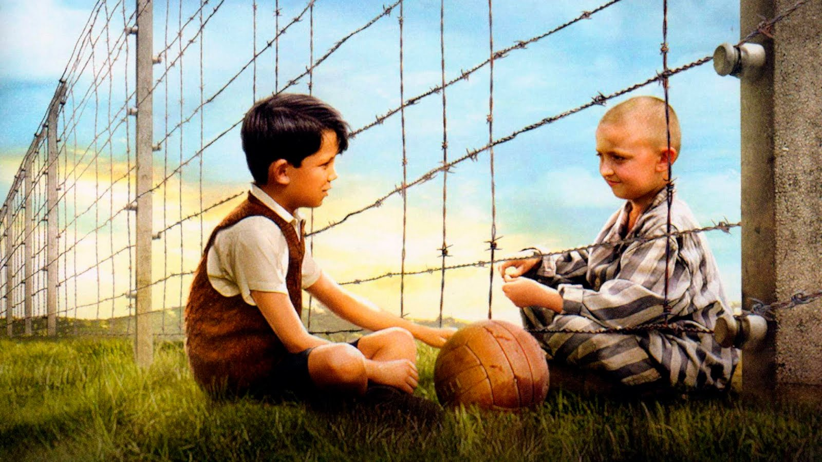
The friendship between Bruno and Shmuel in “The Boy in the Striped Pyjamas” by John Boyne
Click the above image to watch their friendship in action…

Slide 7
Read this extract from the story on your own. Keep the theme of friendship in your head…
Highlight any parts of the extract which refer to friendship in some way.
Class Annotation…The Board Run!
Teacher to select pupils across the class to highlight/annotate some of the points they have found onto the board.

Slide 8
Using what we have just done, what do we learn about friendship in this extract from the story?
Think about:
Bruno’s friends in Berlin
The bond between Bruno and Shmuel
Using the chart below, write down the quotes from the extract to support your ideas.
Bruno’s Berlin Friends | Bruno and Shmuel

Slide 9
Using your PEEL skills
Write 1 PEEL paragraph for the following question?
What do we learn about Bruno’s friendship with Shmuel in the extract from “The Boy in the Striped Pyjamas”?
Be brave and put your hand up to share your paragraph with your teacher and your classmates.

