Slide 1
Lesson 6
Learning Objectives:
To analyse friendships in children’s literature = Roald Dahl’s “Matilda”.

Slide 2
Private Reading – 10 Mins

Slide 3
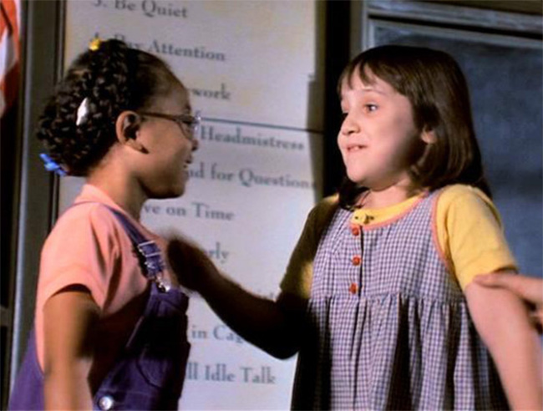
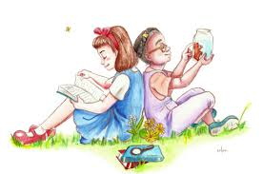
The friendship between Matilda and Lavender in “Matilda” by Roald Dahl
Click the above image to watch the beginning of their friendship…

Slide 4
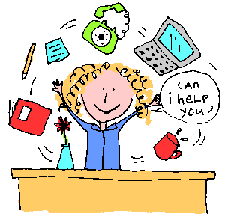
Teachers
Teachers, like parents and friends are an important part of growing up. After all, most children spend 13 years in school!
Think about your favourite teacher in your junior school. Why was s/he your favourite? Discuss in pairs. You don’t have to name them!
Share your ideas as a class.

Slide 5
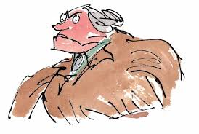
Teachers in “Matilda”
Miss. Honey – Matilda’s class teacher
The Trunchball – The Headteacher of Crunchem Hall Primary School

Slide 6
Roald Dahl’s description
Dahl uses the following quotes to describe the two teachers
Can you work out which quote belongs to which teacher?
“...If a group of children happened to be in her path, she ploughed right on through them
like a tank.”
“She had a lovely pale oval face with blue eyes and her hair was light-brown”
“...If you get on the wrong side of Miss Trunchbull she will liquidise you like a carrot in a kitchen blender.”
“Her body was so slim and fragile one got the feeling that if she fell over she would smash into a thousand
pieces, like a porcelain figure.”
“...You could almost feel the dangerous heat radiating from her as from a red-hot rod of metal.”
“she possessed that rare gift for being adored by every small child under her care”
“She had a lovely pale oval face with blue eyes and her hair was light-brown”
“...An enraged rhinoceros.”
“Her whole body seemed to swell up like a bullfrog’s.”
“mild and quiet person who never raised her voice”
“...an enormous human bomb...”
“...A fierce tyrannical monster.”

Slide 7
Answers! Were you right?
The Trunchbull
Miss Honey
“...If a group of children happened to be in her path, she ploughed right on through them
like a tank.”
“She had a lovely pale oval face with blue eyes and her hair was light-brown”
“...If you get on the wrong side of Miss Trunchbull she will liquidise you like a carrot in a kitchen blender.”
“Her body was so slim and fragile one got the feeling that if she fell over she would smash into a thousand
pieces, like a porcelain figure.”
“...You could almost feel the dangerous heat radiating from her as from a red-hot rod of metal.”
“she possessed that rare gift for being adored by every small child under her care”
“She had a lovely pale oval face with blue eyes and her hair was light-brown”
“...An enraged rhinoceros.”
“Her whole body seemed to swell up like a bullfrog’s.”
“mild and quiet person who never raised her voice”
“...an enormous human bomb...”
“...A fierce tyrannical monster.”

Slide 8
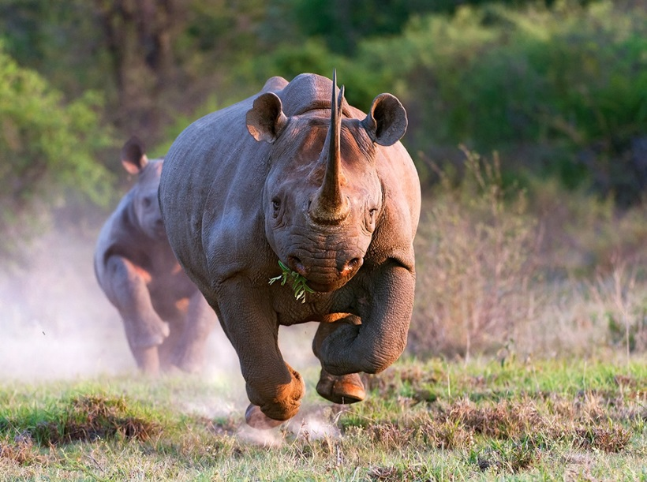
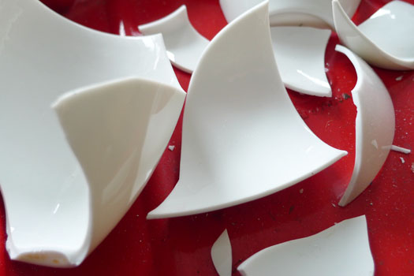
Your impressions
Challenge – Why does Dahl present the women so very differently?
Select 1 quote for Miss. Honey and 1 quote for The Trunchbull and draw the image that is created in your mind
To help you…
“Her body was so slim and fragile one got the feeling that if she fell over she would smash into a thousand pieces, like a porcelain figure.”
“...An enraged rhinoceros.”

Slide 9
Creative writing
Using everything from the last 6 lessons, write a description of your imaginary favourite teacher.
Remember to include the following:
Language devices
Interesting vocabulary
Different types of sentences
Be as creative as you can!
If you have time, you can draw an image to go with your description.

Slide 10
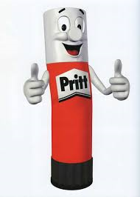
Learning from our Peers
Swap exercise books with your neighbour.
Read their paragraph carefully…can you see the following things:
Language devices?
Interesting vocabulary?
Different types of sentences?
On a separate piece of paper, write down 1 thing you really like about your neighbour’s paragraph – what went well… (WWW)
Write down 1 thing your neighbour could do to make their paragraph even better – even better if… (EBI)
Once you have finished, please return their book to them and give them the piece of paper to stick into their exercise book under their paragraph.

Slide 11
Feedback and Improvement Time
Using your EBI target, improve the quality of your paragraph
Consider using devices for imagery and sound you have not already used – be as imaginative as you can!
Challenge – Write a paragraph describing either Miss. Honey or The Trunchbull.
Remember to use the devices we have been learning.

