Slide 1
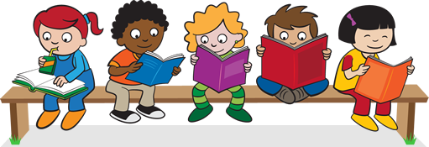
Year 6 – Transition Unit into KS3
Reading Skills
May 2018

Slide 2
Lesson 1
Learning Objectives:
To understand and explain the importance of reading.
To match up language devices to their definitions.
To create your own examples using language devices.

Slide 3
Private Reading – 10 Mins

Slide 4
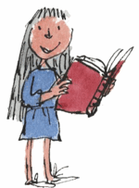
Reading is fun!
Roald Dahl in “Matilda”:
“The books transported her into new worlds and introduced her to amazing people who lived exciting lives. She went on olden-day sailing ships with Joseph Conrad. She went to Africa with Ernest Hemingway and to India with Rudyard Kipling. She travelled all over the world while sitting in her little room in an English village.”
Reading opens up the world to us – our senses come alive as the writer works their magic.
This lesson, we are going to be looking at how the writer allows us to see and hear the world they have created.

Slide 5
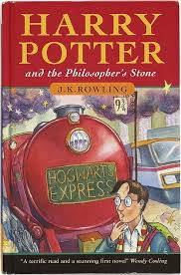
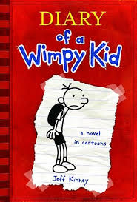
Who is your favourite Author?
In pairs, talk about your favourite author, your favourite book?
What makes your book/author your favourite?

Slide 6
Language Devices
Have you heard of them before?
What are they?
Match the device to its description on the right hand side
Some of these you will recognise but some you may not but that is absolutely fine! Match up as many as you can.

Slide 7
Onomatopoeia
Match up!
Imagery
A figure of speech that shows a resemblance between things of different kinds = usually formed with “like” or “as”.
A form of metaphor in which animals, ideas and things are presented as having human qualities = The drums were weeping today.
Simile
A group of words that create a mental image. Usually refers to the five senses = sight, touch, smell, hearing and taste.
The repetition of vowel sounds in a sequence of nearby words = The monster spoke in a low mellow tone – the repetition of the “O” sound.
Metaphor
Personification
The repetition of the same sound, a consonant at the beginning of two or more words immediately succeeding each other.
A figure of speech in which one thing is described as if it were another = “Life is just a bowl of cherries”.
Assonance
Sibilance
Sound systems which over emphasise the “s” or “ch” sounds and produce a hissing sound.
The term used to describe words whose pronunciations suggest their meaning = bang, buzz, slap, fizz
Alliteration

Slide 8
Onomatopoeia
The Answers!
Imagery
A figure of speech that shows a resemblance between things of different kinds = usually formed with “like” or “as”.
A form of metaphor in which animals, ideas and things are presented as having human qualities = The drums were weeping today.
Simile
A group of words that create a mental image. Usually refers to the five senses = sight, touch, smell, hearing and taste.
The repetition of vowel sounds in a sequence of nearby words = The monster spoke in a low mellow tone – the repetition of the “O” sound.
Metaphor
Personification
The repetition of the same sound, a consonant at the beginning of two or more words immediately succeeding each other.
A figure of speech in which one thing is described as if it were another = “Life is just a bowl of cherries”.
Assonance
Sibilance
Sound systems which over emphasise the “s” or “Ch” sounds and produce a hissing sound.
The term used to describe words whose pronunciations suggest their meaning = bang, buzz, slap, fizz.
Alliteration

Slide 9
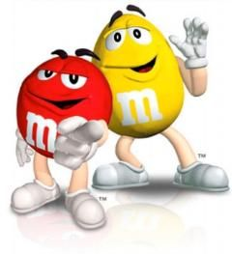
Sights and Sounds
Pick 2 devices which create a sound and 2 devices which create an image in your head
Using your artistic talents, draw them:
Onomatopoeia
Personification

Slide 10
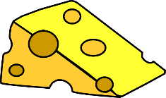
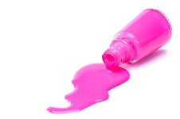
Writing your own examples
Sound | Imagery
Lee was a cheesy, wheezy cheese freak who liked to eat cheese all week. (Assonance) | As friends, we are two peas in a pod! (Metaphor)
The lightening crashed through the night waking me up with a fright. (Onomatopoeia) | Today, I’m feeling as fresh as a daisy. (Simile)
Sally sells seashells on the sea shore. (Sibilance) | Without my glasses, I am as blind as a bat. (Simile)
Paige’s pink polish pours profusely. (Alliteration) | The trees danced back and forth in the wind. (Personification)

Slide 11
Reflection: Language Devices
How well do you understand these devices?
You will be creating and identifying language devices throughout Year 7 when you go to your new schools.
Do not worry if you can only remember and use a few.
The more you come across them, the better you will become!
This is hard, so much to remember.
Almost there, need to practise a little more.
This makes sense to me, I get it.

Slide 12
Lesson 2
Learning Objectives:
To identify language devices in a text.
To use language devices in your own writing.

Slide 13
Private Reading – 10 Mins

Slide 14
Can you find examples in this piece of writing?
Label the highlighted examples I have found for you
Can you find any others?
Stars twinkled overhead in the midnight sky. The only sounds that punctuated the night were the crackling and spitting of the flames in the campfire. A gentle, cool breeze drifted across the forest landscape, kissing the faces of the mesmerized children. The smell of marshmallows toasting over the flickering fire wound their way up the children’s noses. Flames stood tall and proud, their sparks illuminating the dark, creating dancing shadows on the children’s eager faces. All present were completely silent, as still as marble statues. They sat, watching, waiting, for the tales of old to begin.

Slide 15
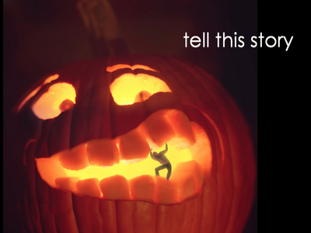
Can you write your own description?
Use this image to help you write a piece of description.
Aim to use as many language devices as you can!
Pupils to share their pieces with the class.
As you listen, see if you can pick up on the
devices used.

Slide 16
Reading and Writing
Language devices are important for both your reading skills and your writing skills.
Reading =
Writing =
You identify them in a text and explain what the effect is.
You use them in your own writing to make your writing more interesting, encouraging the audience to read more.

Slide 17
Reflection: Language Devices
How well do you understand these devices after this lesson?
You will be creating and identifying language devices throughout Year 7 when you go to your new schools.
Do not worry if you can only remember and use a few.
The more you come across them, the better you will become!
This is hard, so much to remember.
Almost there, need to practise a little more.
This makes sense to me, I get it.

