Slide 1
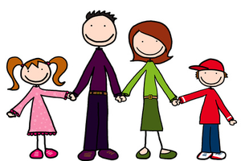
“Parents’ Sayings” by Michael Rosen
You’re old enough to wash your own socks.
He’s not coming through that door again, I can tell you.
If it’s true what your teacher said then you can say goodbye to that coat we were going to get you.
You do it and like it.
When did you last wash your feet?
Why don’t you do a Saturday job?
The answer’s NO.
The biscuits are for everyone – OK?
Don’t mind me, I’m just your mother.
You haven’t ridden that bike of yours for years.
You try and leave home and I’ll chuck you out on your ear.
You’re certainly not going to put that up on any wall in this house.
Do you know what a Hoover is?
You can pay for the next phone bill.
If you don’t like this gaff – find another one.
Just ‘cos he’s doing biology he thinks he’s going to be a brain surgeon.
Do you remember that lovely Christmas when he was six?
Read this poem in pairs and highlight 4 things the Parent/Guardian says to their child.
Think carefully…what could Rosen be saying to parents?
Discuss as a class.

Slide 2
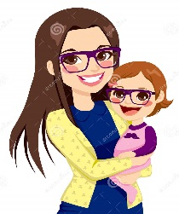
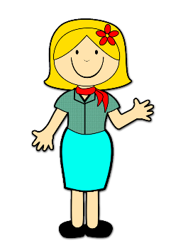
Pictorial Annotation of the Poem
In Pairs = which line do you think each of the images belongs to? Teacher to select pupils to add their ideas to the board.
You’re old enough to wash your own socks.
He’s not coming through that door again, I can tell you.
If it’s true what your teacher said then you can say goodbye to that coat we were going to get you.
You do it and like it.
When did you last wash your feet?
Why don’t you do a Saturday job?
The answer’s NO.
The biscuits are for everyone – OK?
Don’t mind me, I’m just your mother.
You haven’t ridden that bike of yours for years.
You try and leave home and I’ll chuck you out on your ear.
You’re certainly not going to put that up on any wall in this house.
Do you know what a Hoover is?
You can pay for the next phone bill.
If you don’t like this gaff – find another one.
Just ‘cos he’s doing biology he thinks he’s going to be a brain surgeon.
Do you remember that lovely Christmas when he was six?
What clues to we get about the relationship between the Parent/Guardian and the child?
Discuss your ideas in pairs and then share as a class.

