Slide 1
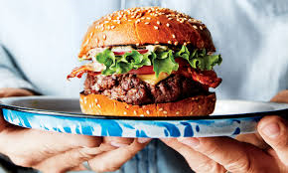
Writing a PEEL Paragraph…The Burger
Point = Your opening sentence which focuses on the question you have been asked.
Evidence = The quote you have selected from the text to support your ideas.
Explanation = Your analysis of the quote you have selected. You breaking it apart and explaining it in as much detail as you can to show your understanding of it.
Link = The link back to the question to keep your answer focused on what you have been asked.

Slide 2
Writing a PEEL Paragraph…The Burger
Point = Your opening sentence which focuses on the question you have been asked.
Evidence = The quote you have selected from the text to support your ideas.
Explanation = Your analysis of the quote you have selected. You breaking it apart and explaining it in as much detail as you can to show your understanding of it.
Link = The link back to the question to keep your answer focused on what you have been asked.

