Slide 1
Find your letter, sit down and read it!

Slide 2
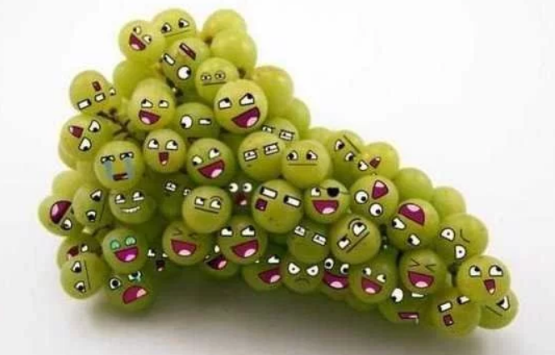
Wednesday 26th June 2019
We are learning to write effectively for audience and purpose.
Dear 5 Maple,
Welcome to your future classroom! We are very pleased to have the opportunity to get to know you all for a whole day and we hope that that when you leave us that you will be excited, enthusiastic and eager to take on the challenges of Year 6 at Emmbrook Junior School. As well as today being your first chance at seeing how Year 6 feels, you also get the opportunity get to know us a bit bette, so please do ask any questions about the SATs, Manor and other aspects of Year 6 that may be worrying you or excited about!
Year 6 is a monumental year for many different reasons: a residential trip away from home, which for some will be the first stay away from your family; taking on responsibilities around the school in the form of House Captains and monitors; a summer production and it is the year of those little national tests… but we mustn’t worry too much about those. This is also the year that you will make choices that will impact the next seven years of your schooling as you will visit many secondary schools and apply to the one of your choosing. No wonder the current Year 6 are exhausted!
We are both looking forward to guiding you though this year and help prepare you for your next steps in life. We promise that there will be fun and adventure throughout the year, but also be prepared that it will be, what has always been, a year of hard work and dedication to strive to be the very best that you can.

Slide 3
Wednesday 26th June 2019
We are learning to write effectively for audience and purpose.
With this, we are looking forward to all of the highs, and the lows, and the only concern that either of us have is that somebody in our class is saddened or unsure by any situation. We are in this together. So let’s take Year 6 by the horns and get stuck in!
This morning’s task is to write back to us. We would really like to know more about each and every one of you, so construct you letter carefully to describe your strengths (and weaknesses), what you are looking forward to in Year 6, any worries that you might have as well as what you are really looking forward to. Tell us about your hobbies, if you belong to any extra-curricular clubs or associations, who is your favourite author (and why) and in general what you enjoy spending time doing. The more you tell us, the better we can tailor your learning experiences for the word go in September.
We look forward to reading your replies!

Slide 4
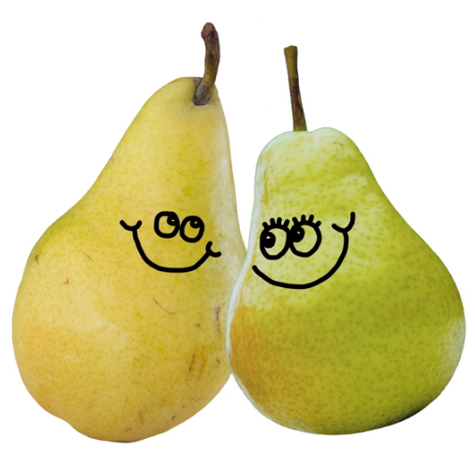
Wednesday 26th June 2019
We are learning to write effectively for audience and purpose.
Using our letter to you, what do you think the success points for your own letter should be?
Basics | Grammar | Vocabulary

Slide 5
Wednesday 26th June 2019
We are learning to write effectively for audience and purpose.
What did we ask to find out about you?
What is inside you head?

Slide 6
Wednesday 26th June 2019
We are learning to write effectively for audience and purpose.
Model write and edit:

Slide 7
Wednesday 26th June 2019
We are learning to write effectively for audience and purpose.
Write up:
1) Is your writing successful? What do I mean by that ?
2) Spend 10 min proof-reading and editing your draft.
3) Using paper supplied, present your letter to the best standard that you are capable of.

