Slide 1
Welcome
Thank you for joining us today
Please:
Mute your microphone
Turn off your cameras
Turn on your Chat box to communicate with us whilst on mute
Please ask questions by raising your hand or via the Chat box

Slide 2
Implementation Berkshire Healthcare

Slide 3
What is ChatHealth?
A confidential & anonymous text messaging service for parents/carers and young people
Run by our Specialist Community Public Health Nurses – Health Visitors & School Nurses and their team.
Started by Leicestershire Partnership NHS Trust, package now sell to other trusts
70 NHS partners have adopted it (across England, Wales, & Northern Ireland)
Available for 2.8 million young people & parents/carers and over 3.9 million 0-19 yr olds
40% of Health Visiting services now use ChatHealth
60% of School Nursing services now use ChatHealth
400,000 messages sent to health professional 2021-2022
Please note running in Bracknell, Reading, West Berks & Wokingham only
Notes:
Julia

Slide 4
What is ChatHealth?
Text messaging service - anonymous or can give personal details
Response within 24 hours
Messages can be on any health topic
A conversation could go on for a few messages or be resolved in 1 message e.g. by sending links to additional resources
Conversations recorded so no need to repeat if conversation continues over following days with different licence holders and ability to add notes for practitioners to review
Runs 9 – 4.30pm Mon – Fri (excluding bank holidays) all year round
Immediate message is sent confirming receipt, if out of hours bounce back message directing to information until able to return message
Staff will have ongoing training and supervision
Strict confidentiality rules
Notes:
Julia

Slide 5
What is ChatHealth?
Convenient
Can park a question
Traditional ways to get help often stigmatised & difficult to access
Feedback
young people feel more comfortable discussing sensitive issues via a messaging helpline
busy parents value its convenience
Helps under-served and 'hard-to-reach' groups
Early interventions – prevent problems escalating
Notes:
Julia

Slide 6
Berkshire Healthcare launching 5 ChatHealth services
Health Visiting
Parents of 0-5 yrs.
School Nursing
Parents of 5 – 19 yrs.
Young people 11 – 19 yrs.
Young people with SEND 19 -25 yrs.
Care Leavers 19 -25 yrs.
Notes:
Julia

Slide 7
ChatHealth Reports HV monthly reports showing peak days
Notes:
Kirstie
This data was for the 1st month of July.

Slide 8
ChatHealth Reports HV monthly reports showing peak hours
Notes:
Kirstie

Slide 9
ChatHealth Reports HV monthly themes of contact
579.Contact-Type
 | Jul-2022 | Total
Appointment request/admin | 19 | 19
Behaviour Management | 2 | 2
Bottle feeding | 9 | 9
Breastfeeding | 5 | 5
Colic/reflux | 6 | 6
Constipation/stool queries | 9 | 9
Dental | 2 | 2
Diet/nutrition/lifestyle | 4 | 4
General development | 6 | 6
Immunisations | 1 | 1
Minor illnesses | 8 | 8
Other | 10 | 10
Parenting advice/support | 1 | 1
Signposting | 1 | 1
Sleep | 3 | 3
Speech and Language | 5 | 5
Toilet training | 1 | 1
Vitamins | 1 | 1
579.Reason-for-closing
 | Jul-2022 | Total
Conversation completed via ChatHealth | 12 | 12
Face to face arranged | 3 | 3
Onward referral to another service | 1 | 1
Service user no longer engaging | 7 | 7
Notes:
Kirstie

Slide 10
Parents/Carers 0 – 5 yrs
Top reasons for contact (2021-22)
Infant feeding
Minor illnesses
General development
Busiest time Mondays 9.00 – 12.00
Notes:
Kirstie

Slide 11
Young People
Top reasons for contact
Busiest time Monday 15.00 – 16.00
Notes:
Julia

Slide 12
Parents/Carers 5 – 19 yrs.
Top reasons for contact
Emotional health & wellbeing
General health
Parenting advice and support
Busiest time Thursday 9- 11am
86% of parents said ChatHealth conversation helped them
Notes:
Julia

Slide 13
What the parents say:
“To reach someone easily and get a response so fast is really reassuring. I thought I would need a long wait to speak to anyone“
What the young people say:
“It has made me feel more at ease. I feel like I can easily talk about the way I feel and not be judged.”
What the staff say:
“Many young people seem to find it easier to text rather than call or speak face to face.”
“Parents that are unlikely to contact us by phone do contact us via ChatHealth, such as some younger parents and those struggling with anxiety or other mental health issues.”
“ChatHealth allows those who don’t regularly engage with our services to reach us when they require support.”
Notes:
Julia

Slide 14
Marketing
Health Visiting ChatHealth
“soft launch” 4th July (To date 552 conversations, with 108 July and 444 August) big launch 19th September
School Nursing ChatHealth
Parents 11 – 19 yrs big launch from 3rd October
Young people 11- -19 yrs big launch from 3rd October
Young people with SEND 19 -25 yrs & Care Leavers 19 -25 yrs 2023 launch
Posters will be distributed to Children’s Centres, schools, health settings, GP’s, libraries & other community venues in September
Notes:
Kirstie

Slide 15
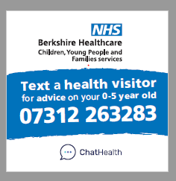
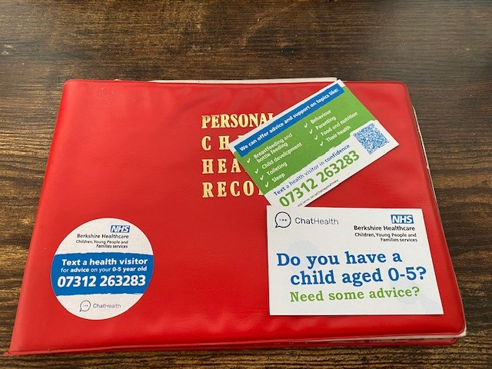
Marketing (continued)
Stickers placed on front of “Red Books”
Wallet sized cards with ChatHealth details to be given at all Health Visiting & School Nursing contacts & for other services to distribute
Wallet sized cards with details of ChatHealth will be distributed via the immunisation team to all year 7, 8 & 9s at their immunisation sessions
Social media campaign
CYPF website
Notes:
Kirstie

Slide 16
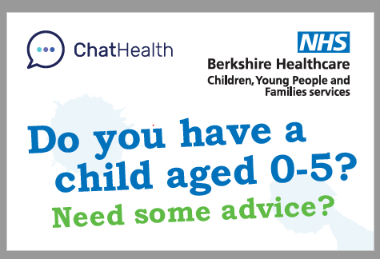
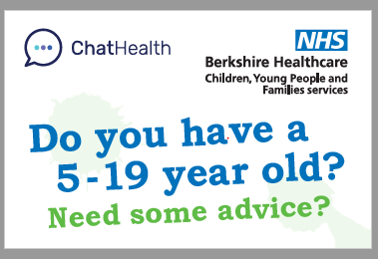
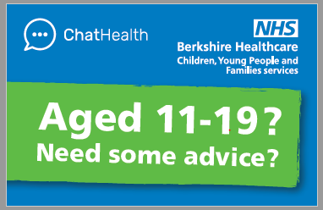
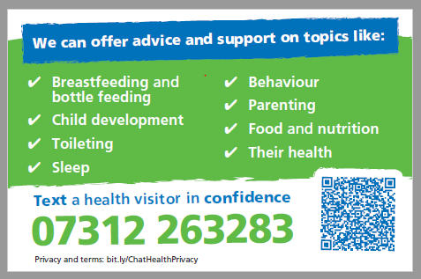
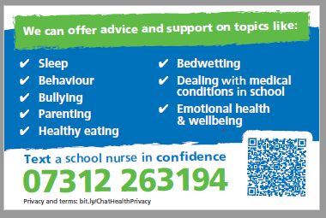
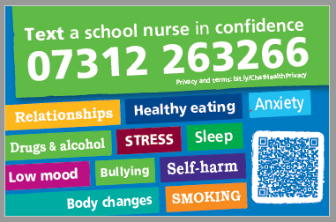
Marketing(continued)
Wallet sized Cards
Notes:
Kirstie

Slide 17
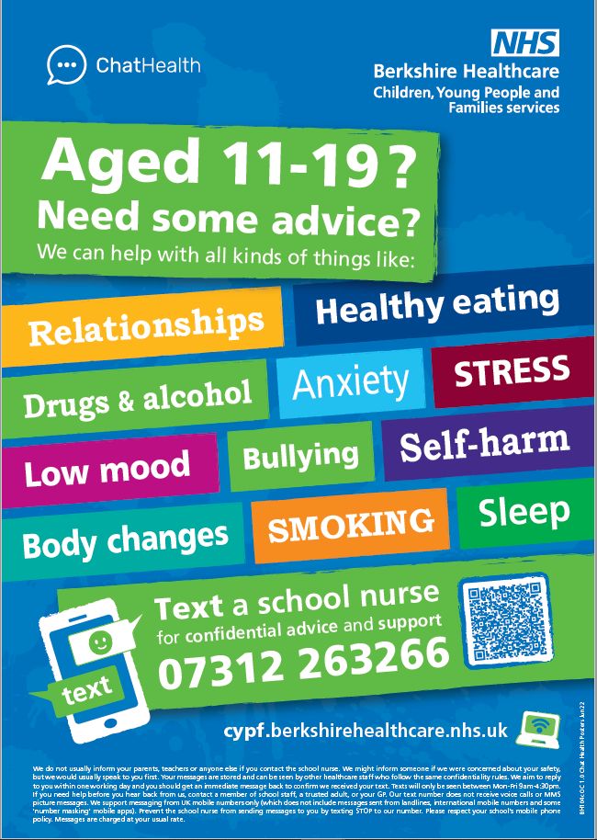
Marketing(continued)
Posters
Notes:
Kirstie

Slide 18
ChatHealth Texting Numbers
Health Visiting
Parents of 0-5 yrs 07312 263283
School Nursing
Parents of 5 – 19 yrs 07312 263194
Young people 11 – 19 yrs 07312 263266
Notes:
Kirstie

Slide 19
Thank you
Any questions…

