Slide 1
BACS Processing
Clare Garner
School Business Manager - Gorse Ride Schools
Lianne Wright / Karen Munkenbeck
Group Finance - WBC

Slide 2
How can BACS help?
Reduce the need for cheques
Save time writing/printing/signing cheques
Save on stationery and postage costs
Reduce reconciliation time
Eliminate problem of uncashed cheques
More control over cash flow

Slide 3
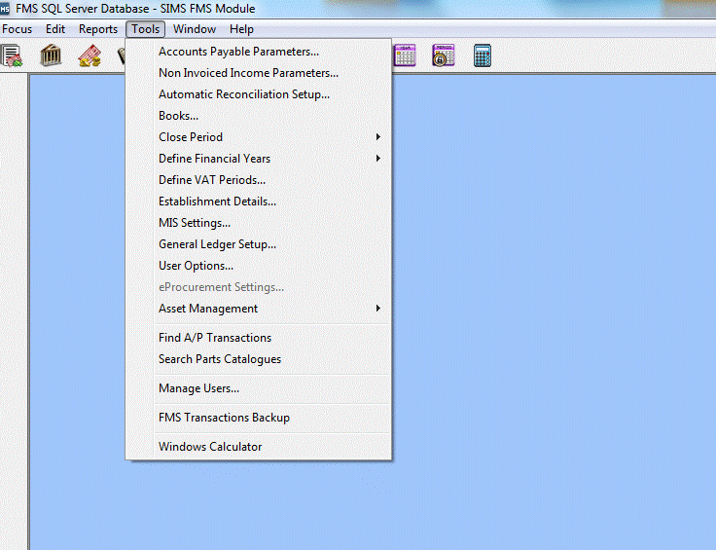
FMS - Using BACS for the first time…

Slide 4
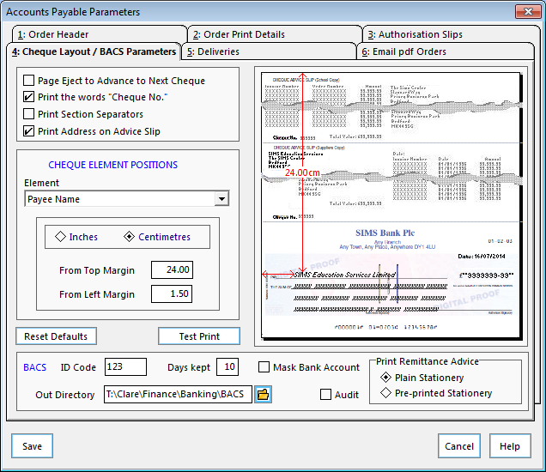
FMS – Setting up BACS Parameters…
Enter 3 digit number for BACS ID code – this will make up part of the BACS transmission filename.
Specify a backed up location to store BACS files.

Slide 5
FMS - Using BACS for the first time…

Slide 6
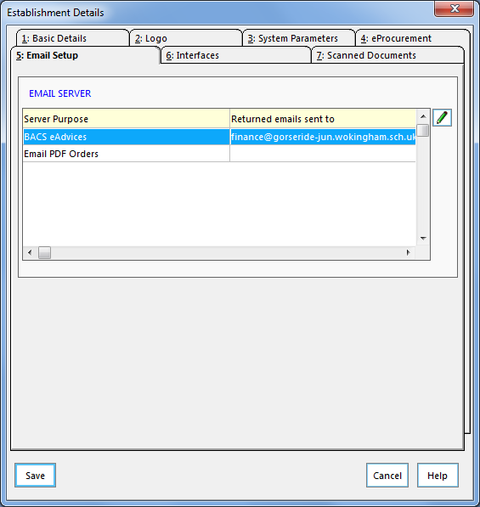
BACS Email Setup
You can enter specific email address details and also a message that will be sent to the supplier at the point a BACS file has been generated or at any time after that.

Slide 7
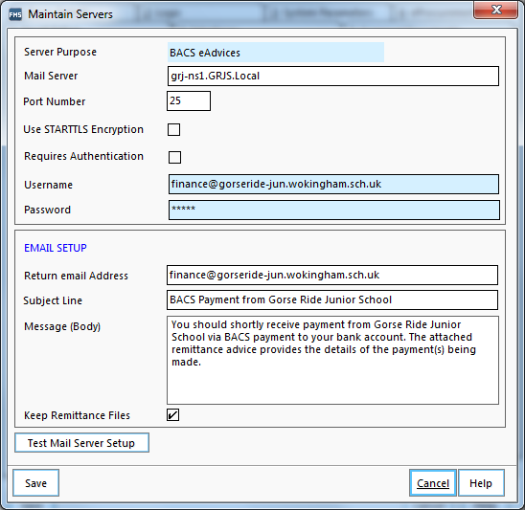
BACS eAdvice Settings
You need to enter your local email server name

Slide 8
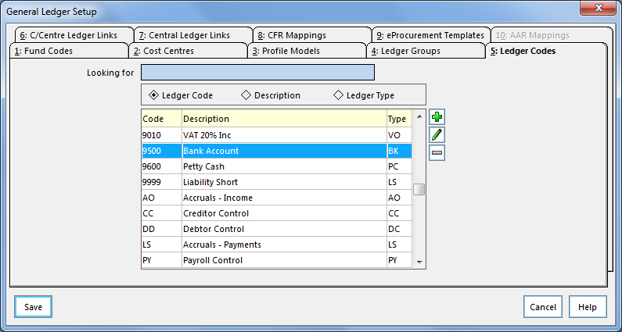
Bank Account Ledger Setup
Via Tools / General Ledger Setup
Select Bank Account

Slide 9
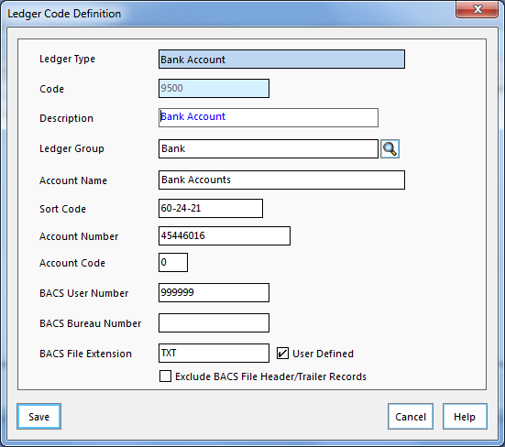
Bank Account Setup
BACS User Number is supplied by bank or use a dummy number like 999999
Tick User Defined box and enter txt into the BACS file extension
Ensure ‘Exclude BACS File Header/Trailer Records’ is not ticked

Slide 10
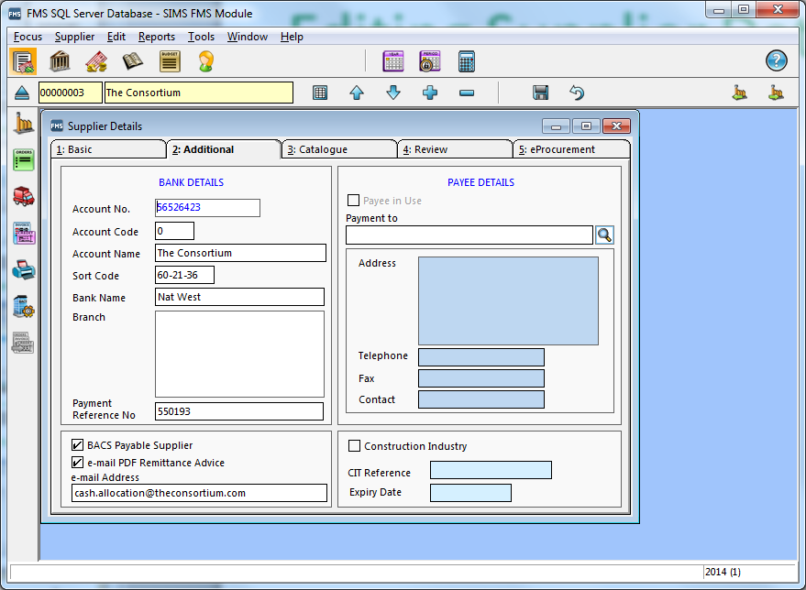
Editing Supplier Details
Bank details required
Payment reference number can be invoice number or account number
If ‘BACS Payable Supplier’ is not ticked invoices will appear in cheque runs not BACS (see note below also)
If a supplier email address is not added a remittance will be printed which can be posted. Suppliers may need to be contacted to obtain a remittance email address as it is often not included on invoices
Only alpha numeric characters in Account Name or file will be rejected by Bankline
If you wish to do one off cheque payments there is an option to do this in the cheque run screen – no need to change the settings (i.e. untick BACS Payable Supplier) in this screen.

Slide 11
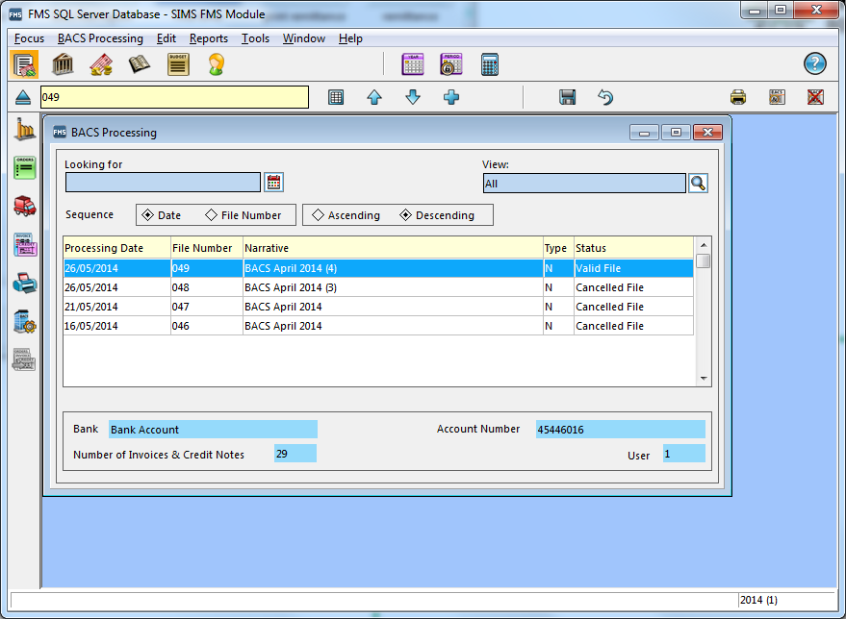
Starting a new BACS run
Click on plus sign to add new BACS run
See all previous BACS runs
Focus / Accounts Payable / BACS Processing

Slide 12
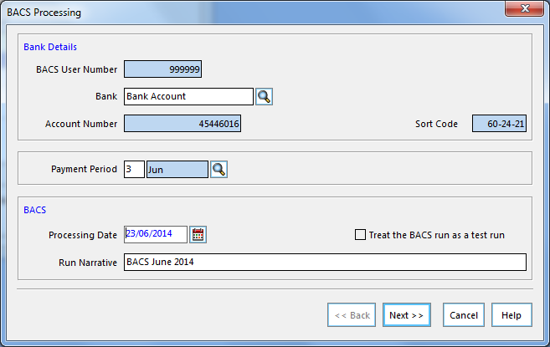
BACS Processing…
Processing Date – the date the payment will be processed by your bank and should be set for at least 3 days ahead to allow time for authorisation. Need to take bank holidays into account. WBC schools are not set up for next day payments as they are more expensive.
Test run – to create a BACS file to send to the bank to test the process but no details will be posted in FMS

Slide 13
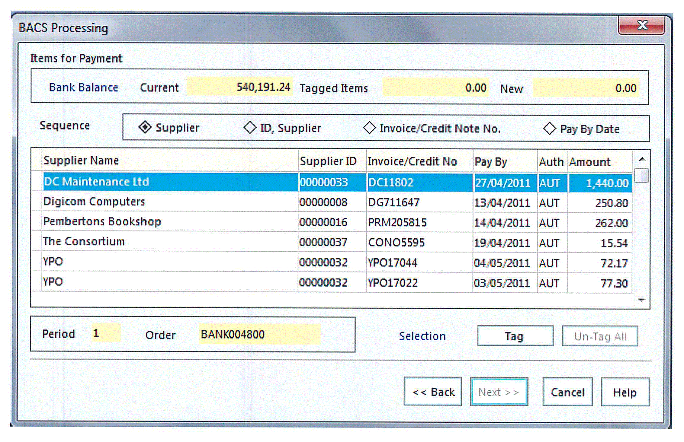
BACS Processing…
Very similar to cheque processing screen – tag invoices and click Next > >

Slide 14
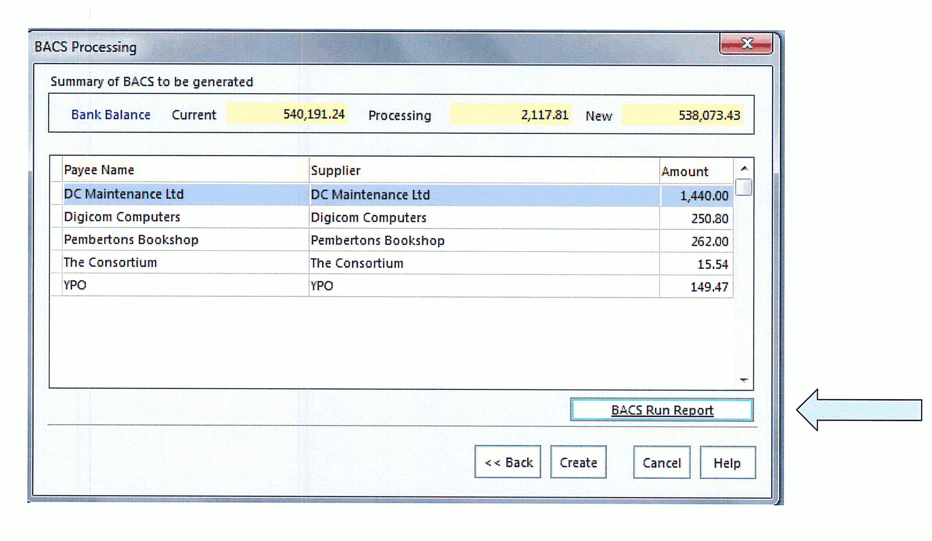
BACS Processing…
Print the BACS run report

Slide 15
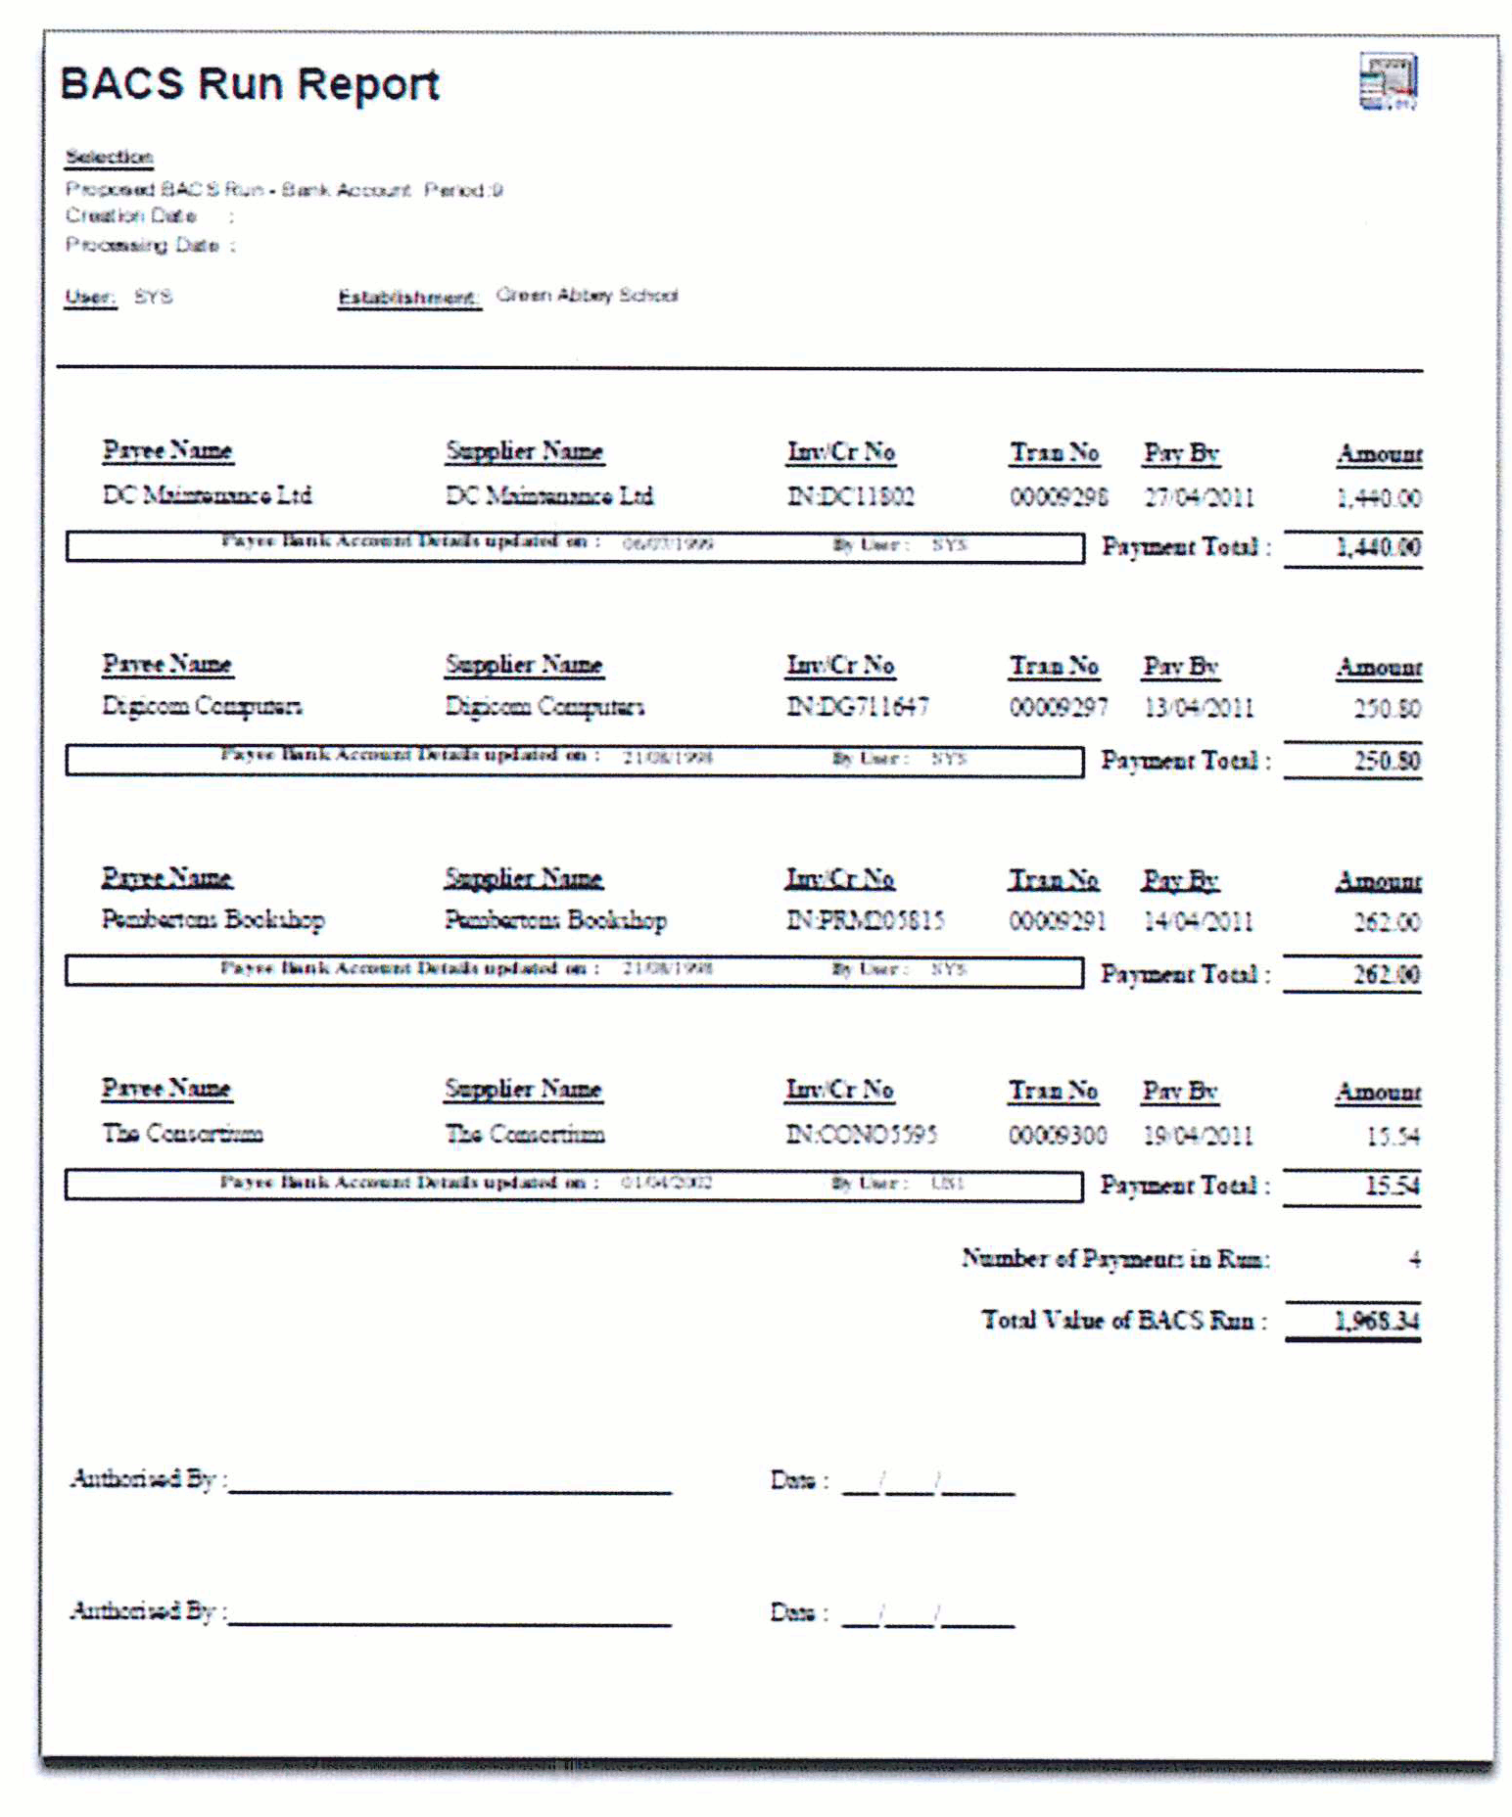
BACS Run Report
This is the only form on which signatures are required
Once signed photocopy for each supplier and attach to back of invoice(s)

Slide 16
Create BACS Run…
Click ‘Create' to generate the BACS file

Slide 17
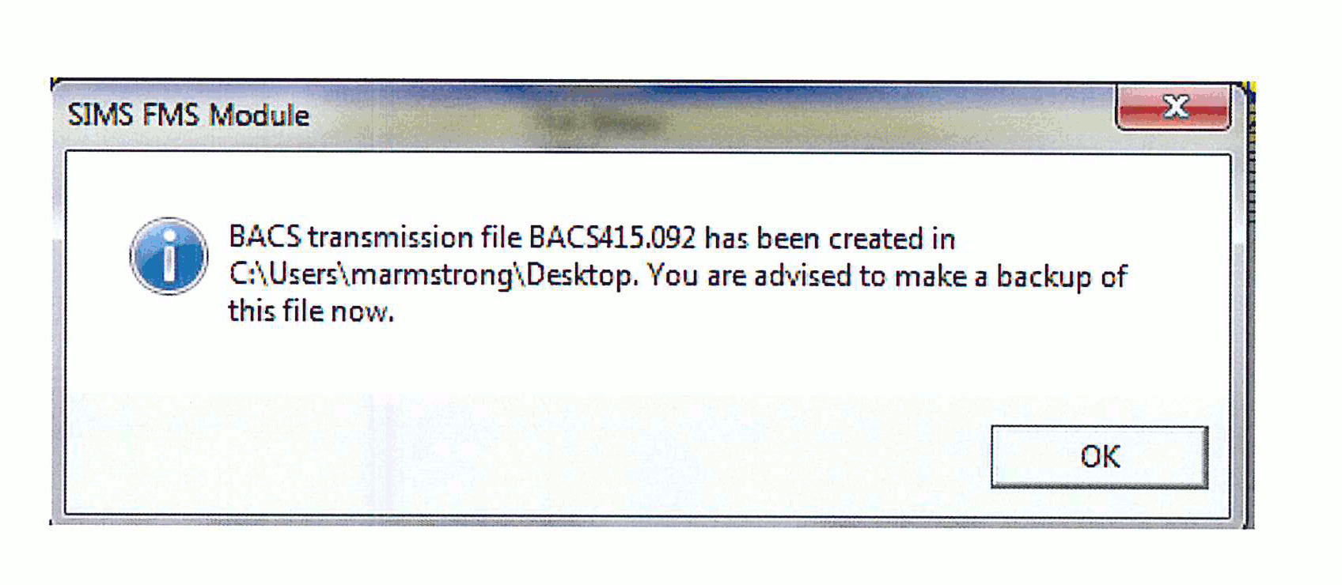
BACS Processing…
The file is saved and where you specified in Accounts Payable Cheque/BACS Parameters, which is where the file name details are set up. The file will have a .txt extension as specified in Tools, General Ledger Setup, Ledger Codes, Bank.
Make a note of BACS filename and location on (suggest on BACS Run Report)

Slide 18
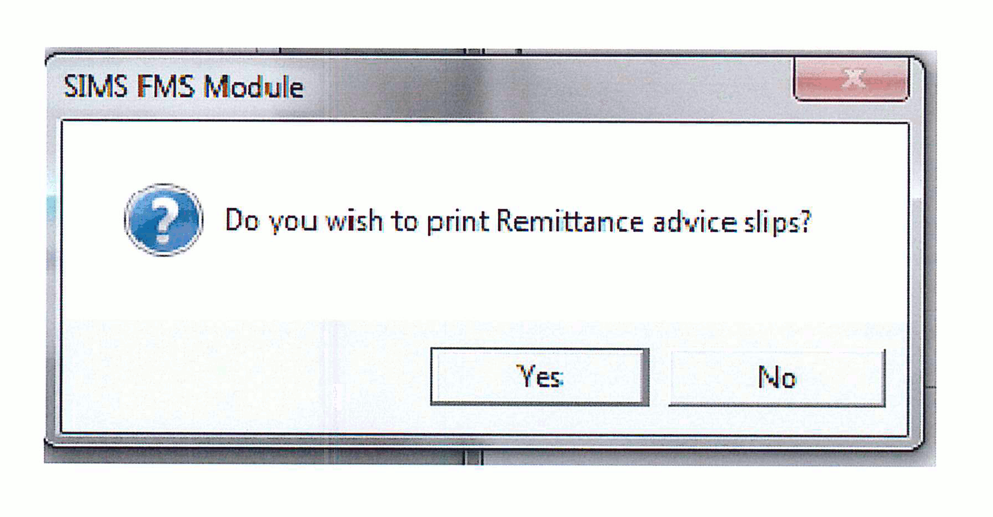
Remittance Advice Slips
If you have entered an email address in the supplier details an email will be sent otherwise a remittance will be printed. I would advise email as it is quicker and otherwise you are not saving a stamp! If you click ‘No’ you can send/print these at a later date, perhaps nearer the payment time.

Slide 19
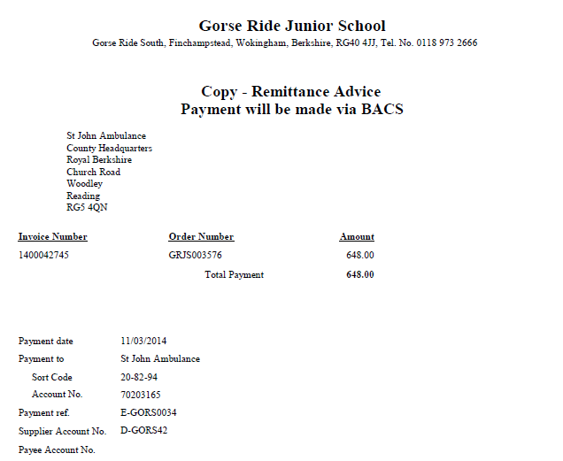
Example Remittance Advice

Slide 20
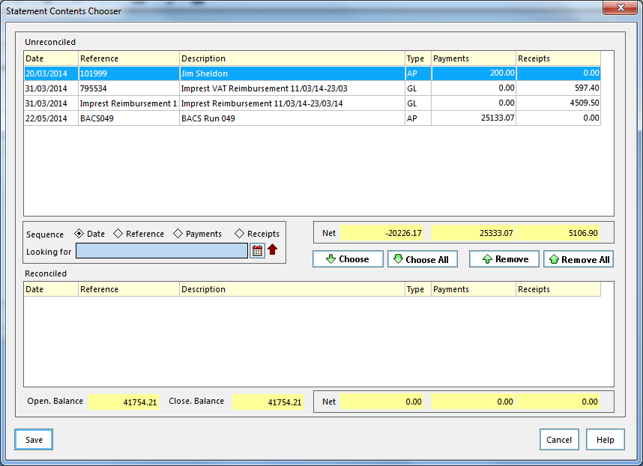
Reconciliation
When you are reconciling each BACS run appears as a single item rather than as multiple cheques so reconciling is much quicker.

Slide 21
Year End - Important
BACS runs DO NOT transfer across years after a Preliminary close so you must reconcile all BACS transactions before this as they will not appear on bank reconciliation in the new year.

Slide 22
Bankline Process
Once the BACS file has been created it should be uploaded to Bankline (instructions on how to do this will be issued by WBC Finance).
Print out the Payments summary from Bankline and file with BACS Run report.
Your Headteacher (or whoever is your authoriser) will need to log on to Bankline within 24 hours to authorise the BACS file.
WBC Finance will arrange Bankline access and apply for card reader for your authoriser if they do not already have this

Slide 23
Starting the process…
Contact Karen Munkenbeck karen.munkenbeck@wokingham.gov.uk who manages the set up process with Nat West. All instructions, cards and readers will then be issued.
Make a start adding BACS account details for your suppliers.

Slide 24
For Further Information
Accounts Payable Handbook within FMS
Help button within FMS
Clare Garner for FMS info
Lianne Wright / Karen Munkenbeck from WBC Group Finance for Nat West
Capita Helpdesk

Slide 25
BACS – In summary
Reduce/eliminate the need for cheques – most suppliers now accept BACS – also employees
Save time writing/printing/signing cheques – only one signature required for each BACS run
Save on stationery and postage costs – each BACS payment costs 28p versus 62p or 53p for stamps and no expensive cheque stationery required.
Reduce reconciliation time – only one item to reconcile for multiple payments
Eliminate problem of uncashed cheques
More control over cash flow – you know exactly when payments are due to leave the bank

Slide 26
BACS – Any Questions…

