Slide 1
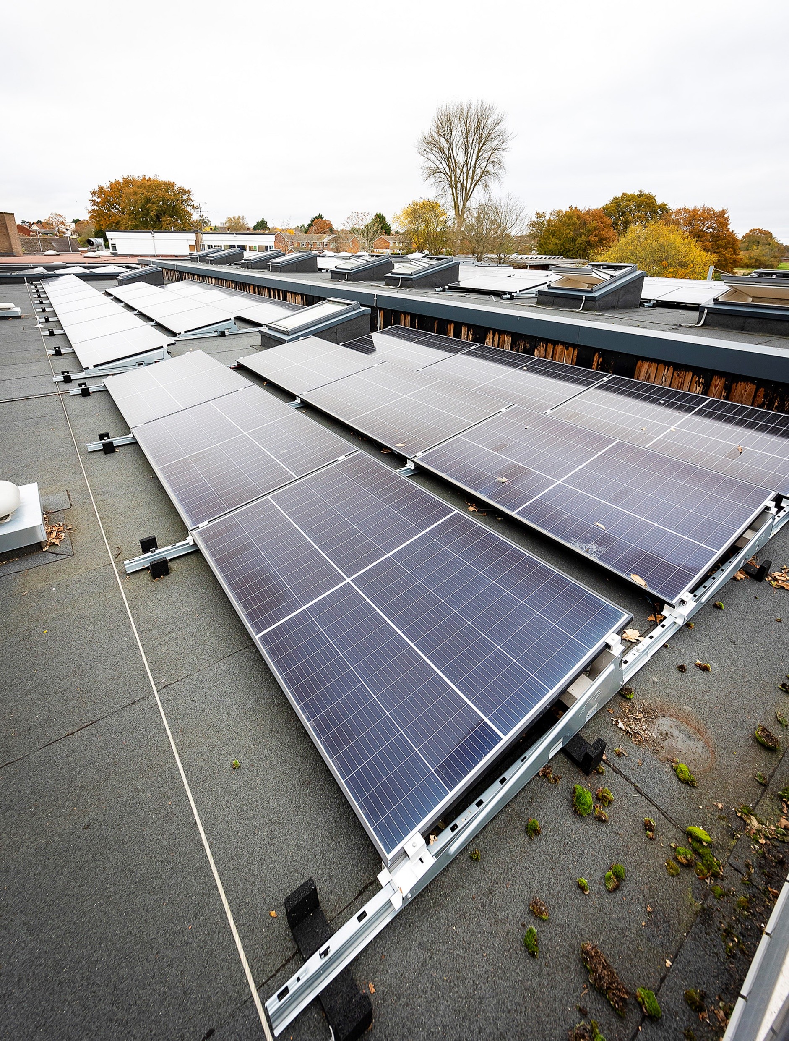
Energy Team Update
Georgina Wisby
07710 117674
Hoyte Swager
07809 310938
Casey Streat
07834 150283

Slide 2
Discussing today:
Green Tariffs/Energy Pricing
Energy Saving Projects
Solar, Battery and EV Rollout
First Business Water/Water Usage Analysis
Condition Reports

Slide 3
Energy Pricing/Green Tariffs
Prices have been historically low – low starting position
WBC have historically advised to account for 10% every year, in readiness for the ‘big one’.
Prices are still not confirmed & can continue to increase until April 2022.
As of February 2022, CCS has stated a price rise on average of:
A decrease from the figures provided in January 2022
Pricing is relative – looks massive, is massive but against a low start point, so relatively, still very low / competitive.
As before, feel free to check the market but beware of how particularly brokers price up contracts
Brokers may email schools directly over the next few months,
In essence, brokers get paid more the higher the fee to the end customer
You won’t be able to get a better deal than frameworks who buy on your behalf.
 | January 2022 - average | February 2022 - average
Electricity | +61% | +51%
Gas | +117% | +105%

Slide 4
Energy Saving Projects
As always - we are looking for energy saving projects at schools:
LED Lighting
Insulation - pipe, cavity & loft insulation
Heating upgrade
Solar PV/Battery storage
Electric Vehicle charging points
If you have any projects, you would like us to look into please let us know. If your site has a projects undertaken, then we request the site stays on the CCS contract.
Single Glazing Projects:
Casey has been working on getting the single glazing projects up and running.
The contractor now has all the information from sites. Casey will be getting in touch to arrange site visits & arranging a suitable date for the installation.

Slide 5
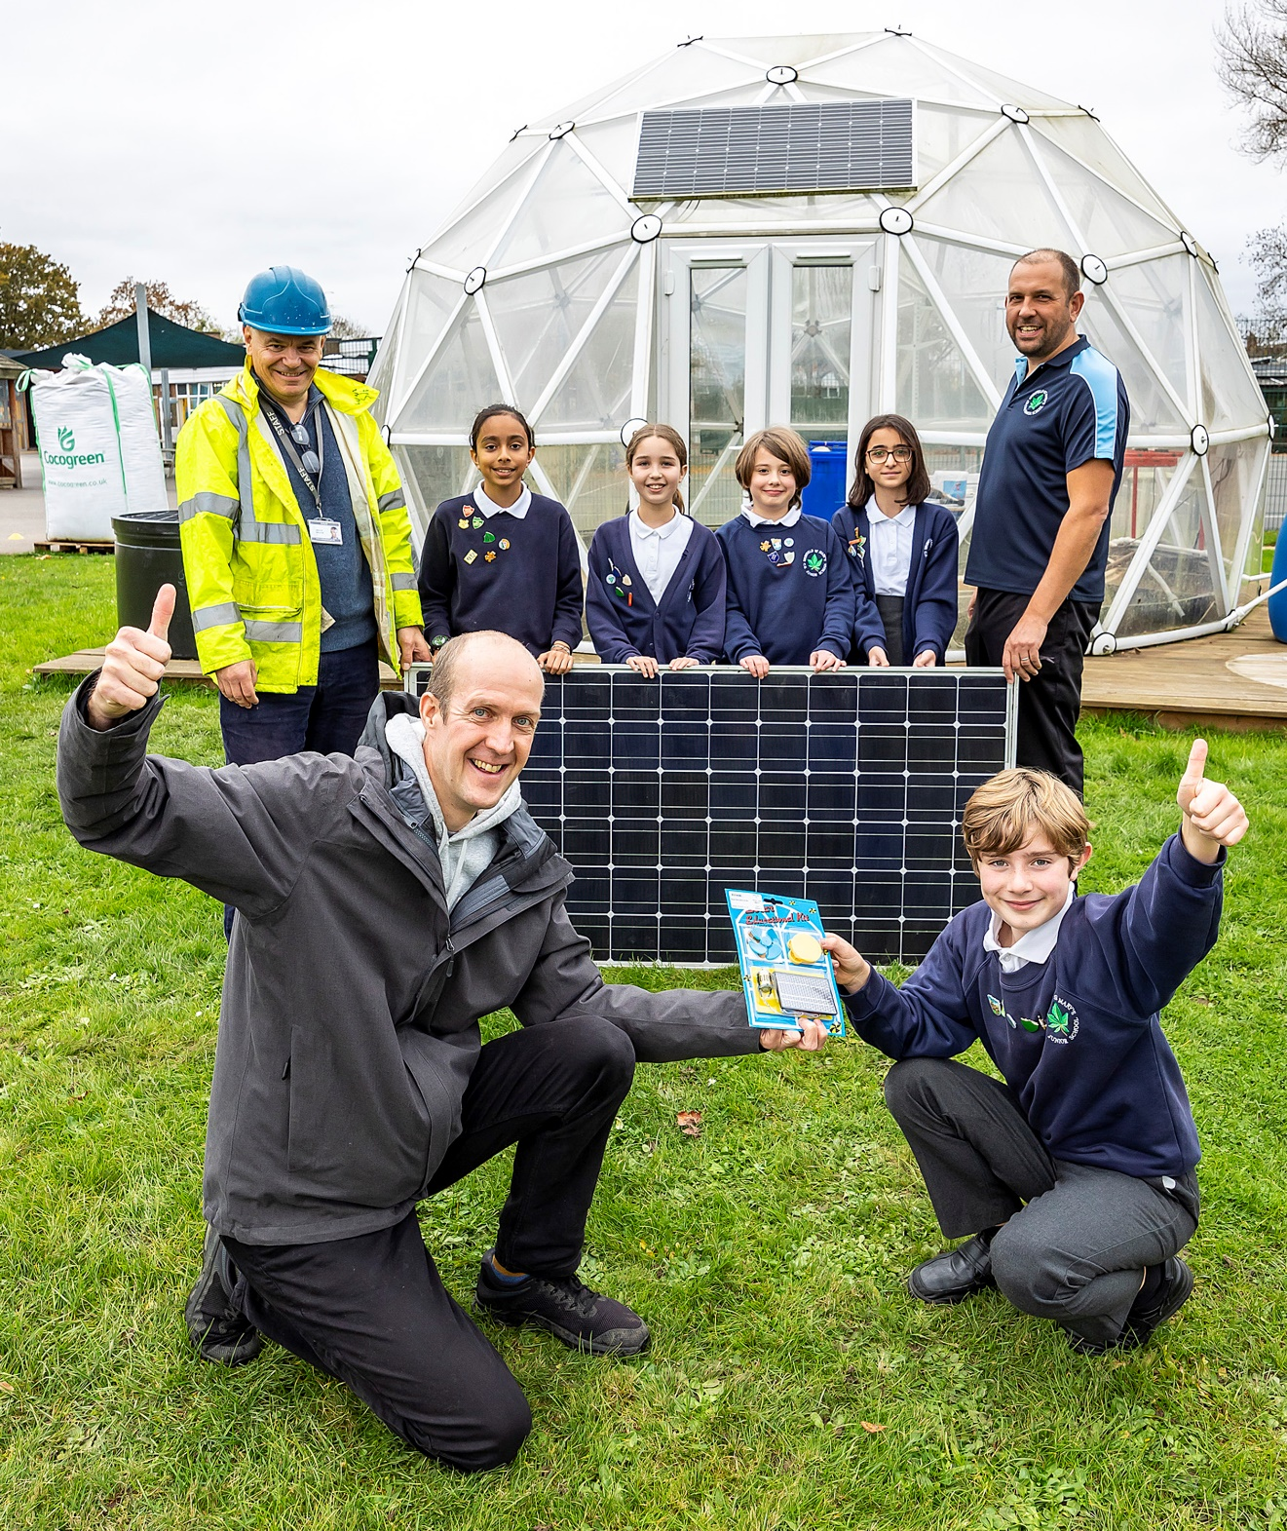
Solar, Battery and EV Rollout
In 2022, all schools will be approached about installing solar PV panels or extending currently solar PV, as well as installing solar PV battery storage. With the aim to start installing PV systems across sites later this year.
We will also be sending out an EV survey over the next few weeks, to understand whether your site requires or would like EV charging points installed.
For more information please email hoyte.swager@wokingham.gov.uk

Slide 6
First Business Water / Castle Water
Are you still with Castle Water, but want to move to First Business Water?
Payment of billing at corporate level with BWO recharging to sites, reducing admin overhead locally,
Introduction of AMR to allow accurate billing and early leak detection (for those sites that signed up to AMR),
AMR will allow access to detailed water usage data to aid in defining water saving projects
Are you currently with FBW, want to know about your water usage at your site? Contact Hoyte Swager on hoyte.swager@wokingham.gov.uk to discuss your water usage.

Slide 7
Condition Reports
Over the next few years DfE is conducting new condition reports (CDC2) for schools across the country. The energy team can use the information provided in this report to identify potential efficiency projects and areas of interest for your school.
Once you receive the CDC reports please email a copy to casey.streat@wokingham.gov.uk

