Slide 1
Crossing the Bridges Project
Schools, SACREs and Places of Worship
working together
to enhance Religious Education
Pan-Berkshire
2017

Slide 2
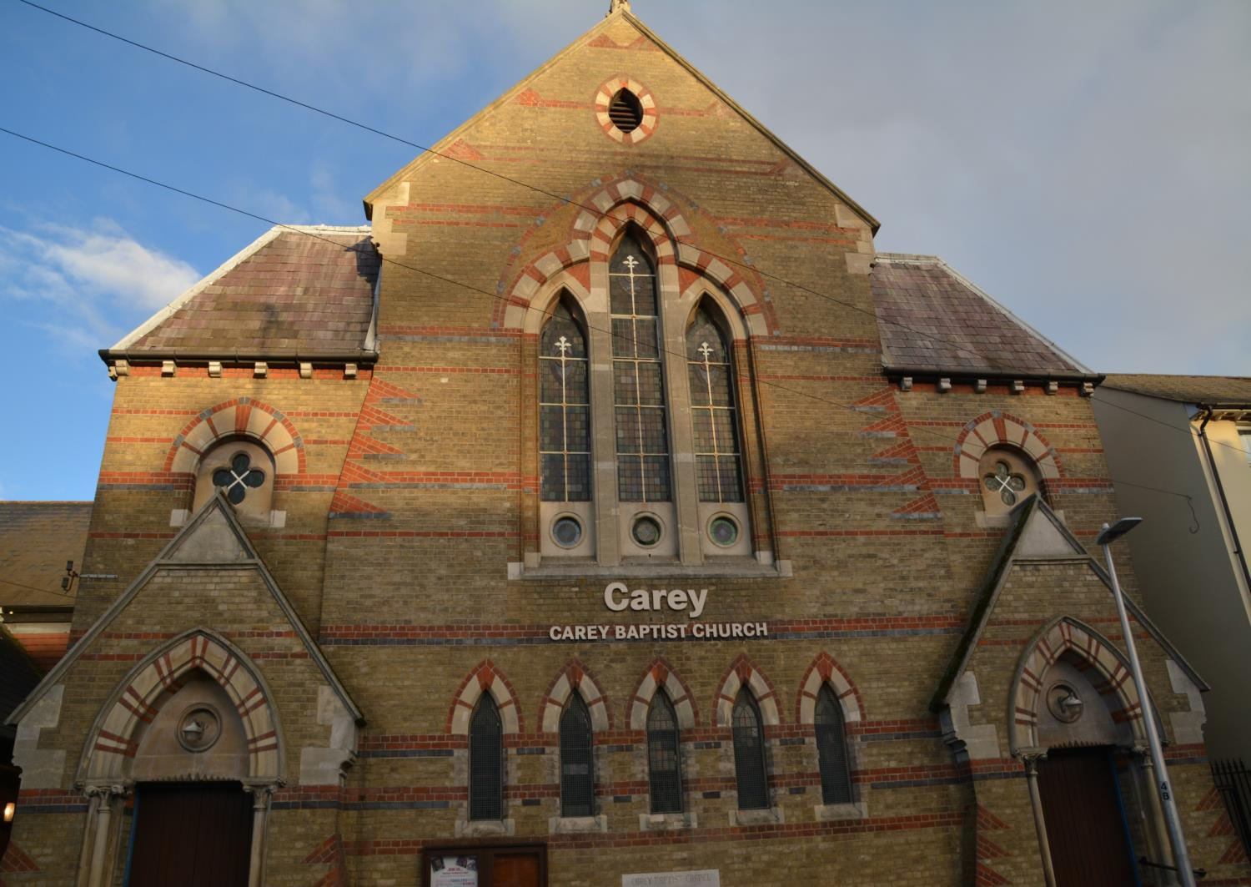
The Carey Baptist Church in Reading

Slide 3
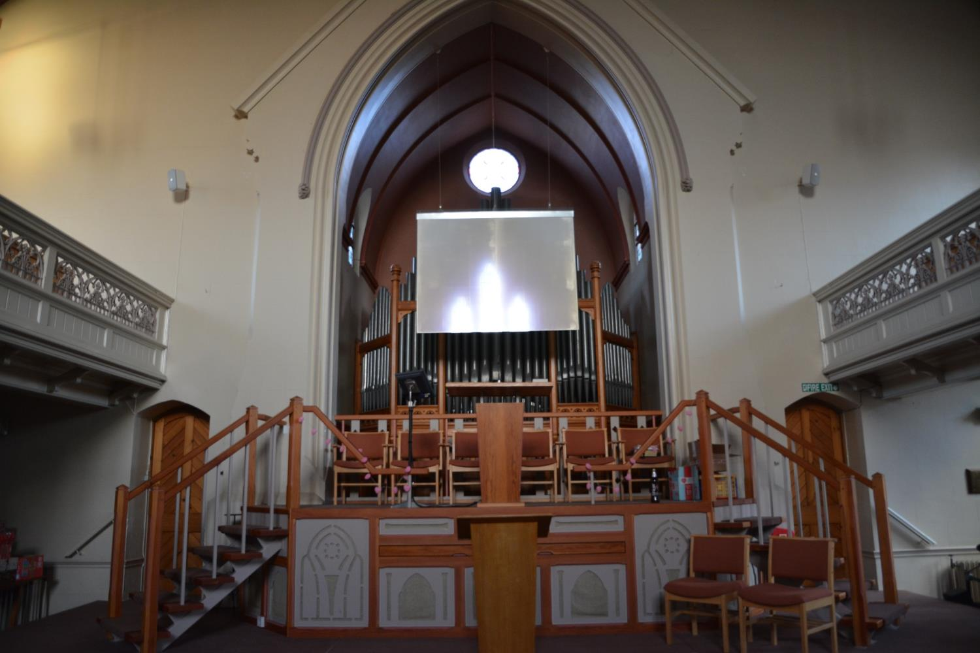
Inside the church there are seats upstairs and downstairs

Slide 4
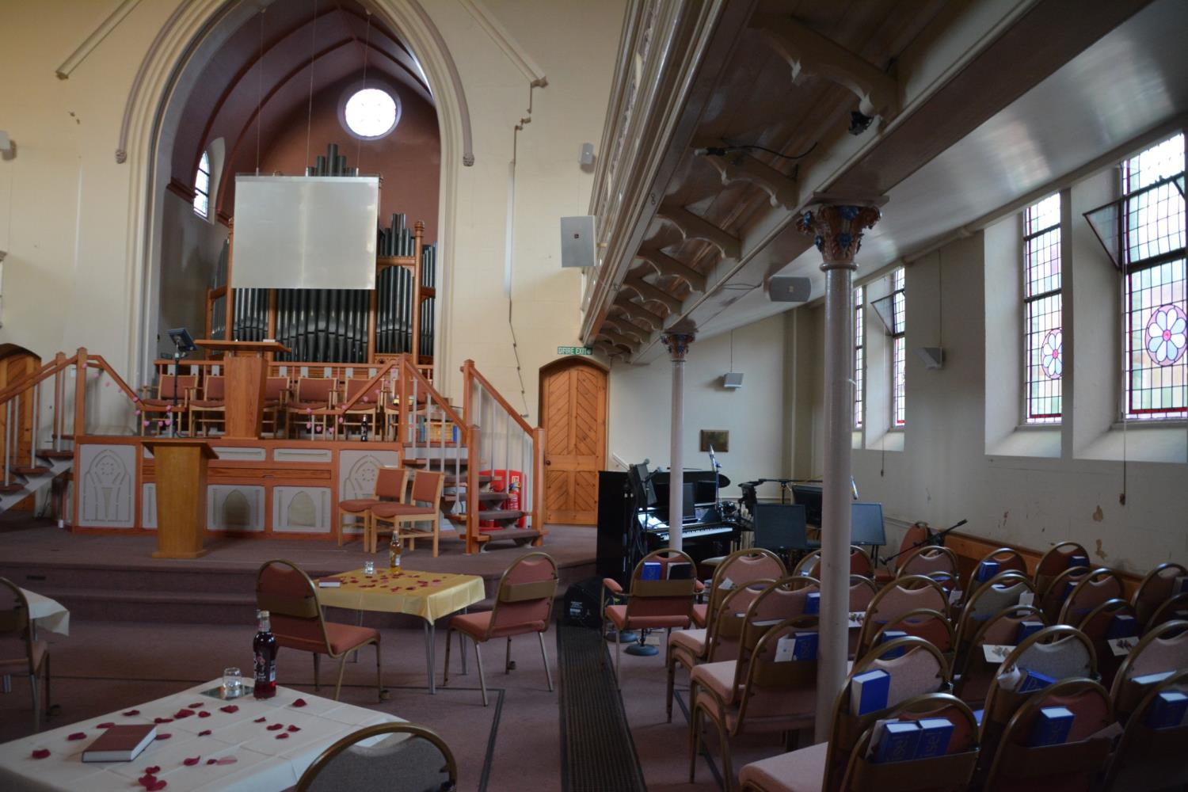
All the chairs can be moved around so that the room can be used for different types of meetings – here it is set up for wedding classes.

Slide 5
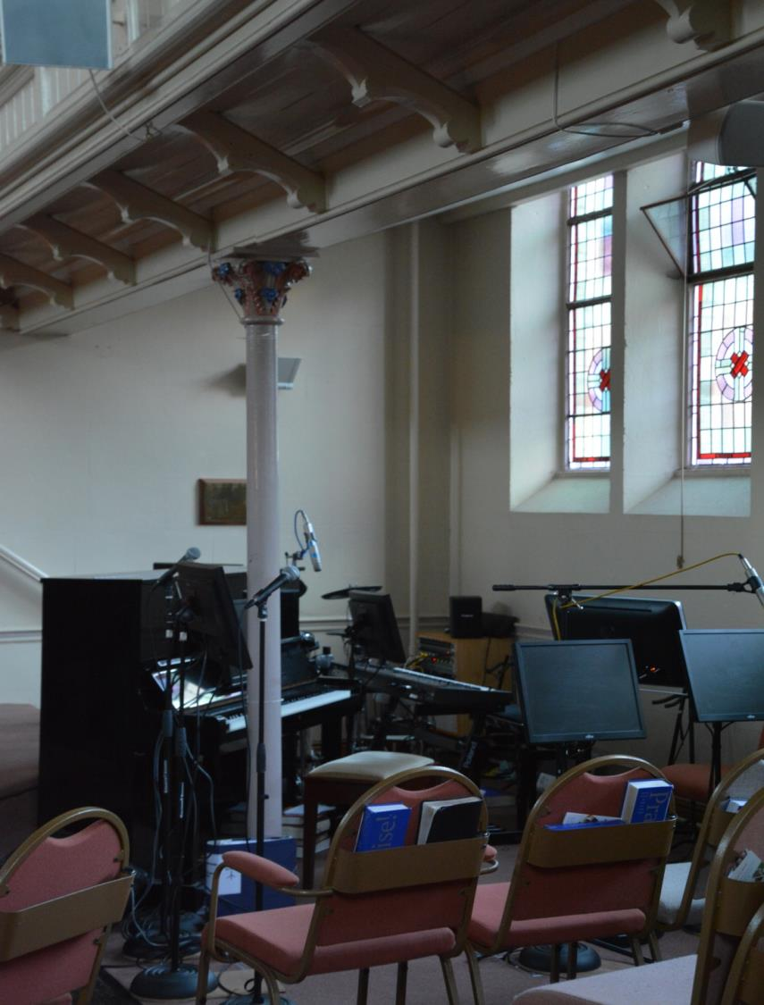
At the front there is a section for musical instruments with a piano, keyboards and guitars.
Music is an important part of the service

Slide 6
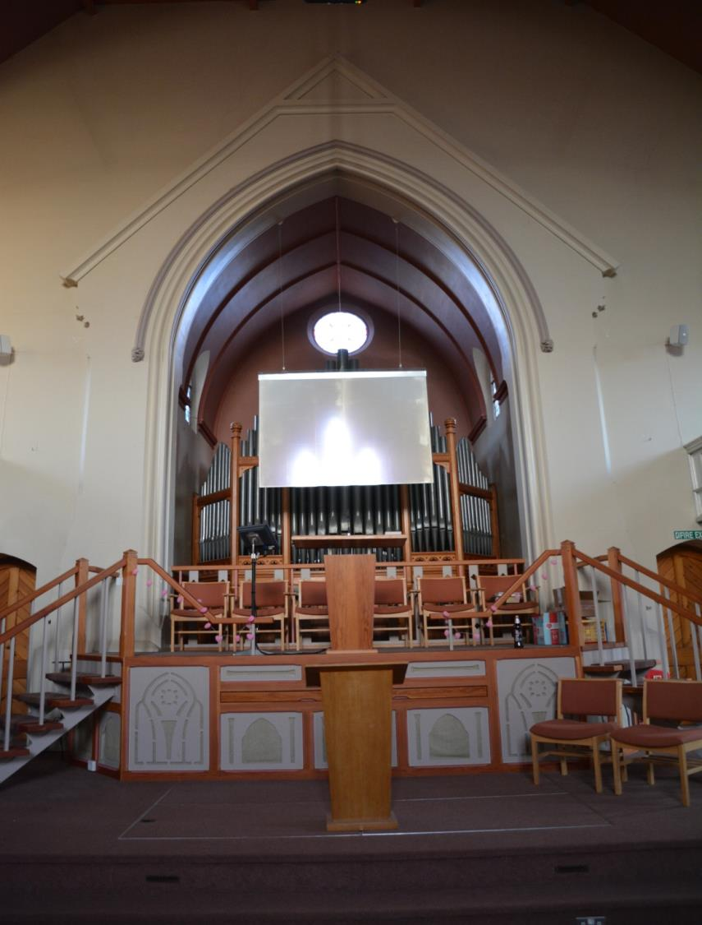
Baptist churches have a place for the pastor to stand
but they also have something that other churches
do not have....

Slide 7
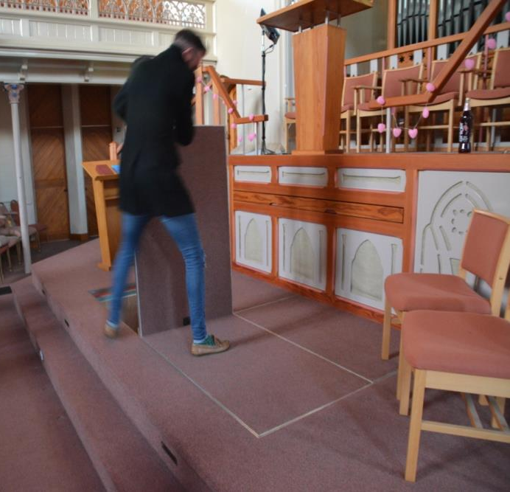
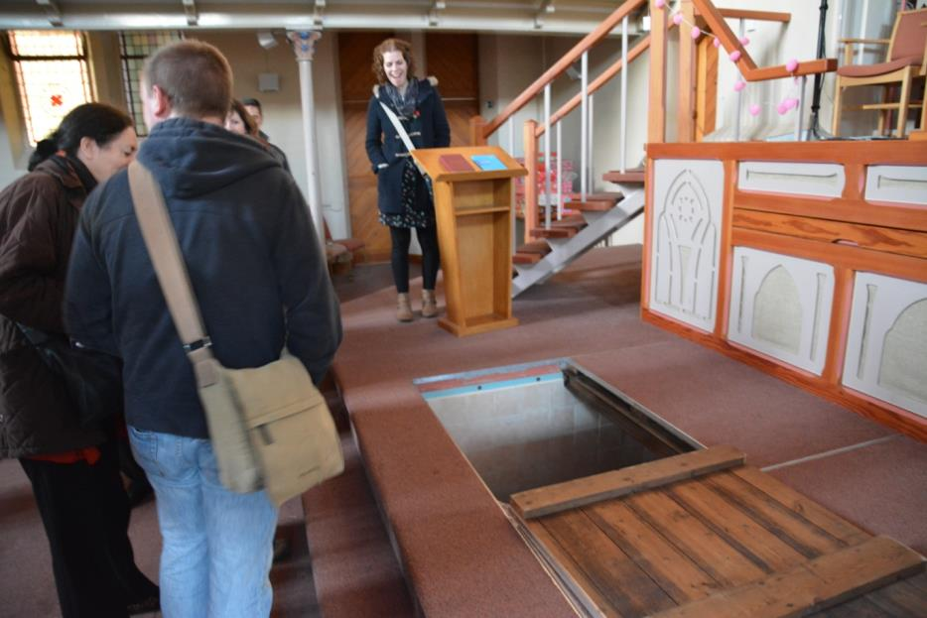
A section of the floor at the front can be removed
Under the floor is a big area called a baptistry
Here people choose to be baptised. This means they are briefly plunged under water.
They do this when they join the Baptist church

Slide 8
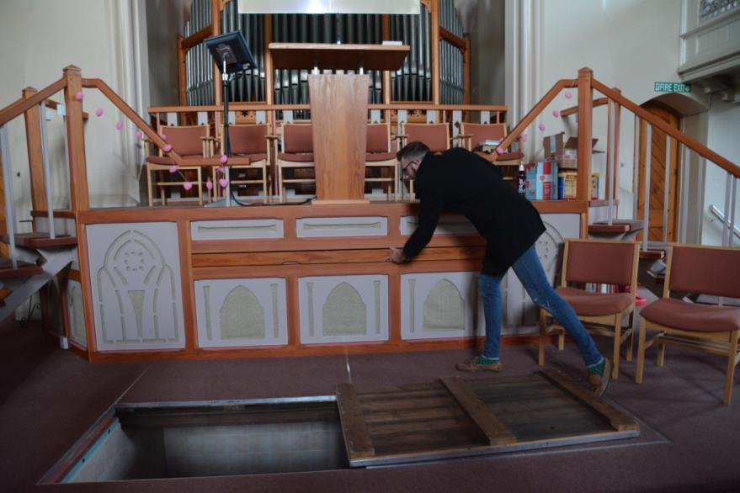
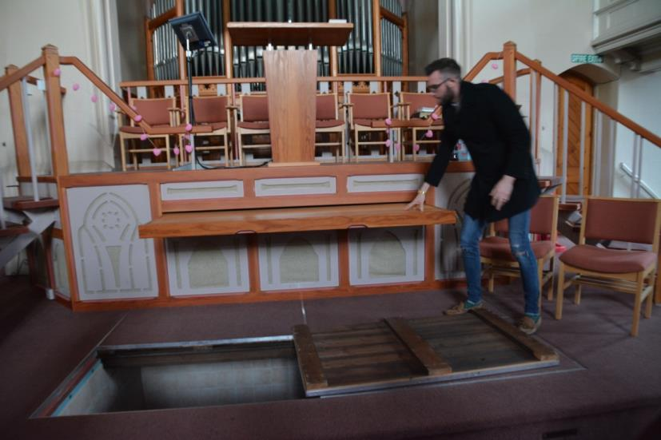
There is also an altar table at the front
In this church the altar slides in and out to give more room

Slide 9
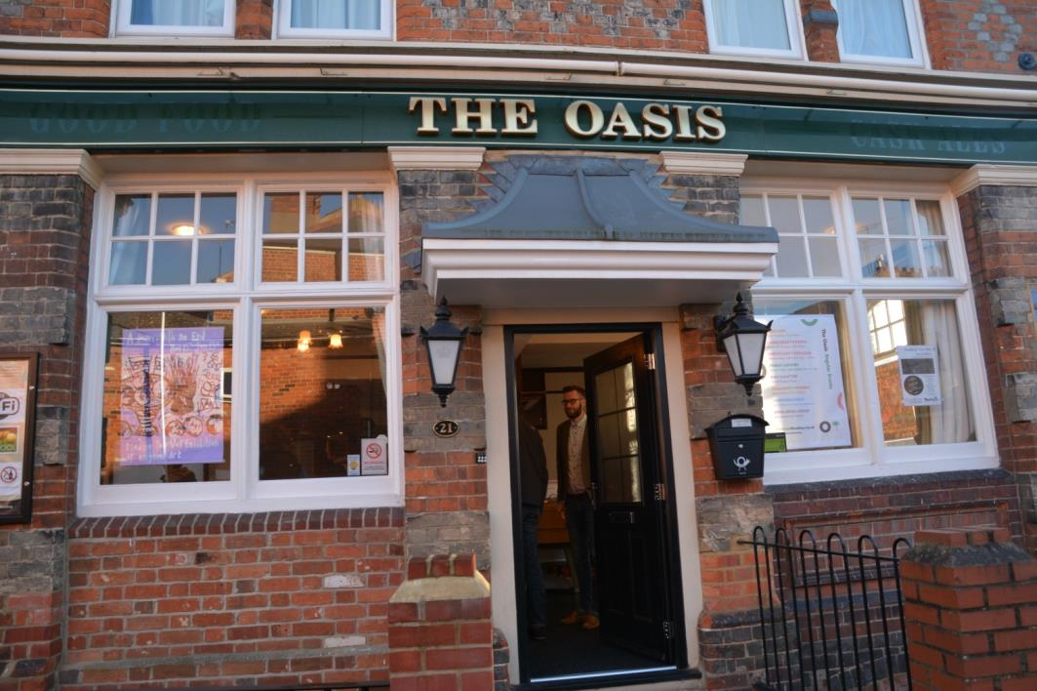
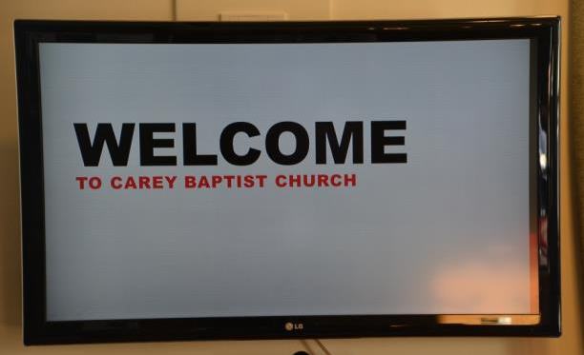
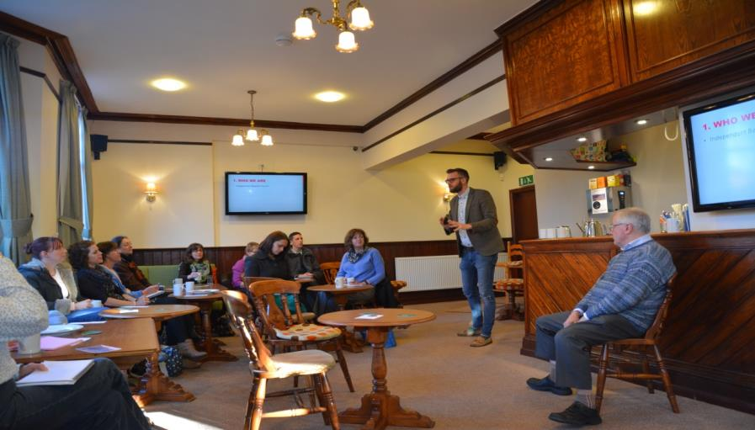
The Carey Baptist church bought an old pub near the church and have turned into a centre for the community
Anyone is welcome

Slide 10
The centre has messages about their beliefs

Slide 11
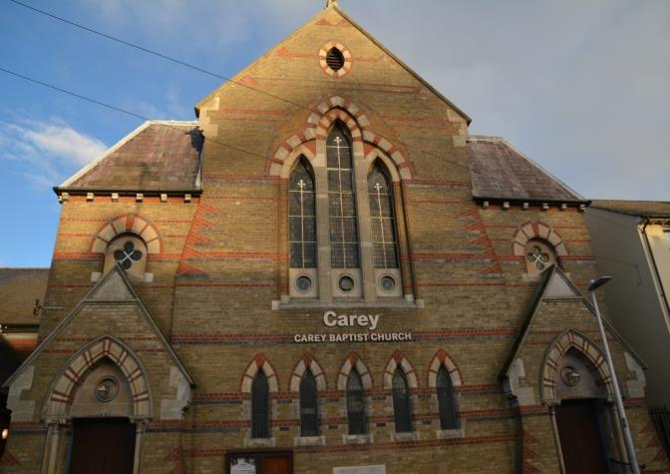
The Carey Baptist church is a mix of new and old ideas – they want people to become Christians but they also want to be part of helping the local community

