Slide 1
Challenging the stereotype

Slide 2
Context and guidance about use (1)
The following images provide an opportunity for discussion around how the stereotypical perception of Gypsy, Roma and Traveller people is often very negative. The people and images over these next six pages give an insight into some of the many successful, hardworking, conscientious members of these communities. They range from international musicians to secondary school learning mentors, soldiers and professional athletes.

Slide 3
Context and guidance about use (2)
By discussing with students:
how stereotypes tend to be created,
what role they serve, and
how they need to be challenged,
this resource will help in the process of challenging stereotypes.

Slide 4
Ideas for use
Identify the people within the slides, through internet search engines, research in magazines and find out more about them.
Develop a story based around a biography of one or more of the individuals.
Produce a short newspaper or magazine article highlighting this positive image of Gypsy, Roma and Traveller people.
Role-play an interview with one or more of these individuals to understand more about them.
Produce a poster or piece of artwork which presents Gypsy, Roma and Traveller people in a way that challenges the stereotype.
Consider how other groups are often portrayed in a negative way by the media, for example, teenagers, football fans.

Slide 5
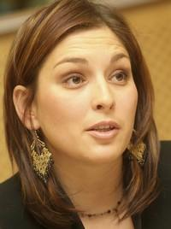
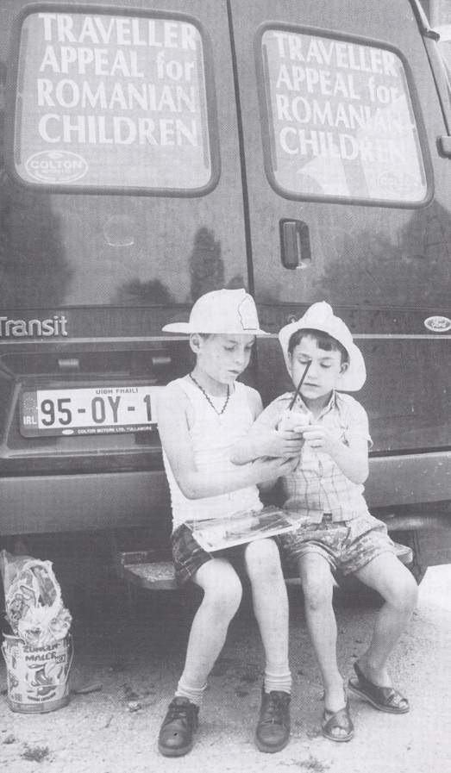
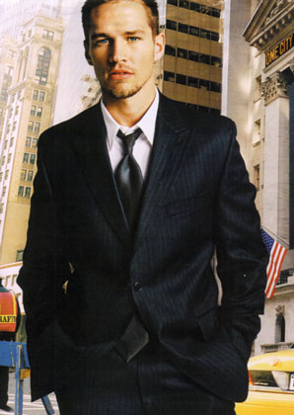
Forget Negative Stereotypes (1)
Member of the European Parliament
Charitable Work
Fashion Model
Photo of Lívia Járóka from the Situation of Roma Women in the European Union, a public hearing at the European Parliament, Brussels, Nov 2005. Used with kind permission.
Photo from Travellers: Citizens of Ireland - Our Challenge to an Intercultural Irish Society in the 21st Century, Murphy. F and McDonagh. C (2000), Photographer: Daniel O’Connell. © Parish of the Travelling People. Used with kind permission.
Photo of James Penfold by Lindbergh, P. © Peter Lindbergh. Used with kind permission.

Slide 6
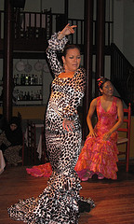
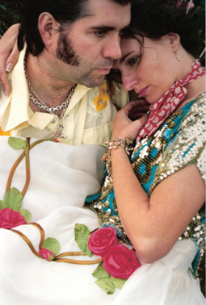
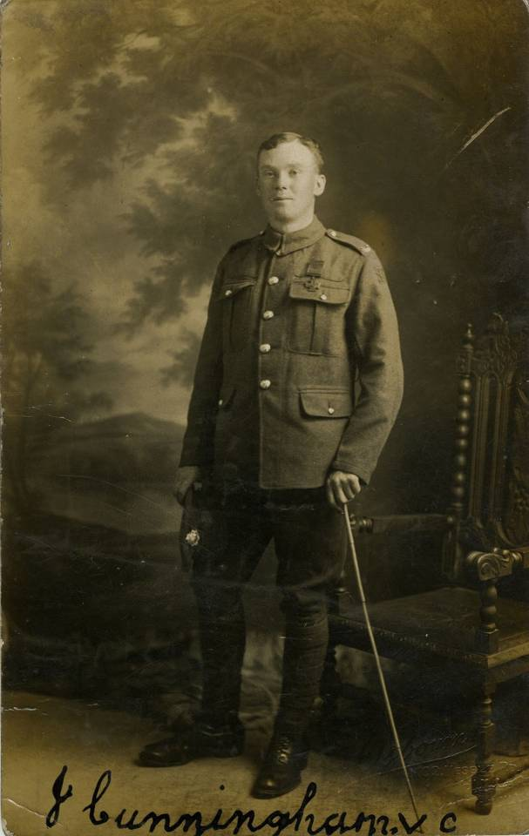
Forget Negative Stereotypes (2)
Dancer
Artists
War Hero
Photograph of Flamenco Dancers by O-Barcelona. Used with kind permission under the terms and conditions of the Creative Commons Attribution 2.0 Generic Licence.
Photograph of artists, Damien and Delaine LeBas. © Tim Walker. Used with kind permission.
Postcard photograph of John Cunningham V. C, held by the Hull Museums Collections. © Hull City Council. Used with kind permission.

Slide 7
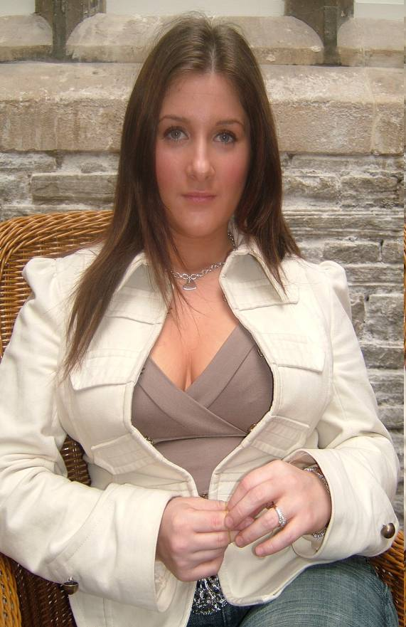
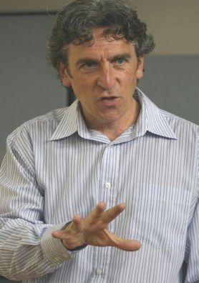
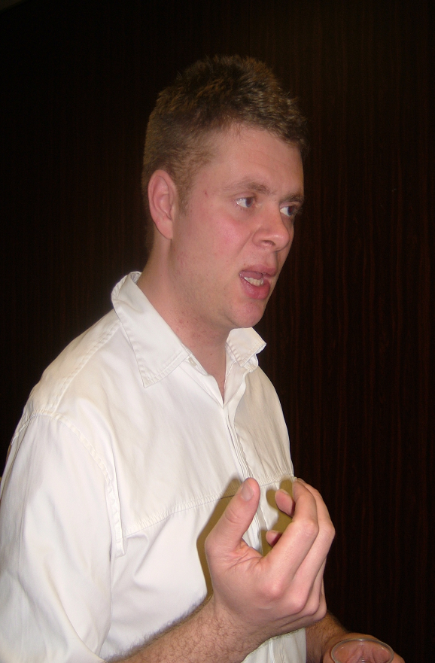
Forget Negative Stereotypes (3)
Learning Mentor
Storyteller
Journalist
Photograph of Learning Mentor. © M. Wilson. Used with kind permission.
Photograph of Storyteller, R. O’ Neill. © Mr and Mrs O’ Neill. Used with kind permission.
Photograph of Journalist. © M. Wilson. Used with kind permission.

Slide 8
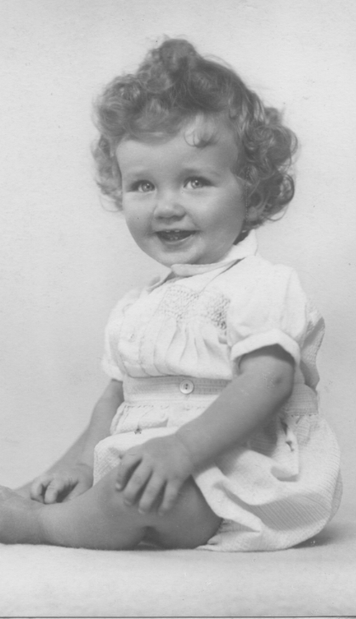
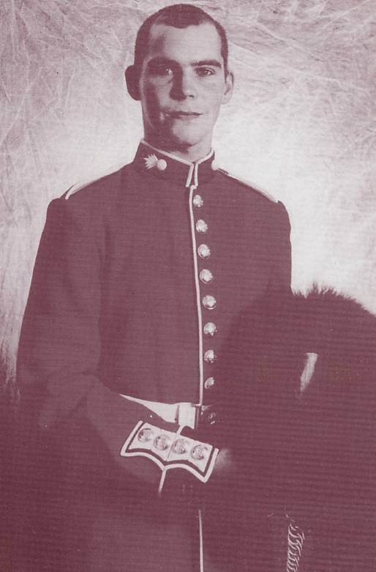
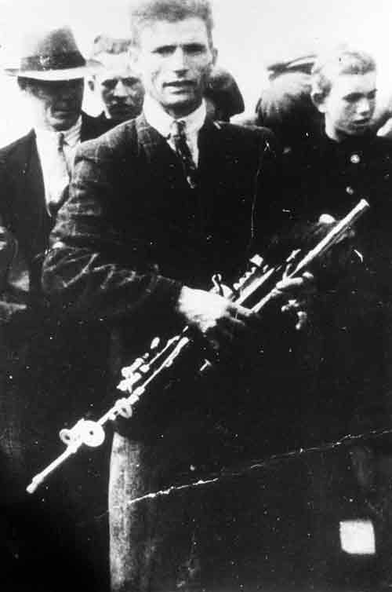
Forget Negative Stereotypes (4)
Baby
Grenadier Guard
Musician
Photograph of Traveller baby. © Wilson estate. Used with kind permission.
Photo of Terry Mercer when he was a Grenadier Guard. © Derbyshire Gypsy Liaison group archives. Used with kind permission.
Photograph of Uileann piper Johnny Doran, photographed in County Mayo in the 1940s. © The National Folklore Collection, University College Dublin. Used with kind permission.

Slide 9
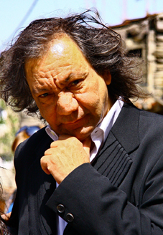
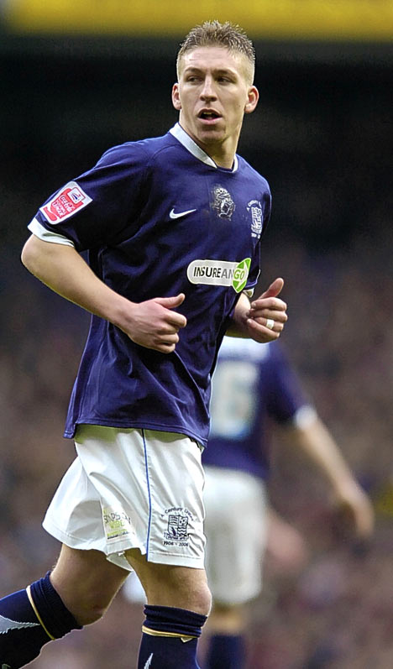
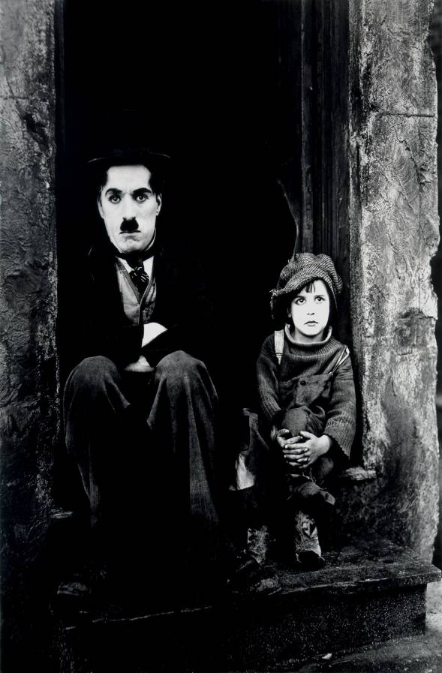
Forget Negative Stereotypes (5)
Film Producer
Footballer
Silent Movie Star
Photo of Tony Gatlif by Miyazma. Used with kind permission under the terms and conditions of the Creative Commons Attribution 2.5 Generic Licence.
Photo of Freddy Eastwood by Walter, A. Daily Mail.
Image of Charlie Chaplin and Jackie Coogan from The Kid (1921), is in the public domain.

Slide 10
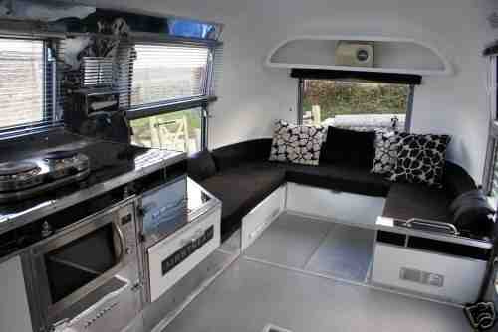
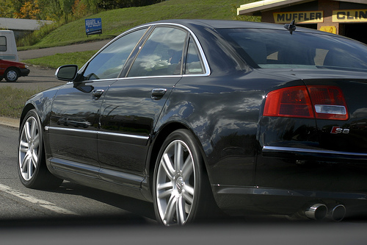
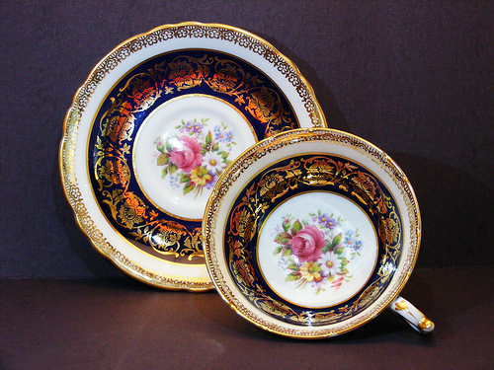
Forget Negative Stereotypes (6)
Spotless
Transport
Fine China
Photo of Airstream Interior by Podknox / Wapster. Used with kind permission under the terms and conditions of the Creative Commons Attribution 2.0 Generic Licence.
Photo of Teacup and saucer by Mickey Glitter. Used with kind permission under the terms and conditions of the Creative Commons Attribution 2.0 Generic Licence.
Photo of s8 by peteSwede. Used with kind permission under the terms and conditions of the Creative Commons Attribution 2.0 Generic Licence.

Slide 11
Names
Lívia Járóka MEP, Irish Travellers collecting for children in Romanian orphanages, James Penfold
Spanish Flamenco dancer, Damien and Delaine LeBas, Jack Cunningham VC – Battle of the Somme 1916
Margaret Stokes – learning mentor, Richard O’Neill – storyteller, Jake Bowers – freelance journalist
Irish Traveller baby 1958, Terry Mercer, Johnny Doran
Tony Gatlif, Freddy Eastwood, Charlie Chaplin
Contemporary caravan interior, Fine China ceramics, Contemporary transport

Slide 12
Acknowledgements
Photo of Lívia Járóka from the Situation of Roma Women in the European Union, a public hearing at the European Parliament, Brussels, Nov 2005. Used with kind permission.
Photo from Travellers: Citizens of Ireland - Our Challenge to an Intercultural Irish Society in the 21st Century, Murphy. F and McDonagh. C (2000), Photographer: Daniel O’Connell. © Parish of the Travelling People. Used with kind permission.
Photo of James Penfold by Lindbergh, P. © Peter Lindbergh. Used with kind permission.
Photograph of Flamenco Dancers by O-Barcelona. Used with kind permission under the terms and conditions of the Creative Commons Attribution 2.0 Generic Licence.
Photograph of artists, Damien and Delaine LeBas. © Tim Walker. Used with kind permission.
Postcard photograph of John Cunningham V. C, held by the Hull Museums Collections. © Hull City Council. Used with kind permission.
Photograph of Learning Mentor. © M. Wilson. Used with kind permission.
Photograph of Storyteller, R. O’ Neill. © Mr and Mrs O’ Neill. Used with kind permission.
Photograph of Journalist. © M. Wilson. Used with kind permission.
12

Slide 13
Acknowledgements
Photograph of Traveller baby. © Wilson estate. Used with kind permission.
Photo of Terry Mercer when he was a Grenadier Guard. © Derbyshire Gypsy Liaison group archives. Used with kind permission.
Photograph of Uileann piper Johnny Doran, photographed in County Mayo in the 1940s. © The National Folklore Collection, University College Dublin. Used with kind permission.
Photo of Tony Gatlif by Miyazma. Used with kind permission under the terms and conditions of the Creative Commons Attribution 2.5 Generic Licence.
Photo of Freddy Eastwood by Walter, A. Daily Mail.
Image of Charlie Chaplin and Jackie Coogan from The Kid (1921), is in the public domain.
Photo of Airstream Interior by Podknox / Wapster. Used with kind permission under the terms and conditions of the Creative Commons Attribution 2.0 Generic Licence.
Photo of Teacup and saucer by Mickey Glitter. Used with kind permission under the terms and conditions of the Creative Commons Attribution 2.0 Generic Licence.
Photo of s8 by peteSwede. Used with kind permission under the terms and conditions of the Creative Commons Attribution 2.0 Generic Licence.
13

Slide 14
14

