Slide 1
Crossing the Bridges Project
Schools, SACREs and Places of Worship
working together
to enhance Religious Education
Pan-Berkshire
2017

Slide 2
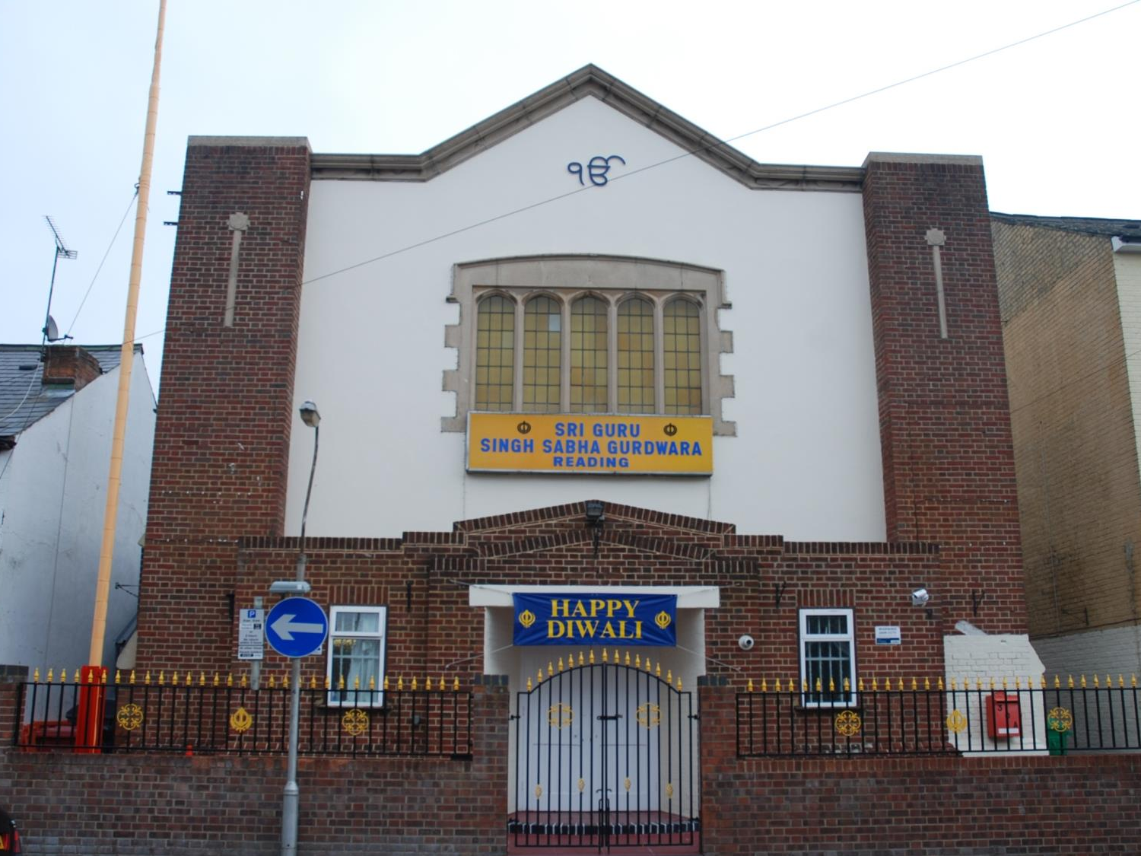
The Sikh Gurdwara in Reading

Slide 3
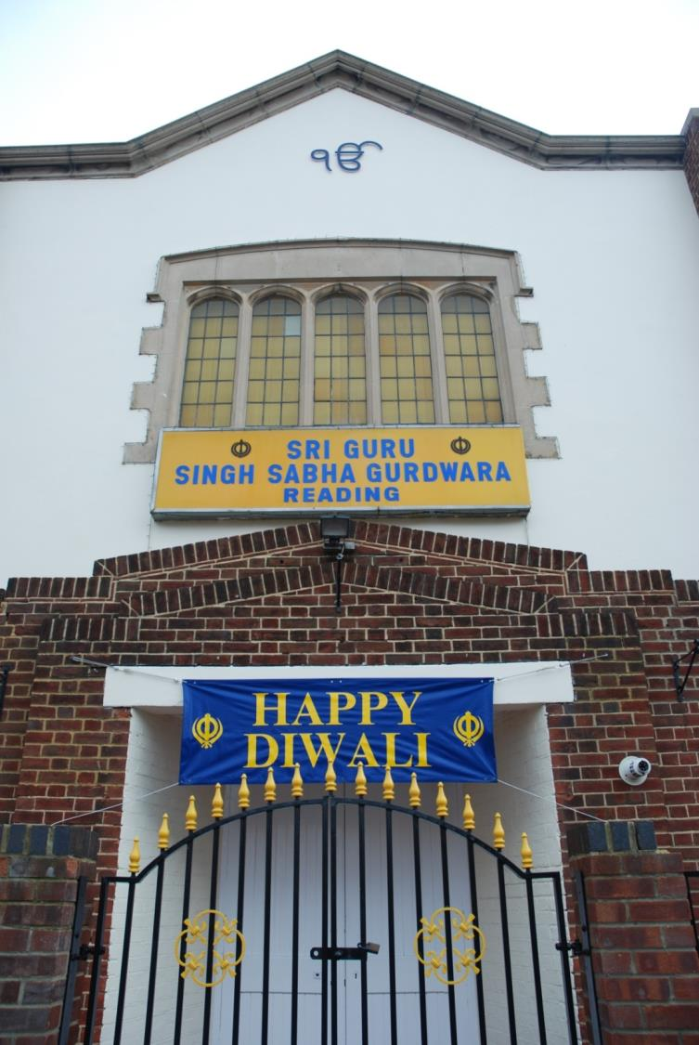
Symbols of Sikhism
Ik Onkar
is a symbol which appears at the beginning the Sikh scripture and means, "One With Everything".
The symbol Ik Onkar gives the idea of one creative being, or
one God.

Slide 4
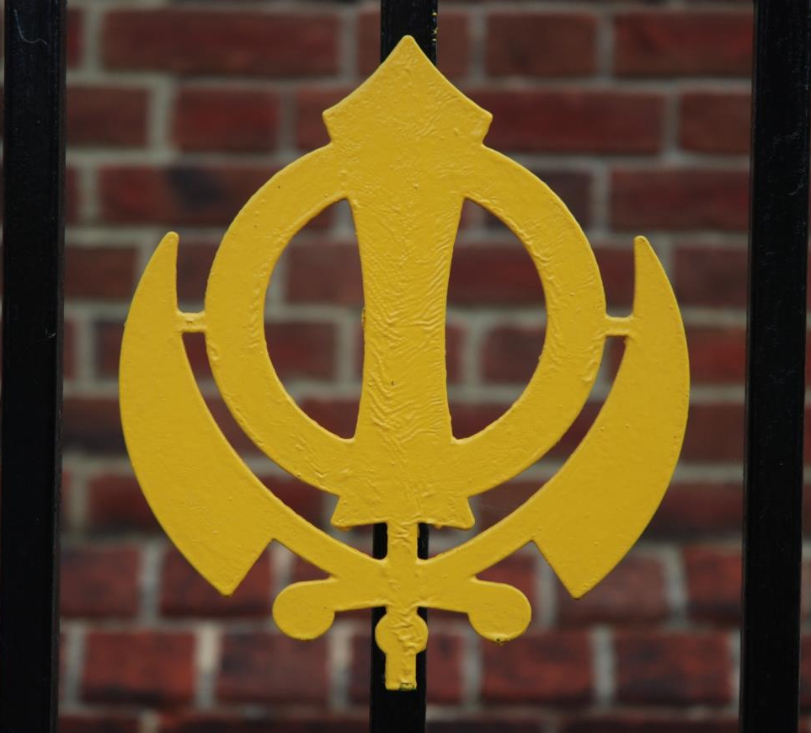
Nishan Sahib
Khanda

Slide 5
The Khanda is a symbol in 3 parts – it stands for God being eternal and also for truth.
Khanda
Nishan Sahib
It reminds Sikhs of their duty to God as well as to the community.

Slide 6
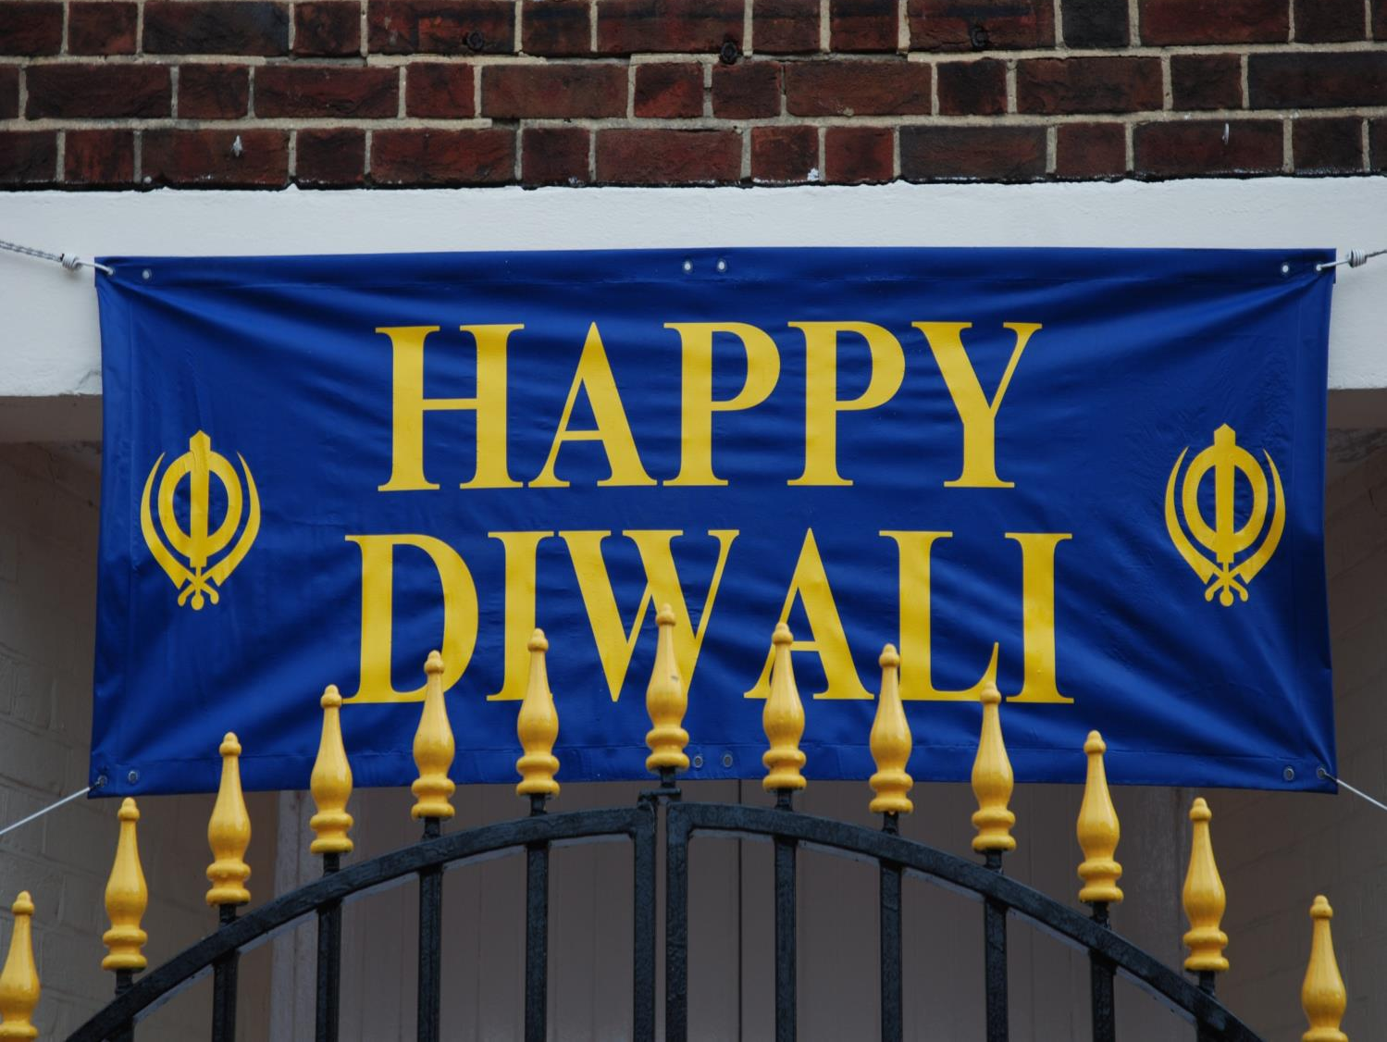
Festival banners are put up to help celebrate

Slide 7
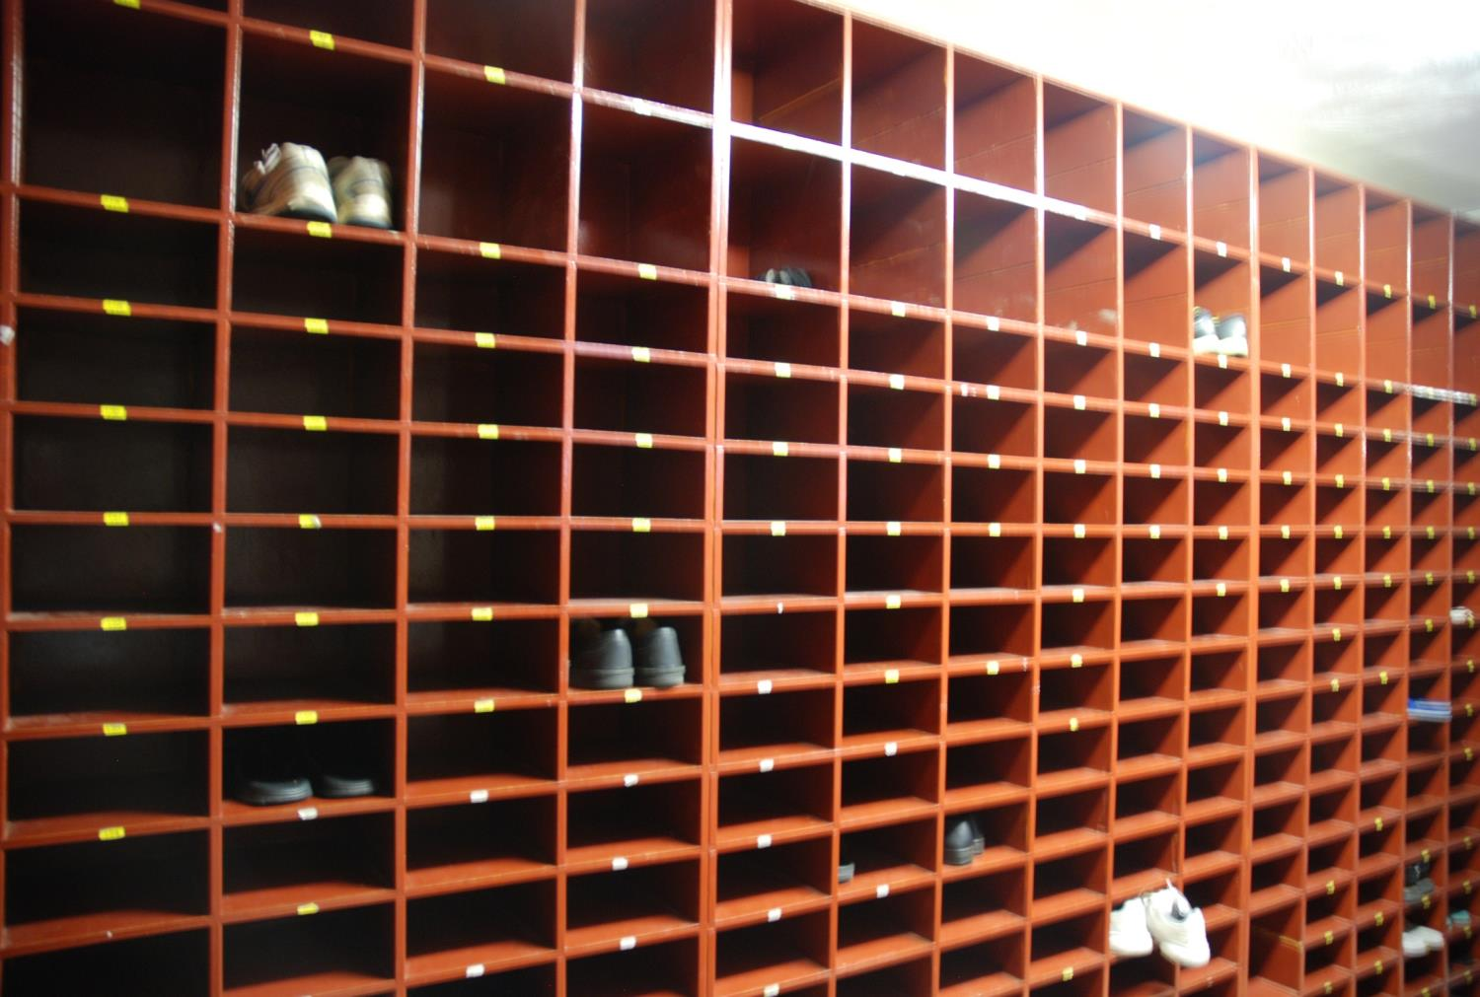
ASikhs take off their shoes inside the Gurdwara and put them in a

Slide 8
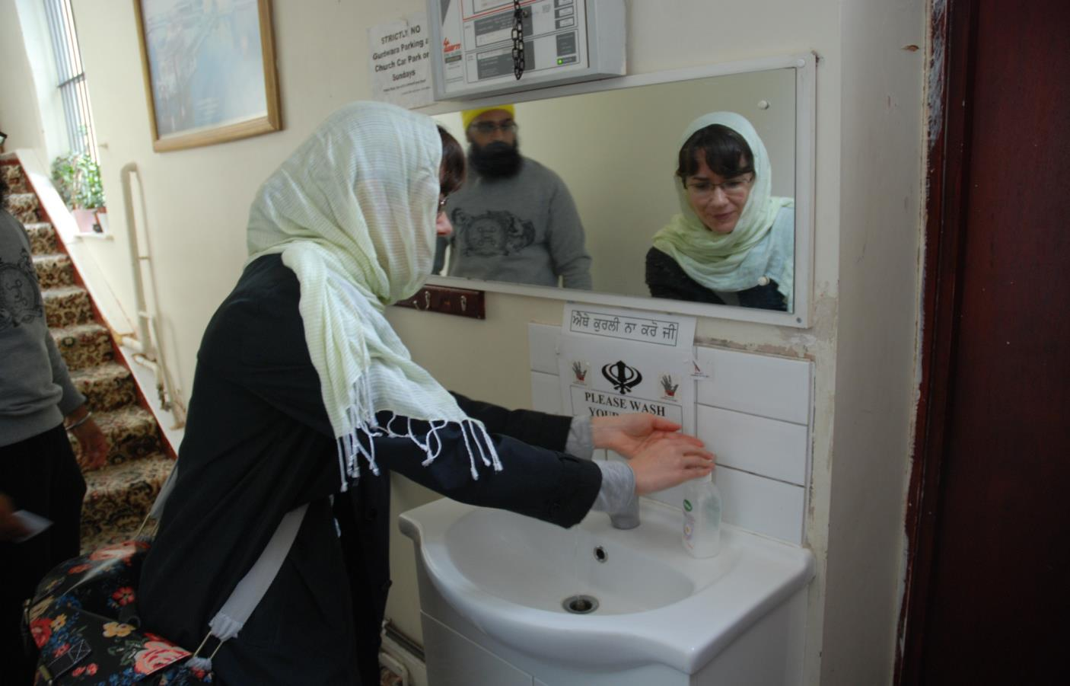
Sikhs also cover their heads and wash their hands before worship

Slide 9
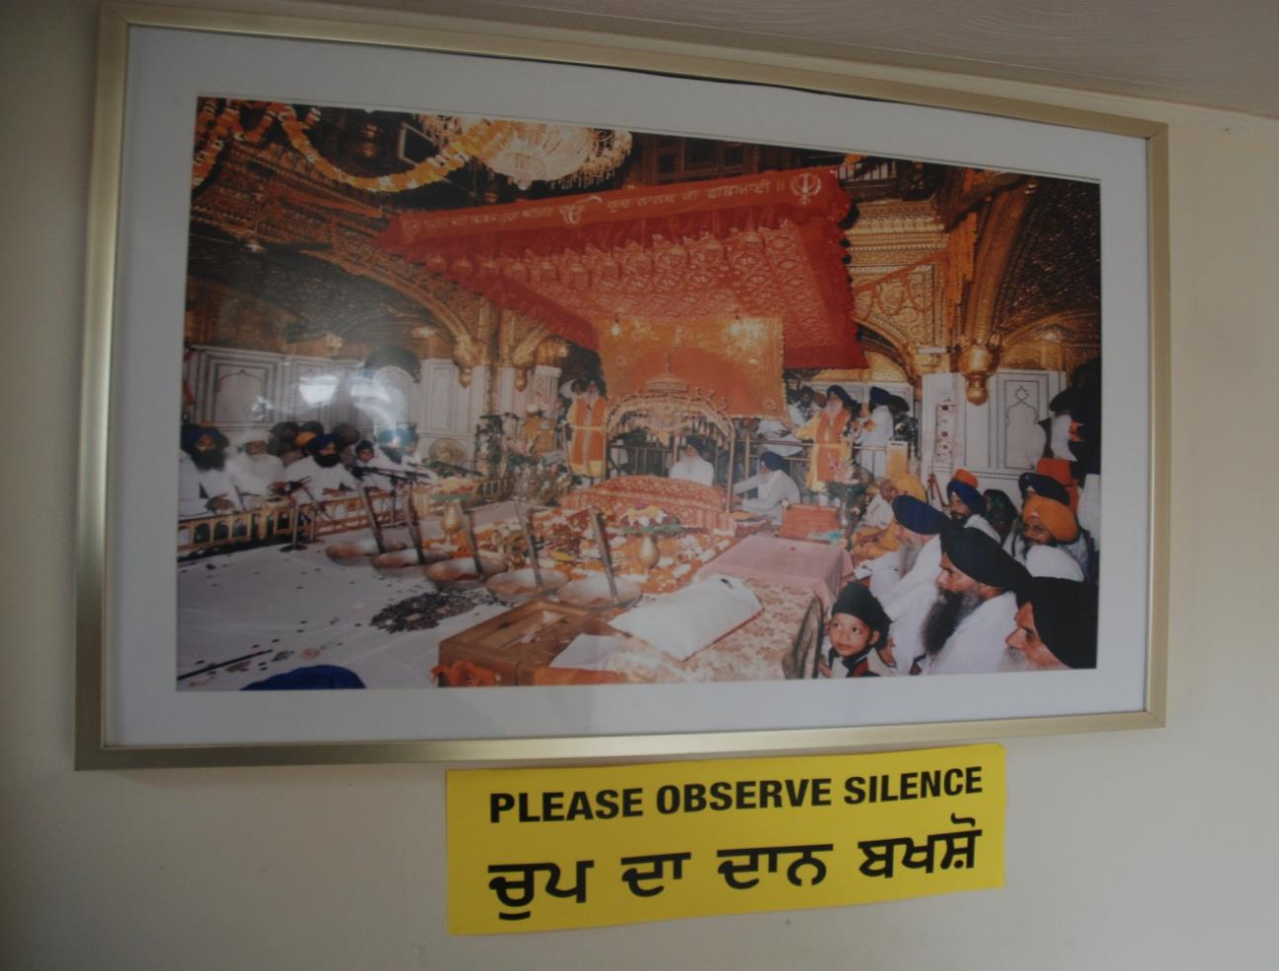

Slide 10
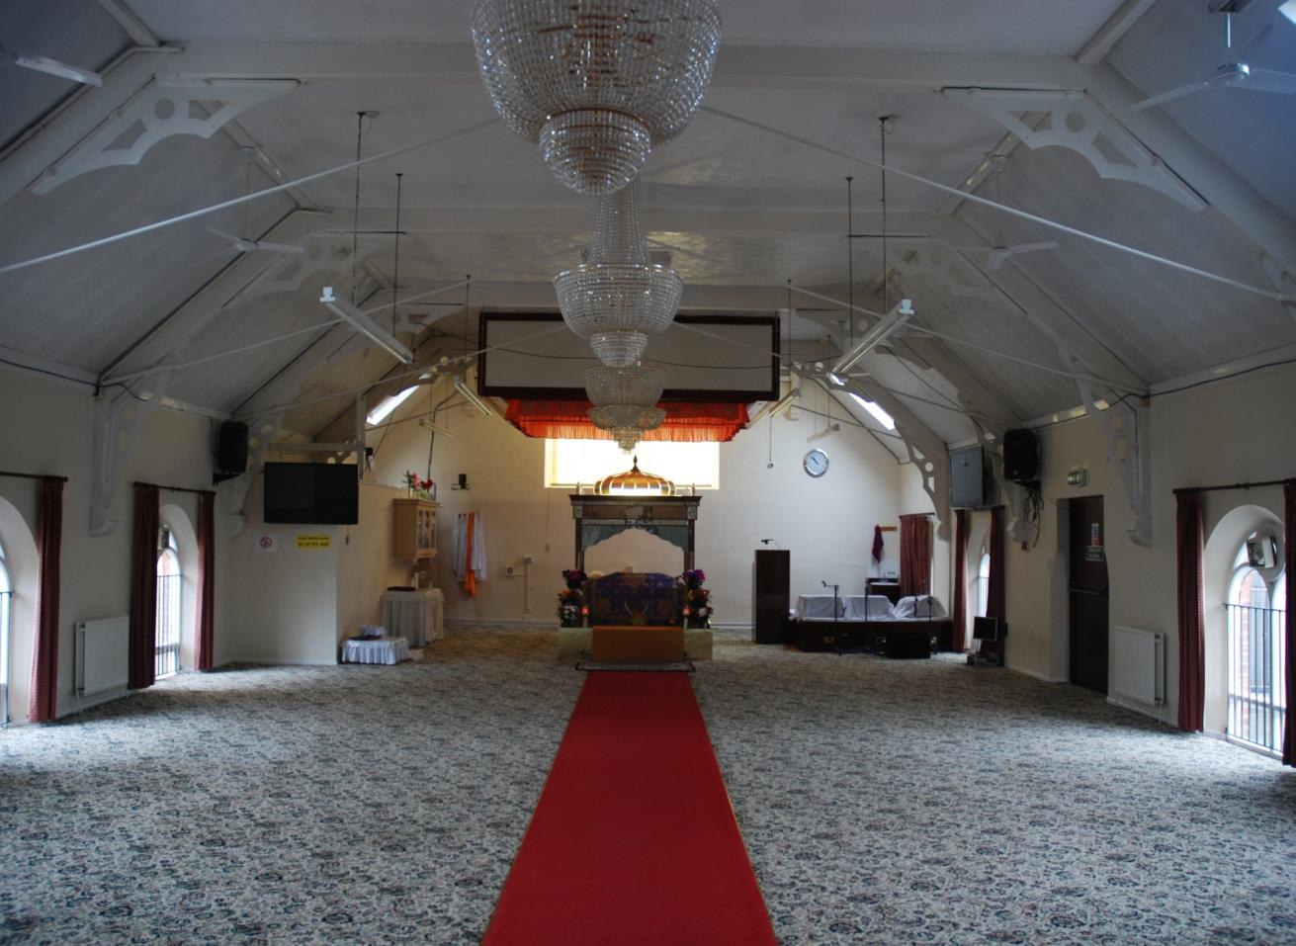
Inside the prayer room

Slide 11
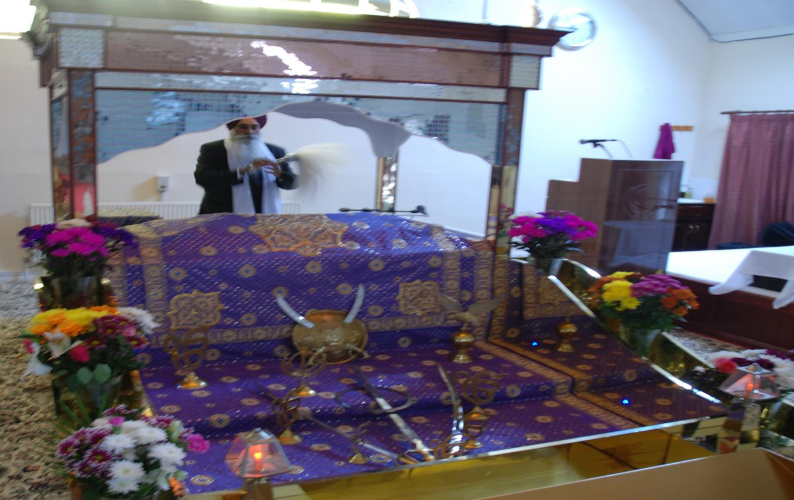
The Holy Book, The Guru Granth Sahib is treated
with great respect

Slide 12
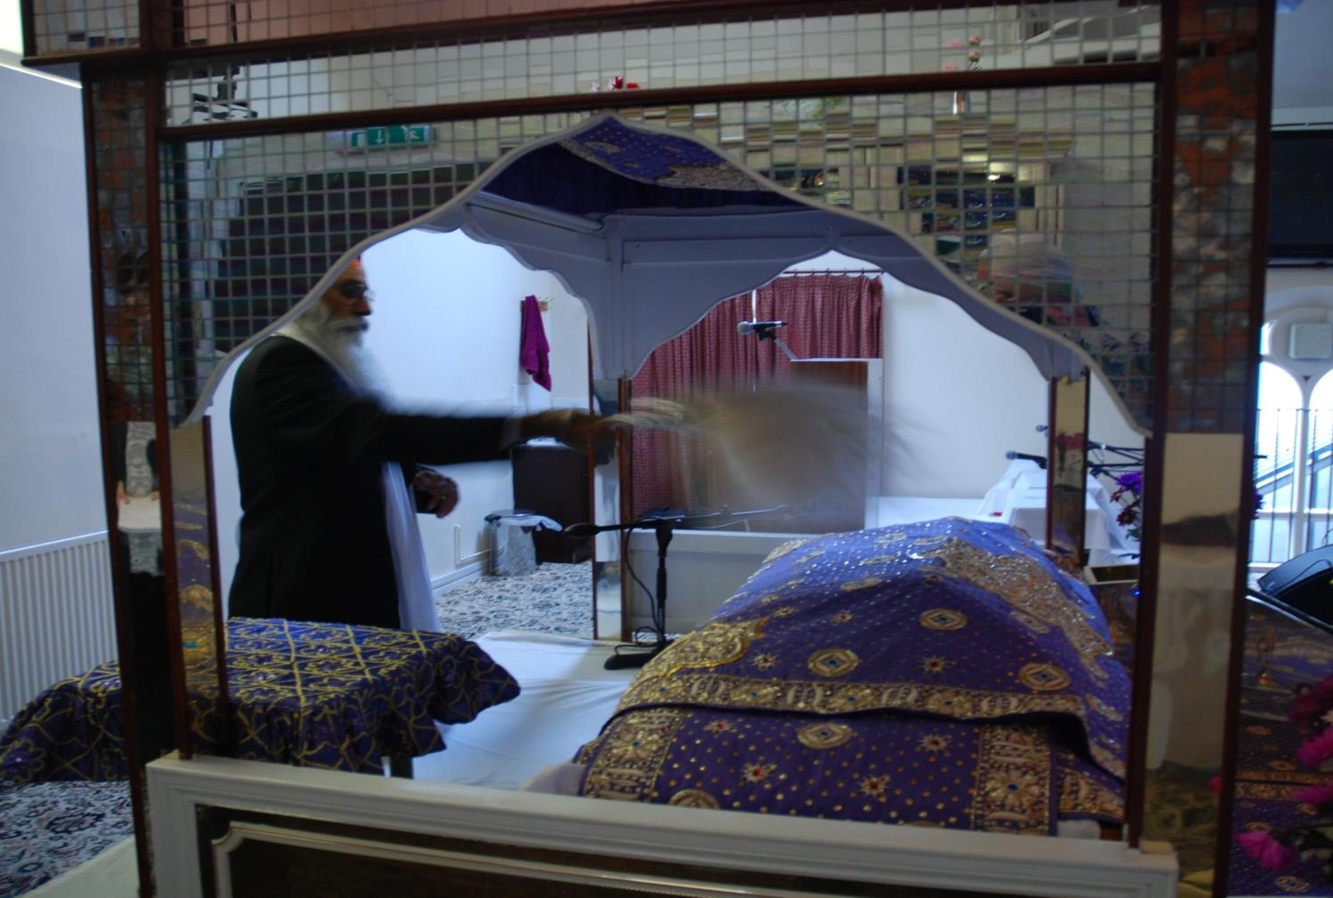
The Guru Granth Sahib is when not being read

Slide 13
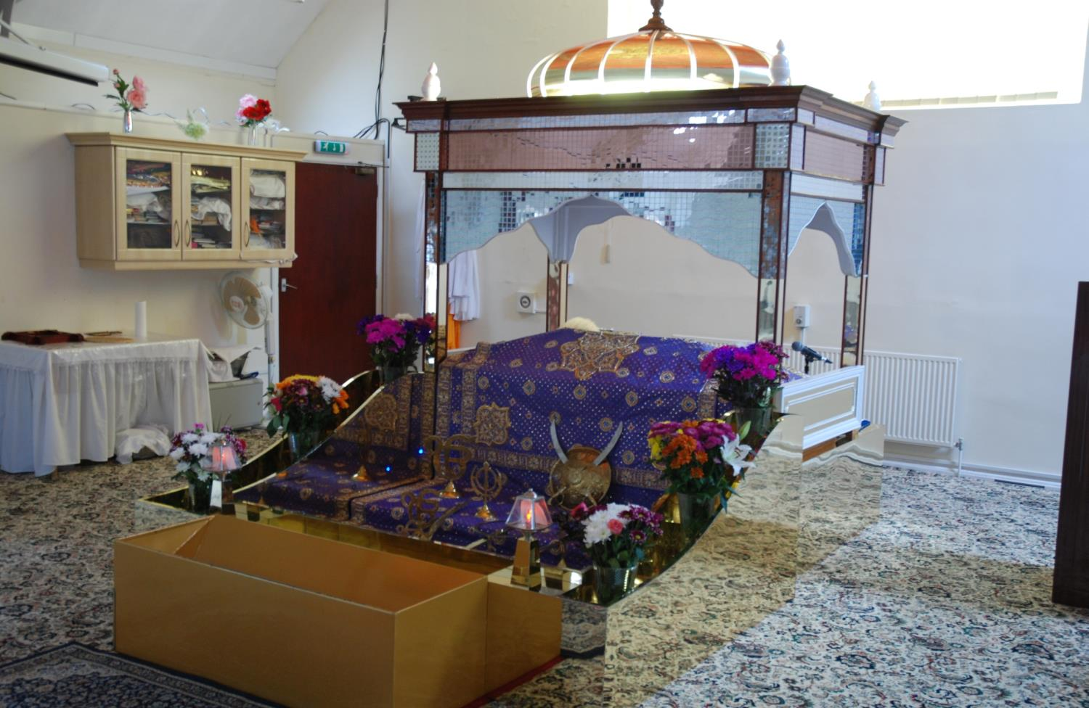
canopy
The Guru Granth Sahib has a canopy over it to show that it is important

Slide 14
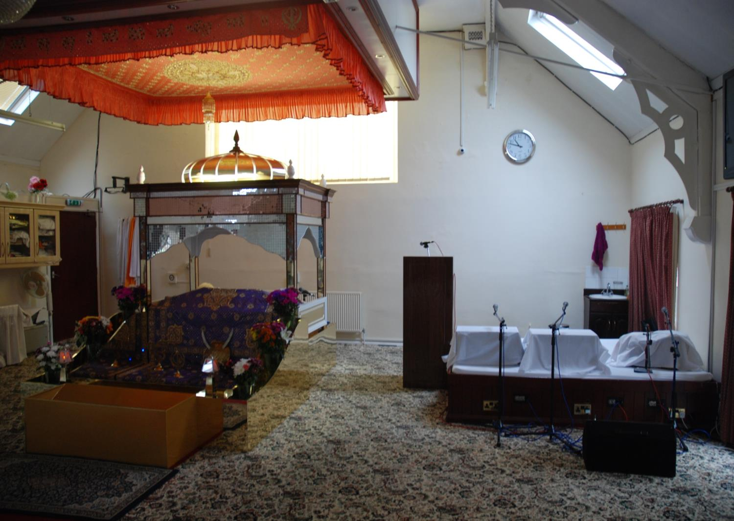
There is also a special place for the musicians to sit

Slide 15
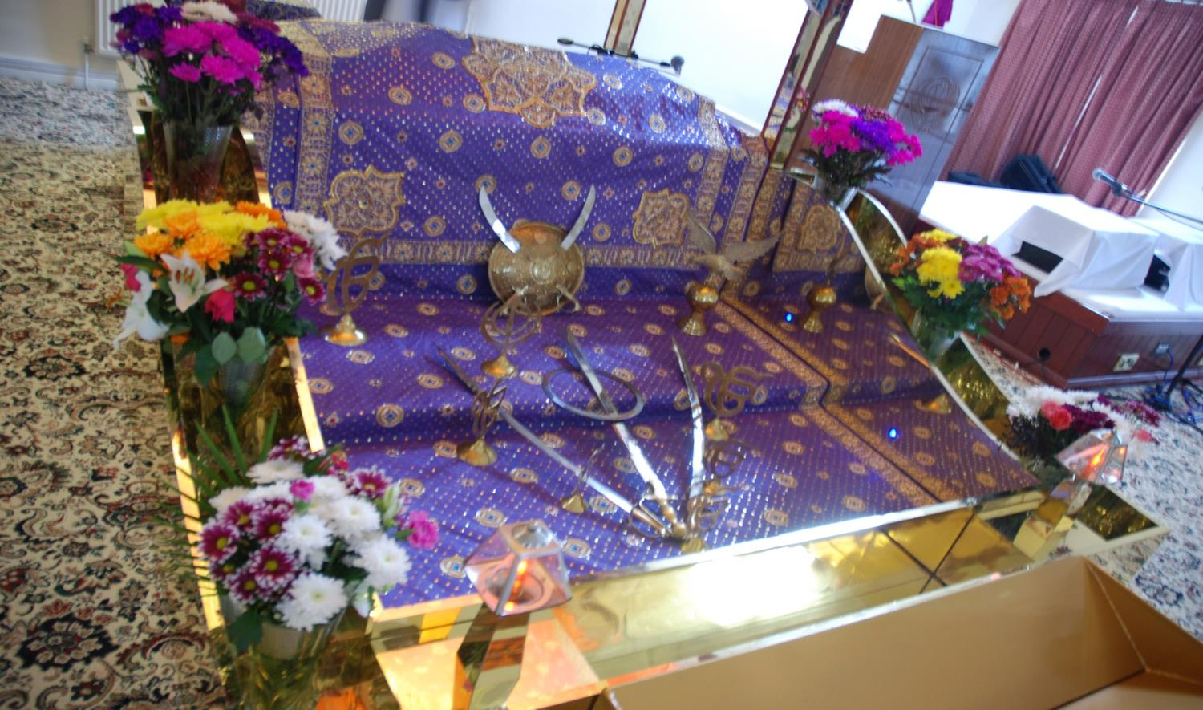
There are symbols and offerings in front of the
Holy Book

Slide 16
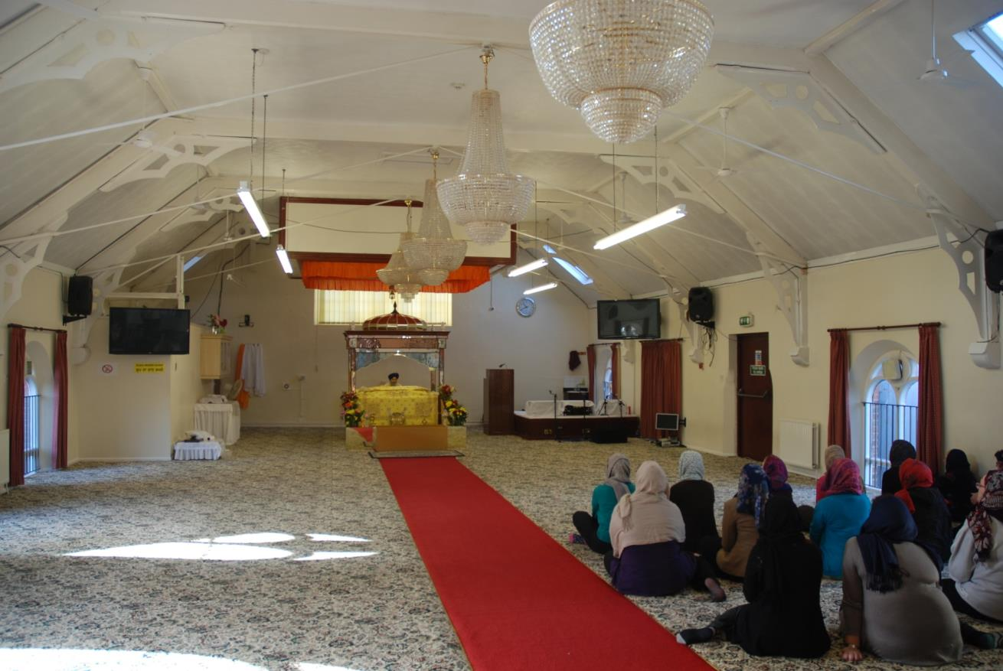
Everyone sits on the floor to show that all are equal

Slide 17
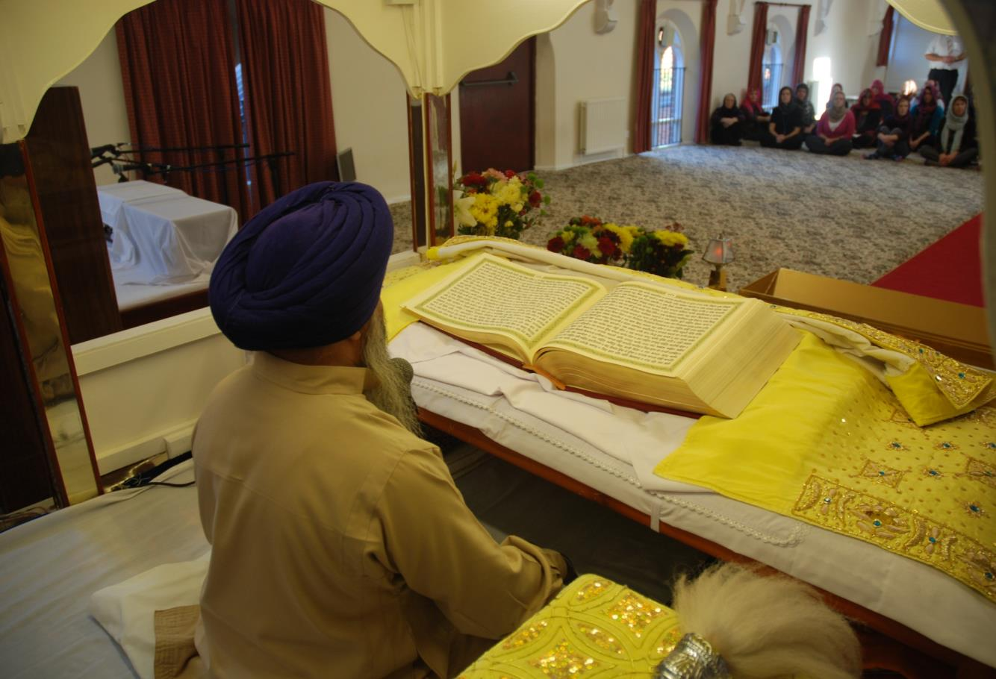
The Guru Granth Sahib is read during worship.
It is a collection of poems praising God

Slide 18
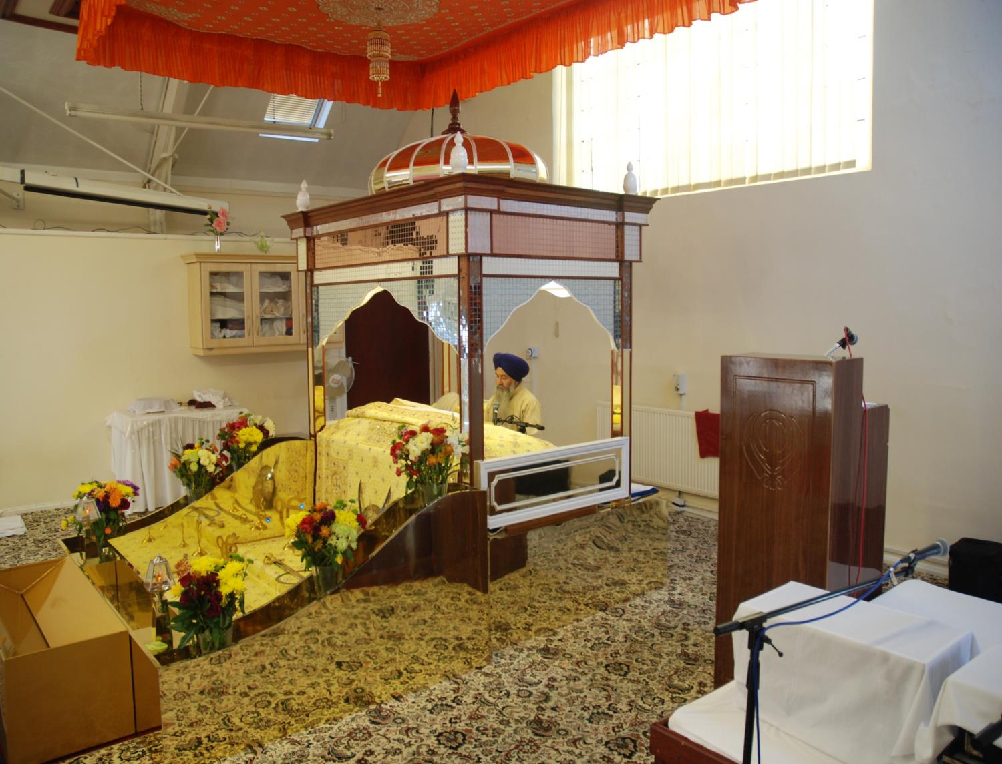

Slide 19
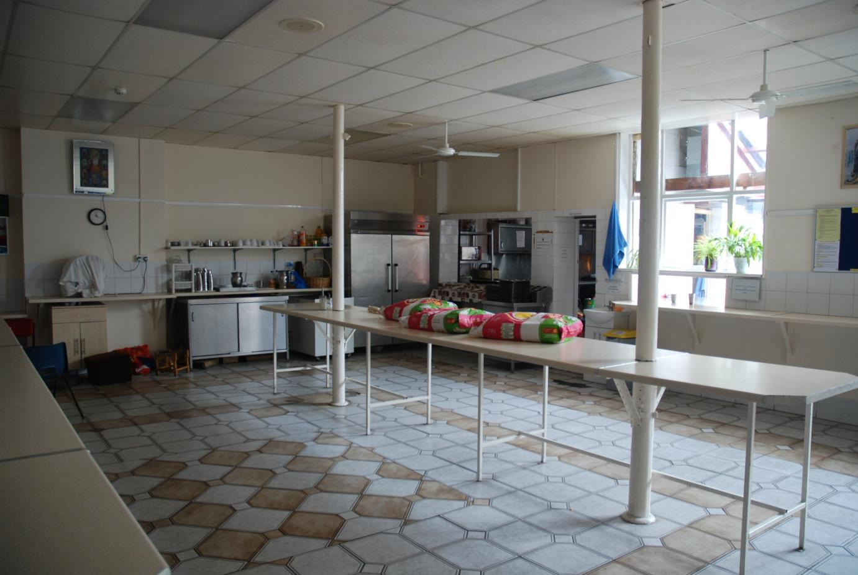
Sikhs believe in The Langar At the end of every service a meal is prepared for the community in special kitchens at the Gurdwara

Slide 20
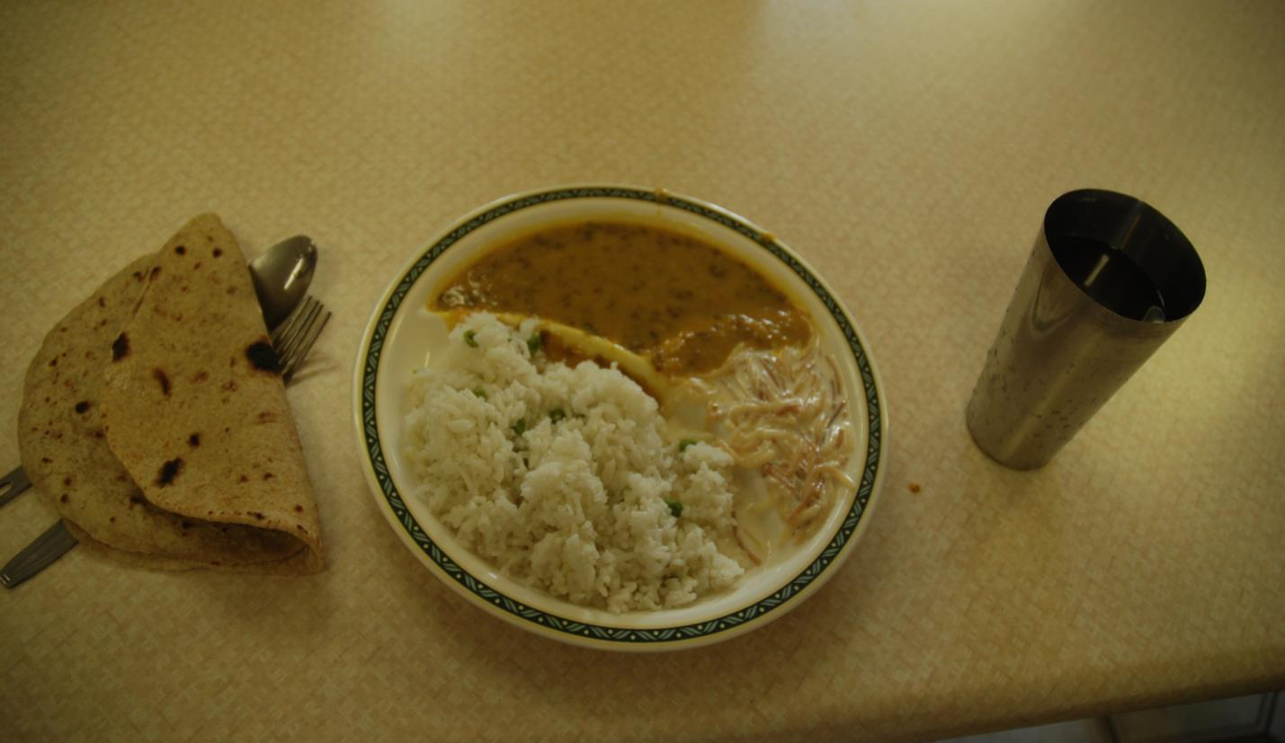
The food is always vegetarian and includes rice

Slide 21
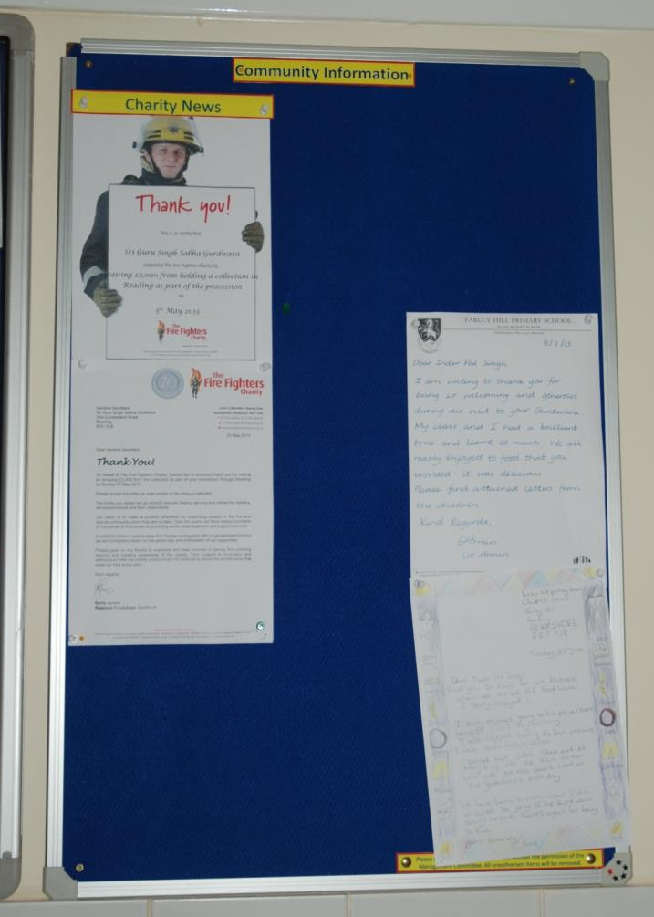
The Gurdwara is also a place for the Sikh community to meet together.
There are notice boards where community information can be shared

Slide 22
Crossing the Bridges Project
Schools, SACREs and Places of Worship
working together
to enhance Religious Education
Pan-Berkshire
2017

