Slide 1
Crossing the Bridges Project
Schools, SACREs and Places of Worship
working together
to enhance Religious Education
Pan-Berkshire
2017

Slide 2
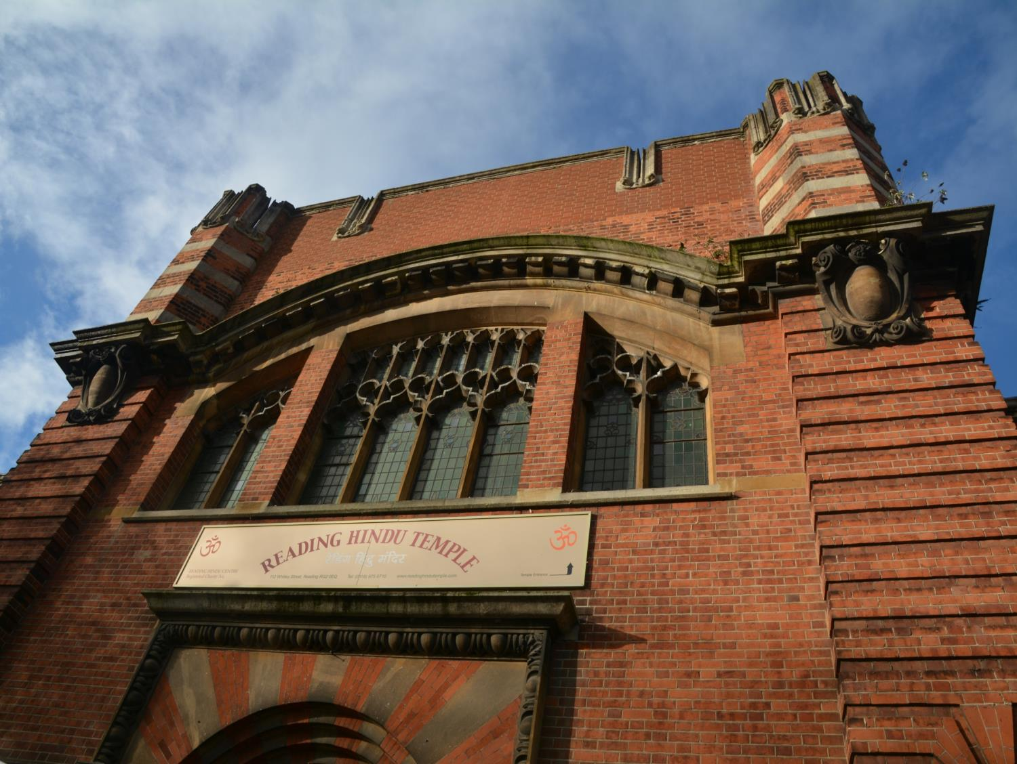
The Hindu Temple in Reading

Slide 3
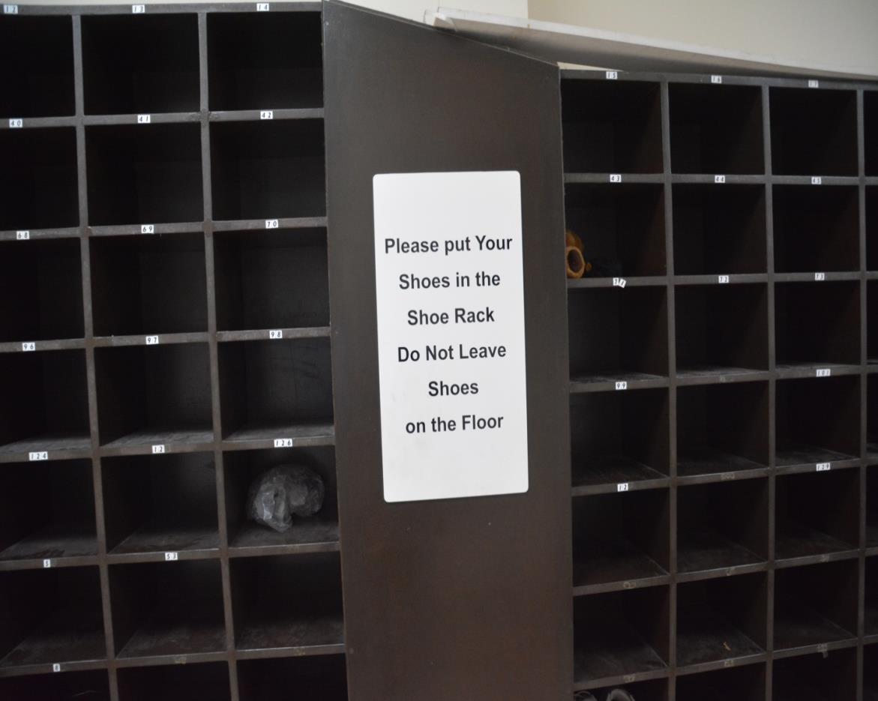
When you go into the temple, you have to take your shoes off.
The shoes can be put in shoe racks like this one.

Slide 4
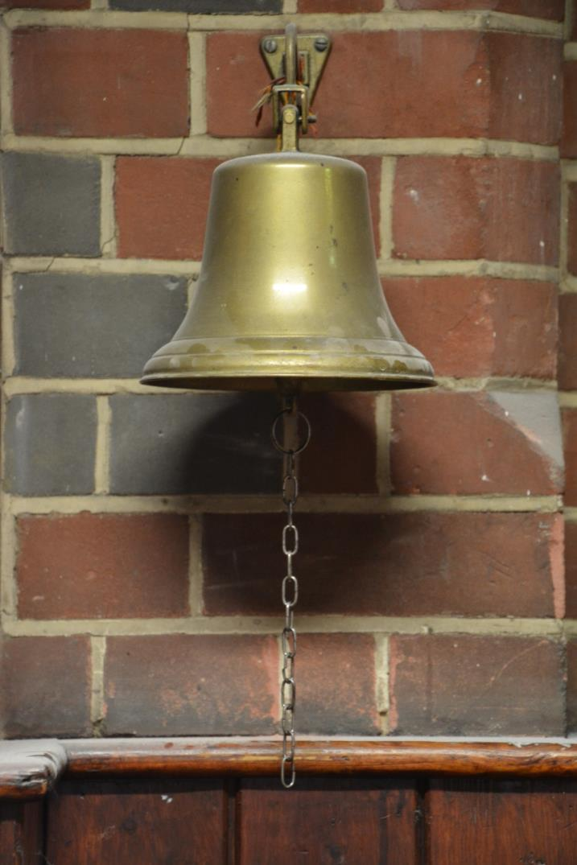
When a Hindu goes into the temple they ring a bell to let God know that they are coming to worship

Slide 5
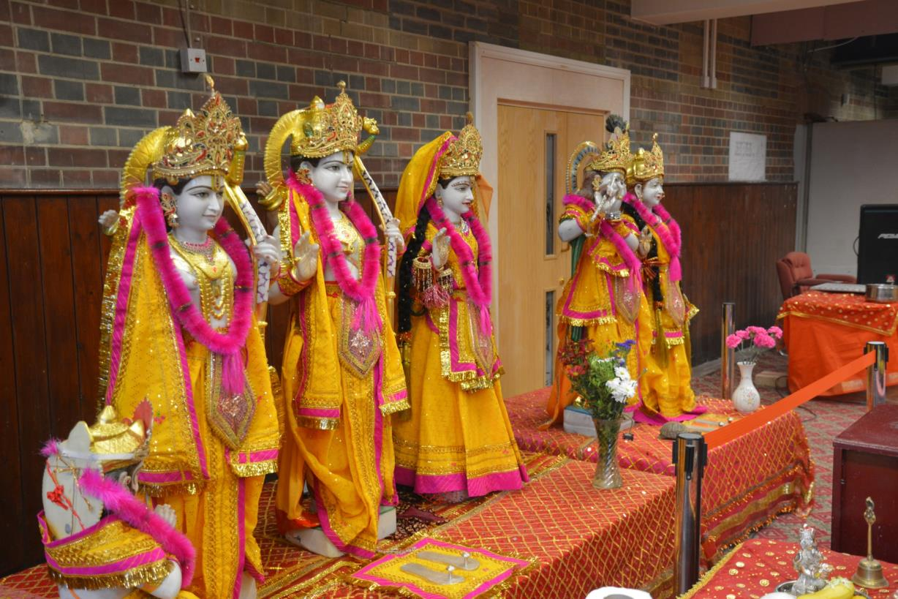
As you enter the Temple you will see many different statues
Hindus believe in one God, Brahman who is experienced and understood
as many different gods and goddesses.

Slide 6
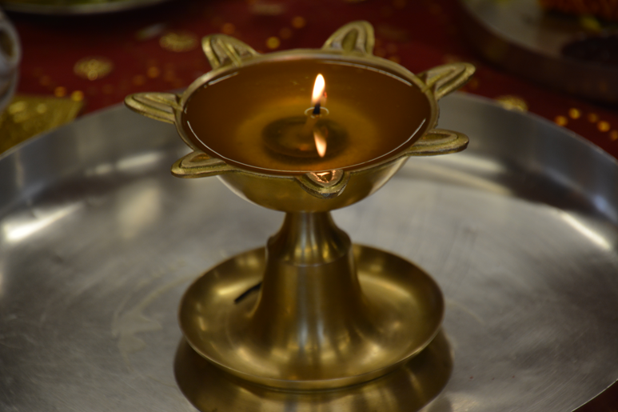
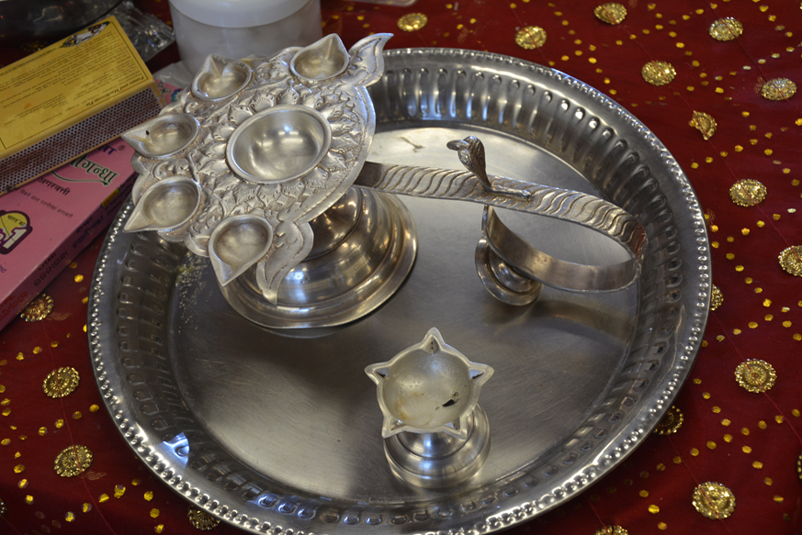
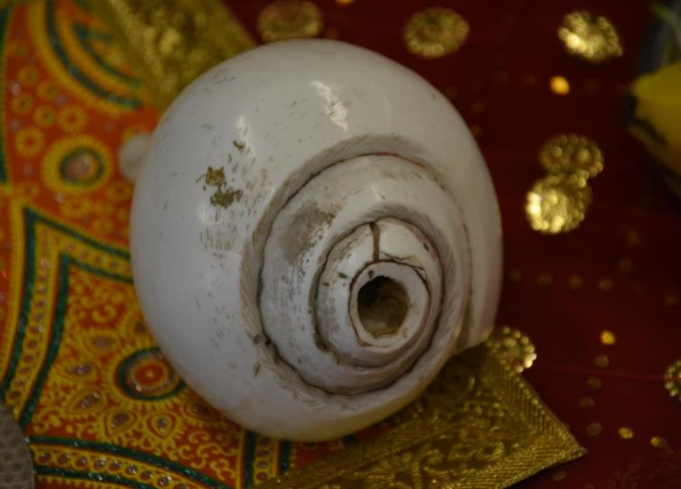
Some of these objects
include
symbols of light
and
a shell

Slide 7
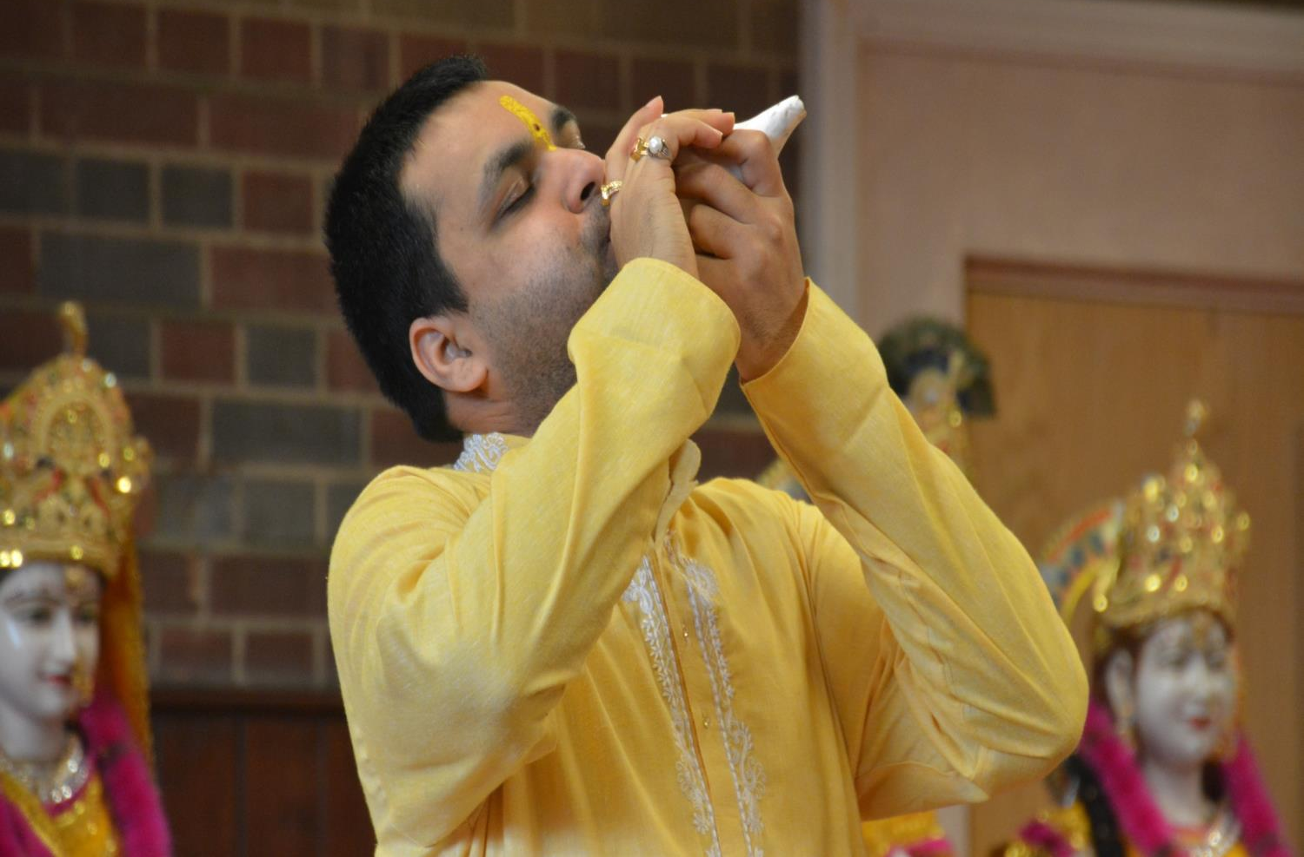
The shell is blown to keep people alert – ready to worship God

Slide 8
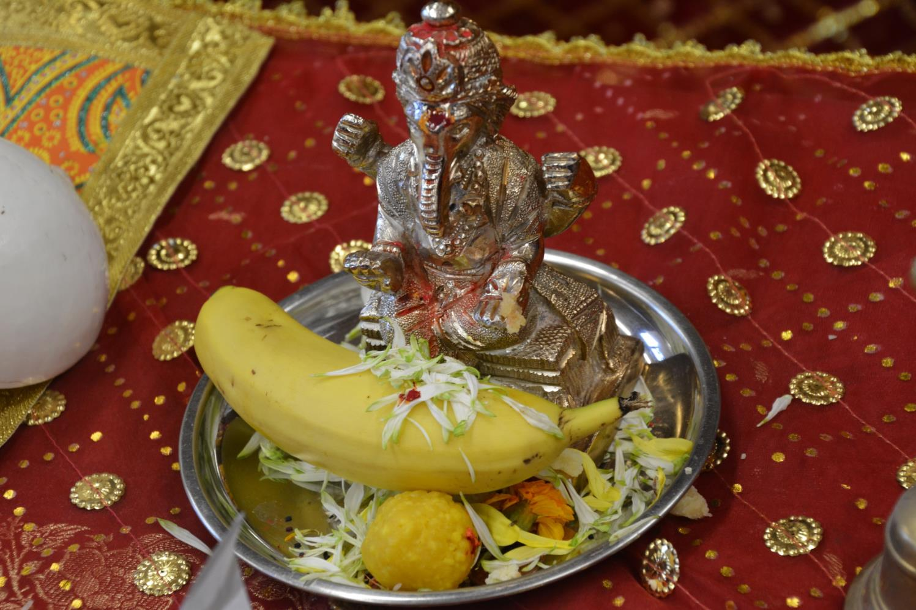
People bring offerings when they come to pray at the temple – usually these offerings include food or flowers

Slide 9
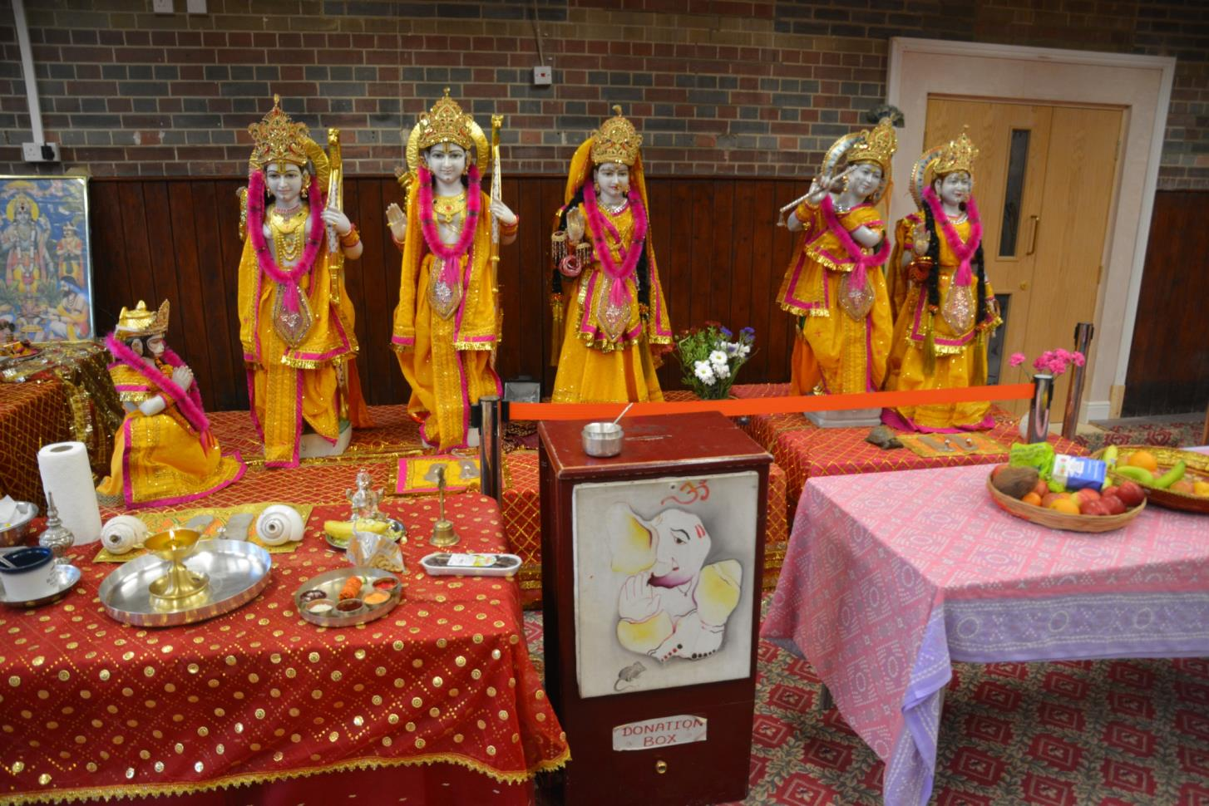
There are many different murtis in the temple,
a murti is a statue or an image of a god or goddess

Slide 10
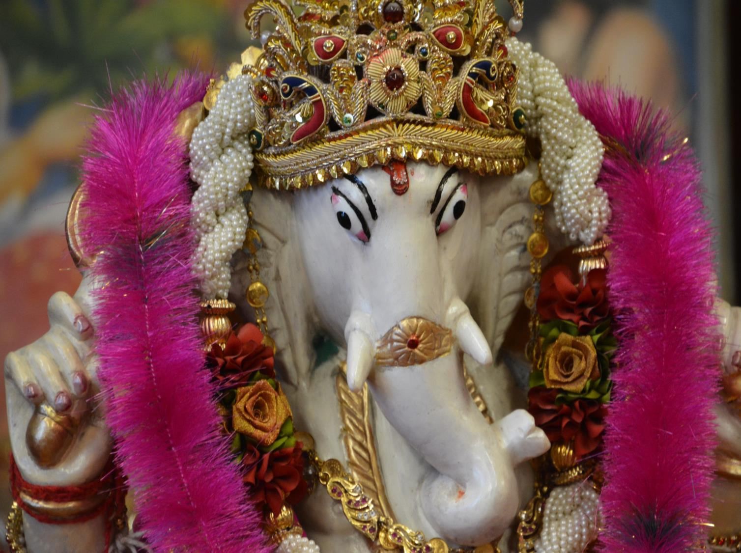
Some gods are part animal
Ganesha has an elephant’s head

Slide 11
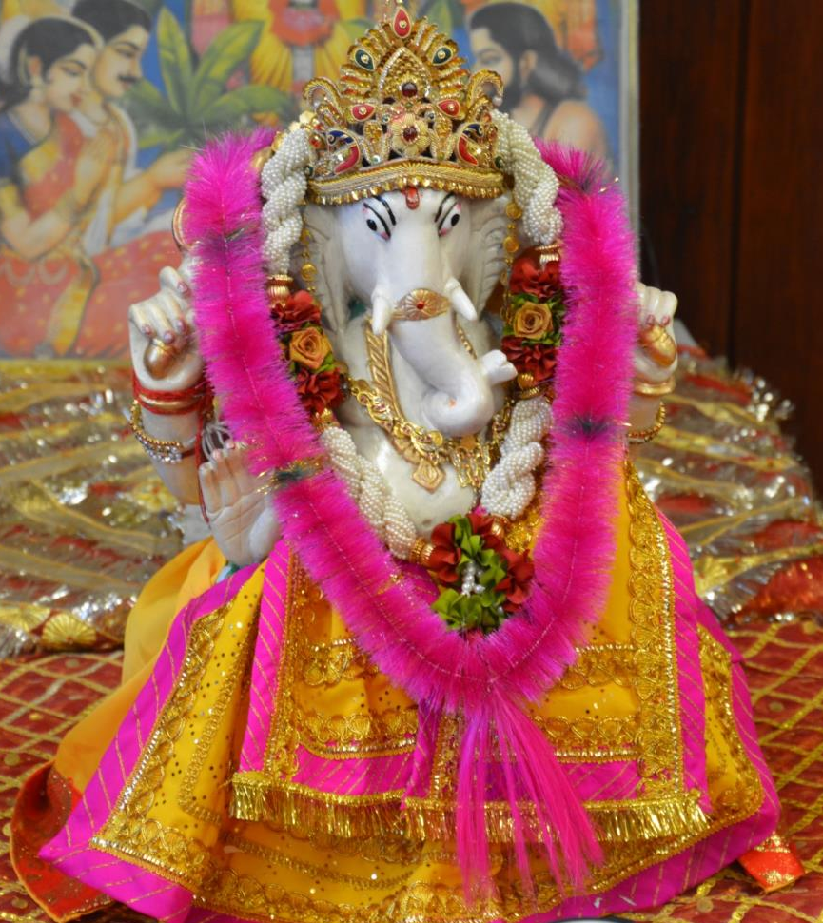
Ganesha is the first god Hindus pray to when entering the temple.
The murtis are dressed in bright colours and are looked after as a sign of respect.

Slide 12
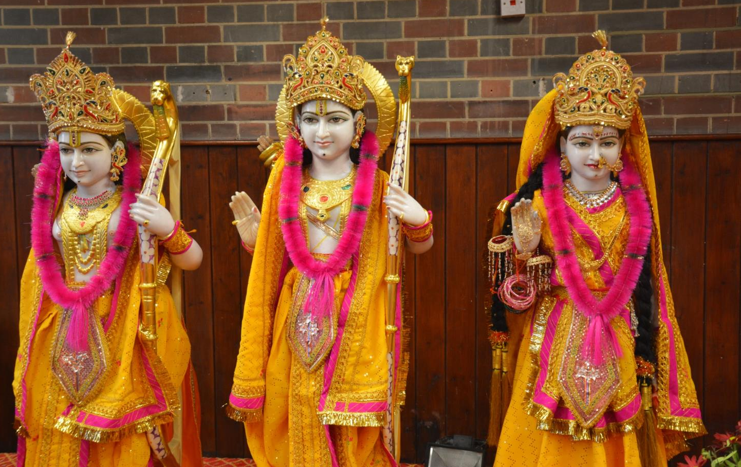
Rama and Sita
Some of the gods are involved in important stories and festivals for example
Rama and Sita are the main characters in the story of Diwali

Slide 13
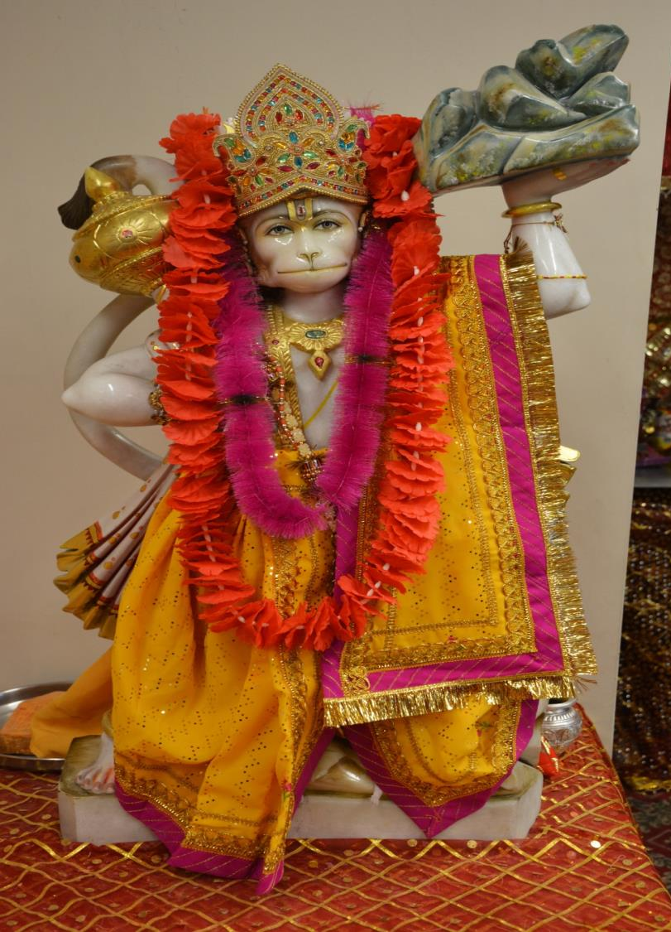
Hanuman
also has a key part to play in the story of Diwali

Slide 14
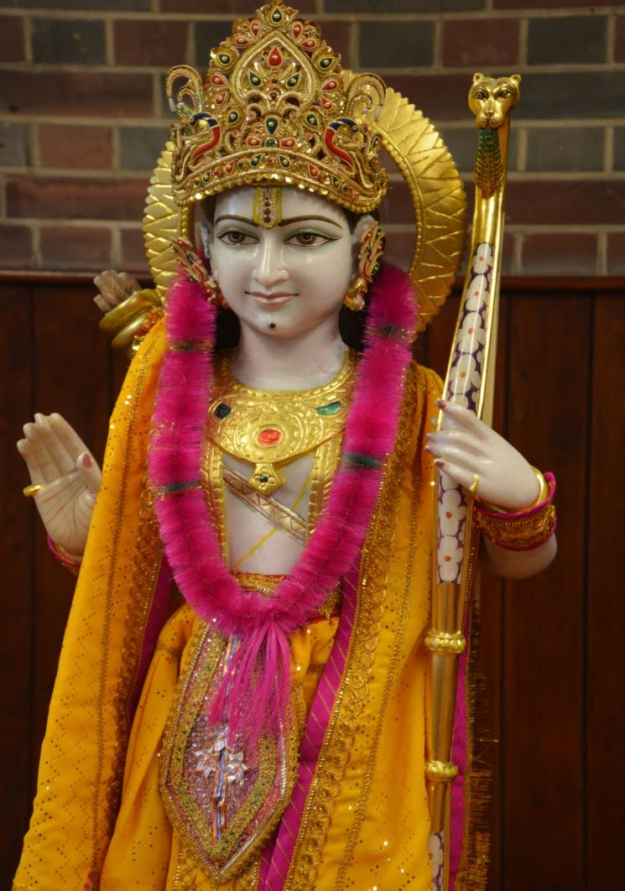
The gods often hold symbols from their stories.
Here
Rama holds a bow

Slide 15
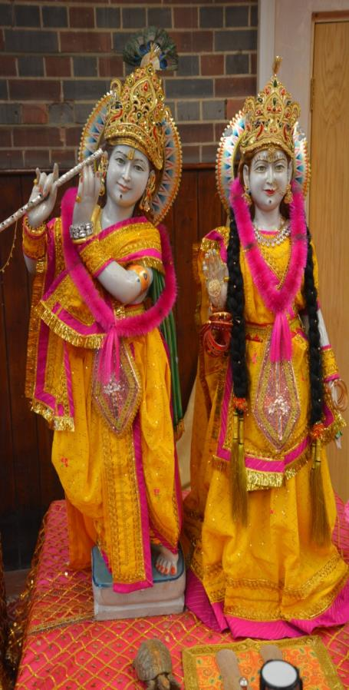
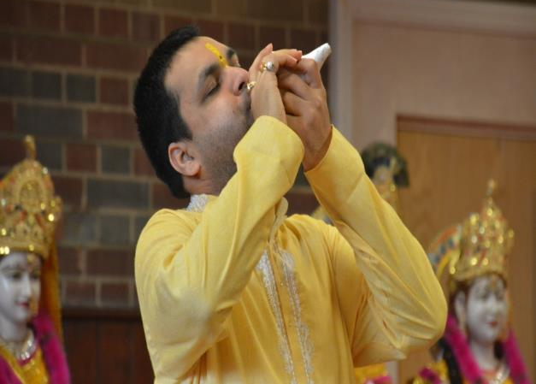
The Hindu Temple
is the centre of the
Hindu community

