Slide 1
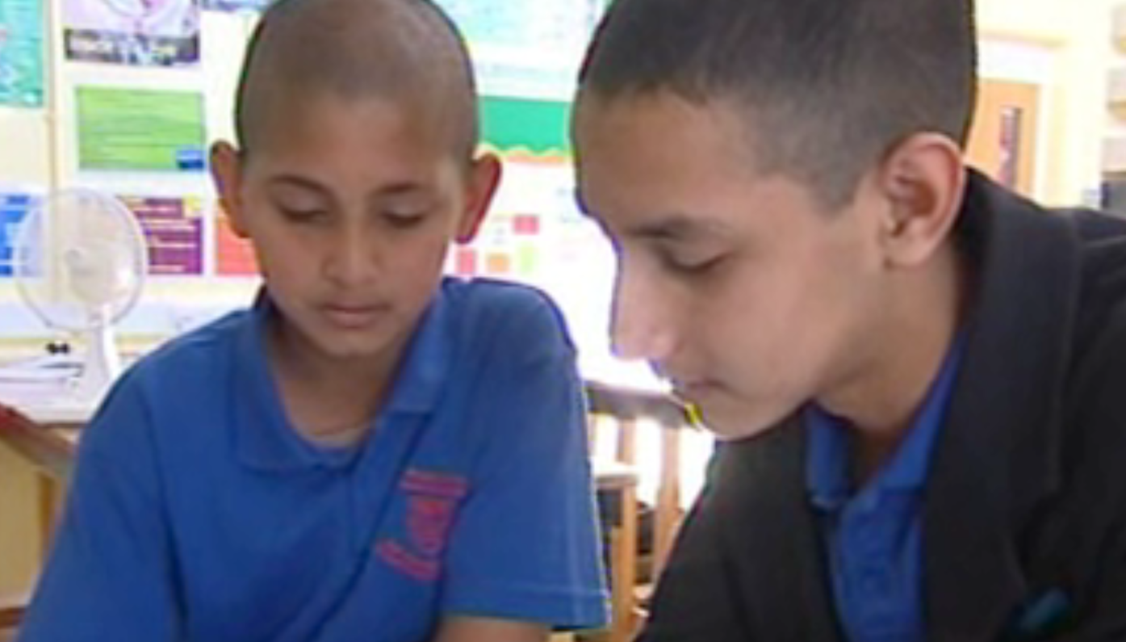
Learning through talk
Martyn Pendergast
Wokingham
23rd April 2012

Slide 2
Why talk?
‘Reading and writing float on a sea of talk’
Barnes, D., Britton, J. and Rosen, H. (eds) Language, the Learner and the School
(1969), Penguin: Harmondsworth

Slide 3
Making the language match the task
Oral language in different contexts will require students to make different language choices
Students engage in a variety of oral activities throughout the school day
Contexts of oral activities can vary according to:
  Purpose
  Topic
  Who is involved
  How it is carried out

Slide 4

Text
Language features
Notes:
Text 1: Language does little work since shared ‘here and now’ context provides much of the meaning
Text 2: Language has to reconstruct some of the context
Text 3: Language has to construct all of the context

Slide 5
‘Delexical’ verbs – no precise meaning
Audience is close - feedback
Shared context, use of pronouns
Text 1:
Try this one…no, it doesn’t go…it doesn’t move...try that…yes…it does, does…a bit…that won’t…won't work, …it’s not metal…these are the best…it’s making them going really fast.
Everyday language – not specialist
Repetition, not ‘worked’ or considered language

Slide 6
First person, still shared context
Use of nouns rather than pronouns
More specialist vocabulary
Text 2:
We tried a pin…, a pencil sharpener, …some iron filings and a piece of plastic. The magnet didn’t attract the pin, but it did attract the pencil sharpener and the iron filings. It didn’t attract the plastic..
Can now guess the context, but still not entirely explicit
Informal, more ‘spoken-like’

Slide 7
More explicit about context
Still personal pronoun – shared context
Past tense
Text 3:
Our experiment was to find out what a magnet attracted. We discovered that a magnet attracts some kinds of metal. It attracted the iron filings, but not the pin. It also did not attract things that were not metal.
More precise and formal verbs
Present tense shows generalisation

Slide 8
Longer and complex sentences
Verbs with precise meanings
Third person – more impersonal or distanced
Text 4:
A magnet is a piece of metal which is surrounded by an invisible field of force which affects any magnetic material within it. It is able to pick up a piece of steel or iron because its magnetic force flows into the metal, turning it into a temporary magnet which is able to pick up, or attract, a piece of steel or iron because its magnetic field flows into the metal, turning it into a temporary magnet. Magnetic attraction occurs only between ferrous metals.
Present tense enables writer to generalise
Very specialist vocabulary

Slide 9
The mode continuum
informal
(often spoken)
formal
(usually written)
(here and now language
accompanying
tasks/action)
(more abstract language
in reflection)
Based on the work of Michael Halliday and Language in Learning across the Curriculum, 2007, State of South Australia, DECS
and web based resource.
Notes:
9
9
The micro scaffolding is the teacher explaining the shift in genre from exploratory talk to more formal presentational talk and modeling what that looks like. In geography, we are constantly saying, that’s a good answer, now can you tell me that again but as you would write it.
Ask participants where they would place each of those examples on the mode coninuum.

Slide 10
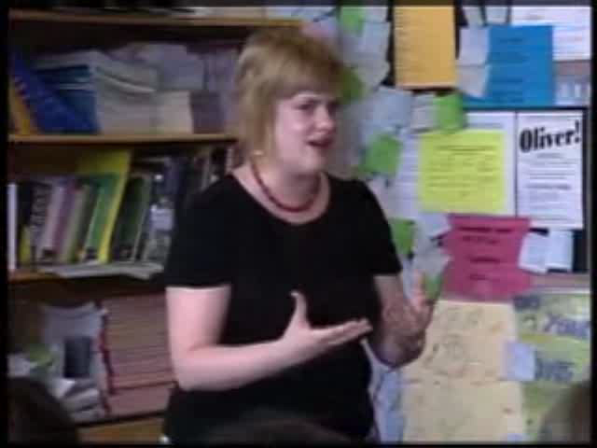
How did they get there?

Slide 11
A teaching and learning sequence
Exploratory talk
Report back to class
Write recount text
Active reading
Speaking as an expert (formal)
Analytical or discursive text

Slide 12
Exploratory talk
Exploratory talk is that in which partners engage critically but constructively with each other’s ideas. Relevant information is offered for joint consideration. Proposals may be challenged and counter-challenged, but if so reasons are given and alternatives offered. Agreement is sought as a basis for progress. Knowledge is made publicly accountable and reasoning is visible in the talk.
Mercer, N. Words and Minds: How We Use Language To Think Together (2000), London: Routledge

Slide 13
How can we encourage pupils to talk productively?
Rules for group talk
Assigning roles
Concrete preparation
Cognitive conflict (asking the right question)
Collaboration
Metacognition
(Adapted from ‘Improving learning through cognitive intervention’ GTCE
www.gtce.org.uk/research/romtopics/rom_teachingandlearning/case_jun01/ )

Slide 14
Bloom’s revised taxonomy
Original and New terms based on Pohl By Kurwongbah State School, Australia

Slide 15
Activities to promote exploratory talk
In pairs or threes, try out a number of exploratory talk tasks. After you have finished each task, consider:
the thinking skills that were promoted by the activity
how you might use the activity in your own subject.
Record your reflections on resource 4
Notes:
Opinion line
Odd one out
Plus –minus-interesting
Concept cartoons

Slide 16


Using dictogloss to develop writing skills in a particular register
First clue
Second clue
Notes:
The extent to which pupils can make the appropriate language choices for any given context will influence their success at school

Slide 17
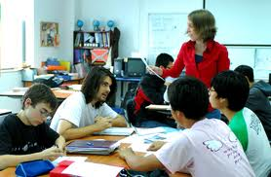



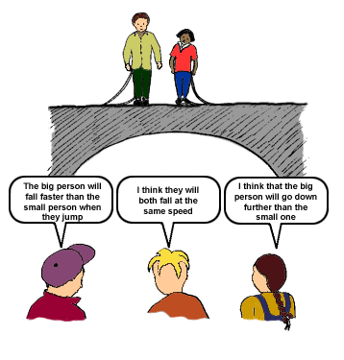

Where does talk fit?
Making language explicit
Collaborative group work
Starters:
Think, pair, share
Snowball
Say what your partner thinks
Development
Prompting
Who can add more?
Come to a consensus
Rehearse feedback
Success criteria/talk observer
Triads
Concept cartoons
Talk partners
Traffic lights
Active reading strategies

