Slide 1
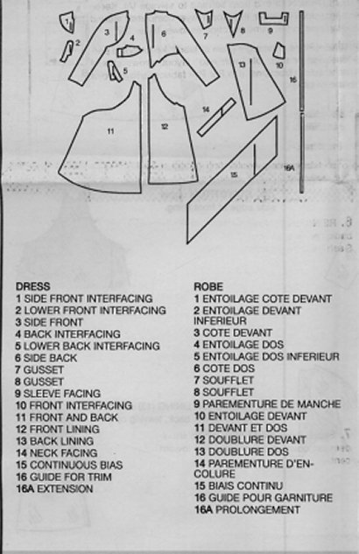
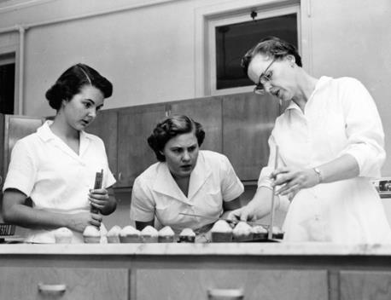
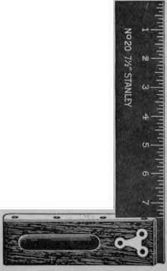
LiLAC
Literacy and Language across the Curriculum
How has it helped DT at George Mitchell School?
Eve Goldman
Helen Marriot

Slide 2
Why bother with Language Across the Curriculum?
Profile of students at GMS
“I know what I want to say but I just can’t write it down!”
Equipping staff with practical strategies
What’s it got to do with Technology?

Slide 3
How can Structured Talk activities help to develop pupils’ language and literacy?
The mode continuum – based on Michael Halliday
Most spoken
‘here and now’,
INFORMAL
Spoken texts written down/written texts spoken aloud
Rehearsed talk
Talk as performance
Most written
Academic language
FORMAL
Notes:
Compare how most of our pupils speak and what we then expect them to produce in an examination; practical classroom strategies we can use to take our pupils further along the continuum; refer to diagram;

Slide 4
Informative text. The Mexican Tortilla.
Recipe. How to marinate Chicken, Mexican Style
“Simply expecting students to be able to produce a variety of genres will not guarantee that it will happen. Such an approach privileges those students who are already familiar with educational discourses from outside school”
J. Polias, Supporting ESL Students with written and Visual Texts Across the Curriculum
Notes:
Why? Texts that students previously had problems with.
Written in the incorrect register used styles and language inappropriate to the task.
Or, from very new arrivals, a list of words or nothing at all.
Previously I had just despaired and moaned, Lilac presented me with some new strategies to try, in order to improve the students mastery of these genres

Slide 5
Making a decision to have literacy objectives
Cooking Objective
To develop an understanding of a new kind of world cuisine and the cooking methods they use.
Literacy Objectives
To develop ability to write recipes
To develop ability to write informative texts, like those that appear in recipe books.
Notes:
Lilac course, over and over again has emphasised that we are all teachers of literacy.
Look at the kinds of texts we expect students to read and write within our subject areas.
Clear to me that technology provided lots of opportunities for teaching about certain text types.
Decided to have a cooking/FT objective and a Literacy objective

Slide 6
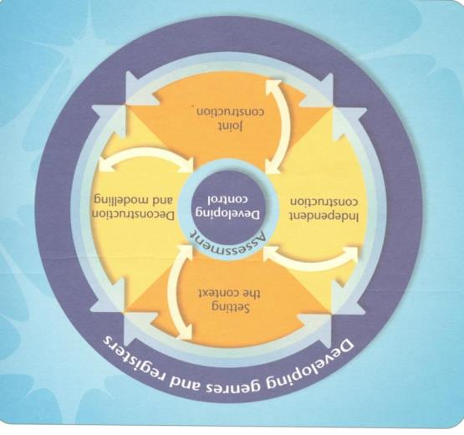
Using a Teaching and Learning Cycle to help planning
Notes:
Lilac course, over and over again has emphasised that we are all teachers of literacy.
Look at the kinds of texts we expect students to read and write within our subject areas.
Clear to me that technology provided lots of opportunities for teaching about certain text types.
Decided to have a cooking/FT objective and a Literacy objective

Slide 7
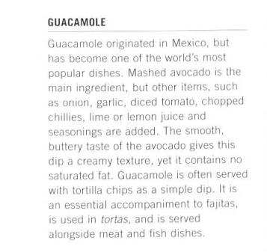
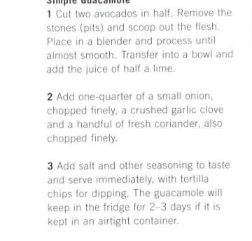
Stage 1. Reading and deconstructing exemplar texts, thus making students aware of the nuances of writing in certain genders, the rules they must conform to.
The word you is not used, the reader is bossed about
No personal opinions
The recipe is ordered using numbers, not time connectives
Notes:
First step, rather than assuming prior knowledge, took the time to deconstruct two texts, similar to those they would write. Read the texts, looked at the language used, Nuances of writing in each style.
Absence of personal opinion in text about Guagamole, Lack of second person, YOU in recipes, layout of a recipe.

Slide 8
Stage 2. Focussed listening/Joint Construction
Each student was given a clipboard and a sheet on which to write notes, that they would later use to construct their texts.
Stopping the daydreaming by giving the students a focus during demonstrations.

Slide 9
Students find demonstrations more interesting as they now, much more active participants
Behaviour during demonstrations is better
Provides an opportunity for joint construction of language.

Slide 10
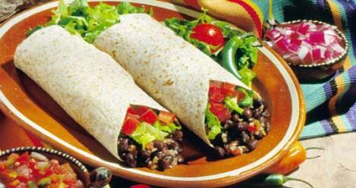
Stage 3. Joint construction of texts
Informative text. The Mexican Tortilla.
Recipe. How to marinate Chicken, Mexican Style
Notes:
Benefits for all groups.

Slide 11
The Results. The effects of making deconstruction of texts and focussed listening a regular part of lessons.
Students are more organised and capable of independently following a recipe in practical lessons
Very new arrivals are much more able to write without the complete support of teachers.
1. Cut the lemon in half and squeeze
2. De-seed the Chilly and chop finely
3. Chop the garlic finely…
Language used more appropriate to tasks given
Writing of students from all ability groups is improved.
Notes:
Benefits to mention, all ability groups benefited. Writing in correct genre, more happy, students more focussed during practical lessons. Mention 9A – Faraaz & Hafeeza. More students taking recipes home.

Slide 12
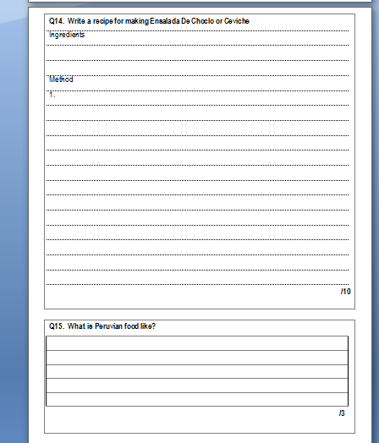
Stage 4. Independent construction of texts
Notes:
Benefits for all groups.

Slide 13
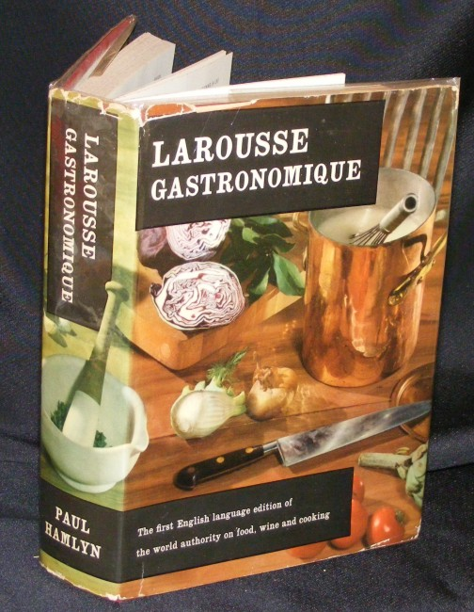
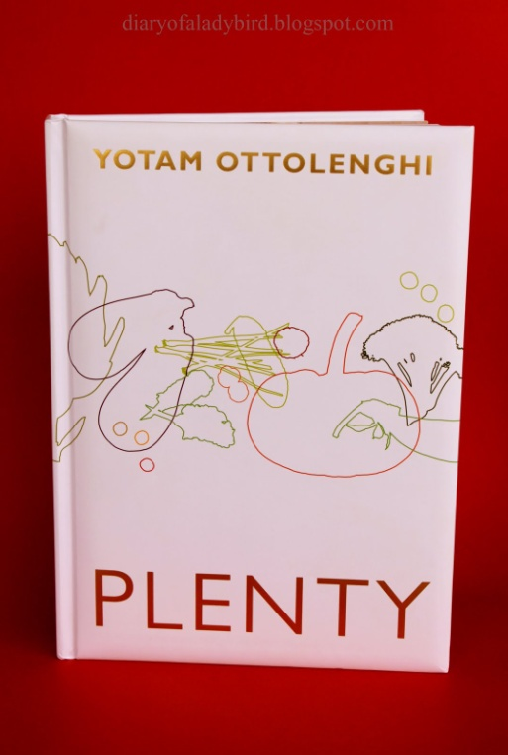
“To become effective readers and writers across the curriculum and to achieve success in their schooling and beyond, students need to understand the choices that writers make, or are allowed to make when constructing texts.”
J. Polias, Supporting ESL Students with written and Visual Texts Across the Curriculum
Notes:
I acvtually hope it will make them read more recipe books, thus continuing learning. .

Slide 14
Spaghetti alla Puttanesca
What can we infer about the text we are about to read from the picture and the title?
Notes:
First: will model some approaches you can use, NOT using an exam text, but which can be applied to an exam text. What can we do if we come across a word which we don’t know? Infer: to draw a conclusion; deduce: to derive a meaning

Slide 15
Fast Finger First: Scanning
Find a word in a language other than English
What ingredients do you need to make this recipe?
How long will it take to cook the meal?
Why do you think it might be called ‘Pasta alla Puttanesca’?
Notes:
NB Which questions got you to use inference and deduction?

Slide 16
What strategies did I use?
Visuals and title first before the text
Prompted you to make predictions and ask questions of the text
Practised scanning skills
Used a strategy check to make skills explicit: scanning, vocabulary
Scaffolded the task – built up confidence
Helped you to ‘find your way around’ the text, ready to deconstruct later
Built up to inference and deduction
Notes:
Finding way around text: understanding how text works; vocab: what can you do if you find a word you don’t know? Chose this task deliberately for two reasons: easier way into topic; modelled some of necessary skills without using an actual exam question } imp of using these kinds of strategies from year 7 onwards – Cheryl Cole. What might I have gone on to do during the next lesson?

Slide 17
Focussed Listening Activity
http://www.youtube.com/watch?v=RKDjetk5Kko

Slide 18
Joint Construction Activity (talk like an expert)
http://www.youtube.com/watch?v=yoGR3lvTrWw

Slide 19
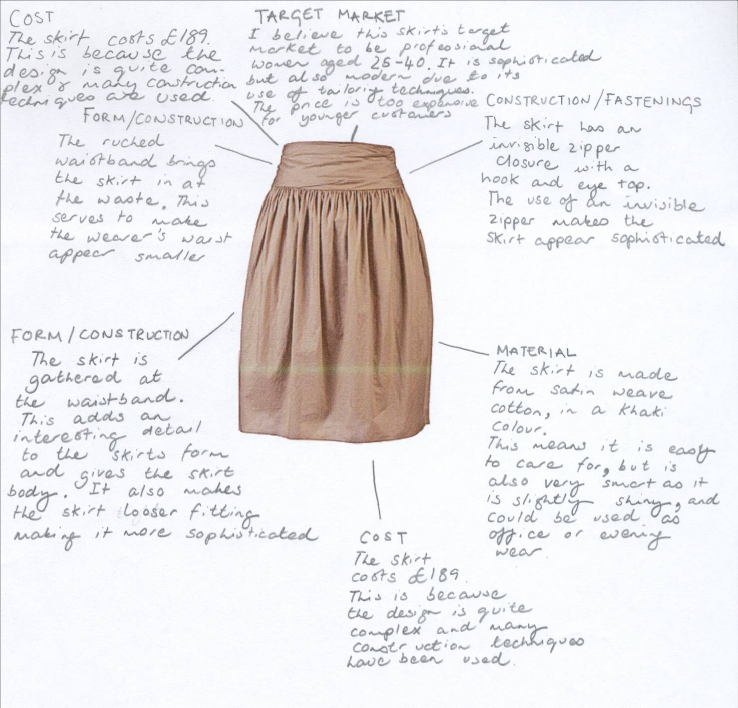
Analysis Texts in Technology (Product Analysis)
What is Product Analysis?
Notes:
We do product Analysis. Important for the students development as designers. Given great importance in PoS

Slide 20
Analysis Texts in Technology (Product Analysis)
What do students normally produce? What problems/misunderstandings can be identified?
Notes:
We do product Analysis. Important for the students development as designers. Given great importance in PoS

Slide 21
Analysis Texts in Technology (Product Analysis)
HEADING
FACT
WHY
Deconstructing the text as a teacher. Developing an understanding of the genre and a student friendly way of approaching it.
Notes:
We do product Analysis. Important for the students development as designers. Given great importance in PoS

Slide 22
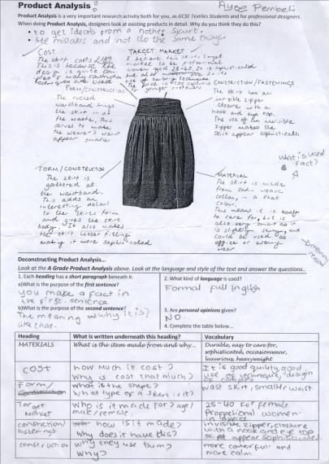
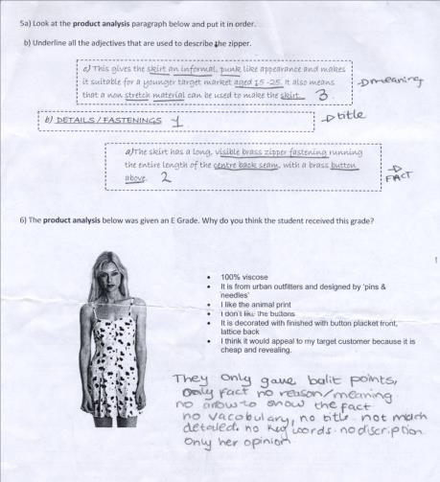
Analysis Texts in Technology (Product Analysis)
Developing exercises. Deconstructing the text with the class
Notes:
We do product Analysis. Important for the students development as designers. Given great importance in PoS

Slide 23
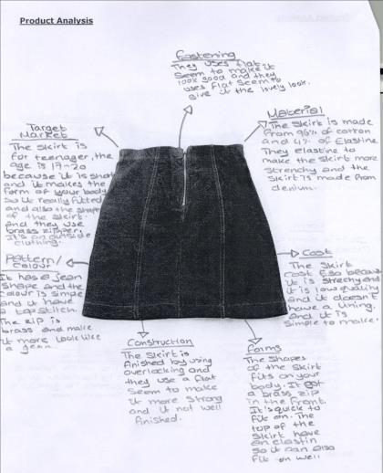
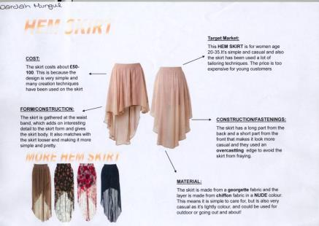
Analysis Texts in Technology (Product Analysis)
Reducing Scaffolding
Notes:
We do product Analysis. Important for the students development as designers. Given great importance in PoS

Slide 24
LiLAC
How do you think it could help you?

