Slide 1
Crossing the Bridges Project
Schools, SACREs and Places of Worship
working together
to enhance Religious Education
Pan-Berkshire
2017

Slide 2
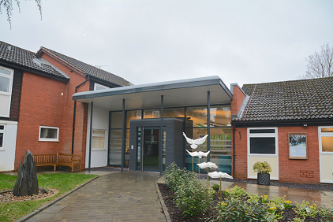
Maidenhead Reform Synagogue

Slide 3
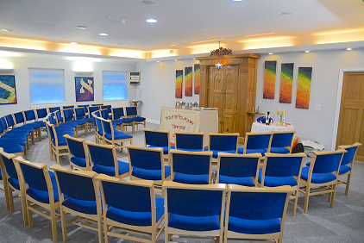
Inside the synagogue

Slide 4
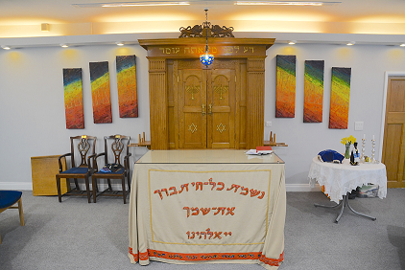
The Ark with the Ner Tamid (ever burning light)

Slide 5
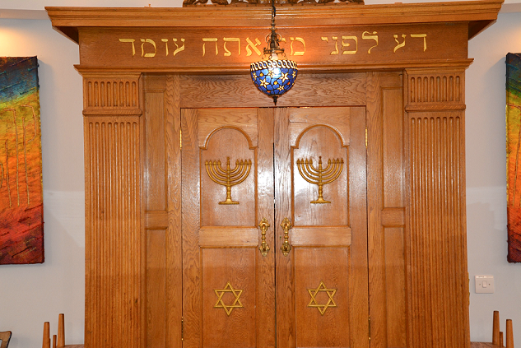
The Ark containsthe Torah scrolls

Slide 6
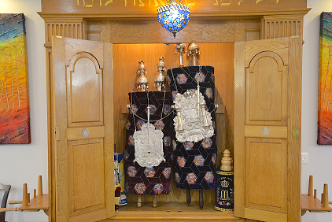
The scrolls are wrapped in special coverings. This keeps the scrolls clean and shows how special they are.
The special cover is called a mantle.

Slide 7
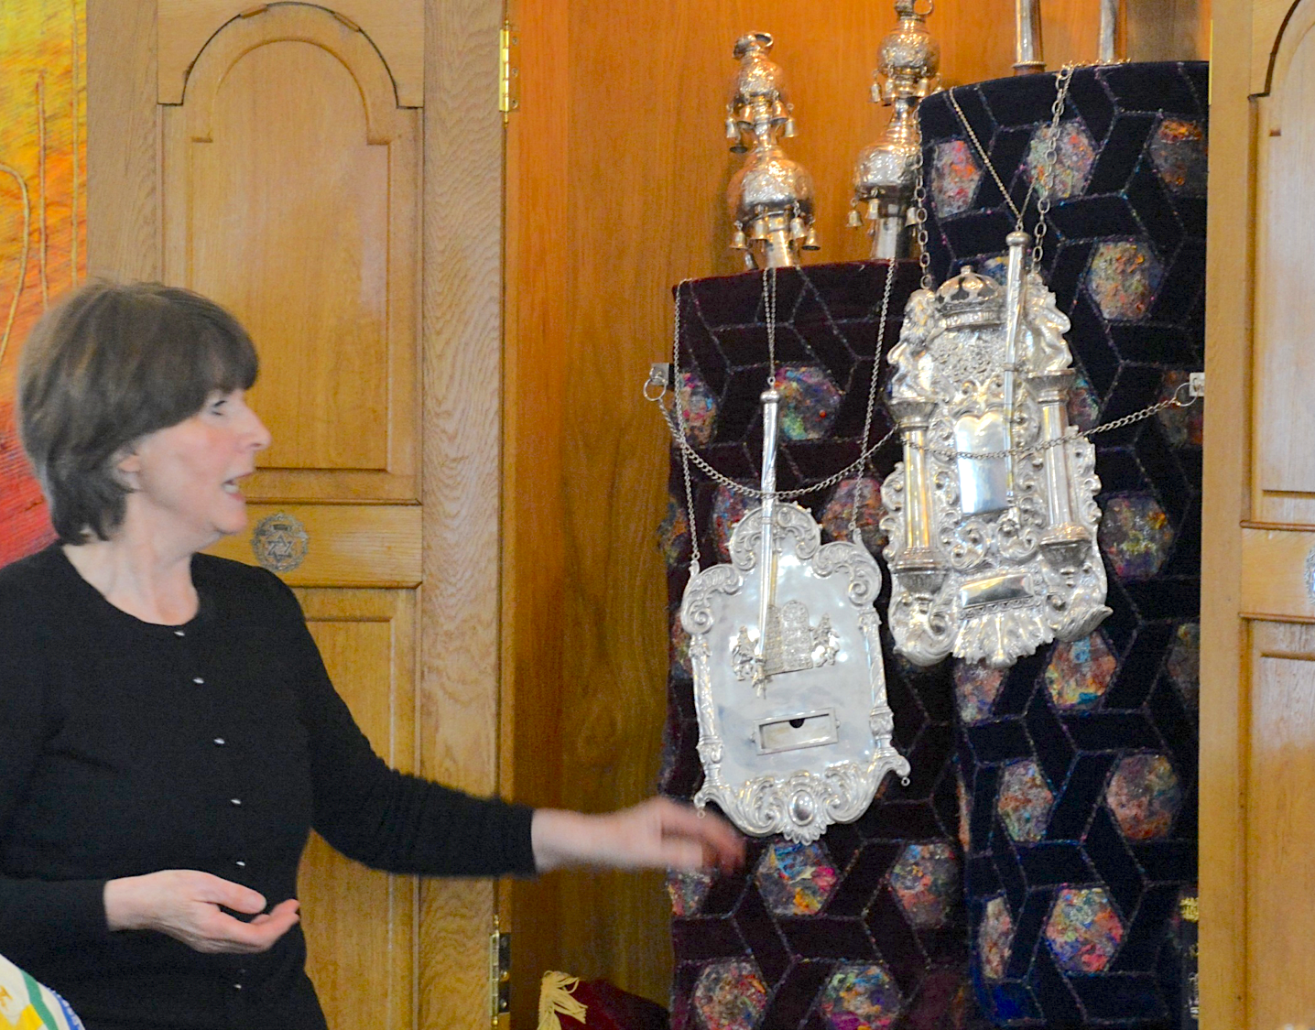
The mantle also has a silver breastplate on it.
This is a reminder of the breastplates that the high priests were instructed to wear.

Slide 8
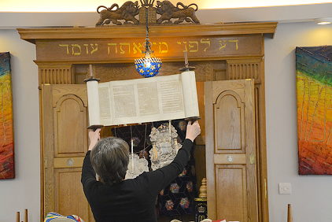
The scrolls contain the holy books and are handled very carefully
The scrolls are written on special parchment. Each scroll is handwritten and must have no mistake on it because it is the word of God for Jews

Slide 9
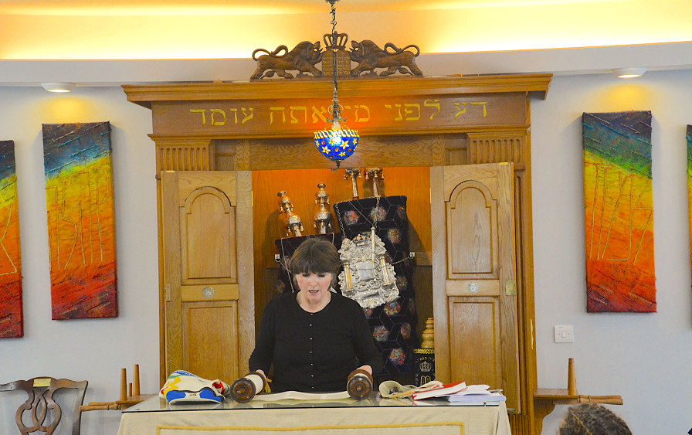
In a Reform Synagogue men and women are allowed to read the scrolls.

Slide 10
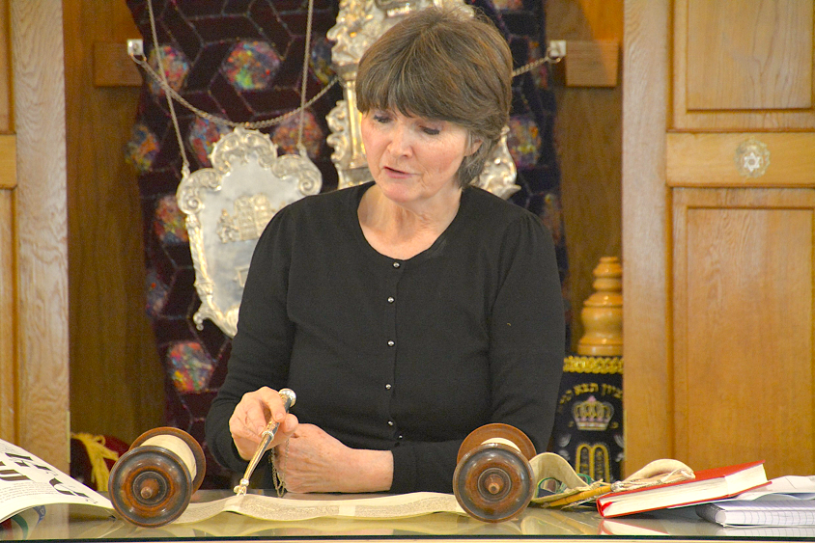
A special pointer called a Yad is used.
This means that the scrolls will not be touched by hand and so will be kept clean.

Slide 11
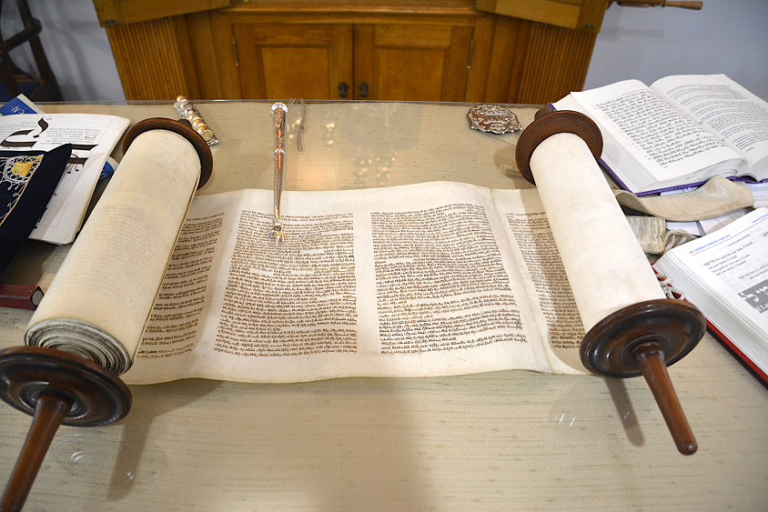

Slide 12
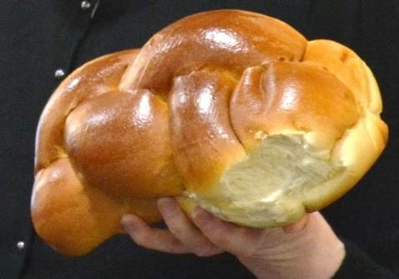
Some of the symbols used at the Shabbat meal were displayed on this table.
The Challah bread was under the blue cloth

Slide 13
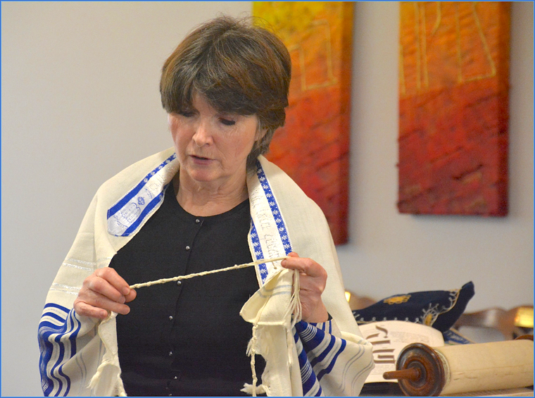
Often a prayer shawl, called a Tallit, is worn
There are fringes at the end with 10 knots at each end (5 on each corner).
The number of fringes and knots adds up to 613 – the number of commandments in the Torah

Slide 14
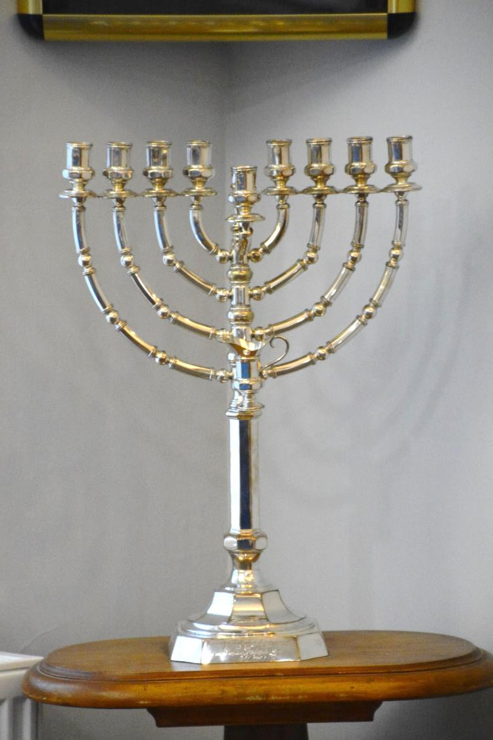
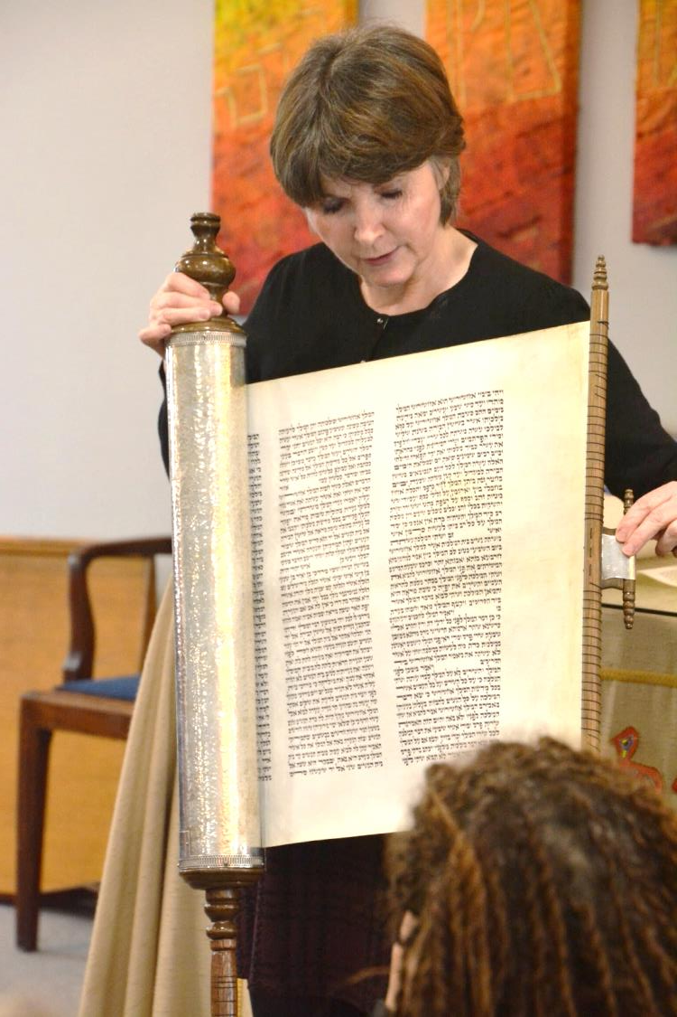
Other symbols are there to remind Jews of famous events for example,
the 8 branched candle holder and servant candle, used at the Festival of Hanukkah and the scroll of the story of Esther – used at the festival of Purim

