Slide 1
Crossing the Bridges Project
Schools, SACREs and Places of Worship
working together
to enhance Religious Education
Pan-Berkshire
2017

Slide 2
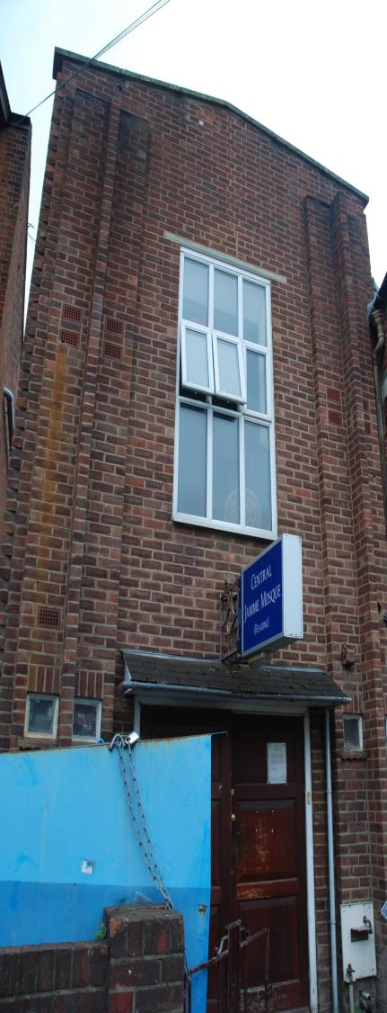
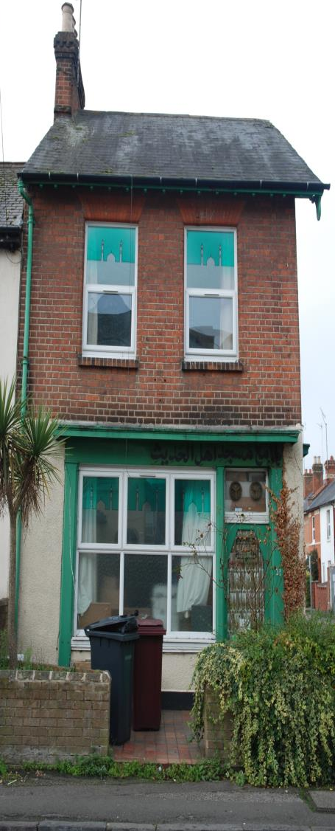
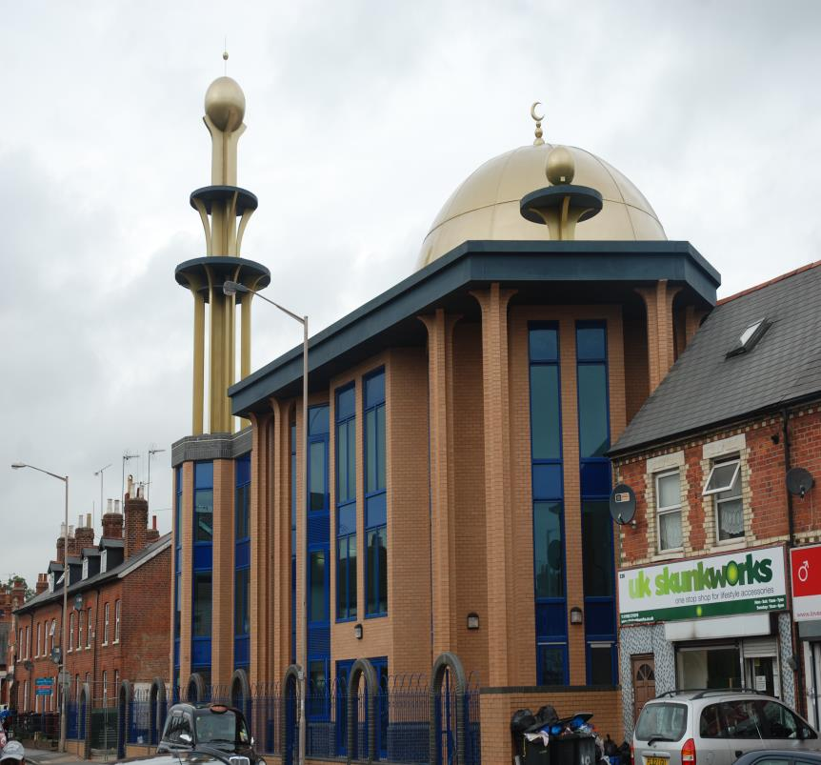
Mosques in Reading

Slide 3
Some Mosques are converted houses

Slide 4
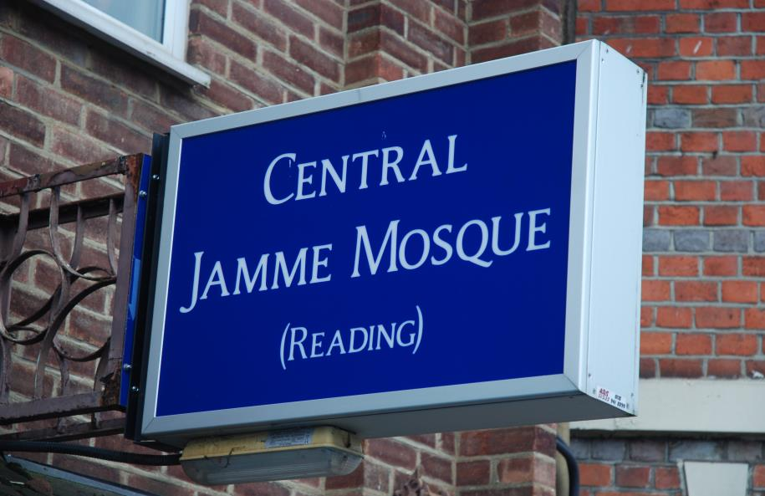
These don’t often look like Mosques from the outside, so they have a big sign!

Slide 5
Some Mosques are specially built, they don’t need a sign!

Slide 6
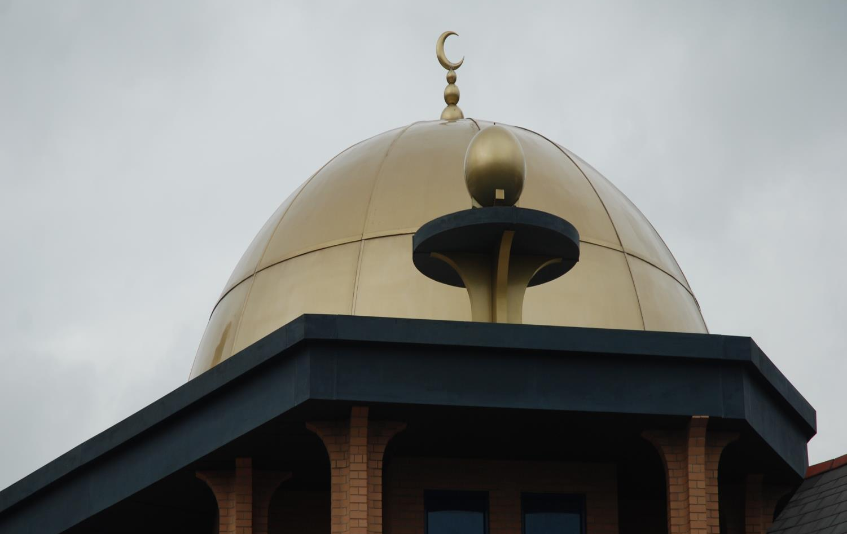
Dome
crescent moon
These Mosques have a dome over the prayer hall.
There is usually a crescent moon, the symbol of Islam, too

Slide 7
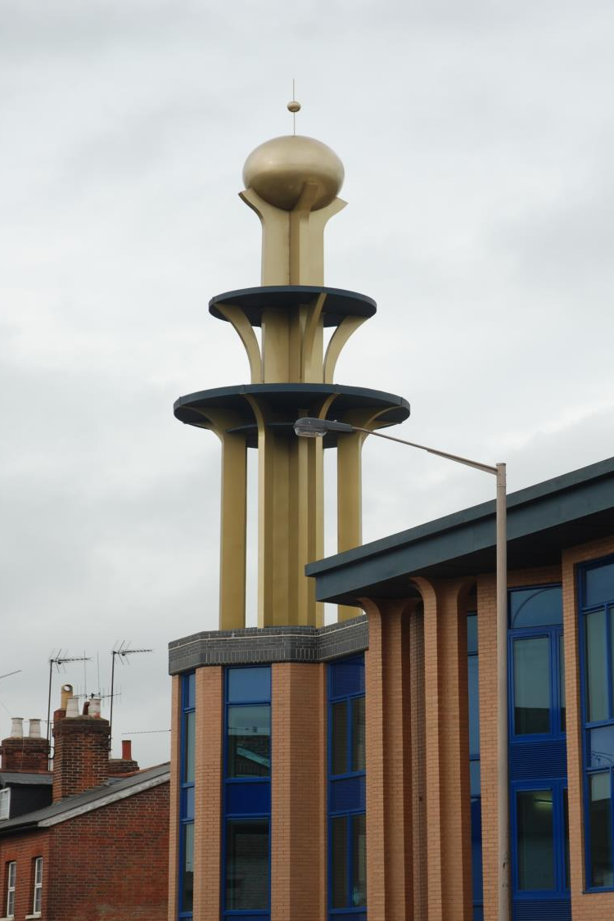
Minaret
They also have a special tower called a Minaret

Slide 8
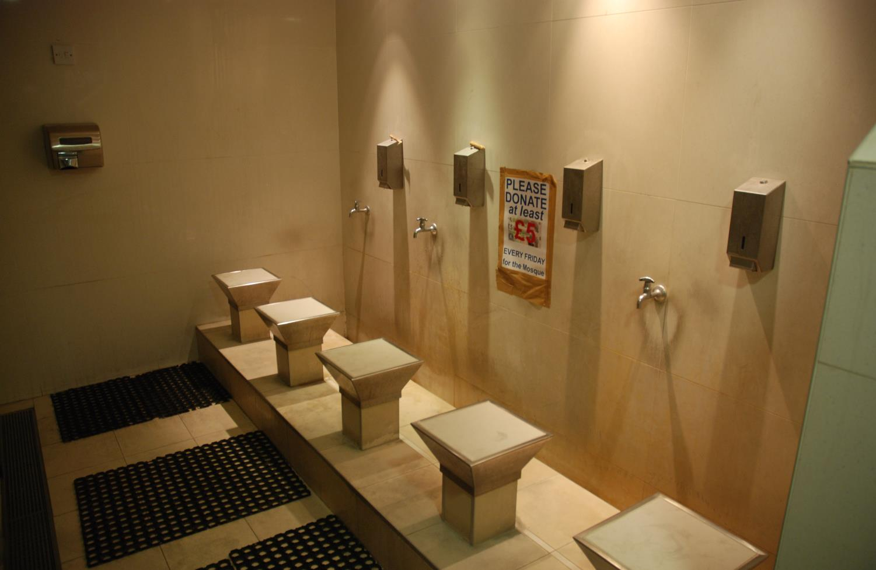
Before Muslims pray in the prayer hall they perform wudu, ritual washing to be clean before God

Slide 9
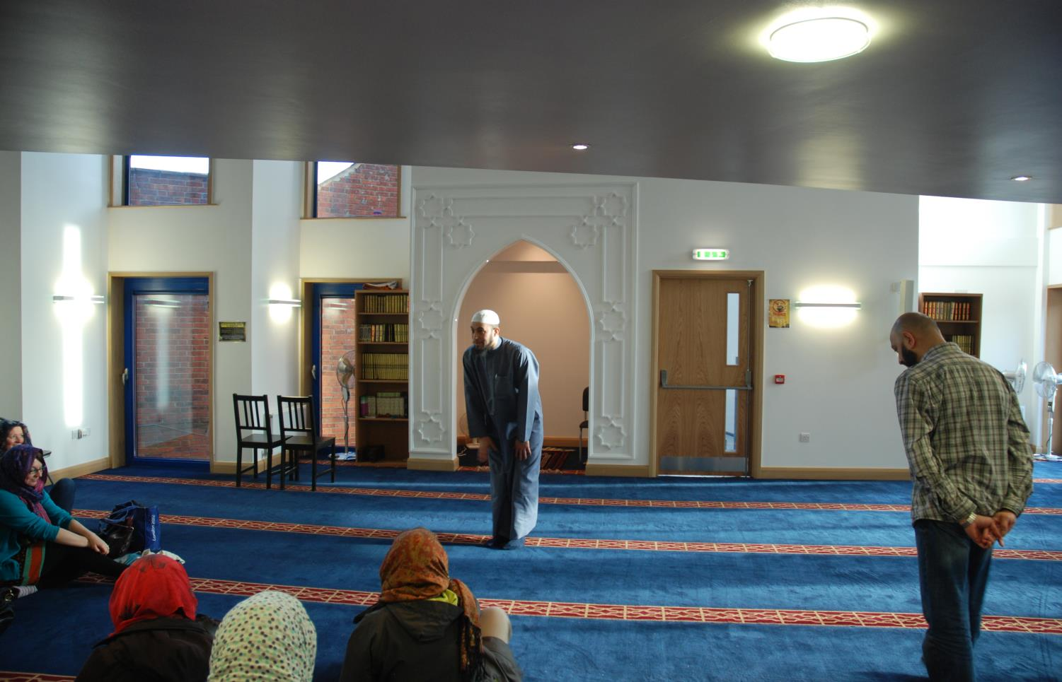
In the prayer hall, everyone sits on the floor to show they are equal in the eyes of God, Allah

Slide 10
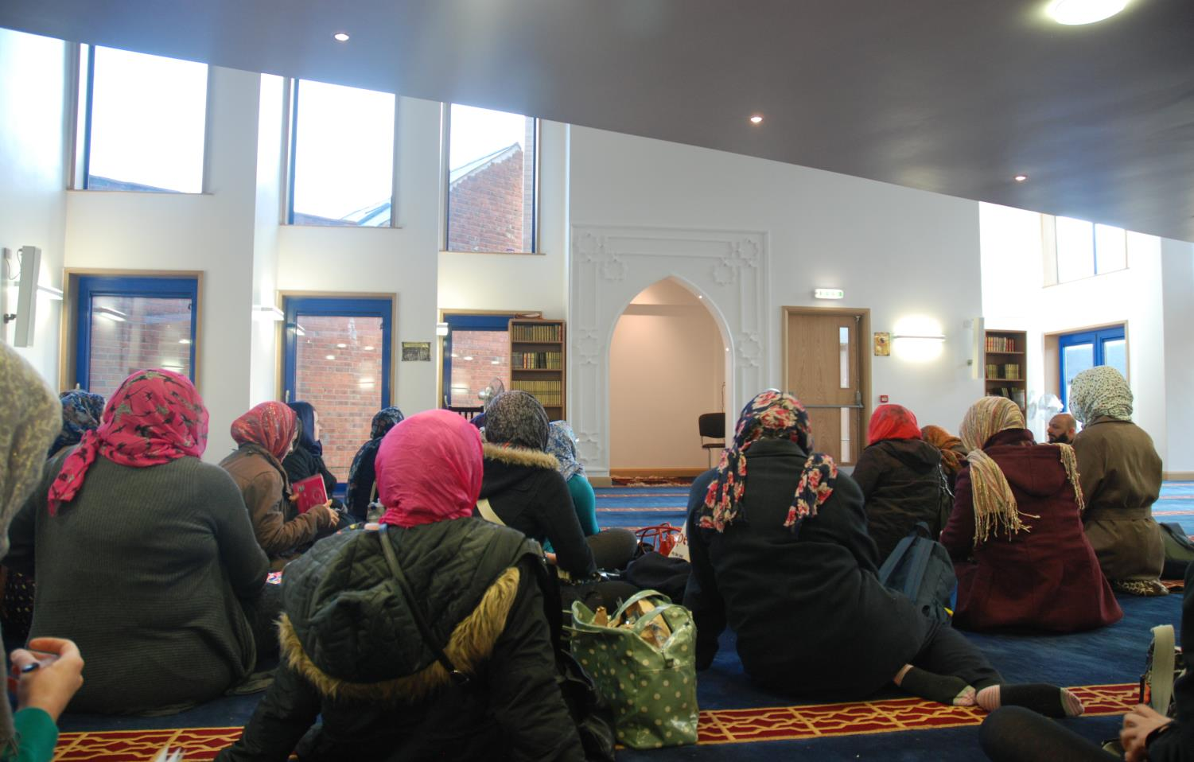
Men usually pray in front of the women, sometimes women are in a separate section

Slide 11
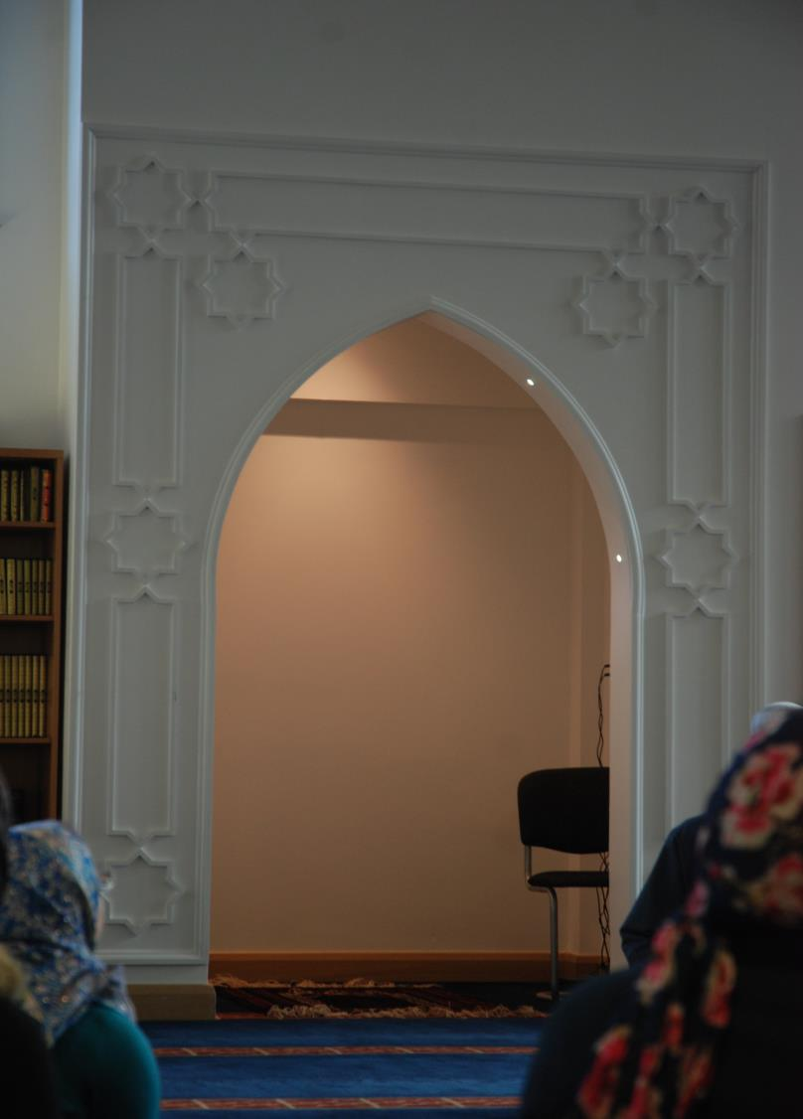
Everyone faces in the same direction. In the Mosque the archway (MIHRAB) is pointing to the holy city of Makkah. Muslims face Makkah when they pray.

Slide 12
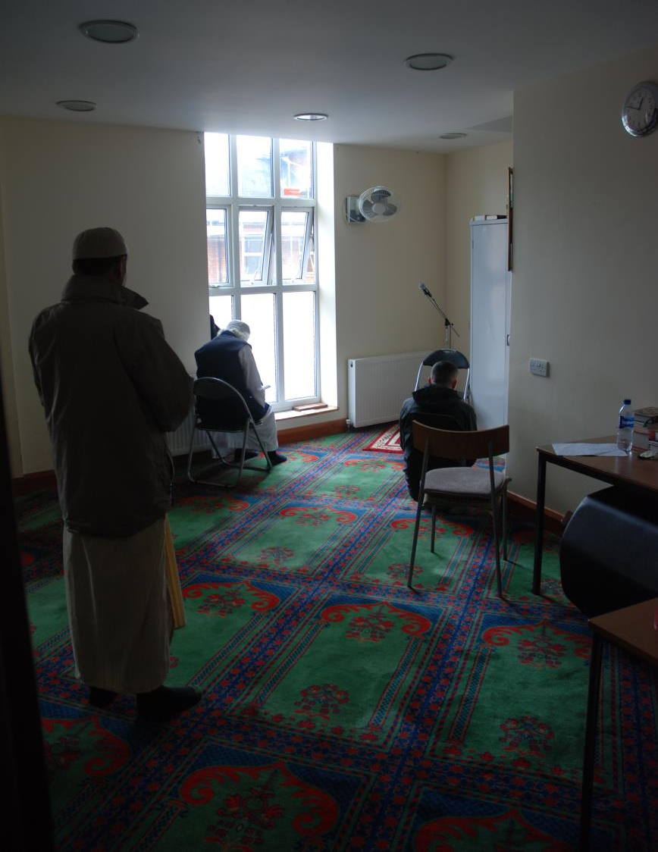
In Mosques that are converted houses, the prayer room can be small, but it still big enough to worship God.

Slide 13
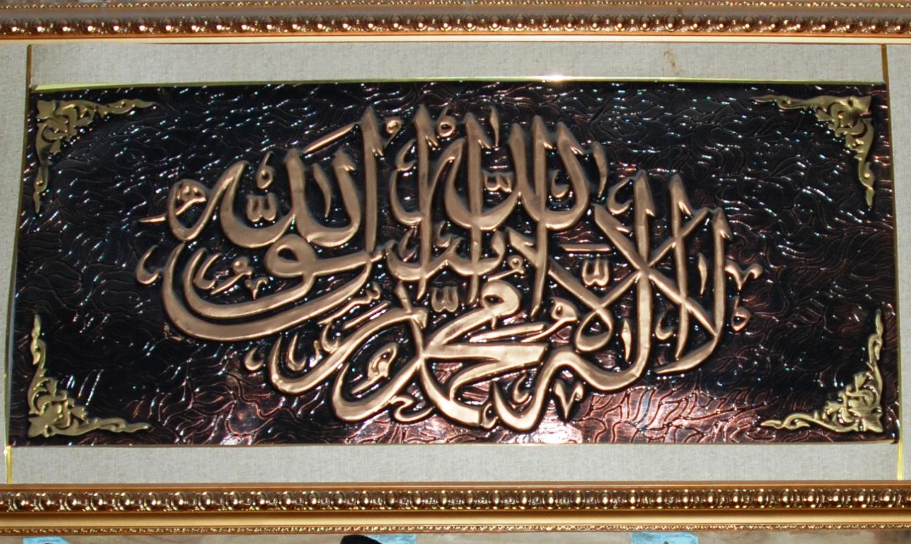
Muslims NEVER try to draw God so they decorate their walls with beautiful writing called Calligraphy. This writing often says how great God is!

Slide 14
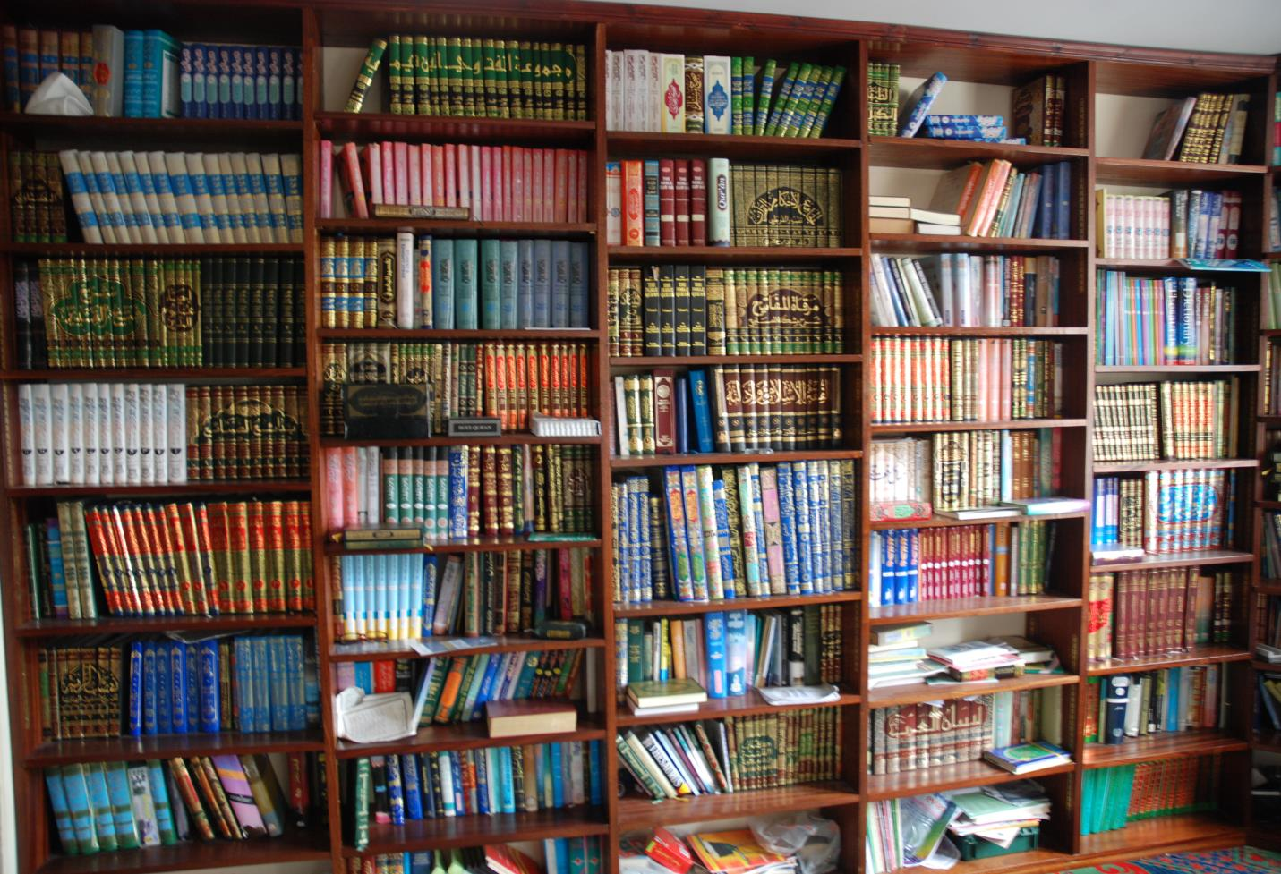
Mosques often have many books that help people understand their holy book, the Qur’an

Slide 15
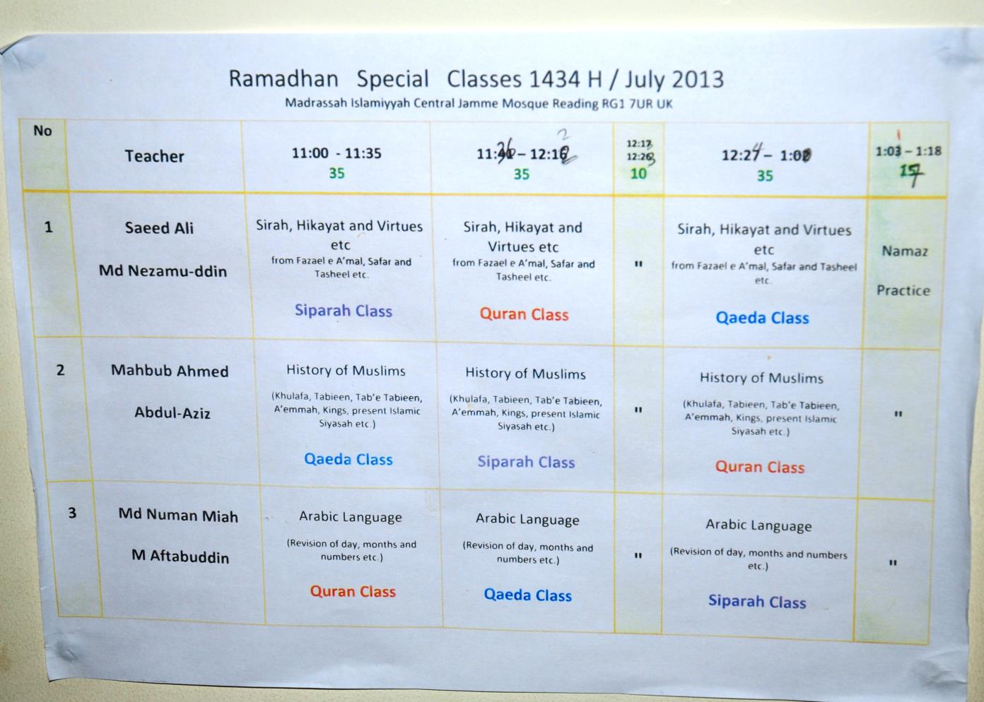
Mosques also run classes to help Muslims learn about their religion

Slide 16
Many Mosques also now have websites. These give information for the community and help Muslims be involved in the life of the Mosque. This helps them feel like they belong in the Muslim community.

Slide 17
Crossing the Bridges Project
Schools, SACREs and Places of Worship
working together
to enhance Religious Education
Pan-Berkshire
2017

