Slide 1
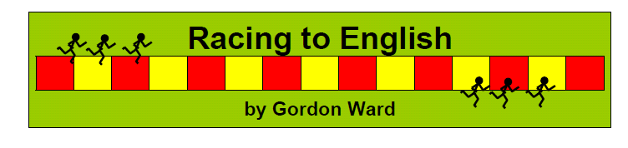
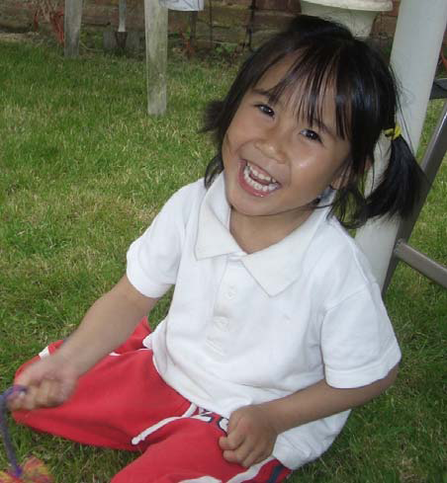

a girl
a boy
Notes:
A resource which can be used with complete beginners and more advanced learners. Some activities are more suitable for younger learners, some for older, but most are suitable for any age.
Can be used by a TA as a programme to help new arrivals learn English. Best with a small group / pair of pupils rather than just one child. If the school has only one child who requires EAL support, choose another child to work with who would benefit from some extra language input (i.e. a child who needs to develop their speaking and listening skills/ social skills/ confidence).

Slide 2
Principles
Repetition
Visuals = understanding
Clear language aims
Modelled language
Oracy, interaction
Fun
More repetition
Notes:
Principles behind Racing to English -
Repetition – EAL chn need time and activities to explore new language
Materials are very visual to aid understanding – photo sets and photo dictionary
Clear language aims – key vocabulary and sentence structures to be modelled.
Oracy – speaking & listening rather than just reading and writing
Fun – games.

Slide 3
Language Functions –
What is language being
used for in the lesson?
Naming
Describing
Comparing/ contrasting
Explaining
Reporting
Expressing position
Giving instructions
Questioning
Agreeing / disagreeing
Predicting
Language Structures–
The grammatical
structures we want children to
understand and use.
E.g.
What’s this?
It’s a ...
The green line is longer than the red line.
The pen is on the table.
Notes:
Language Learning Objectives for each activity:
Words, phrases and sentences you expect to:
DEMONSTRATE to pupils
Expect pupils to REPEAT
Expect pupils to USE
Expect pupils to remember after the lesson.

Slide 4

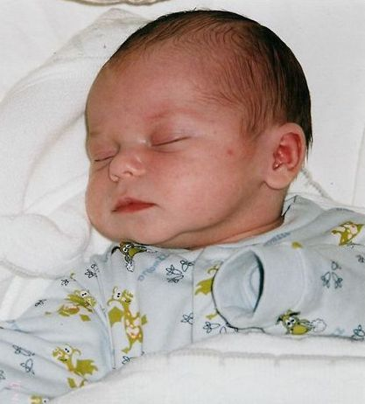
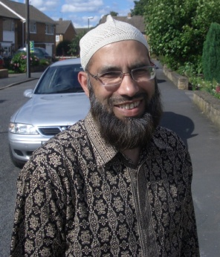
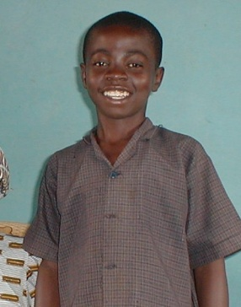
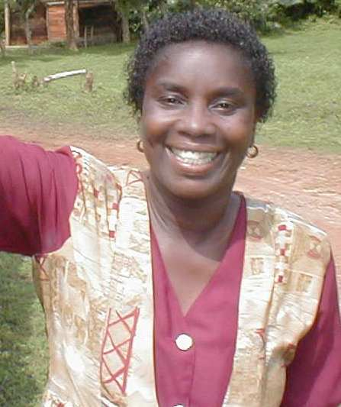
Language learning objectives:
Language functions | Naming
Sentence structures | This is a ___________. Is this a XXX? Yes it is. No it isn’t.
Vocabulary | a man a woman | a boy a girl | a baby (a child)
a girl
a baby
a man
a boy
a woman
Notes:
Importance of modelling not only the new vocabulary but also basic sentence structures that pupils can then use.
Beginners need constant repetition of the key language.

Slide 5
Contents
Racing to English Contents by Type  Photosets
Describe & Draw
Spot the difference
Connect 4
Pairs
Guess which?
Racing to English Contents by Type  Language games
Question Tracks
Racing to English Contents by Type  Stories
Contents by Type  Maths
Notes:
Look in ‘Staff information’ folder on CD to find contents of the CD. Contents by step & teaching order + Contents by type of activity. Both versions are useful.
See Contents document:
28 steps – 6-10 activities in each one, including:
Photosets - 12 – 18 photo cards and matching word cards (+ a page from the picture dictionary and a worksheet in each set) + activities
Stories – with activities and worksheets (some mini stories written by children; some about Eek-eek-eek the mouse OR Billy, Milly, Maisy and Bob that illustrate the use of a particular tense; some true stories about famous people)
Games: 6 types of game-like activities – Connect Four, Guess Which, Pairs, Question Tracks, Spot the Difference, and Describe & Draw. Most of these activities also have a worksheet with them.
Easiest language areas are in the earlier steps. It is suggested that the steps are taught in order – but it’s only a suggestion! Some children won’t need to start at the beginning. Some can miss out certain steps. Focus on the language that the child needs to learn.
Each activity will need to be used several times and it is useful to revisit them periodically even after you think your pupils have learnt the language involved.

Slide 6
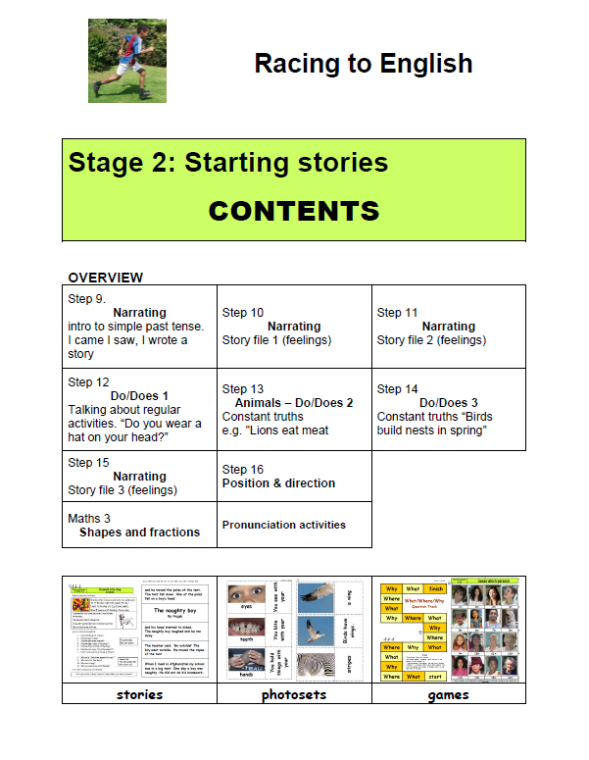
Notes:
2013 version of the CD lists contents differently

Slide 7
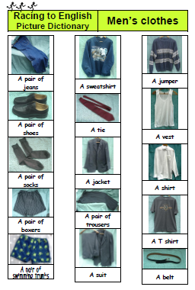
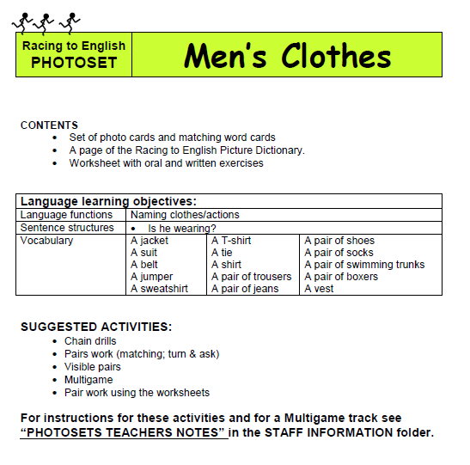
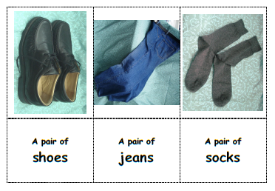
Photosets
Notes:
52 photo sets -
Look in Staff Information folder, Advice Documents – Teachers Notes Photosets for detailed information on how to play each game using the photosets.
Each photo set includes: Title at top. List of contents. Clear learning objectives in the table – vocabulary, language functions and sentence structures. Picture dictionary page – refer to during lesson. (Can use these to make a personal picture dictionary for the pupil.)
Suggested activities:
Chain drills – introduce vocabulary. Ask first pupil ‘What’s this?’ Help him/her to answer. Pupil then asks next pupil ‘What’s this?’ Use just for 3 – 4 minutes.
Pairs work – have 2 sets of pictures to match and name. Or match picture to the word.
Visible pairs – use 2 sets of pictures or set of pictures and set of words. Face down on table. Pick one card and name object. Take turns to pick one card. If 2 match, take them.
Multigame – use track (see back page), dice and counters & set of cards. Take card. Name object / read word / use in sentence. Then throw the dice and move counter.
Worksheets – see next slide
*** May only use SOME of the picture cards at first, especially with younger children. Better to learn a few words then be overwhelmed and learn nothing.

Slide 8
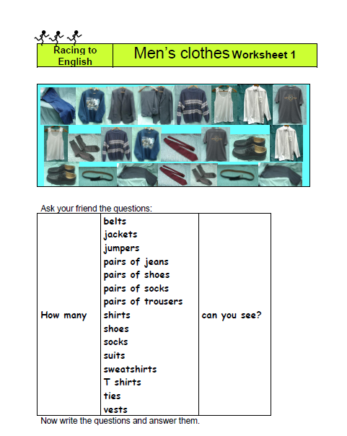
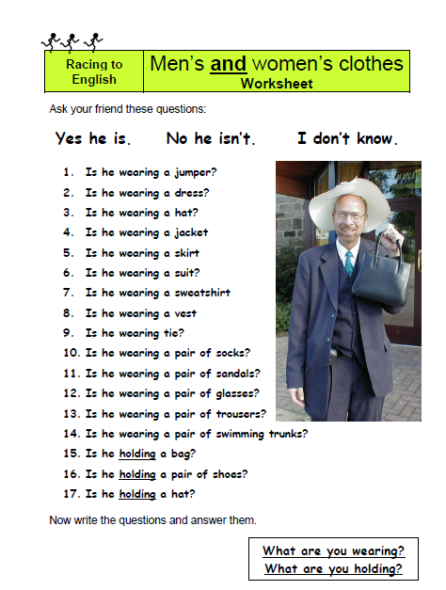
Worksheets
Notes:
Use orally – older children could later write the sentences. Need to hear the sentence structures many times and have the opportunity to practise using the sentence structures.
Worksheets include substitution tables – many based on simple questions. Can generate many sentences / questions. Effective as ensure repetition and show sentence patterns clearly.
Model first – adult says the sentences / asks the questions, then children can attempt to ask each other.

Slide 9
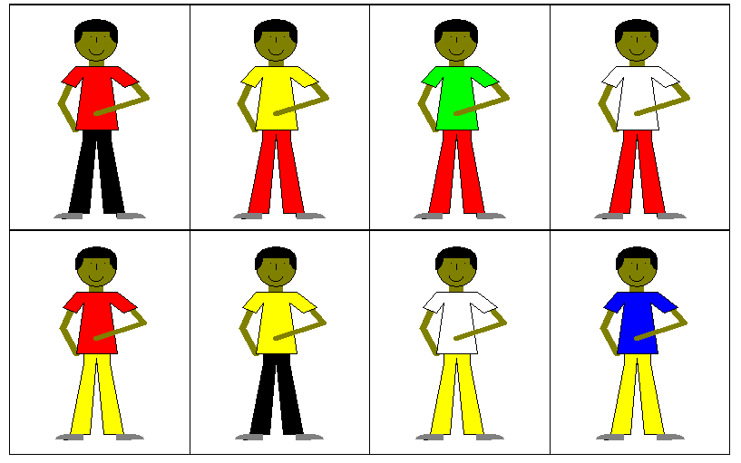
Guess Which?
Notes:
Various ways of using this activity:
Have 2 sets of cards. Adult describes a card for the children to identify.
Child chooses a card. Adult / other children ask questions. E.g. Has he got a yellow t-shirt? Is he wearing red trousers? Child answers yes or no. Adult identifies correct card.
Child describes the card for the adult / other children to identify.
Adult chooses card & children ask questions to identify the correct card.
- NB Importance of accepting attempts at speaking, but recasting language. E.g. Child: ‘trousers black’ Adult: ‘Oh, your boy is wearing black trousers?’

Slide 10

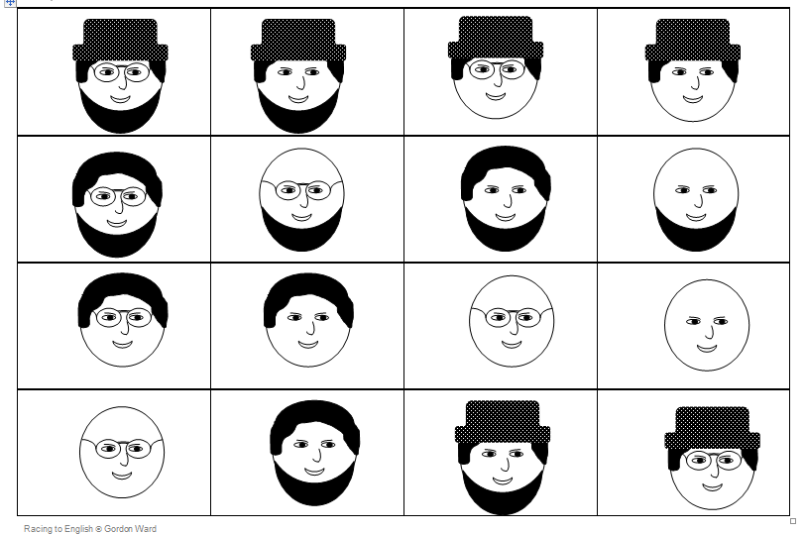



Connect 4
Notes:
Play as 2 teams. One base board and 2 sets of cards, in 2 different colours. Take turns to match card to correct face on board. First team to get 4 in a line wins. Children must read the card or say a sentence about the picture before placing card. E.g. “He’s got a beard but no hair”
For children who can’t read yet, use picture cards instead.

Slide 11
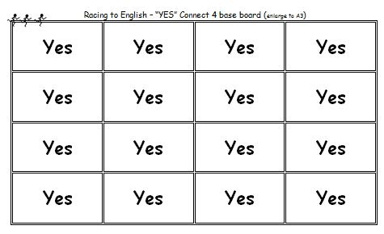


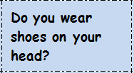
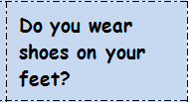
Notes:
Harder version of Guess which – Work in 2 teams. Have a set of cards each, in different colours. Take turns to take and card and read the question. If the answer is yes, place the card on the board. If no, discard. First team to get 4 in a line wins.

Slide 12
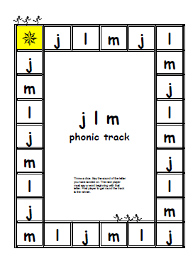
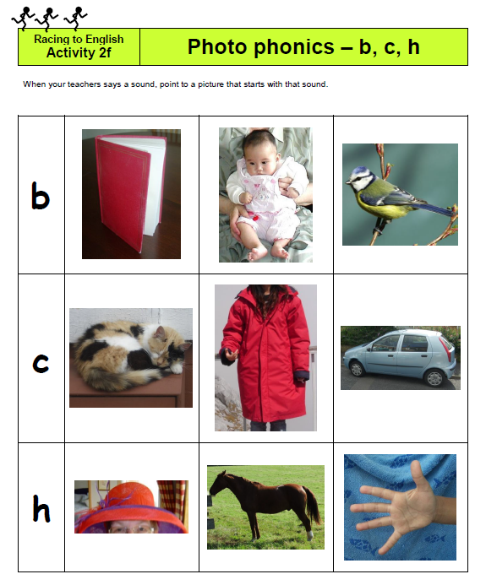
Phonics
Notes:
These are on the new version of Racing to English but there are some free examples on the moonfruit website: racingtoenglish.moonfruit.com
Could be used to reinforce work going on in the classroom or in phonics groups. Older children may not get general phonics teaching so these can be useful.
Important for phonics to be taught in context with lots of visual support. Some EAL beginners find phonics very difficult and may find it easier, at least initially, to be taught whole words using visual support.

Slide 13
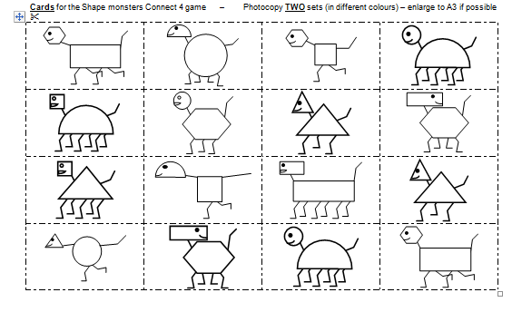
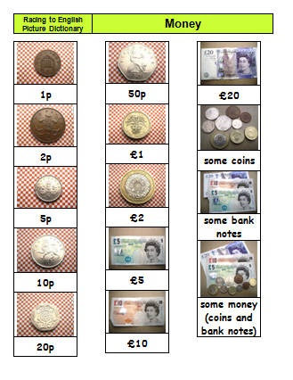
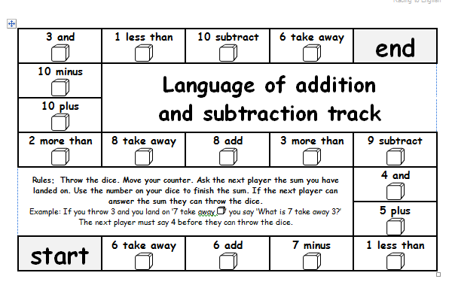
Maths Resources
Notes:
Use to support mathematical language. (Not for teaching mathematical methods - for teaching maths vocabulary.) Lot of oral work rather than pencil & paper maths.

Slide 14
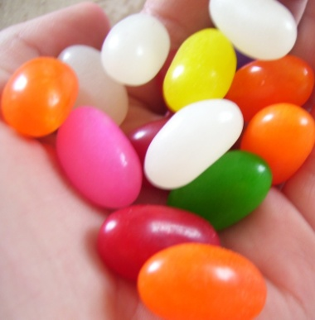
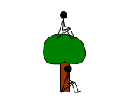
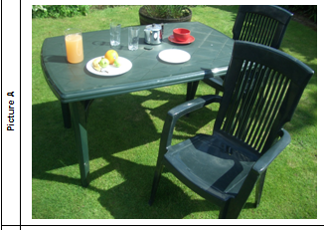
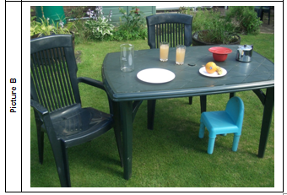
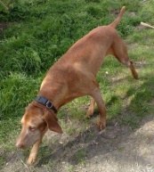
More Activities
Start | When do you wear a coat? | When do you wear sunglasses?
When do you wear? Track |  | When do you wear trousers?
 |  | When do you wear sandals?
When do you wear a swimming costume? | When do you wear gloves? | When do you wear a hat?
When do you wear high heels? | Throw a dice and move your counter. Ask the next player the question in the square you land on. If they can answer it they can throw the dice and move their counter. Answers e.g. never, in the evening, when it’s cold, when I play football, ….
When do you wear a scarf?
When do you wear trainers? | When do you wear a jumper? | When do you wear a tie?
⇨ | ⇩ | When do you wear a dress?
 | ⇦ | When do you wear jeans?
Finish | When do you wear pyjamas? | When do you wear a ring?
One day when I was six years old, my sister said, “Go to the shop. Get some sweets for me.” I went to the shop and I got some sweets. When I came out of the shop, I saw a dog. I started to run home, because I was scared of the dog. The dog started to chase me. I was very scared but an old woman saw me. She walked home with me.
Notes:
Question Track – Chn take turns to throw dice and move counter around track. After each move the child must ask the question in the square they have landed on. The child whose turn is next must answer the question before they can throw the dice.
Spot the Difference - Chn discuss two pictures together OR do as a barrier game where each child has one of the pictures – they don’t show each other their picture but have to talk to each other to find out how their pictures differ
Describe & Draw - Child chooses one picture from the sheet and describes it to partner who draws it
Story File – see e.g.:
Each story file consists of
a true story written by a pupil/student
a sequencing exercise/game
a story sheet with a small copy of the story and set of questions/exercises on the story.
The sequencing game:
Materials: a set of the jumbled story cards for each player
Preparation: pupils shuffle all the sets of cards together and place them in a pile, face down, in front of them.
Rules: The players take it in turn to take a card from the pile. As they collect the cards, players should sequence them to make the story. If a player takes a card that s/he has already collected s/he should put it at the bottom of the pile. The first person to collect all the cards to complete the story is the winner.
Each story sheet has
a set of Yes/No questions
a set of “Have you ever …..” questions
a set of “Wh…” questions – the children are asked to answer these questions using whole sentences.
Page 4 – further exercises
There are a variety of exercises on page 4. The children can be asked to choose which of the exercises are appropriate for them or they can be directed to do one of other of the activities. Two of the exercises, the drawing and the wordsearch, are easy. The other exercises, writing a story and writing the “I don’t know questions” and re-writing the original story are more demanding.

Slide 15

Ordering
2013 version contains over 300 activities
Current cost is £45 + £5 postage
Order from http://www.racingtoenglish.co.uk
Free updates available from
http://racingtoenglish.moonfruit.com
Notes:
See the Document for recording activities used
Suggestion for independent work in the classroom – see note at end of Photosets notes

Slide 16
Racing to English – further support
http://www.racingtoenglish.moonfruit.com/#
- more resources, including all the picture
dictionary pages as one document

