Slide 1
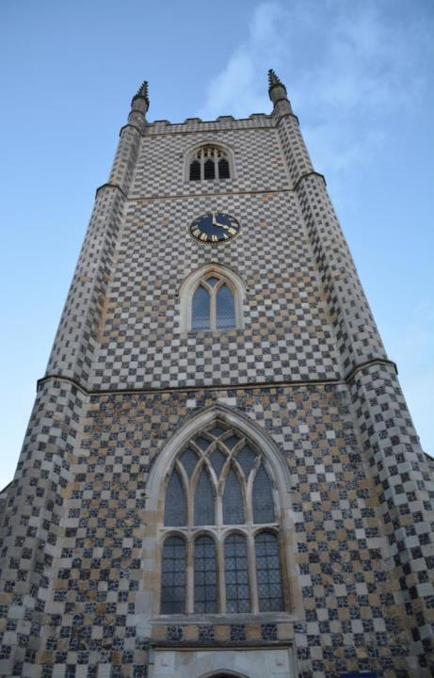
Reading Minster is in the heart of Reading

Slide 2
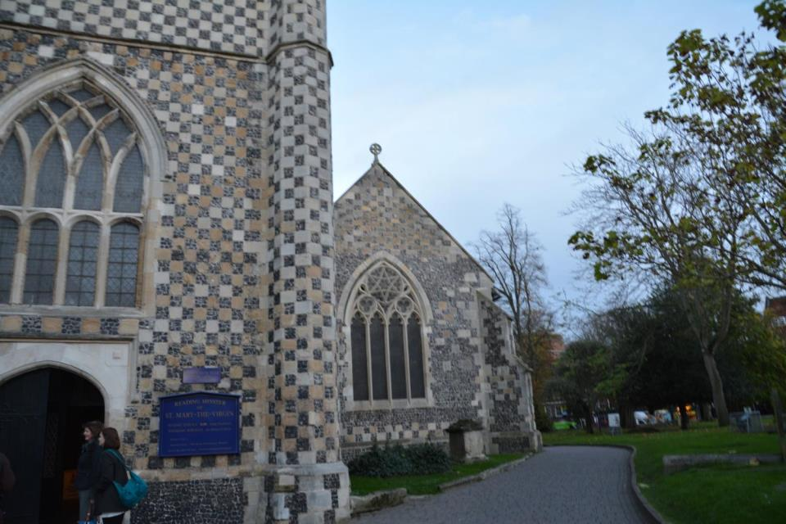
There has been a place of worship here for around 1,000 years!

Slide 3
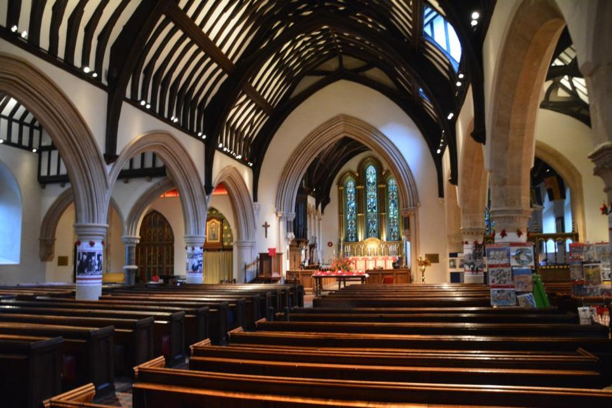
It is a very impressive building inside

Slide 4
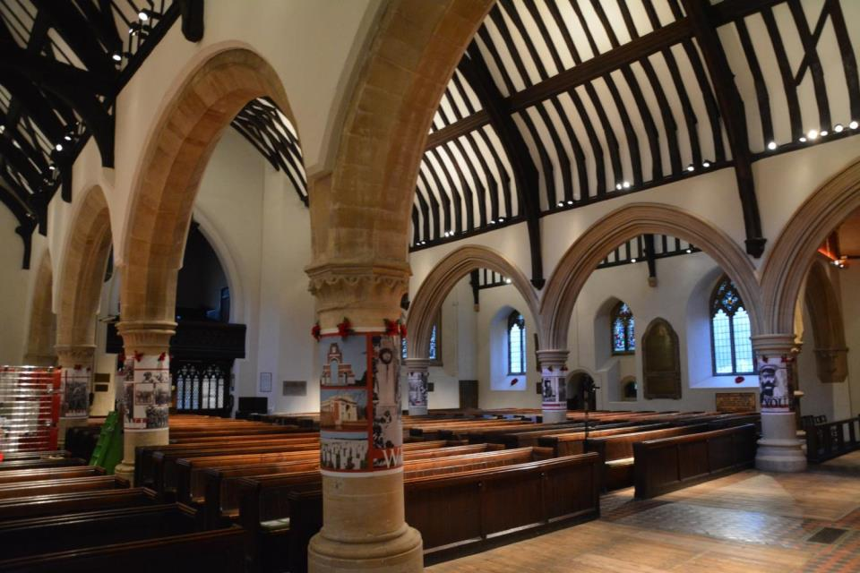
There are many arches – these help keep the roof up

Slide 5
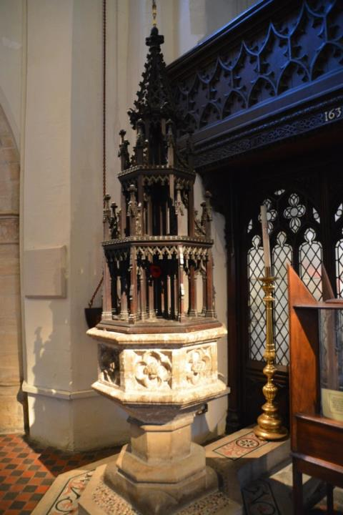
This is used in Christening ceremonies.
This is when a new baby is welcomed into the church.
As soon as you go into the church you will see the FONT. This one is decorated with a big, carved wooden lid

Slide 6
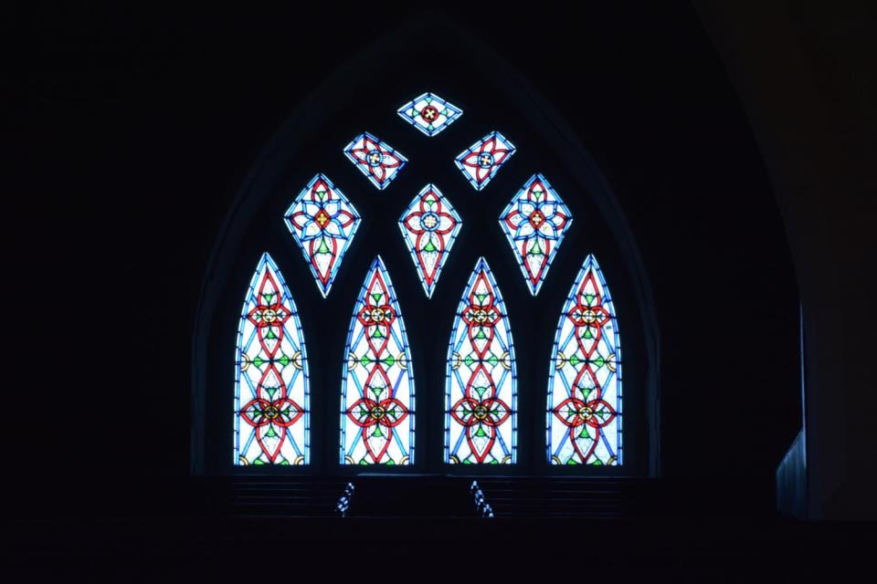
The Minster has many stained glass windows

Slide 7
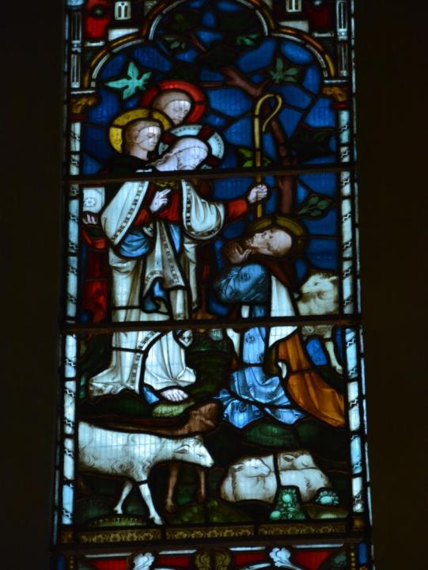
Often these windows show important stories from the life of Jesus

Slide 8
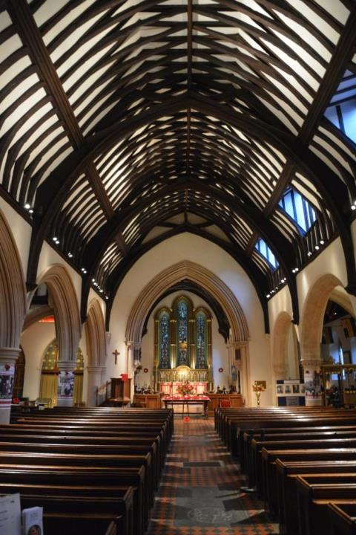
The ceiling looks like an upside down boat.
This main part of the church is called the nave.
The next slides will show you more parts of the church
There are wooden seats for people to sit in, these are called pews.

Slide 9
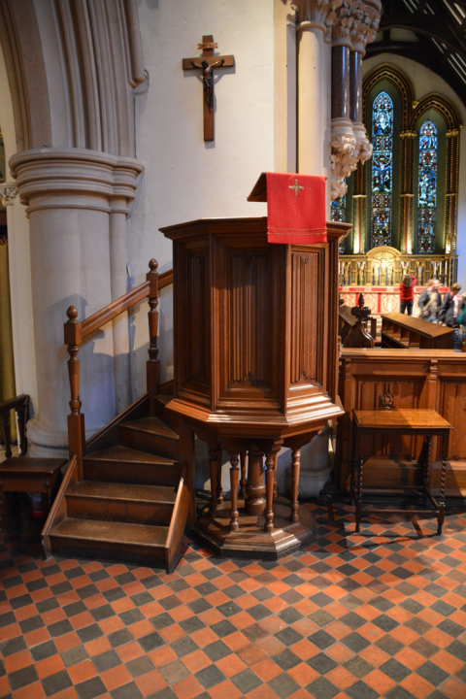
This is called a Pulpit.
The vicar or priest stands in the pulpit when giving a special talk called a sermon.
Above the pulpit you can see a cross with Jesus on. This is called a crucifix.

Slide 10
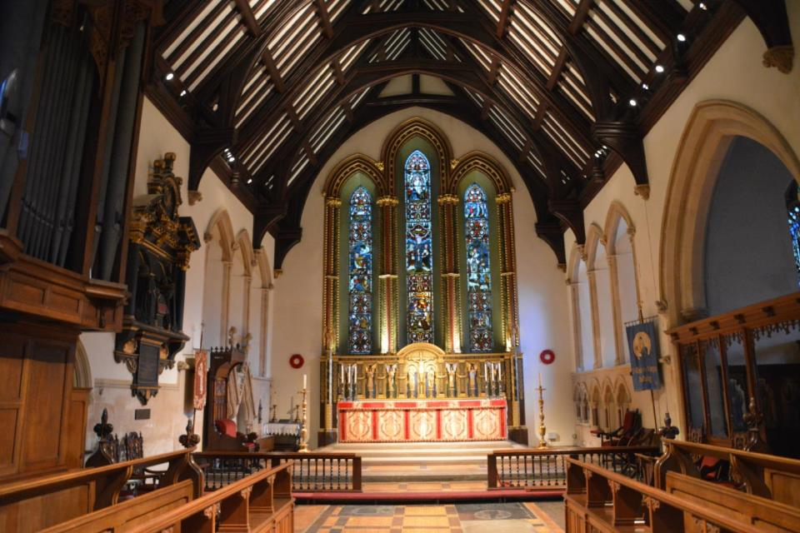
The most important part of the church is the altar

Slide 11
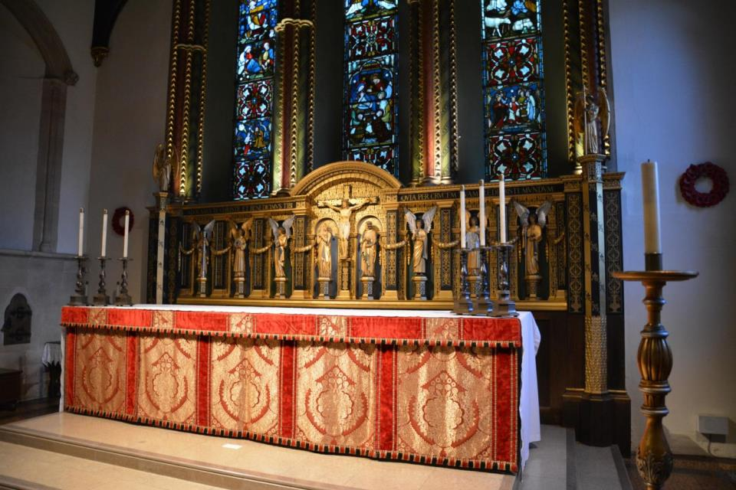
The altar is a table – here the priest or vicar leads the services.
These services remember Jesus - his words and actions

Slide 12
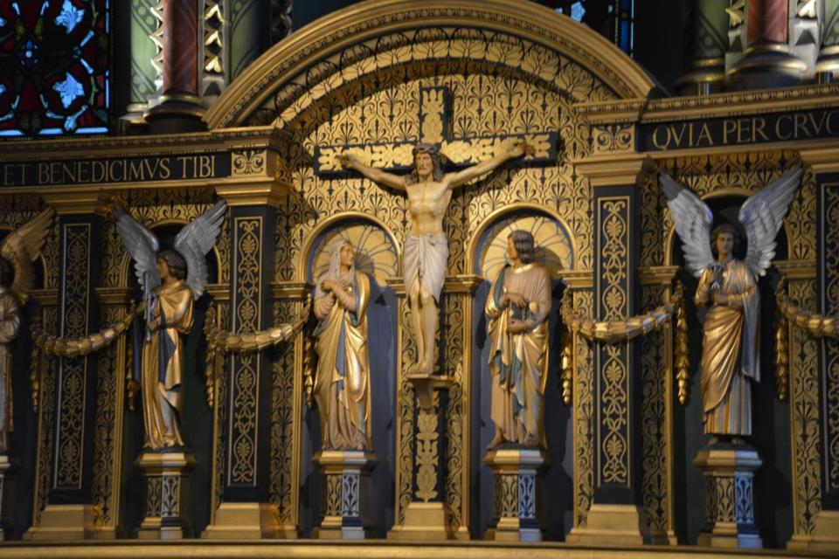
Behind the altar there are carvings remembering Jesus

Slide 13
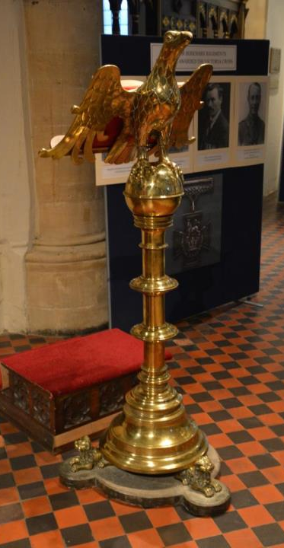
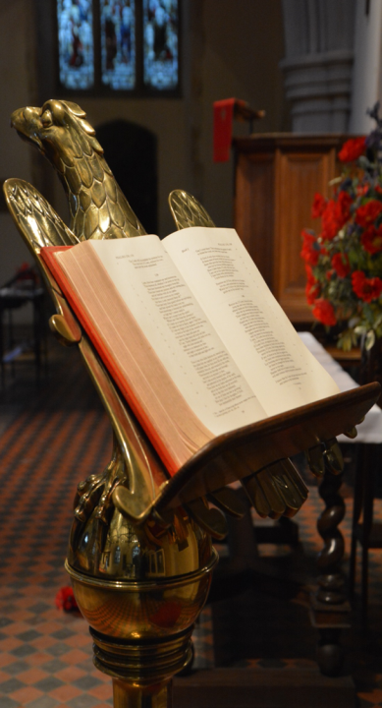
There is a special place for the Bible to be kept – this is called a lectern

Slide 14
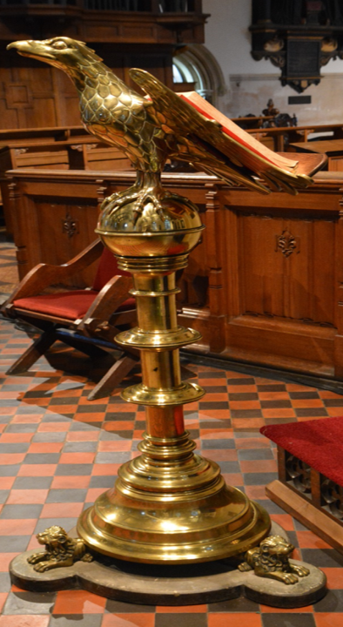
This lectern has a large eagle on it.
This is to stand for the Bible being carried to all the corners of the world.

Slide 15
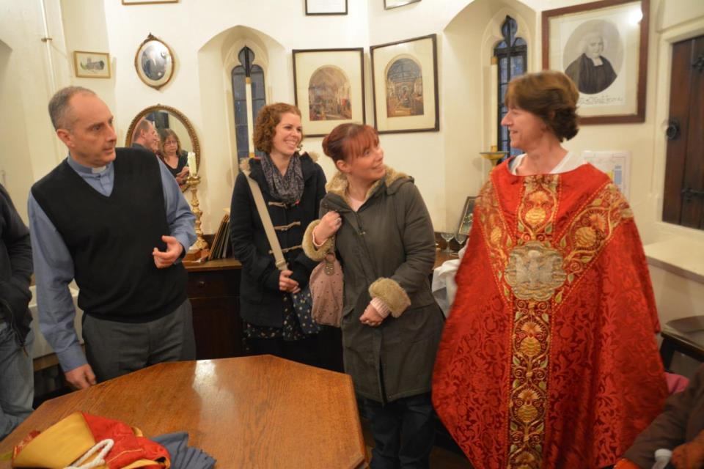
The Reverend Stephen Pullin shows us some of the clothes that he wears when he leads the services – there are different colours for different parts of the Christian year.

Slide 16
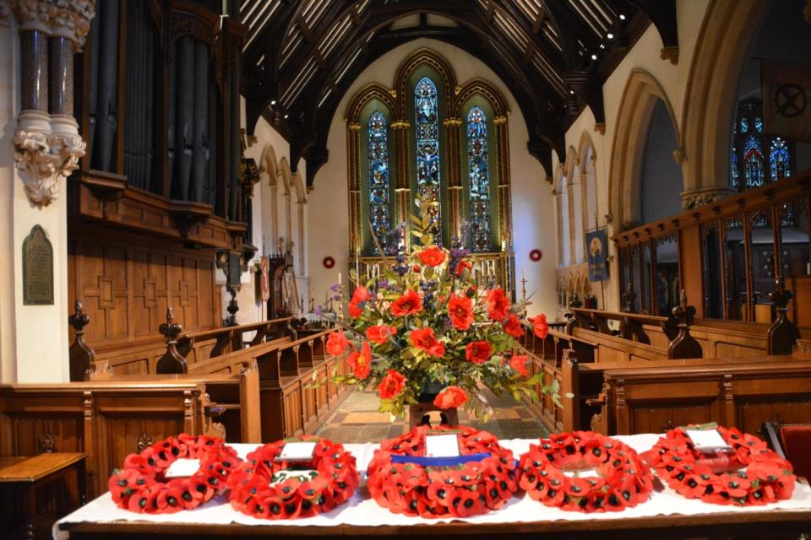
The Minster is used for important services like Remembrance Sunday in November – this remembers all the people who died in the wars.

Slide 17
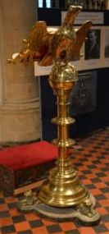
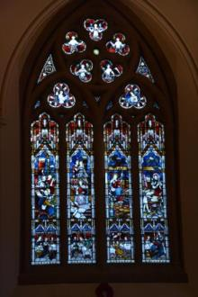
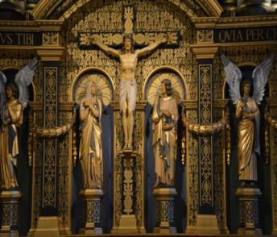
The Minster is a beautiful old church which is trying to welcome new people into its community.

