Slide 1
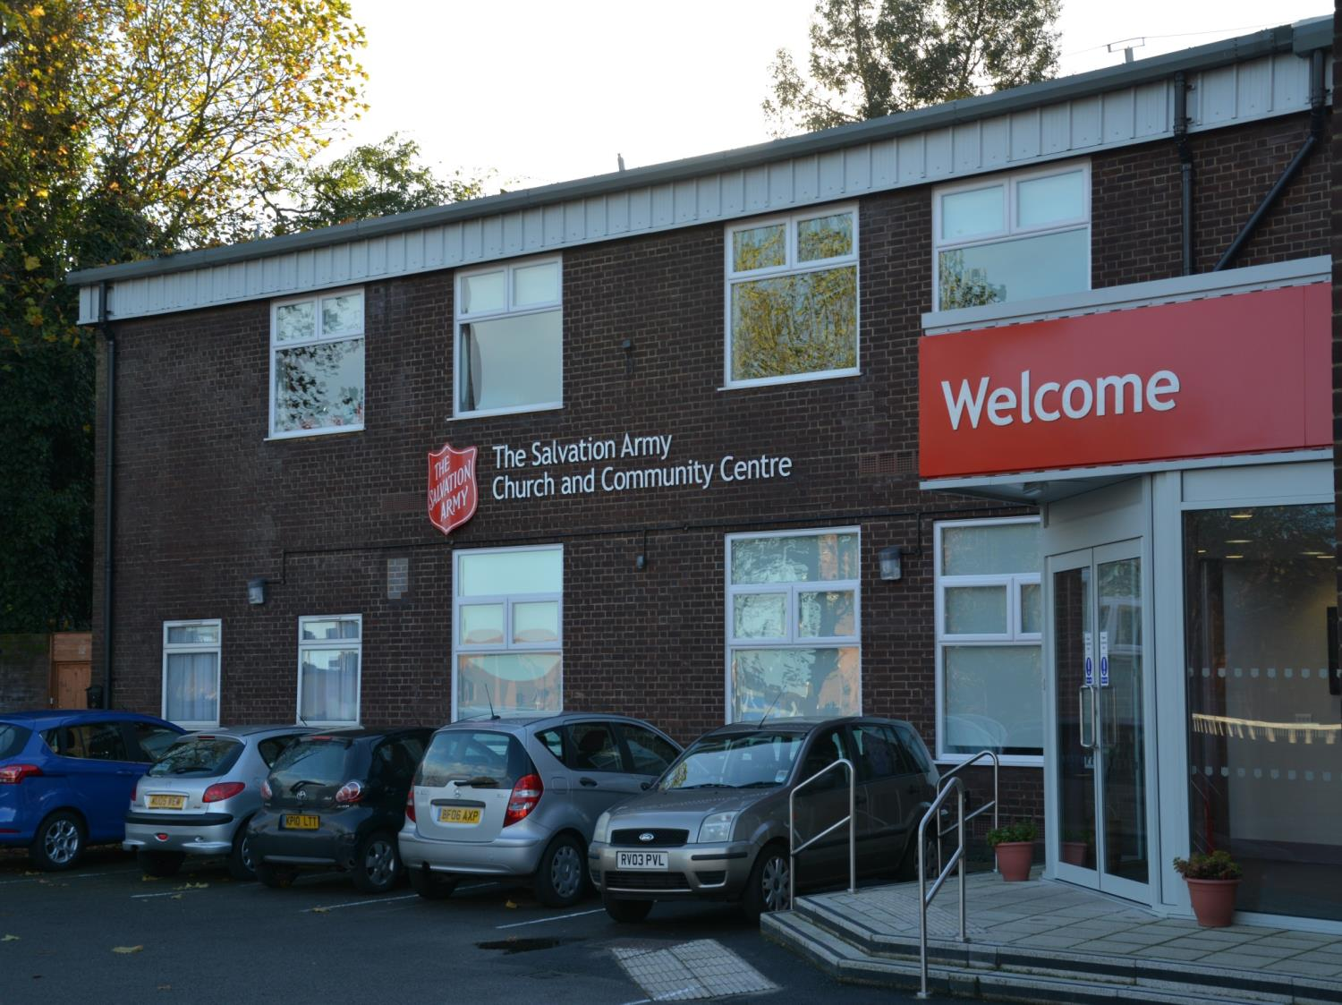
The Salvation Army in Reading

Slide 2
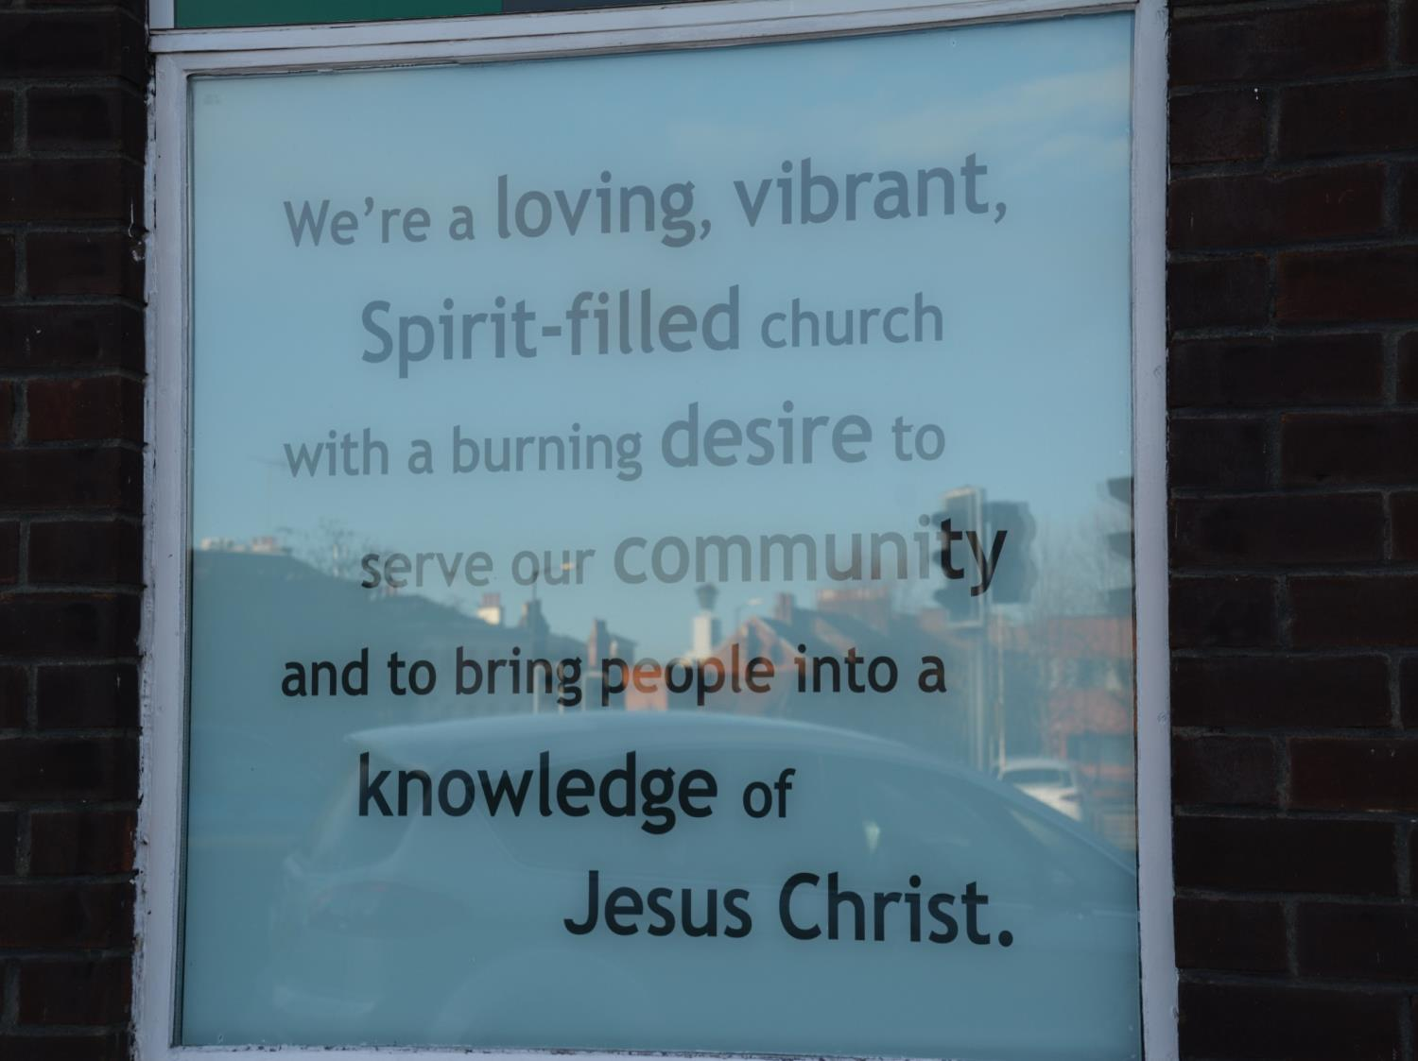
Outside the church is a key message

Slide 3
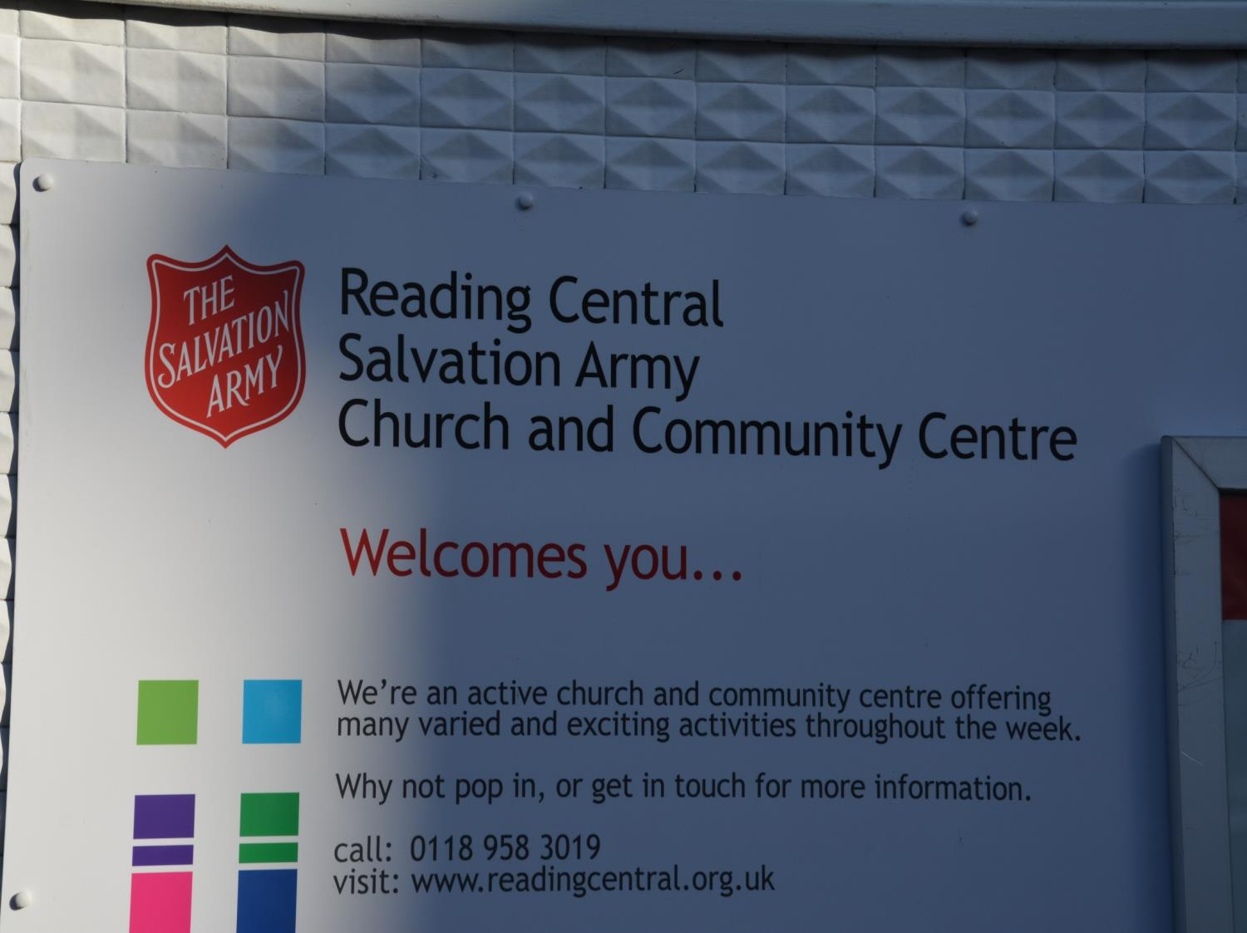
The Salvation Army centre is designed to help all areas of the community

Slide 4
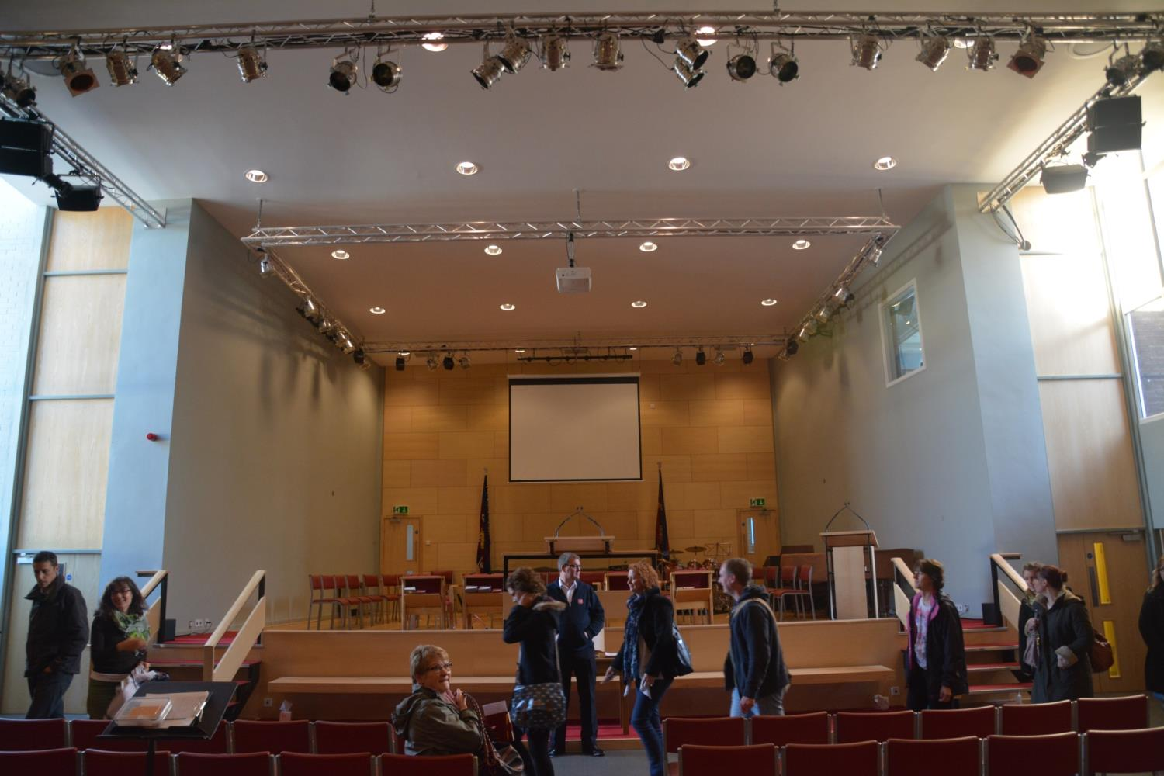
The main hall is where the church services are held
But it is also big enough to be used for community events like theatre and music
it has lights in the roof designed for this

Slide 5
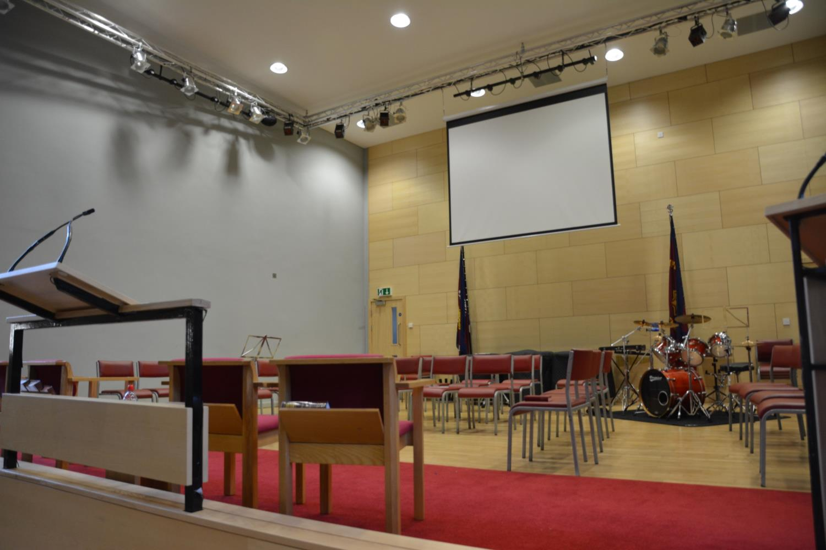
Music is an important part of the Salvation Army – they are known for their brass bands.
Some of the words are shown on a large screen for people to follow.

Slide 6
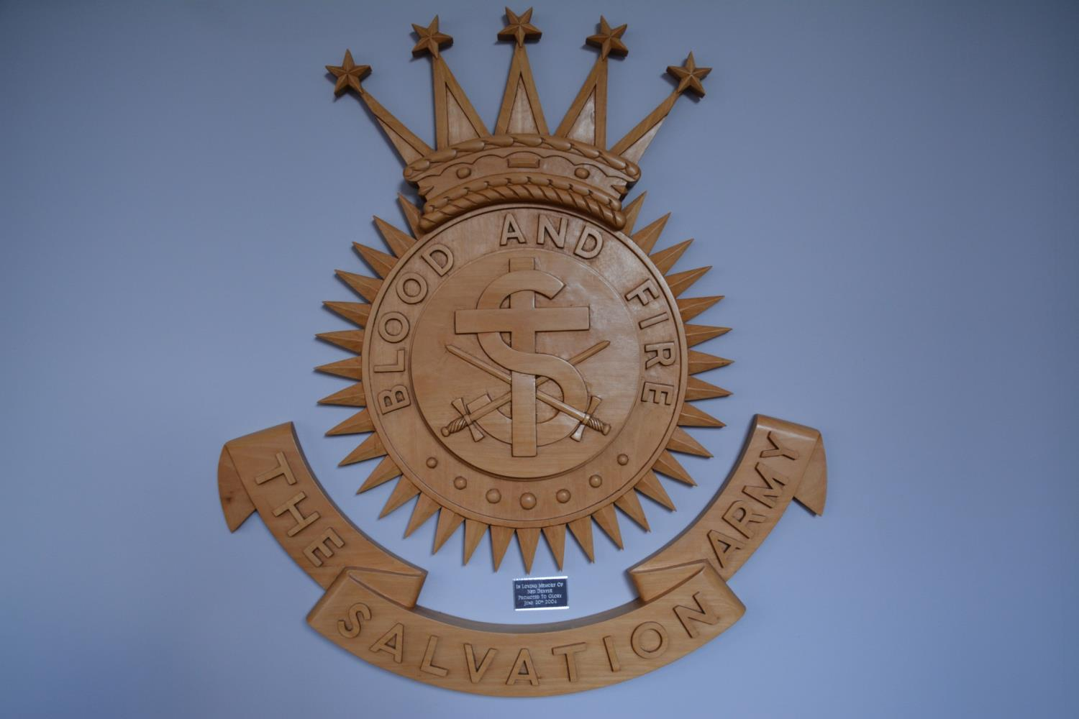
The Salvation Army has two main crests
In this crest you can see the cross of Jesus and two swords. The large S stands for Salvation
Salvation means to be saved – Christians believe that Jesus died to save them from their sins, and if they do good deeds they will be saved and will go to Heaven
They are called the Salvation Army as they try to fight evil, this is why there are two swords. They fight evil by doing good deeds in the community

Slide 7
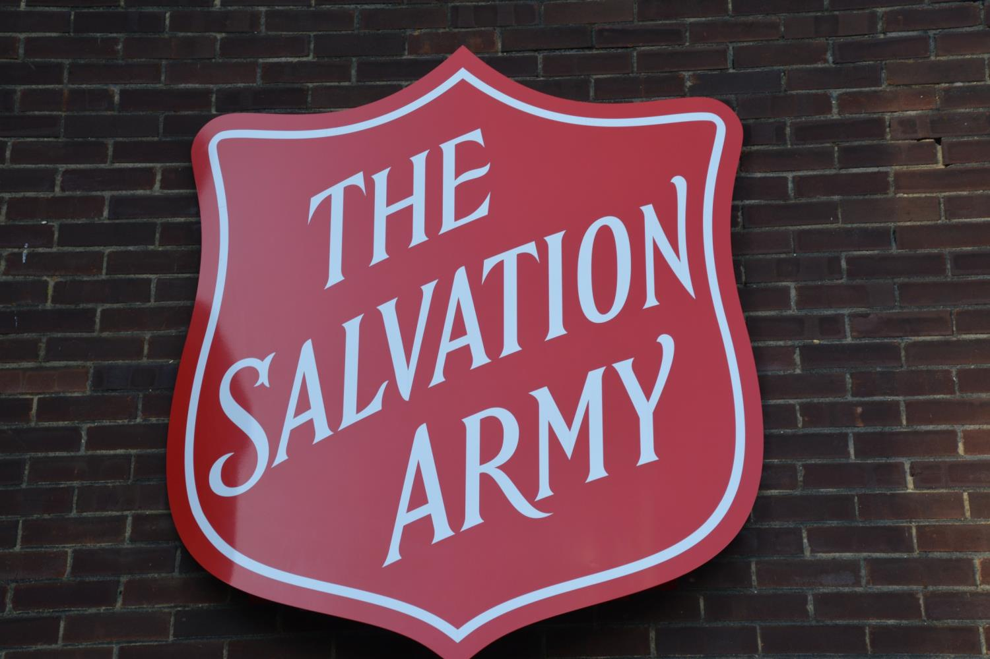
This is the other crest – it shows a shield.
It is on the outside of the building

Slide 8
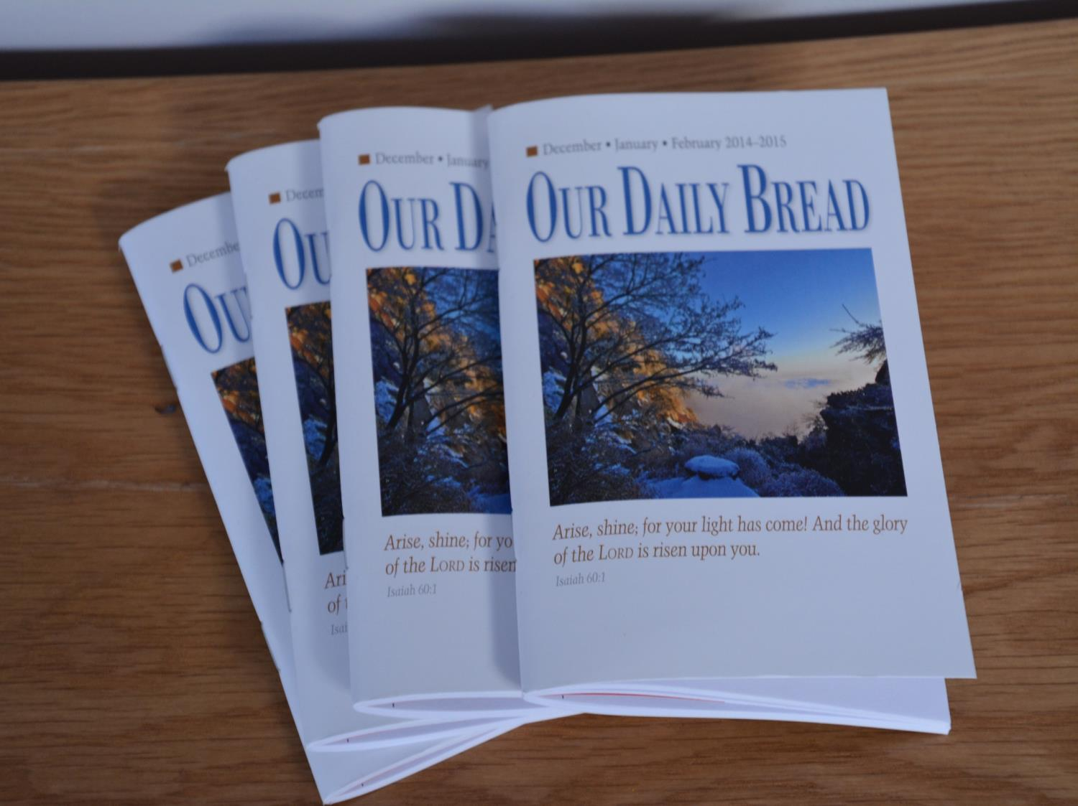
There are booklets explaining events and services

Slide 9
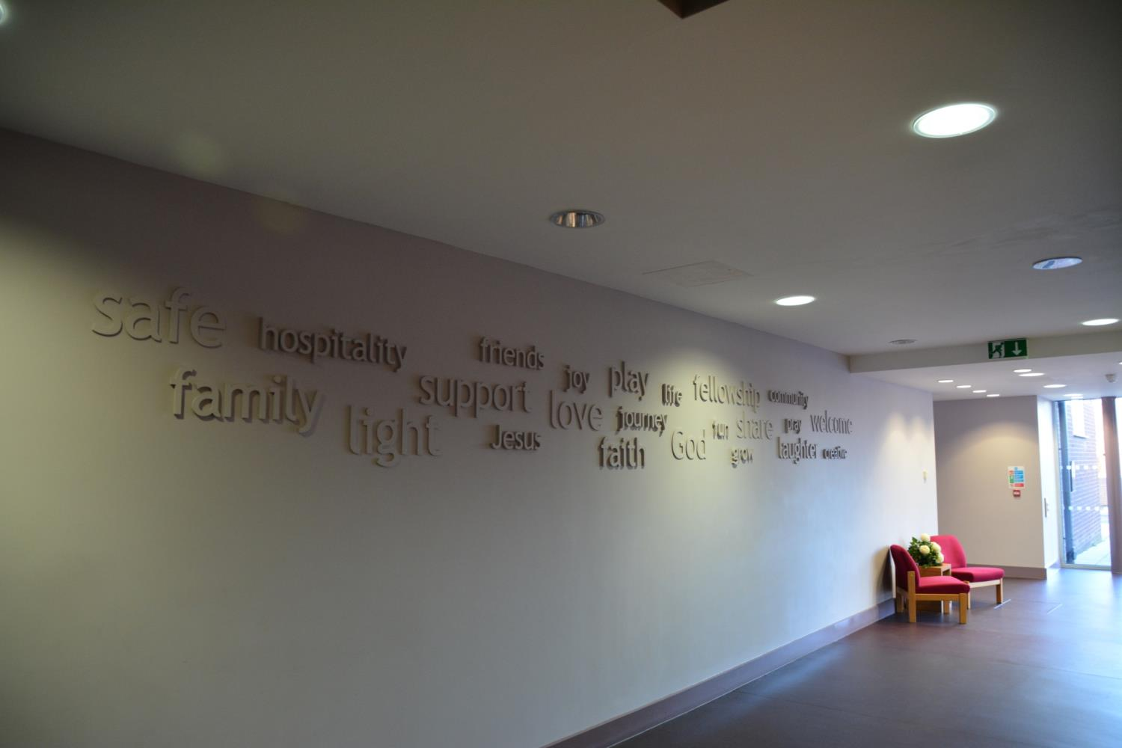
When they were building the new church, they asked their followers to describe what the Salvation Army meant to them
These words are now displayed as you enter the building

Slide 10
These words show what the Salvation Army is all about

Slide 11
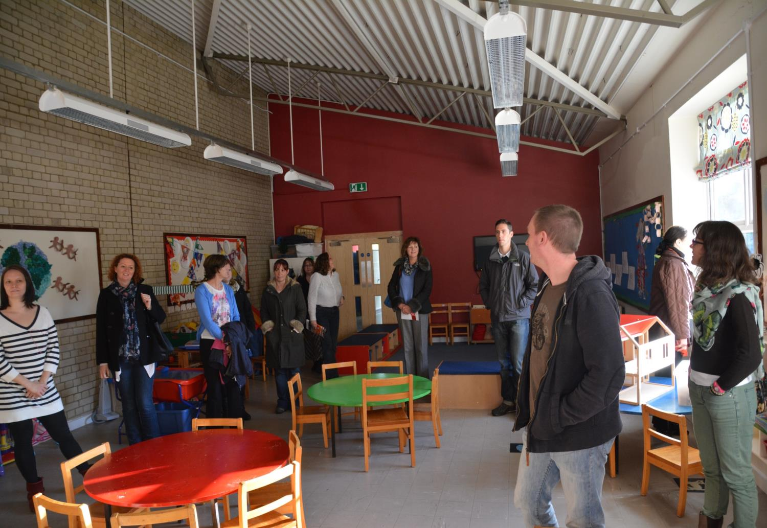
They believe in welcoming the community into their buildings
Some rooms are designed for younger children and have play areas

Slide 12
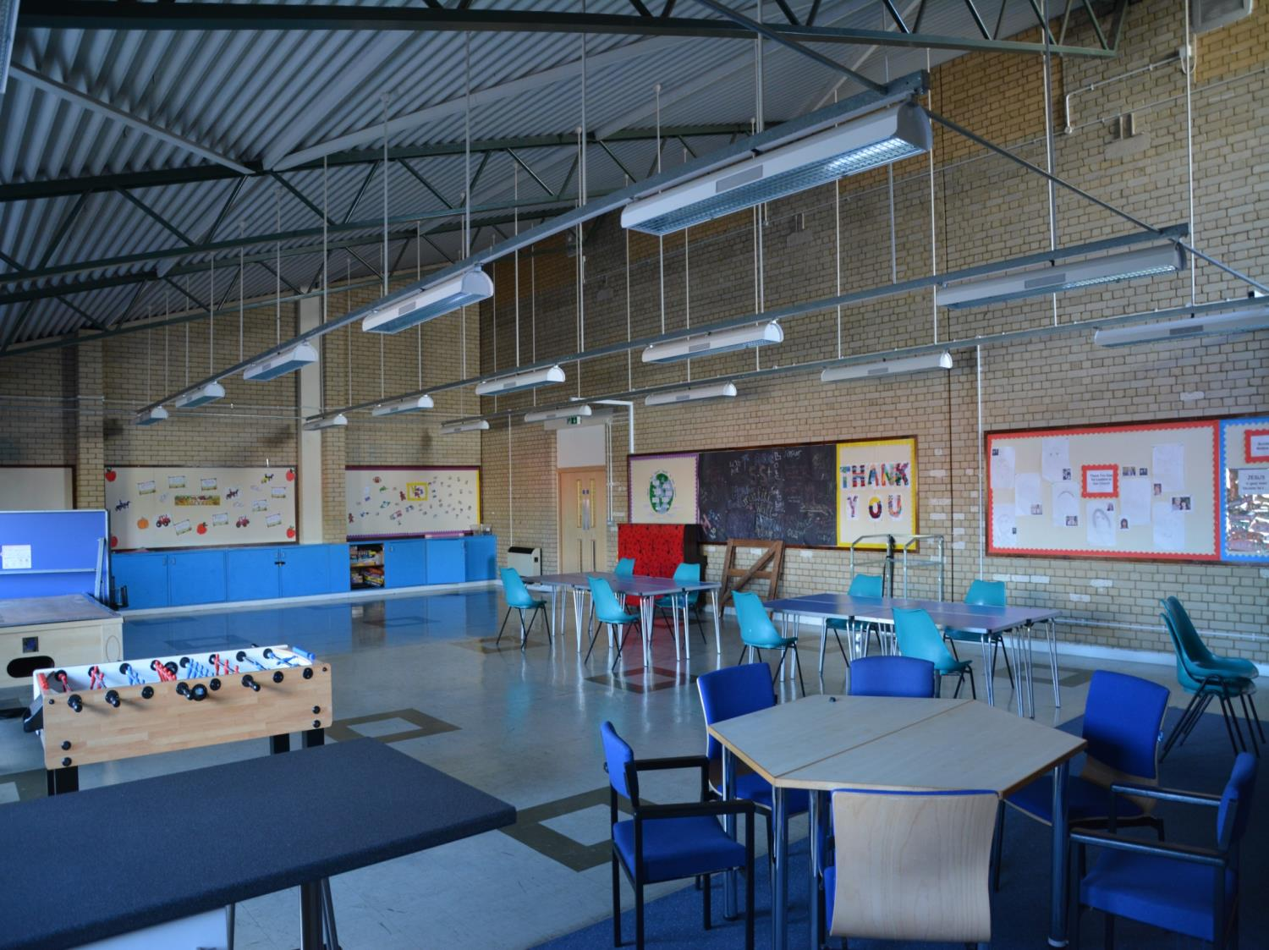
Some rooms could be used for youth projects or adult classes

Slide 13
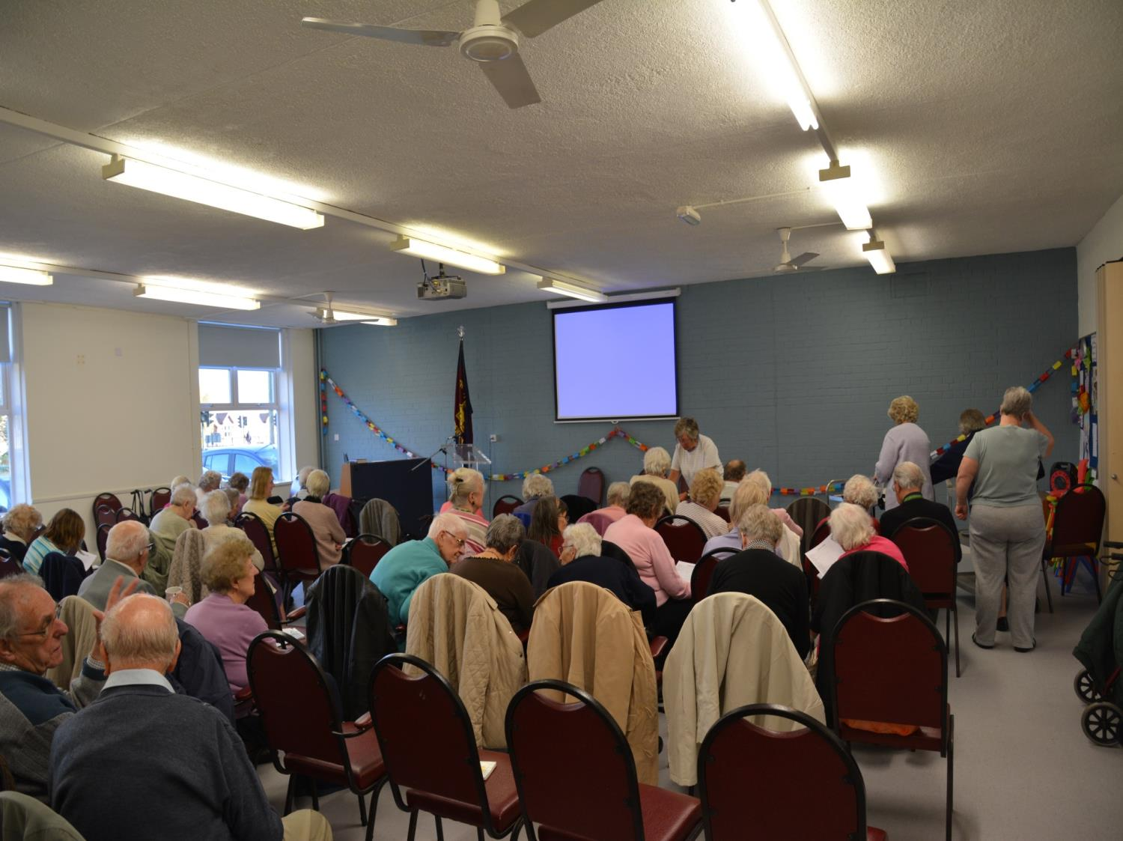
There are many activities for older people too

Slide 14
These slides show how the main goal of the Salvation Army is to serve the community the same way they believe Jesus did.

