Slide 1
Crossing the Bridges Project
Schools, SACREs and Places of Worship
working together
to enhance Religious Education
Pan-Berkshire
2017

Slide 2
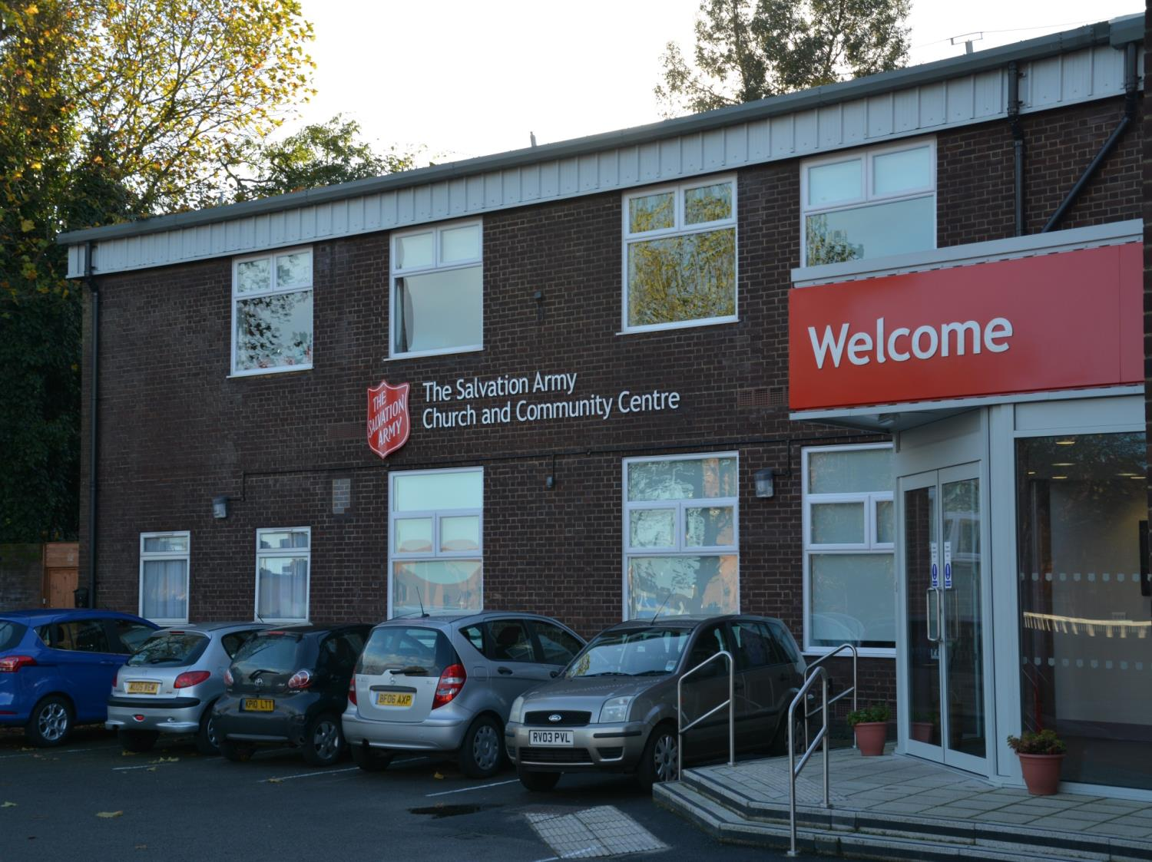
The Salvation Army in Reading

Slide 3
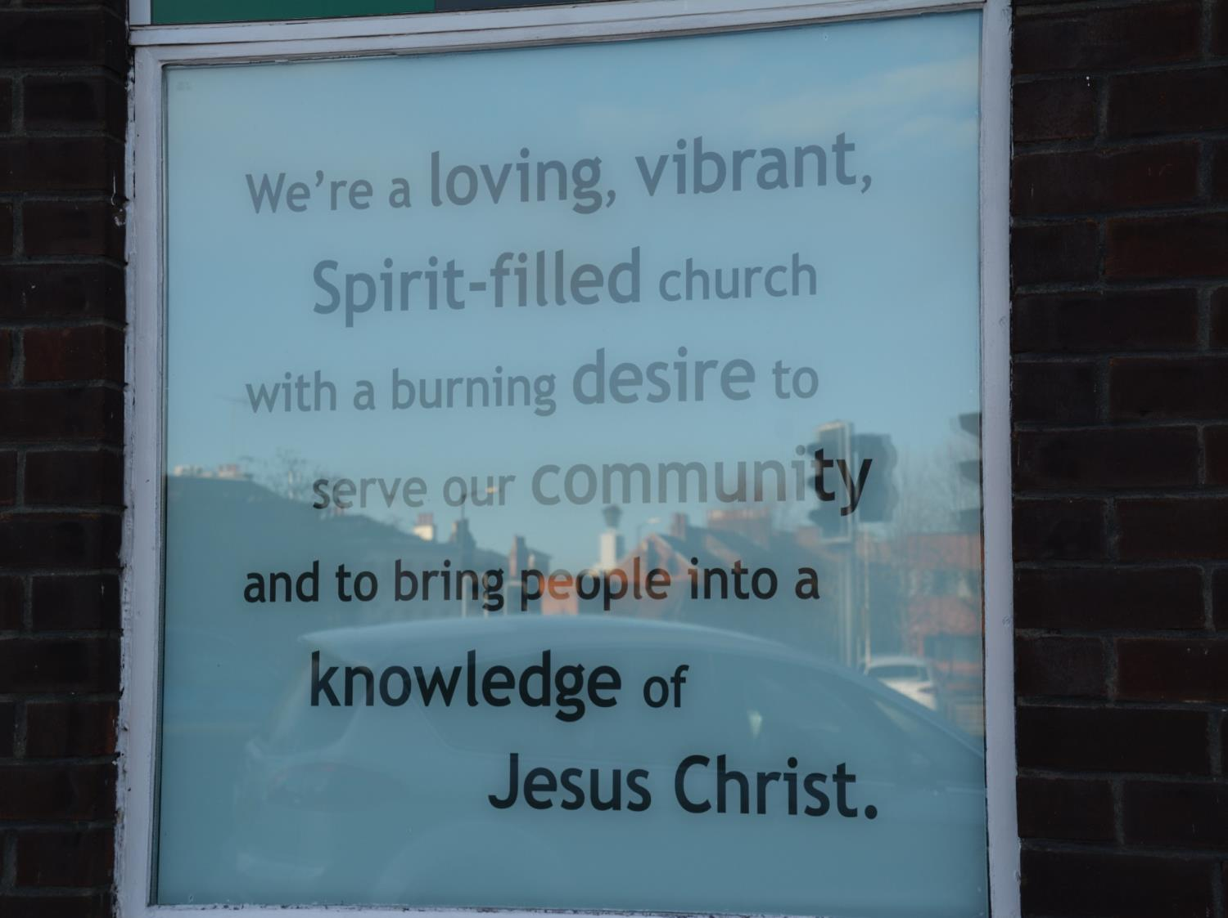
Outside the church is a key message

Slide 4
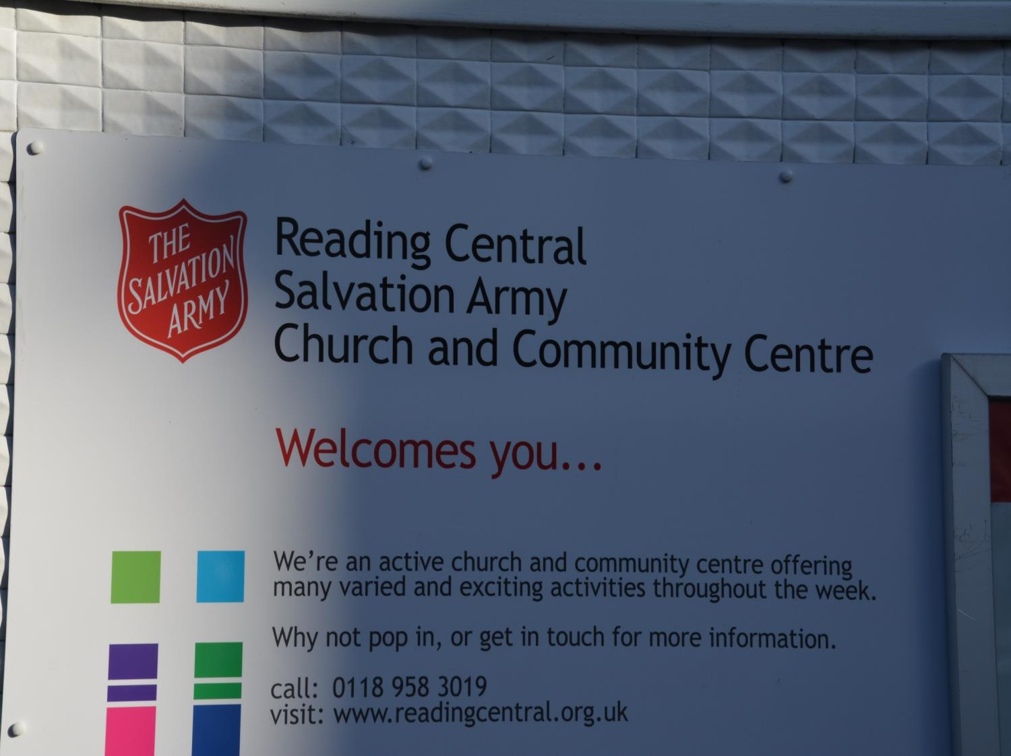
The Salvation Army centre is designed to help all areas of the community

Slide 5
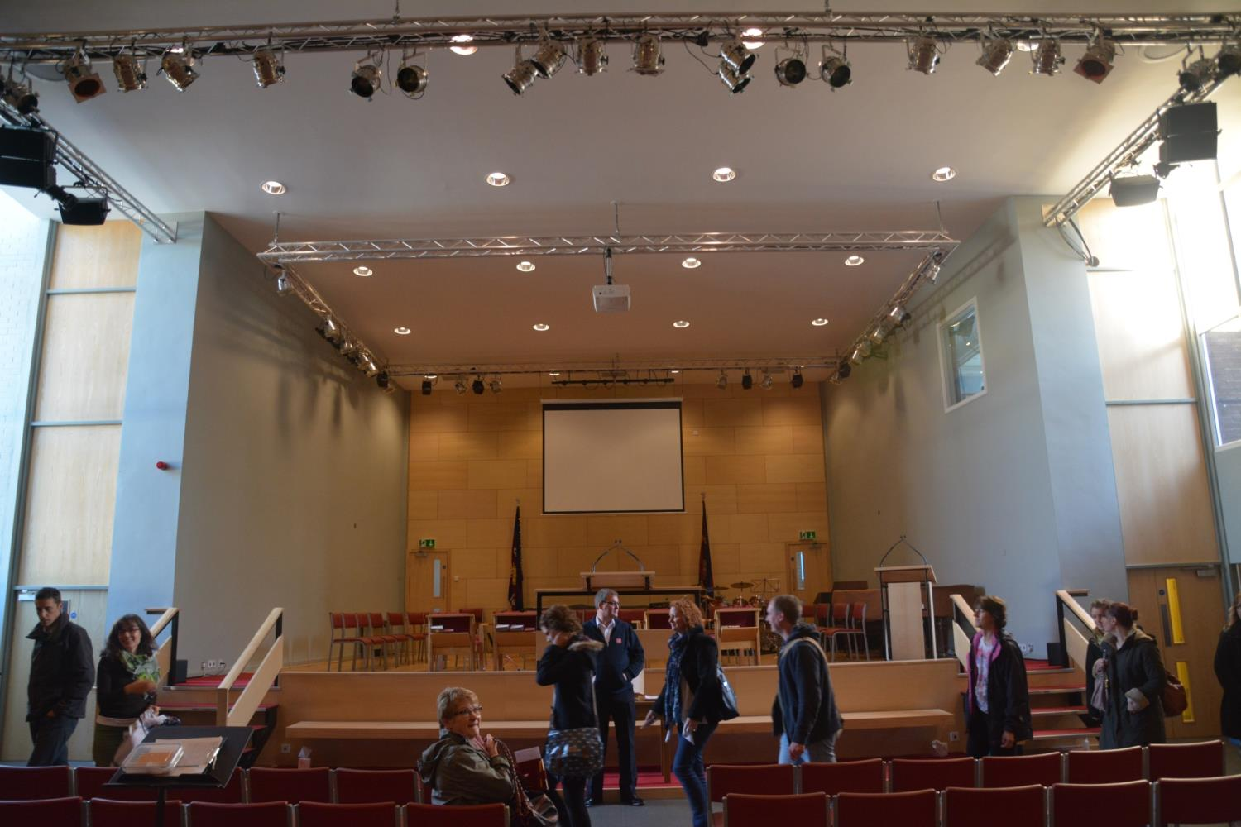
The main hall is where the church services are held
But it is also big enough to be used for community events like theatre and music

Slide 6
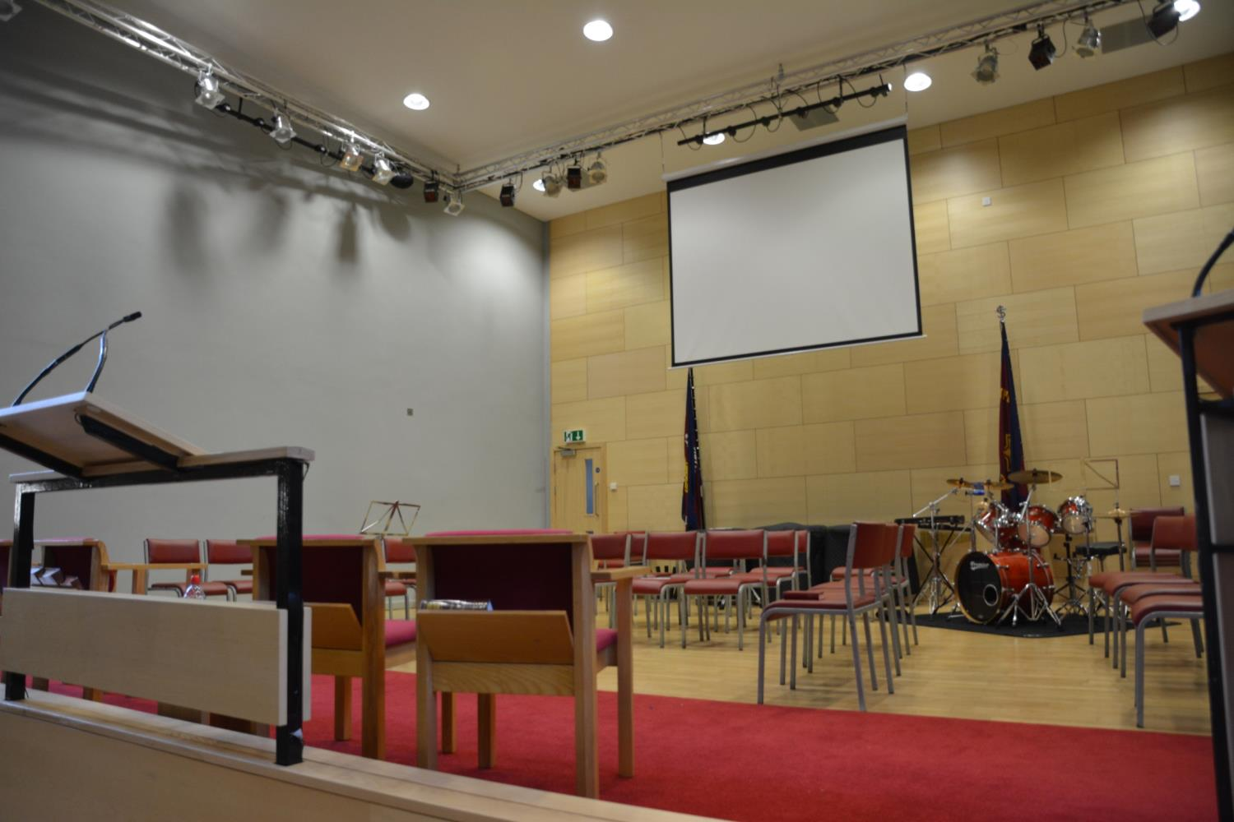
Music is an important part of the Salvation Army worship.
The words are shown on a large screen for people to follow.

Slide 7
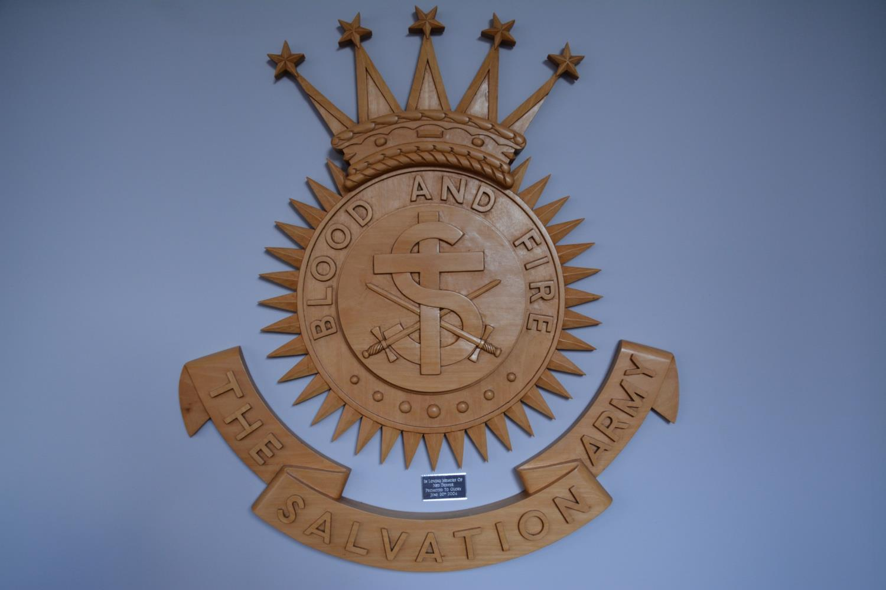
The Salvation Army has two main crests
In this crest you can see the cross of Jesus and two swords. The large S stands for Salvation
They are called the Salvation Army as they try to fight evil, this is why there are two swords. They fight evil by doing good deeds in the community not by using violence!

Slide 8
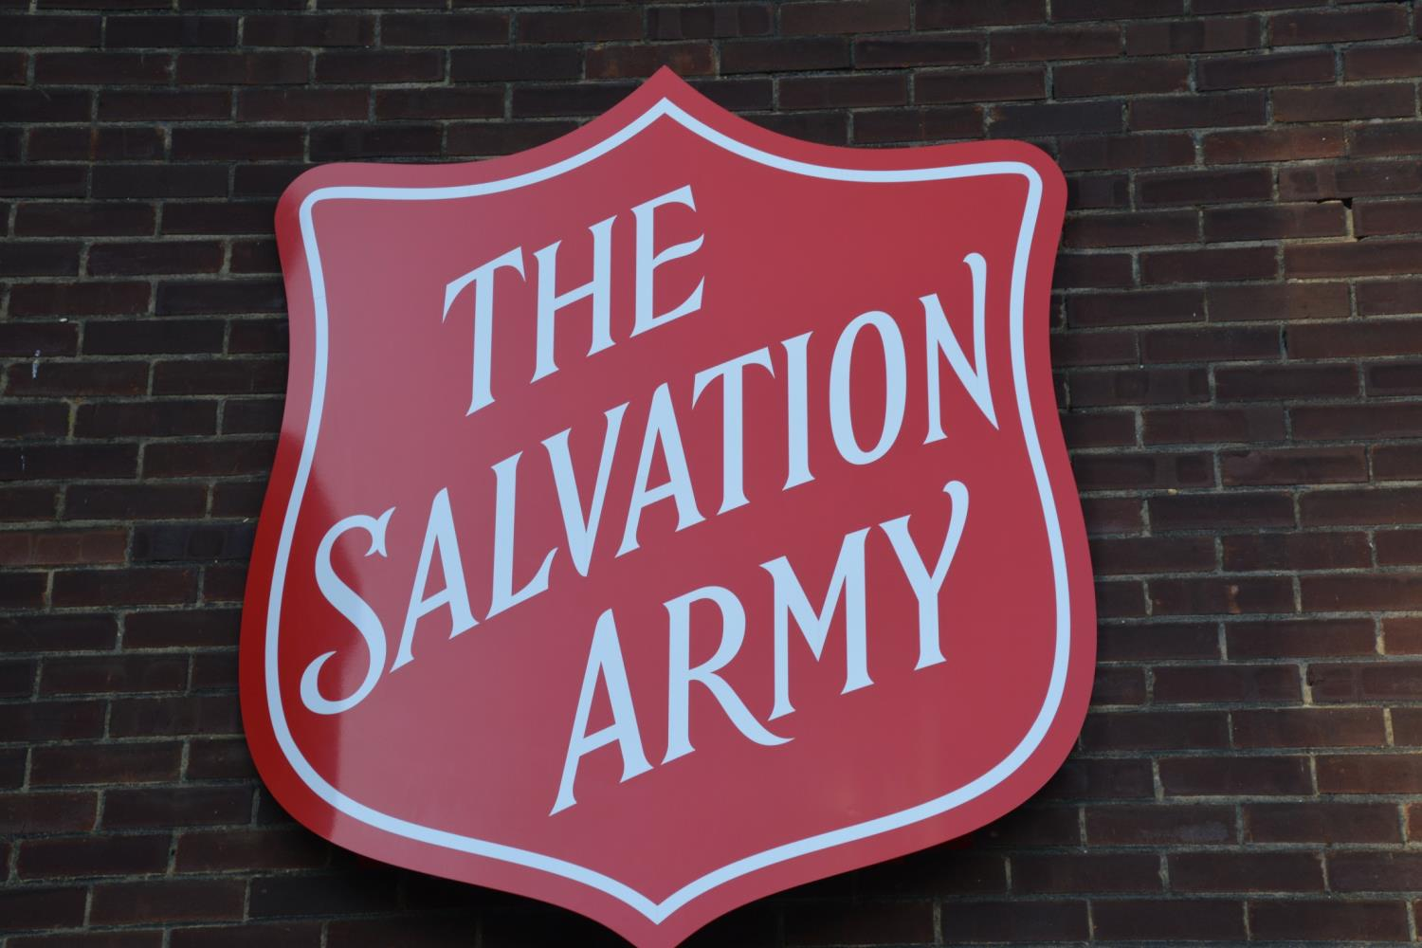
This is the other crest – it shows a shield.
It is on the outside of the building

Slide 9
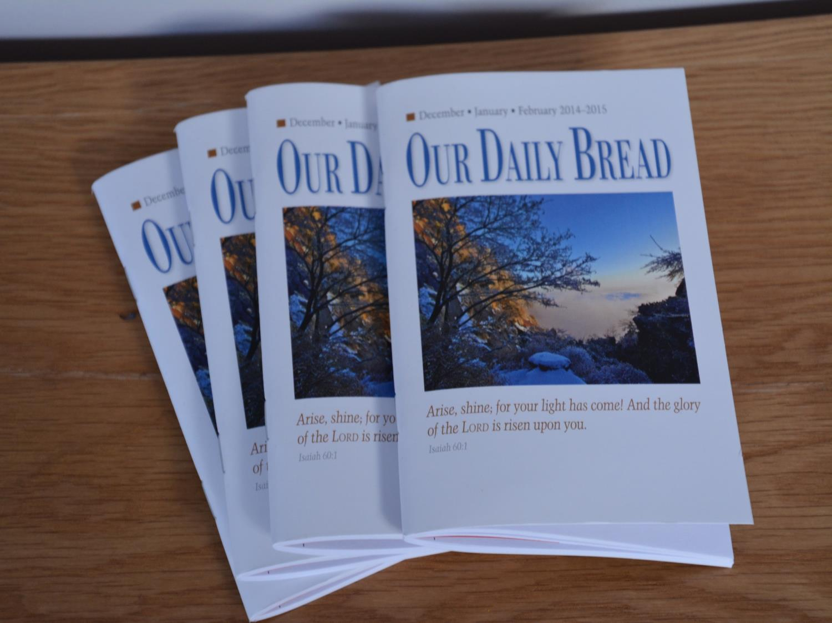
There are booklets explaining events and services

Slide 10
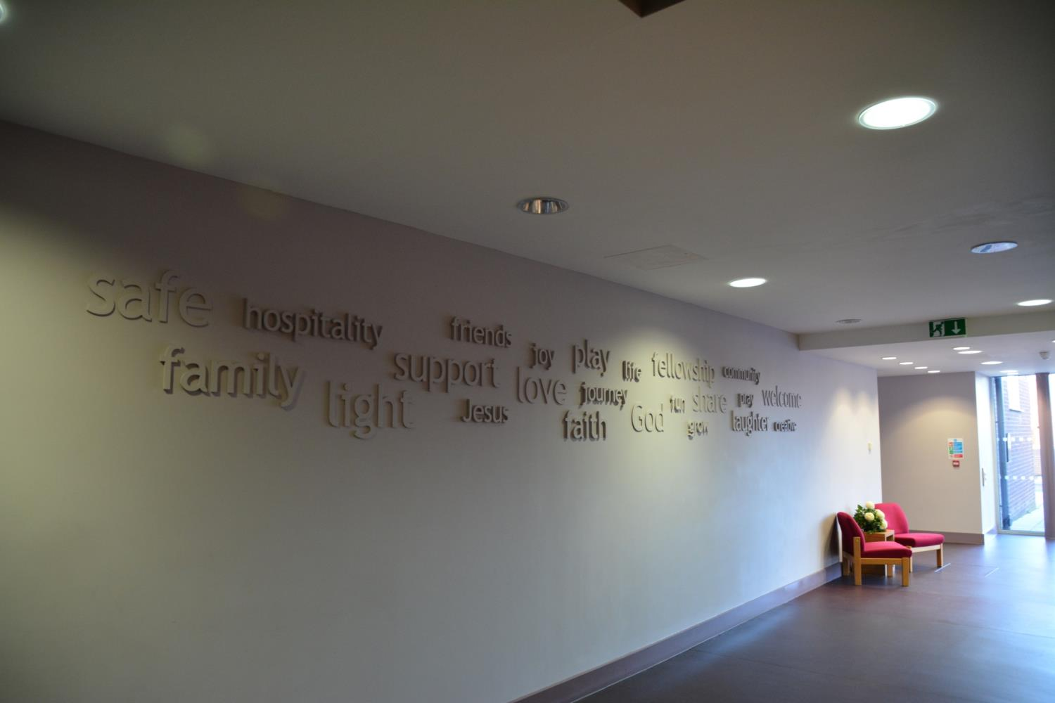
The words reflect beliefs and values of people worshipping here
These words are now displayed as you enter the building

Slide 11
These words show what the Salvation Army is all about

Slide 12
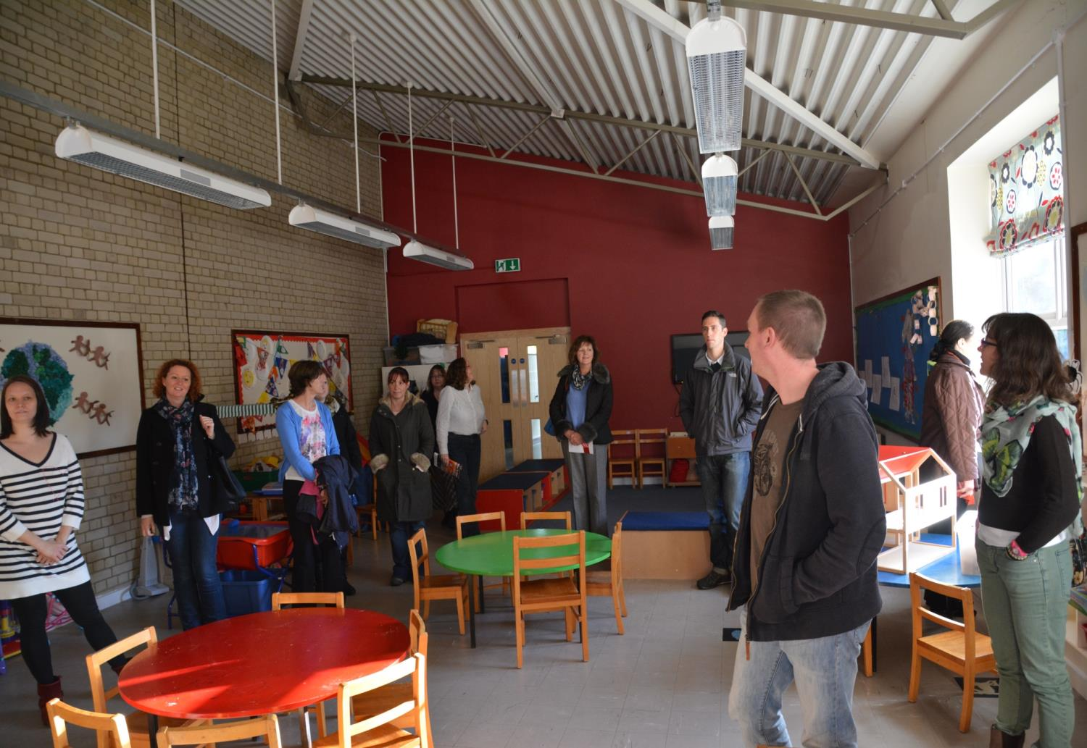
They believe in welcoming the community into their buildings
Some rooms are designed for younger children and have play areas

Slide 13
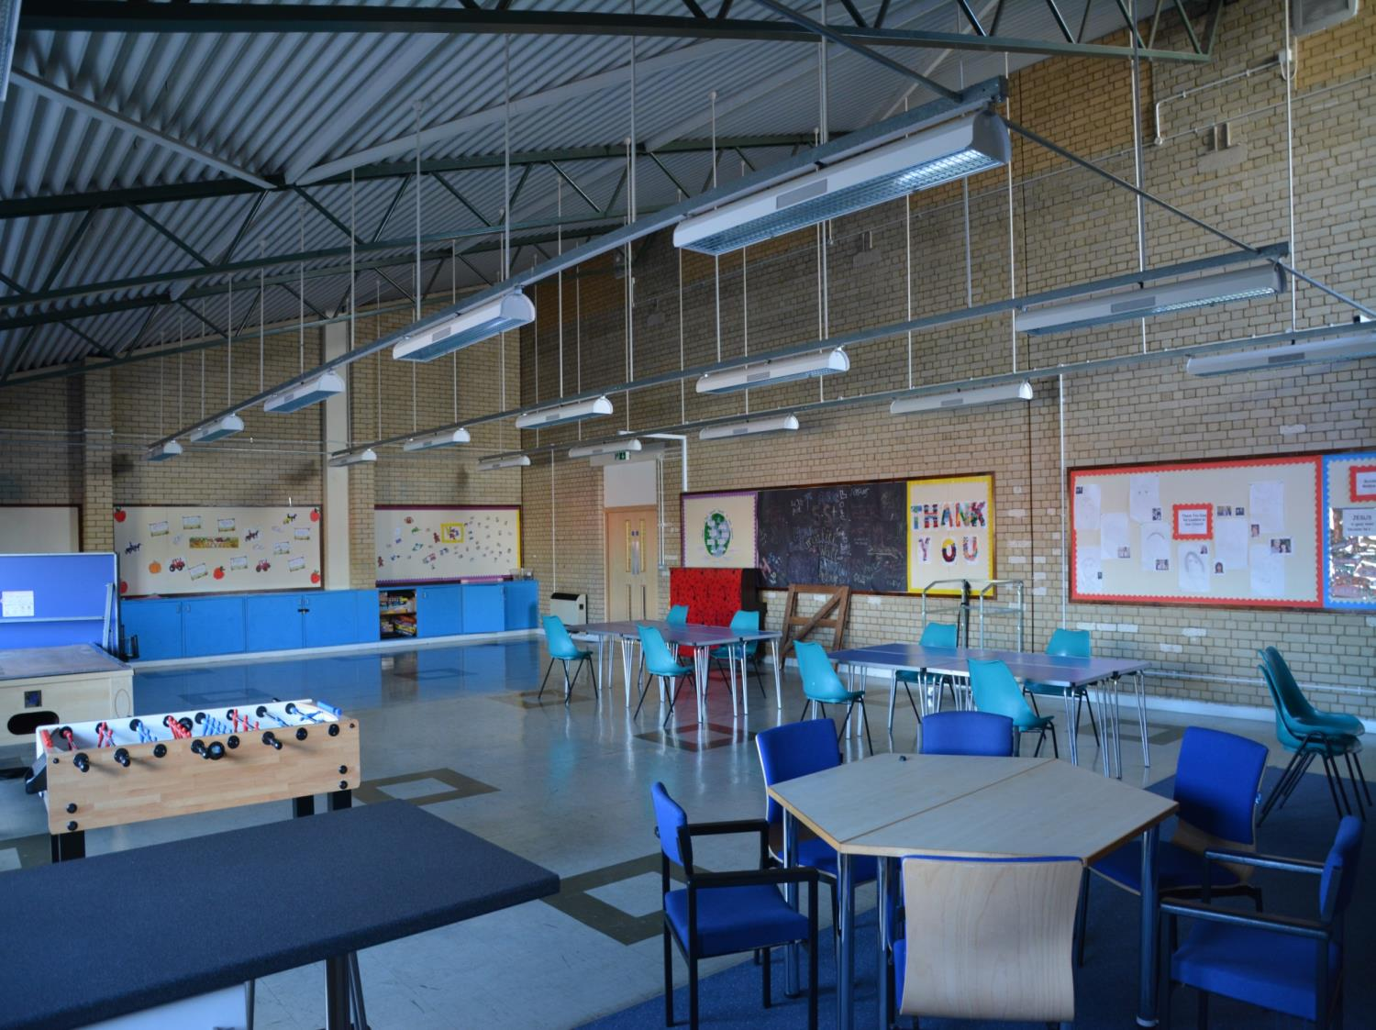
Some rooms could be used for youth projects or adult classes

Slide 14
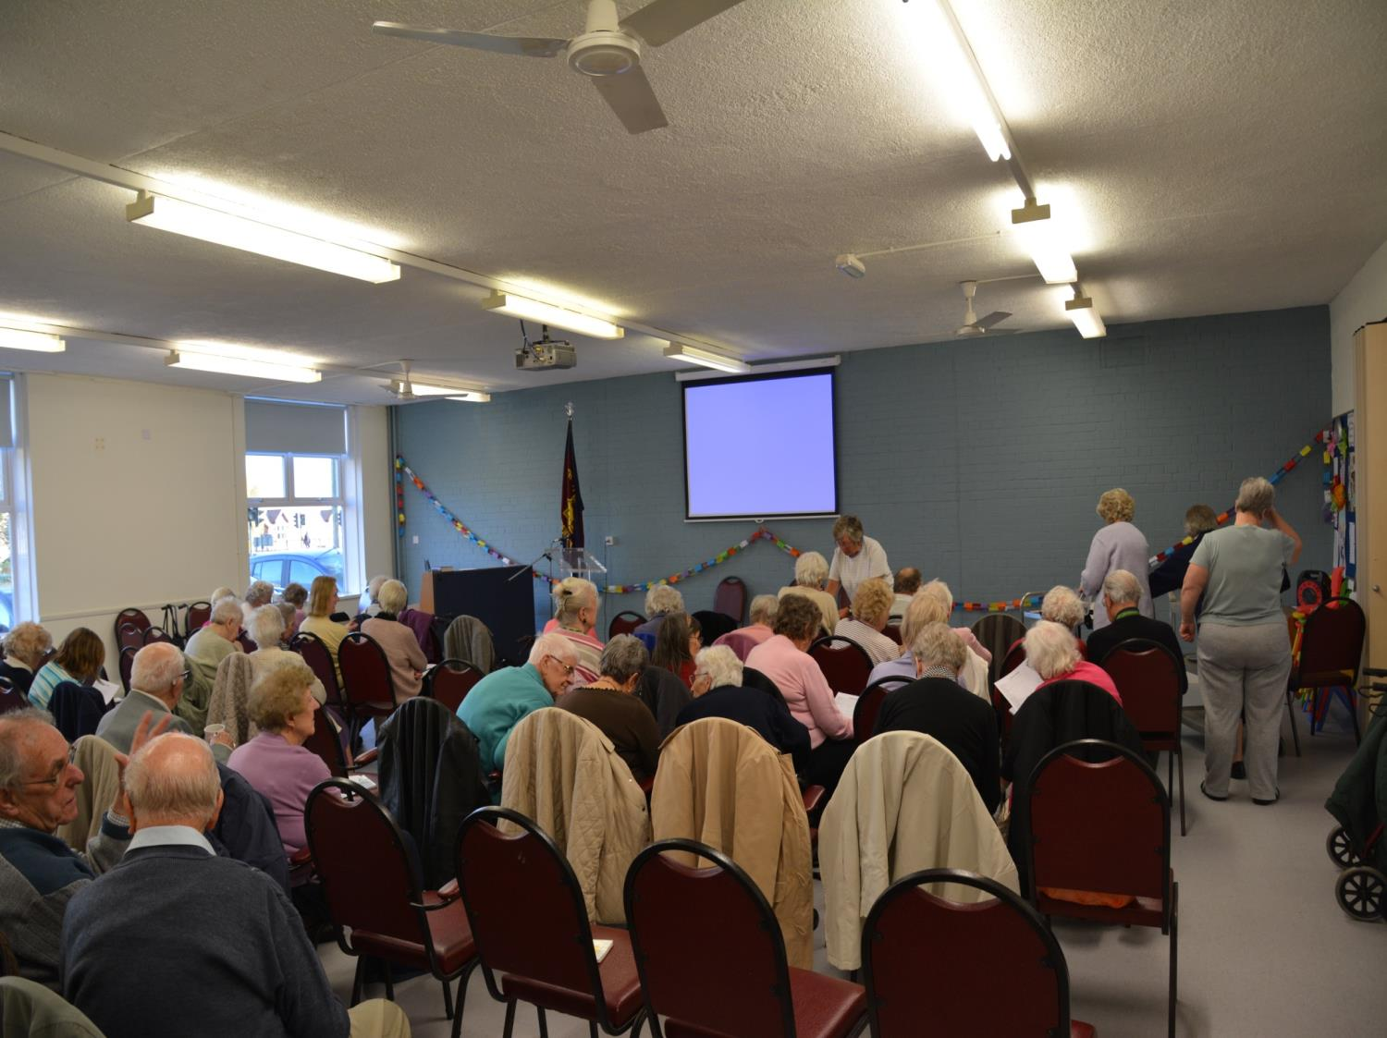
There are many activities for older people too

Slide 15
These slides show how the main goal of the Salvation Army is to serve the community the same way they believe Jesus did.

Slide 16
Crossing the Bridges Project
Schools, SACREs and Places of Worship
working together
to enhance Religious Education
Pan-Berkshire
2017

