Slide 3
Click here

Slide 4
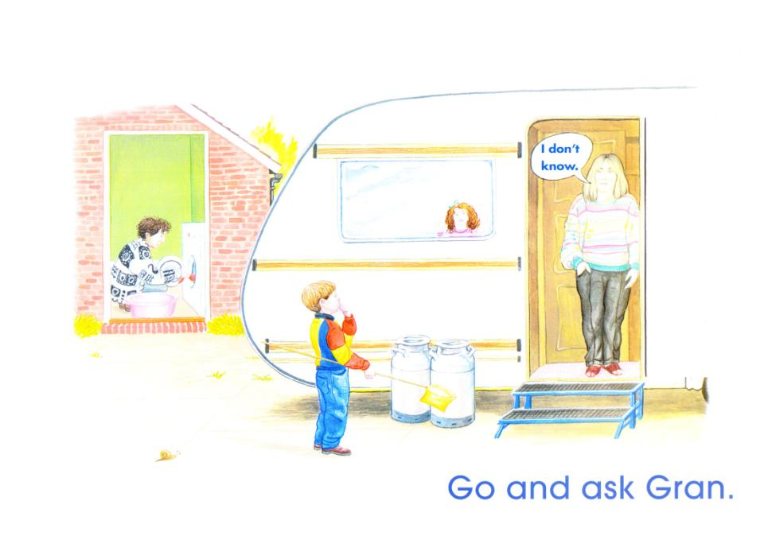

Slide 5
Click here

Slide 7
Click here

Slide 9
Click here

Slide 10
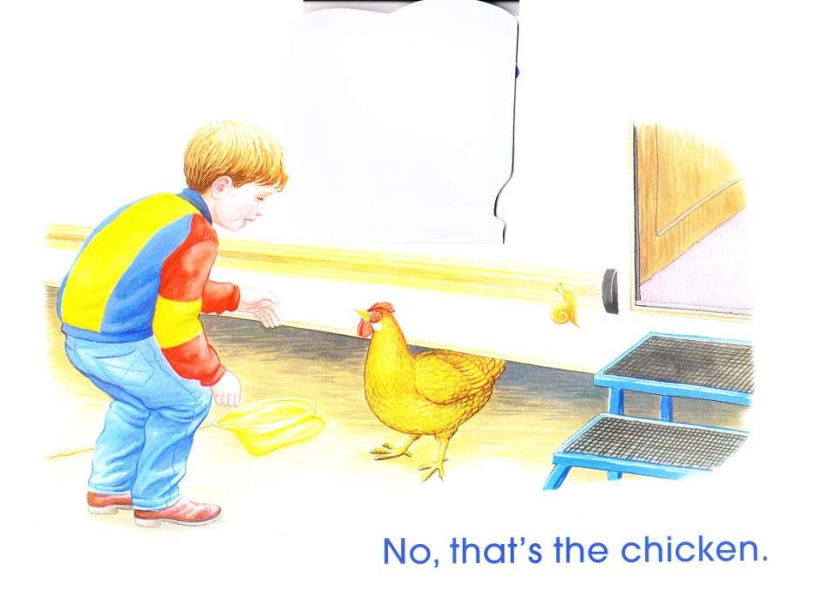

Slide 11
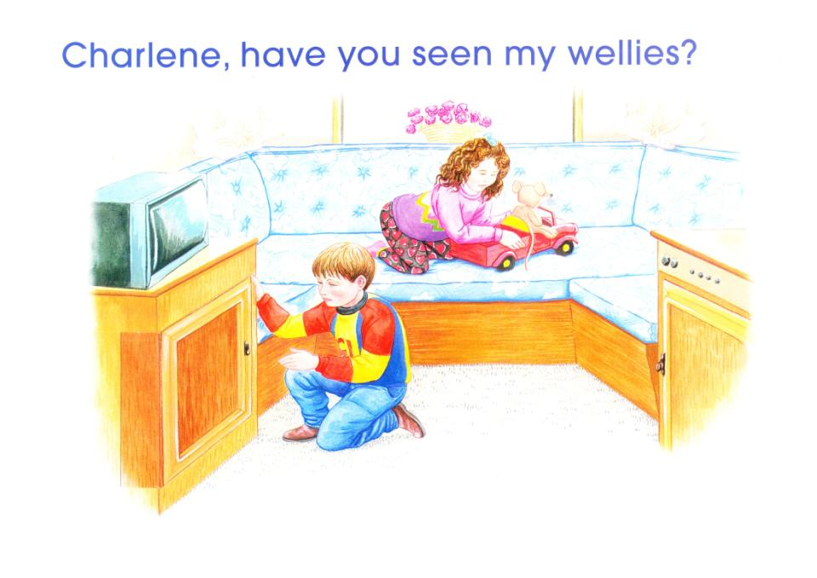
Click here

Slide 12
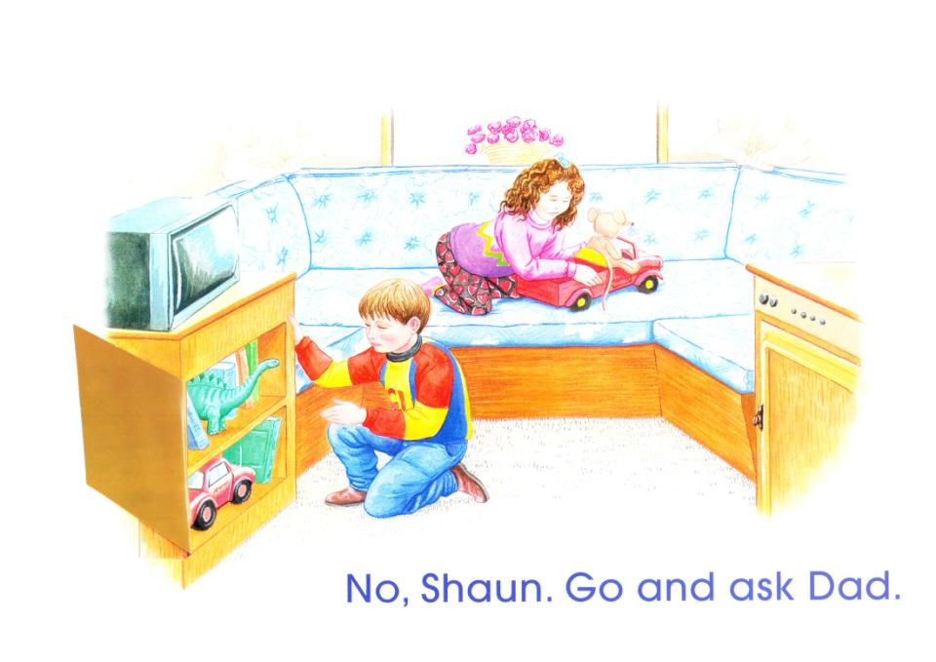

Slide 13
Click here

Slide 15
Click here

Slide 16
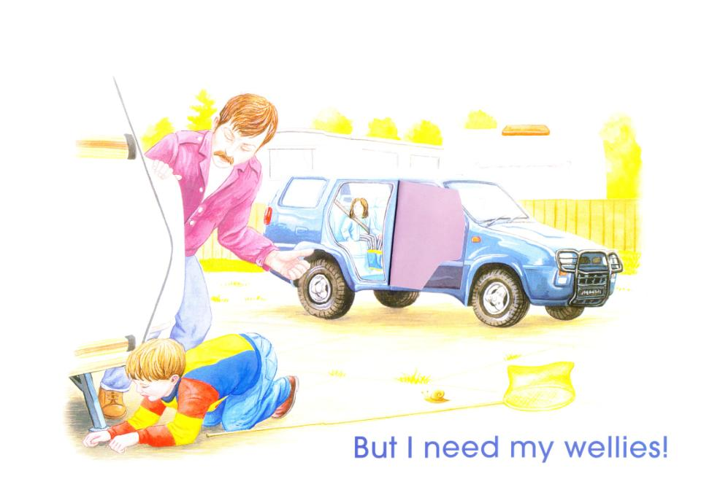

Slide 17
Click here

Slide 19
Click here

Slide 20
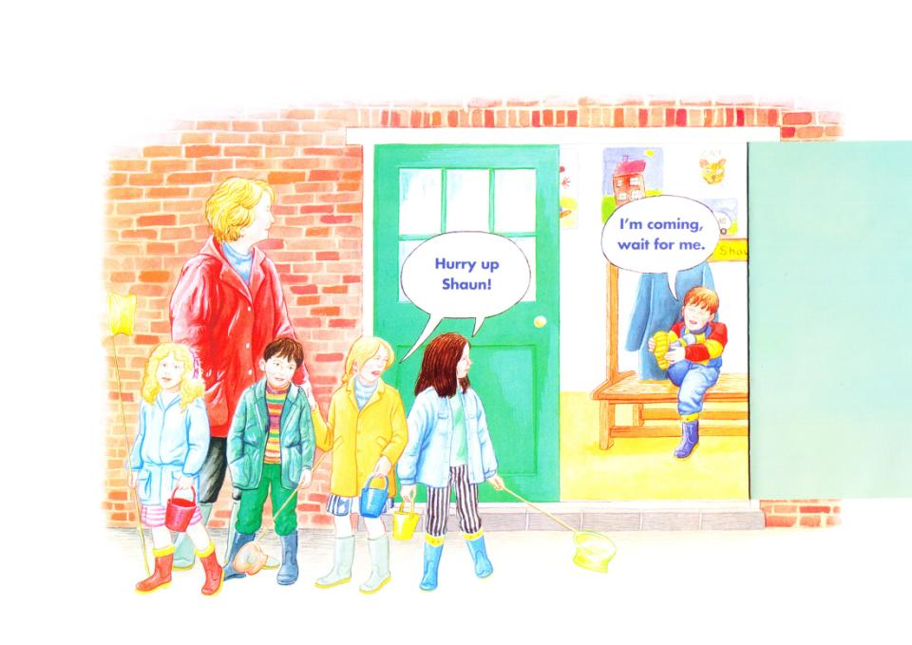

Slide 21
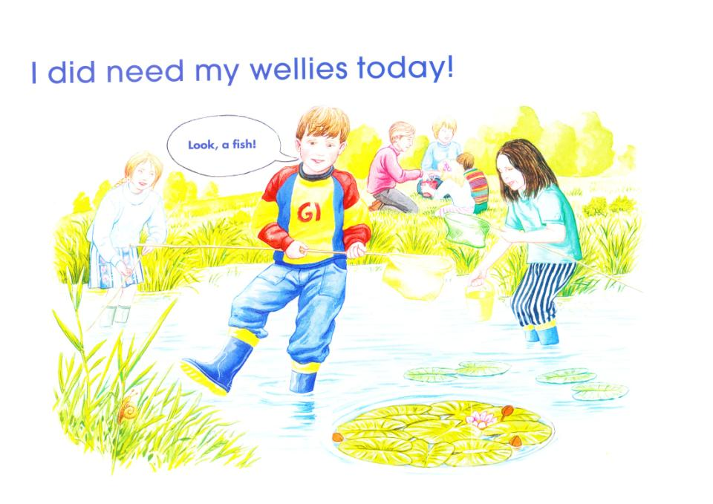
Click here

Slide 22
