Slide 1
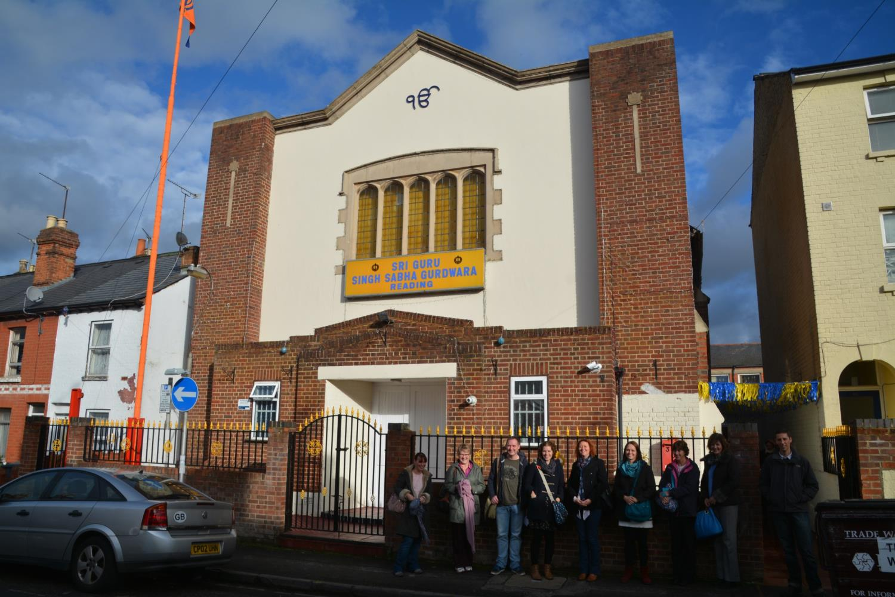
The Sikh Gurdwara in Reading

Slide 2
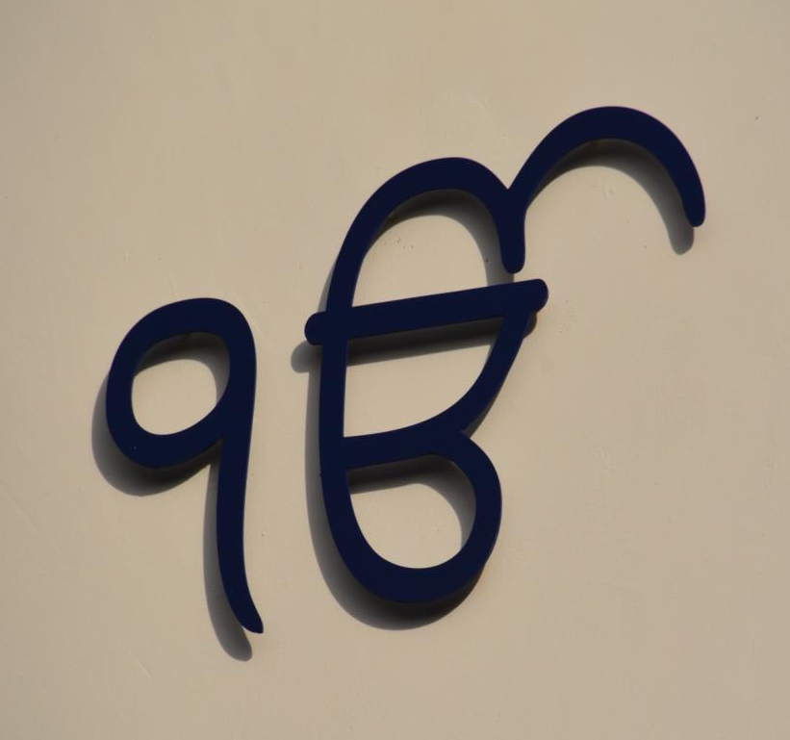
Ik Onkar
is a symbol which appears at the beginning the Sikh scripture and means, "One with Everything".
The symbol
Ik Onkar gives the idea of one creative being, or
one God.
This symbol is on the outside of the Gurdwara

Slide 3
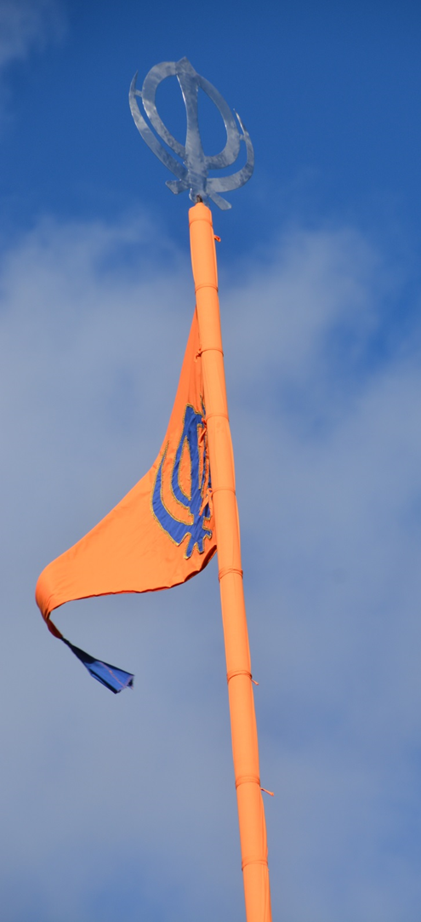
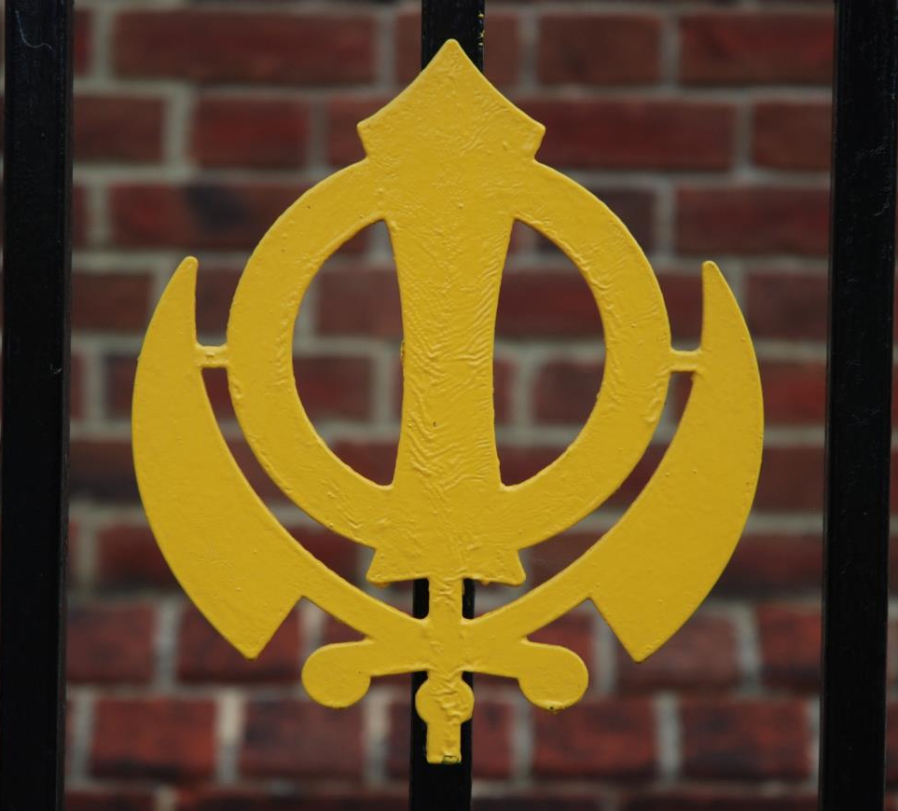
Nishan Sahib
Khanda

Slide 4
The Khanda is a symbol in 3 parts – it stands for God being eternal and also for truth.
Khanda
Nishan Sahib
It reminds Sikhs of their duty to God as well as to the community.

Slide 5
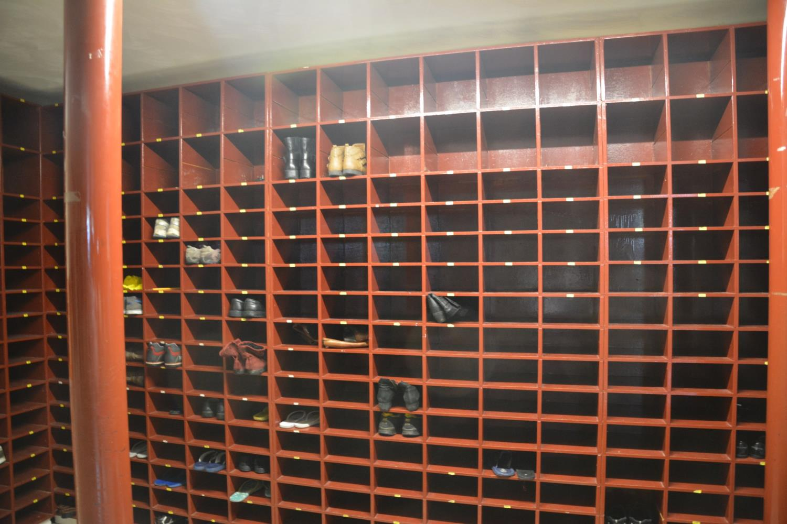
As a sign of respect, Sikhs take off their shoes inside the Gurdwara and put them in a shoe rack

Slide 6
Sikhs also cover their heads and wash their hands before worship

Slide 7
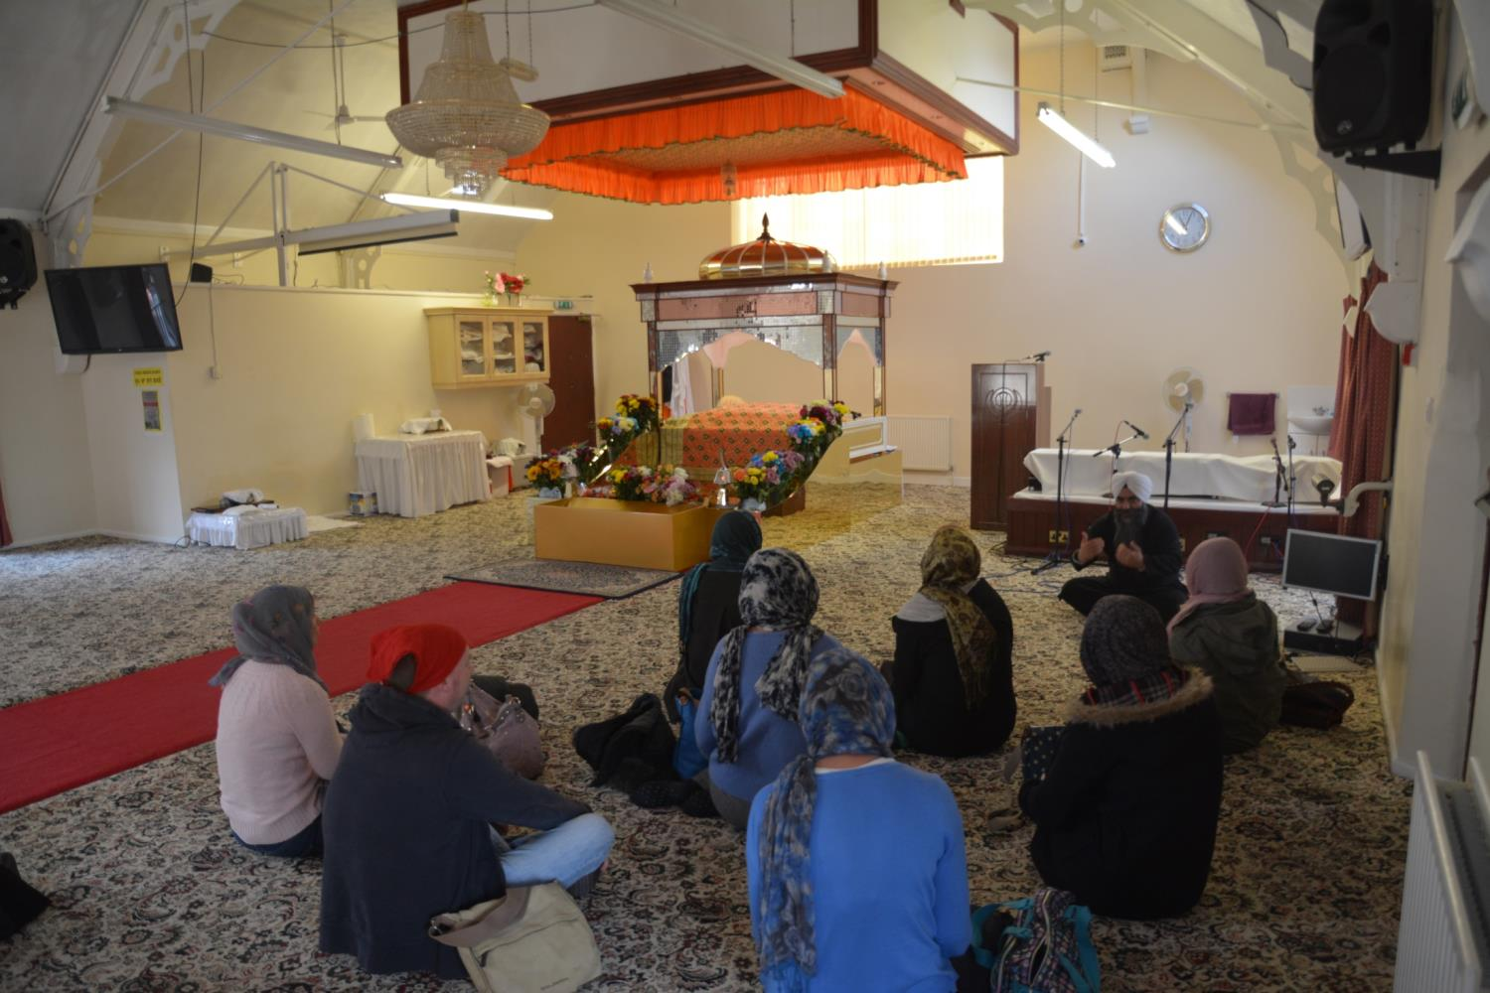
Everyone sits on the floor to show that all are equal

Slide 8
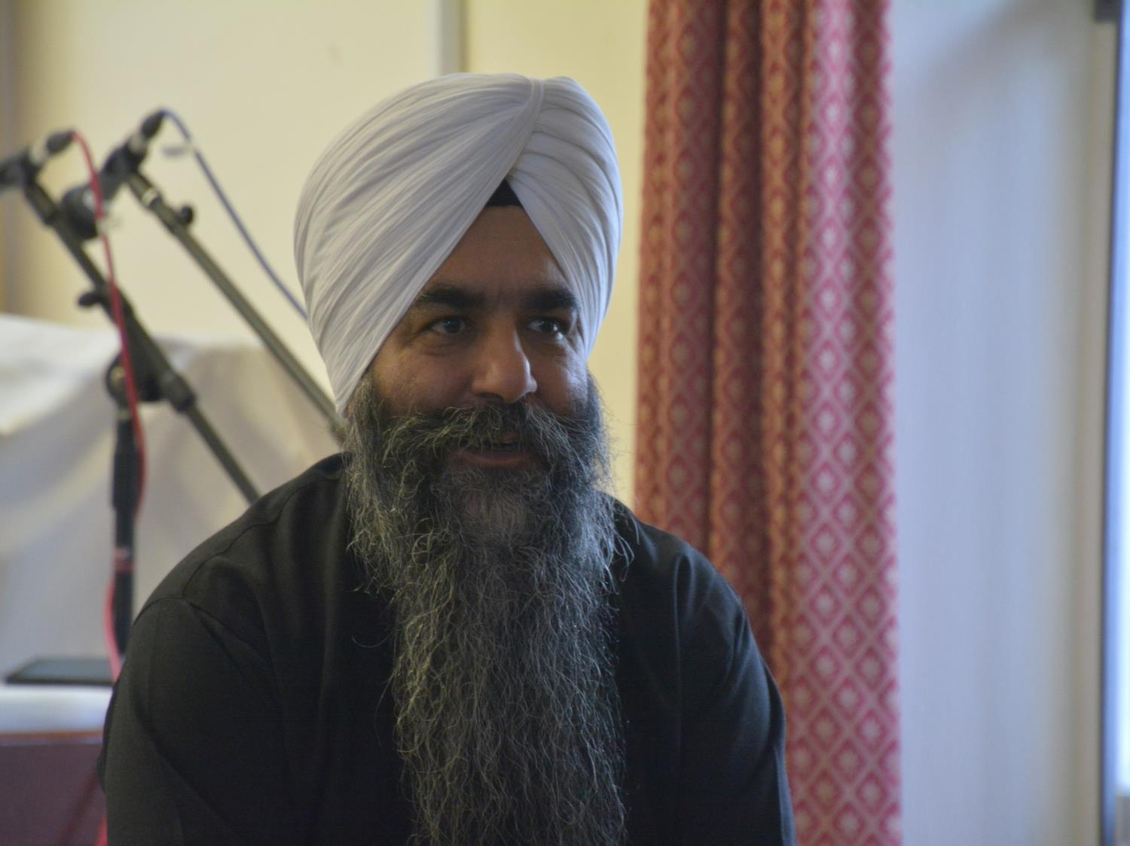
Sikhs do not believe in cutting their hair – it is a gift from God. This is why they wear a turban

Slide 9
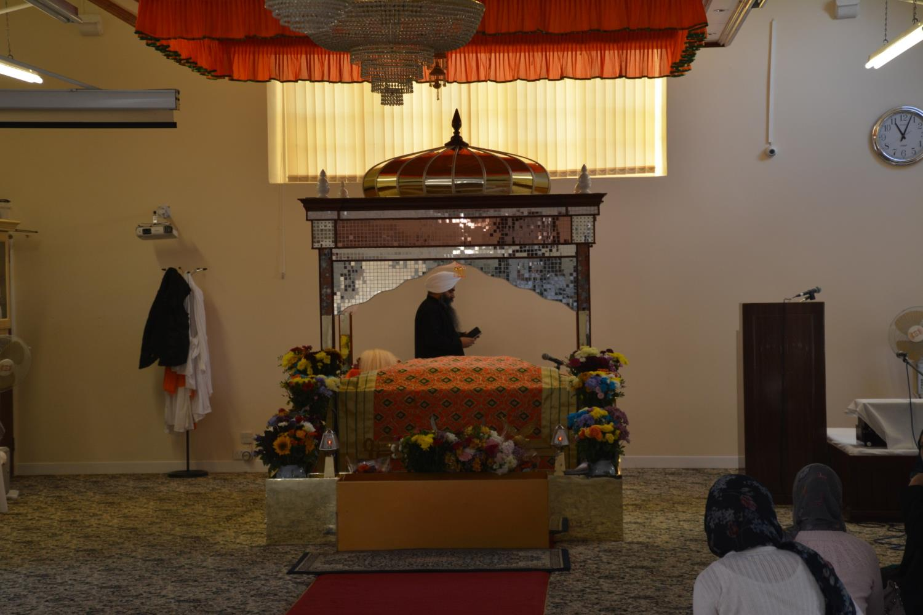
Inside the prayer room there is a special place for the holy book

Slide 10
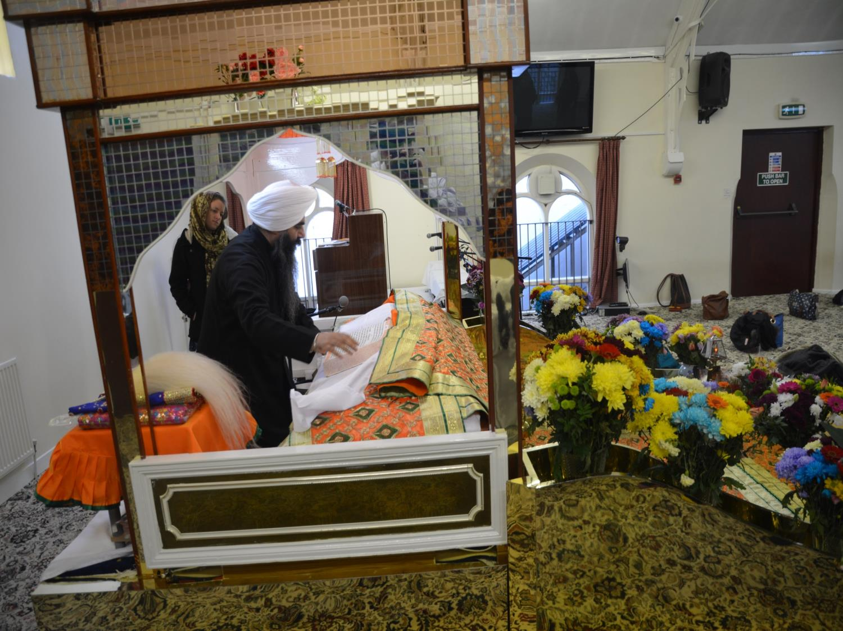
The Holy Book, The Guru Granth Sahib is treated with great respect

Slide 11
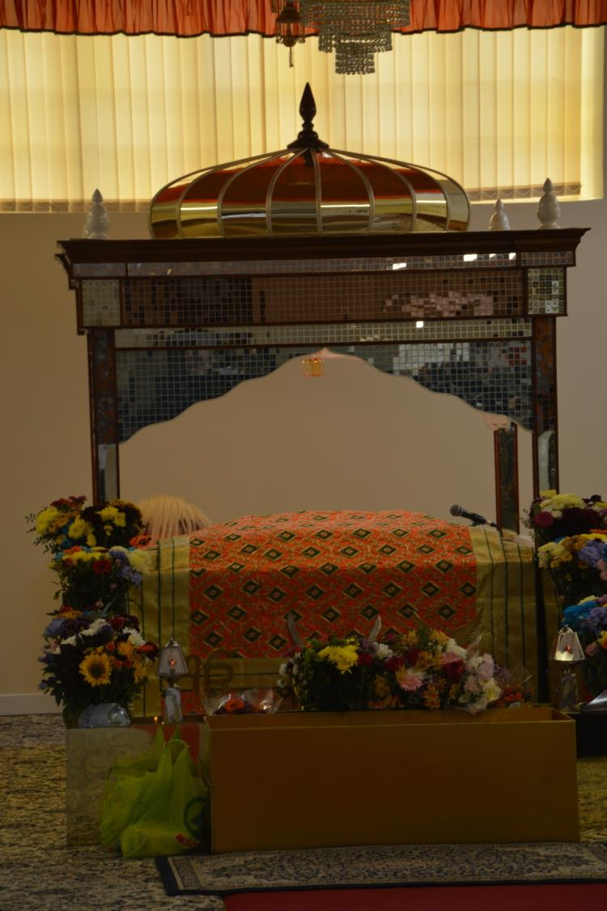
The Guru Granth Sahib has a canopy over it to show that it is important

Slide 12
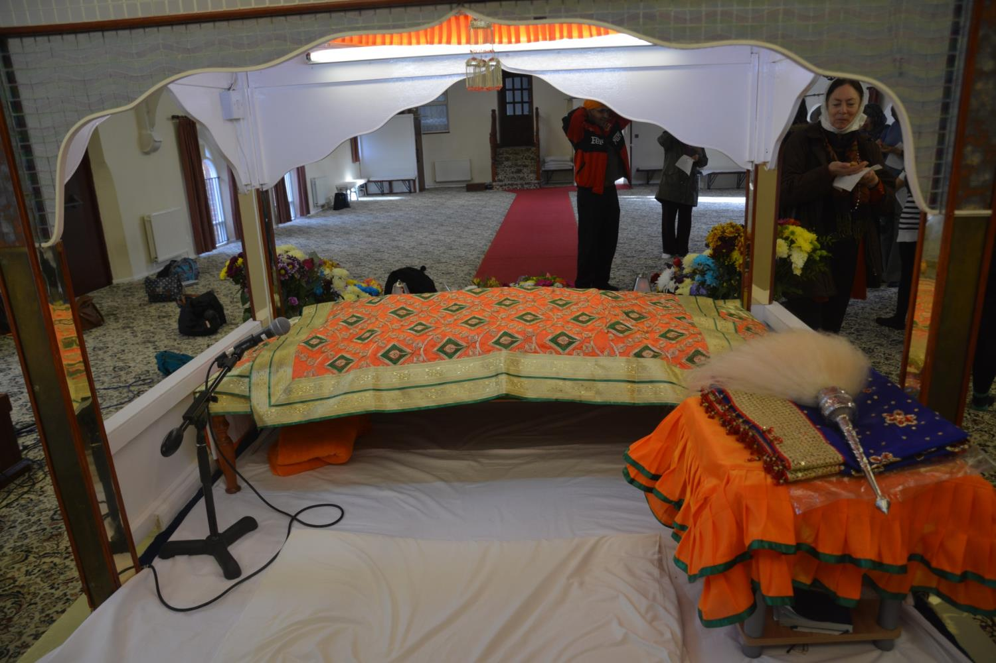
The Guru Granth Sahib is covered when not being read

Slide 13
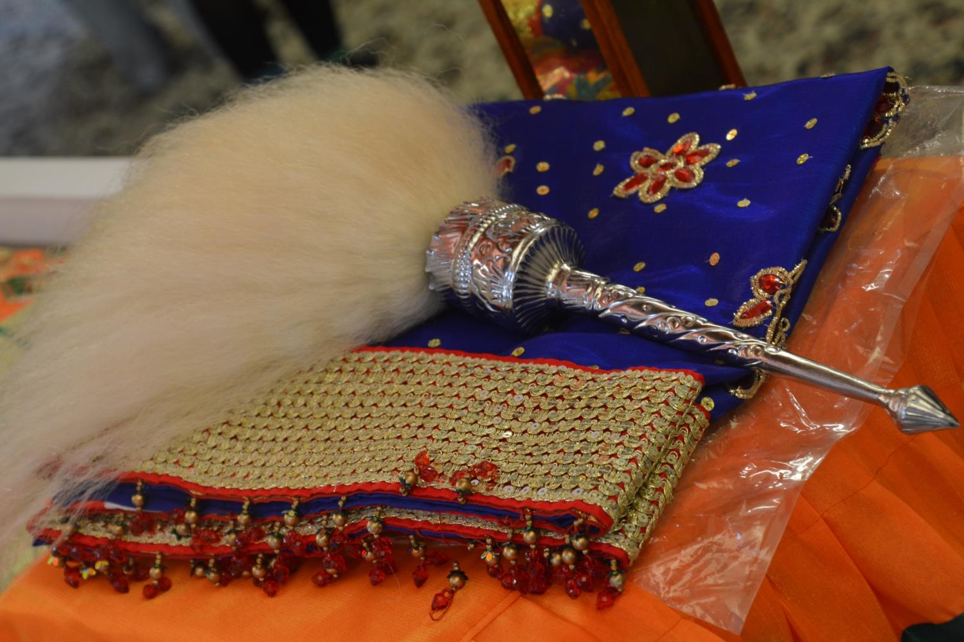
Before reading the holy book a special whisk called a chauri is waved over it

Slide 14
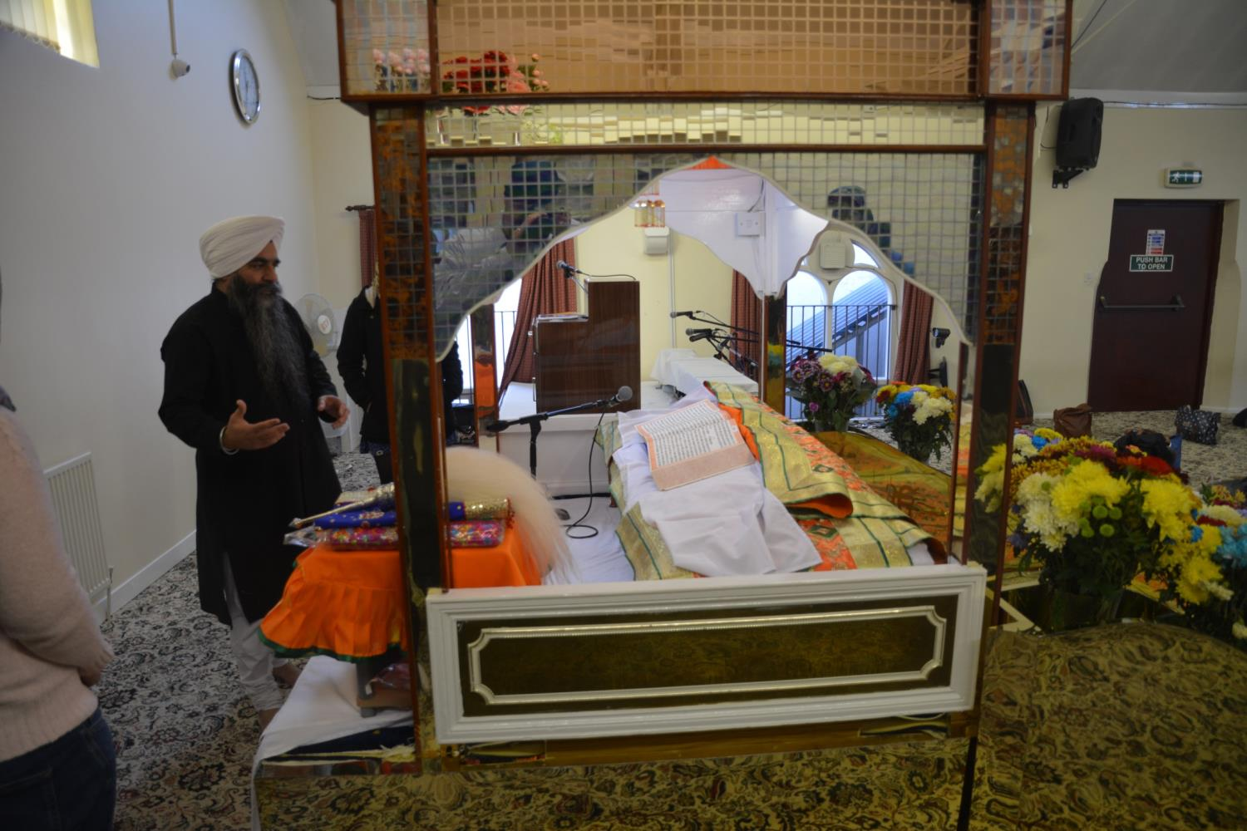
When the book is unwrapped it is ready to be used

Slide 15
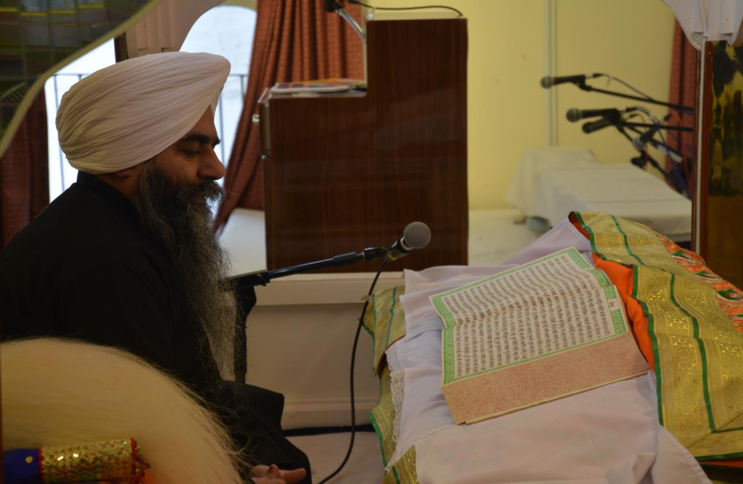
The Guru Granth Sahib is read during worship.

Slide 16
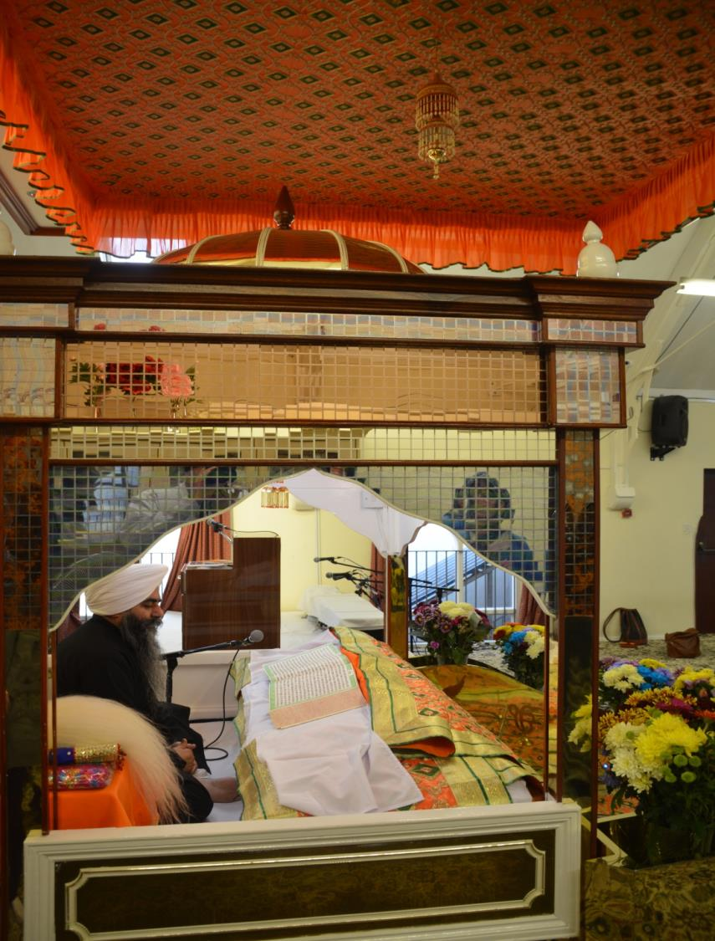
It is a collection of poems praising God

Slide 17
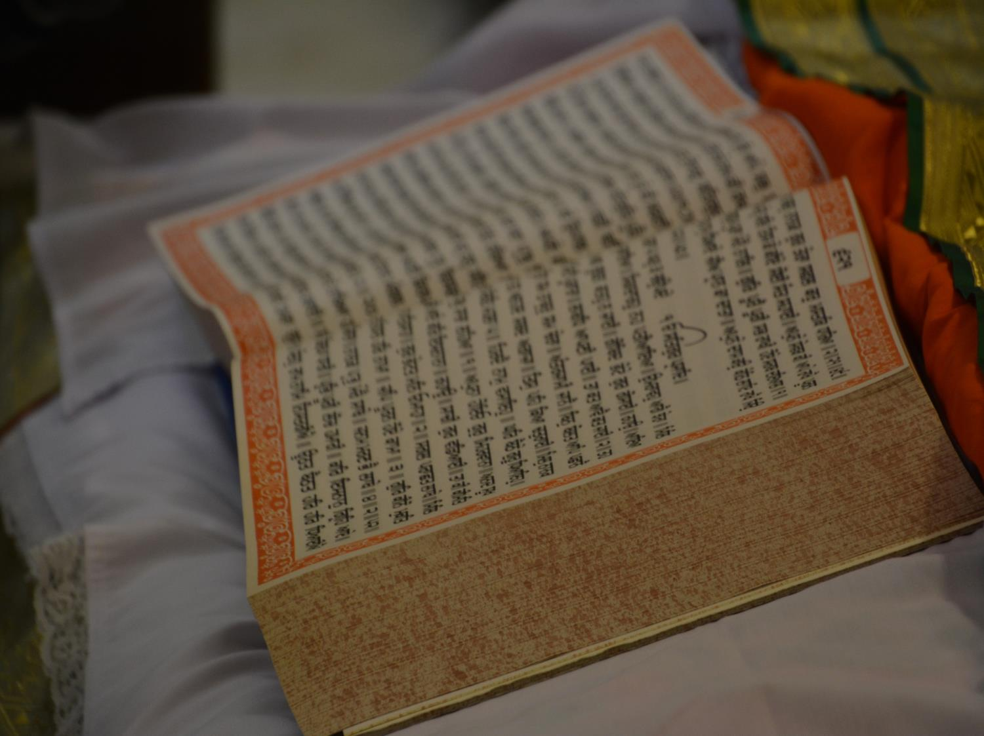

Slide 18
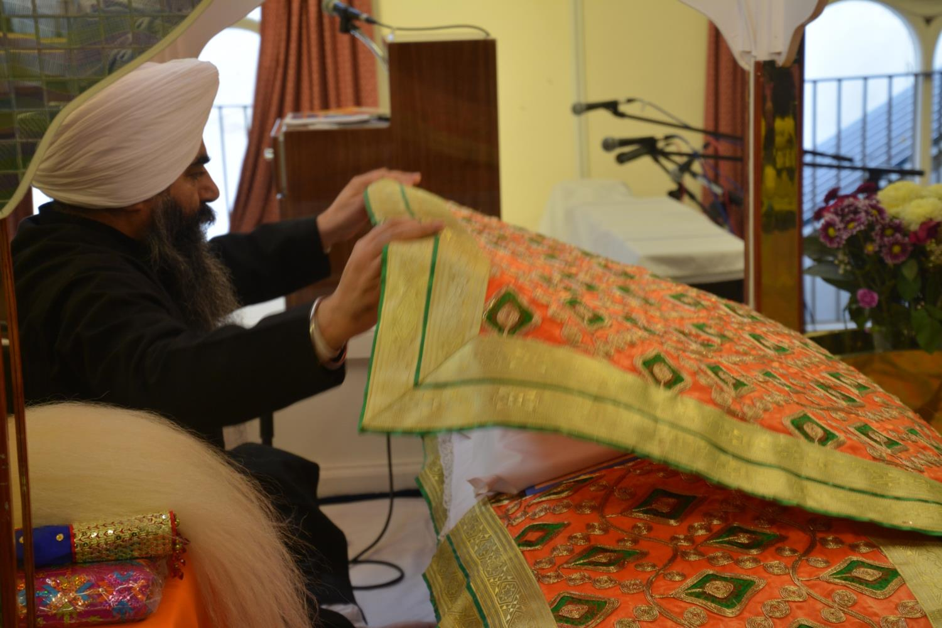
When the reading has stopped the Guru Granth Sahib is wrapped up again.

Slide 19
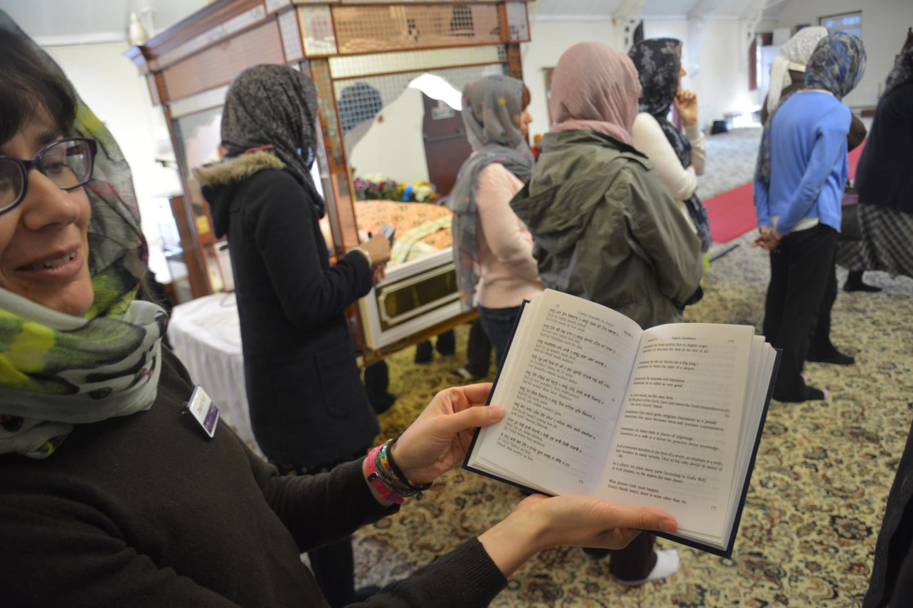
Some of the books are in more than one language

Slide 20
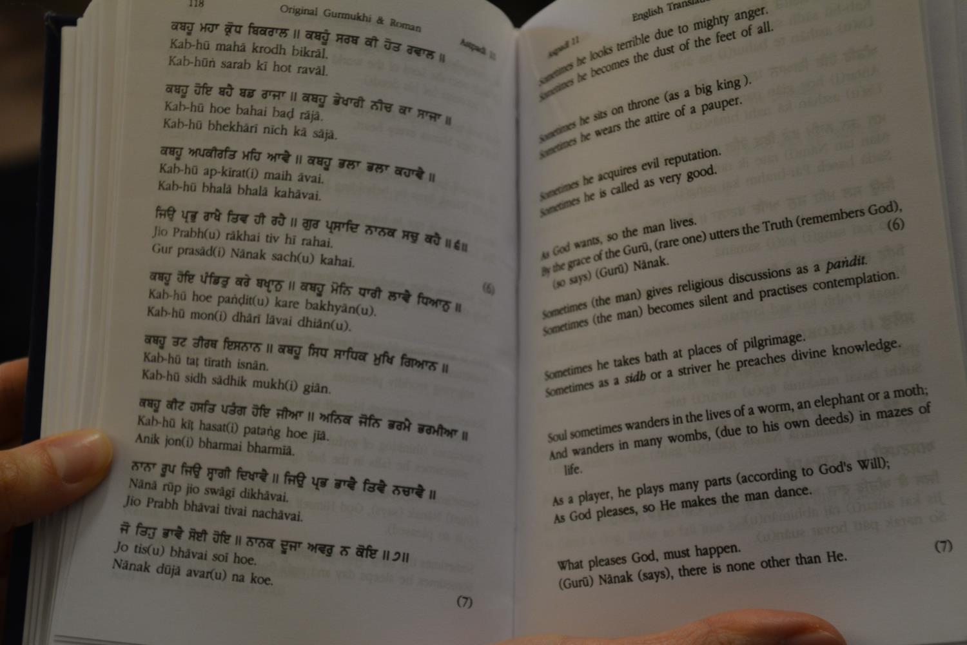
This is to help people understand what is written

Slide 21
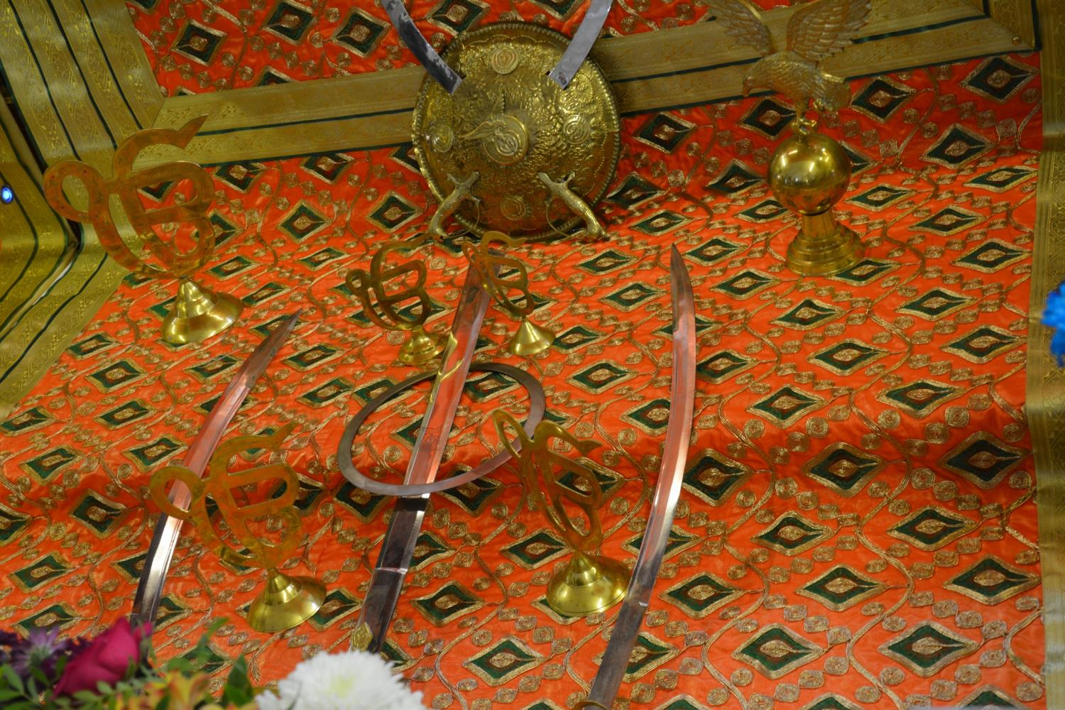
There are symbols and offerings in front of the Holy Book

Slide 22
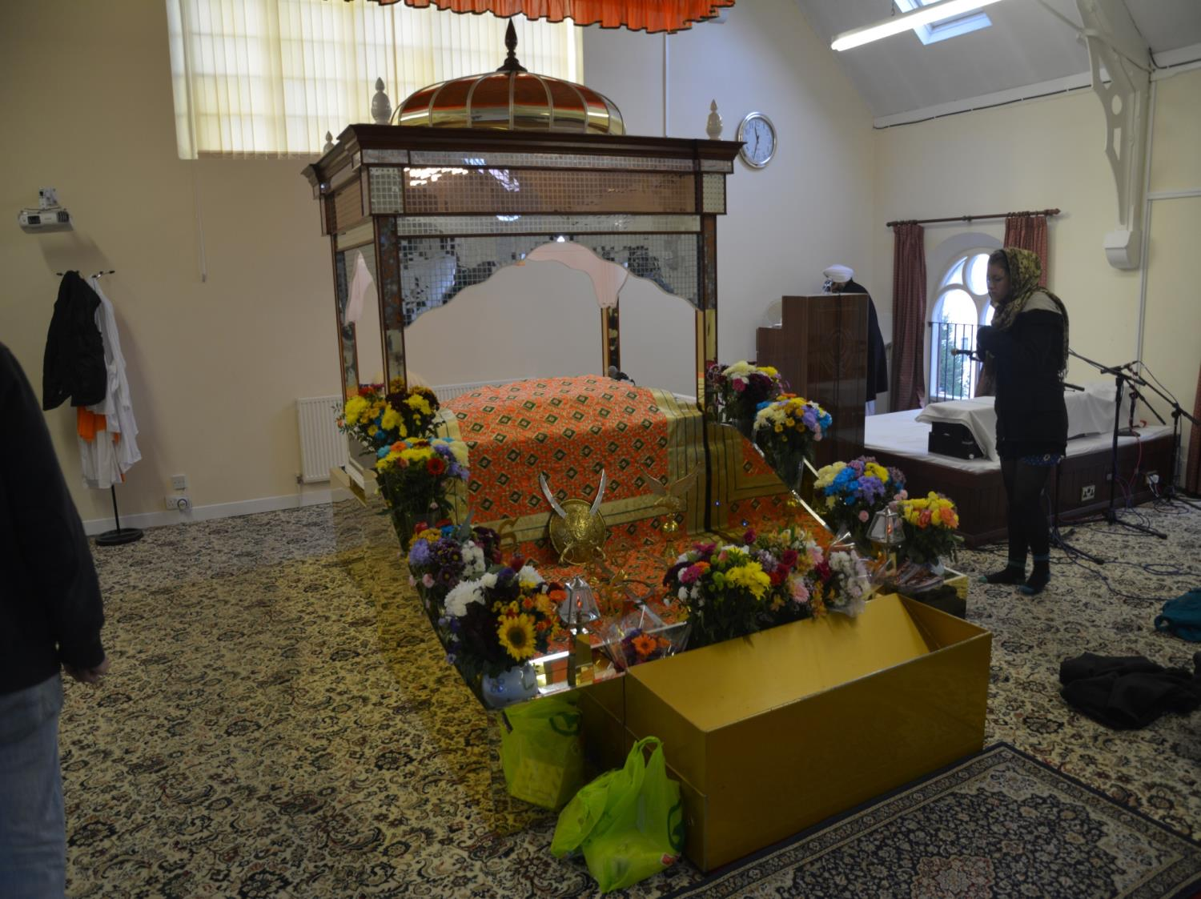
These symbols usually include flowers.
In front of these is a gold coloured donation box.
People give money to the Gurdwara

Slide 23
At the end of each day the
Guru Granth Sahib
is put into
a special room
It is brought out again each morning

Slide 24
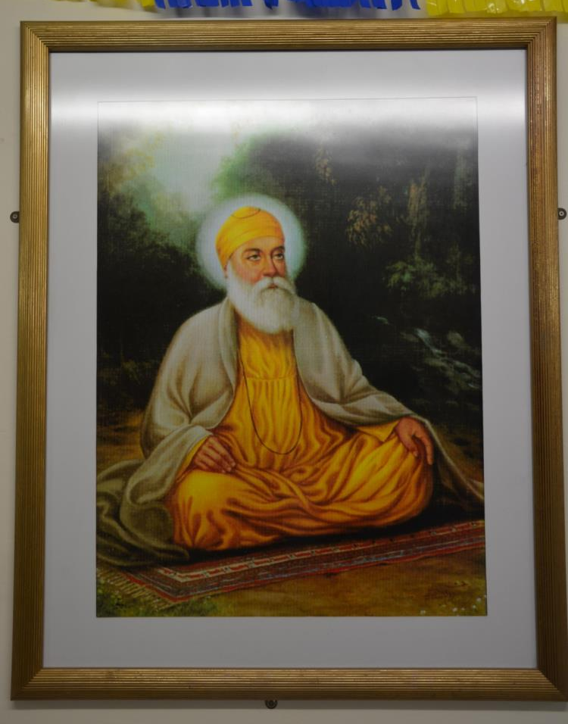
Outside the main prayer room there are often pictures of important teachers or Gurus on the walls.
This one shows
Guru Nanak
The Gurus encouraged people to share with each other

Slide 25
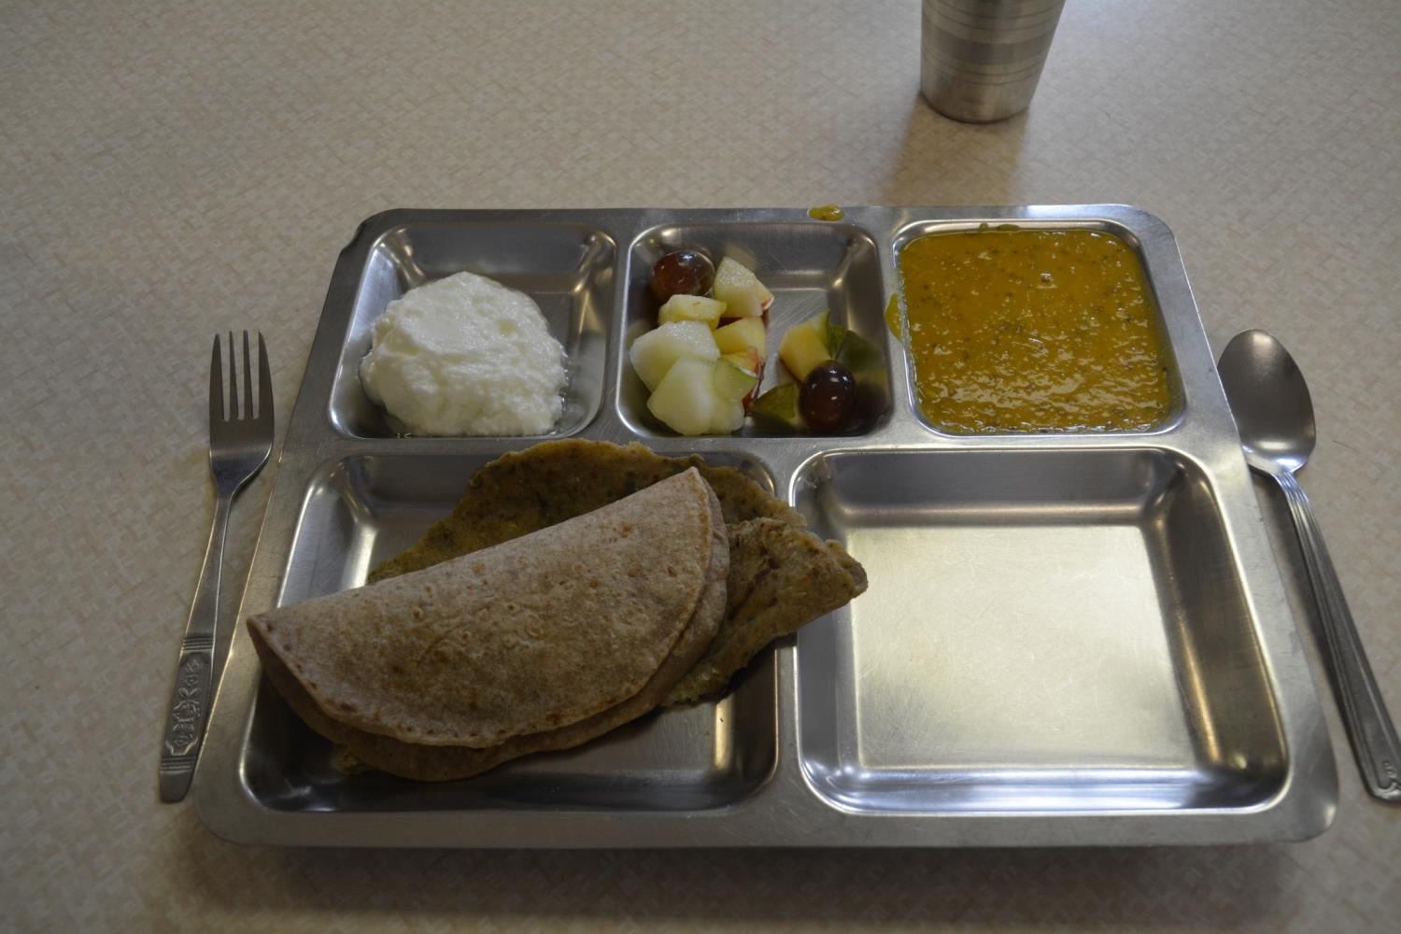
The food is always vegetarian
Sikhs believe in sharing. At the end of every service a meal is prepared for the community in special kitchens at the Gurdwara

Slide 26
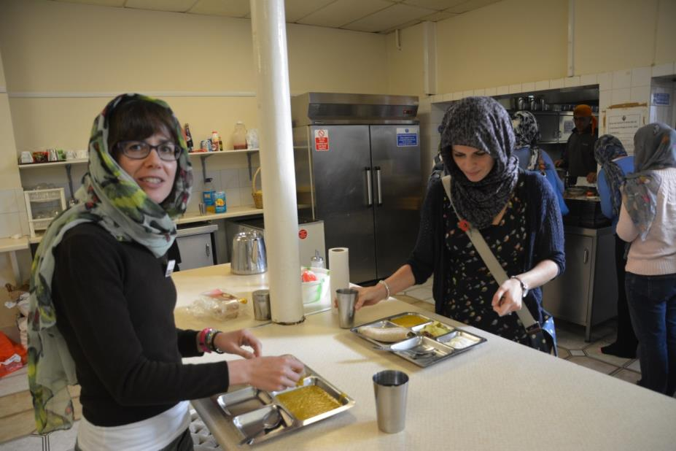
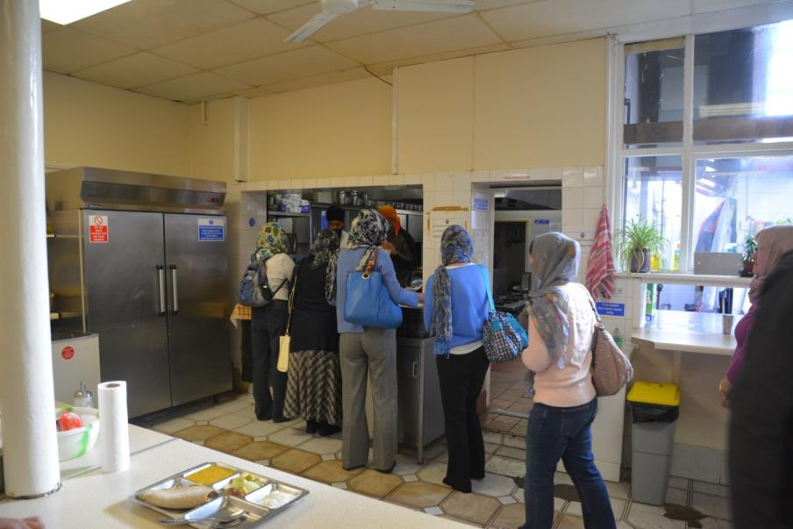
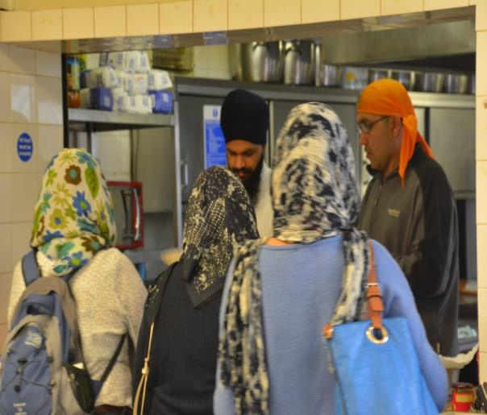
Sikhs serve each other – everyone takes their turn.
Anyone who visits the Gurdwara is given food

