Slide 1
Crossing the Bridges Project
Schools, SACREs and Places of Worship
working together
to enhance Religious Education
Pan-Berkshire
2017

Slide 2
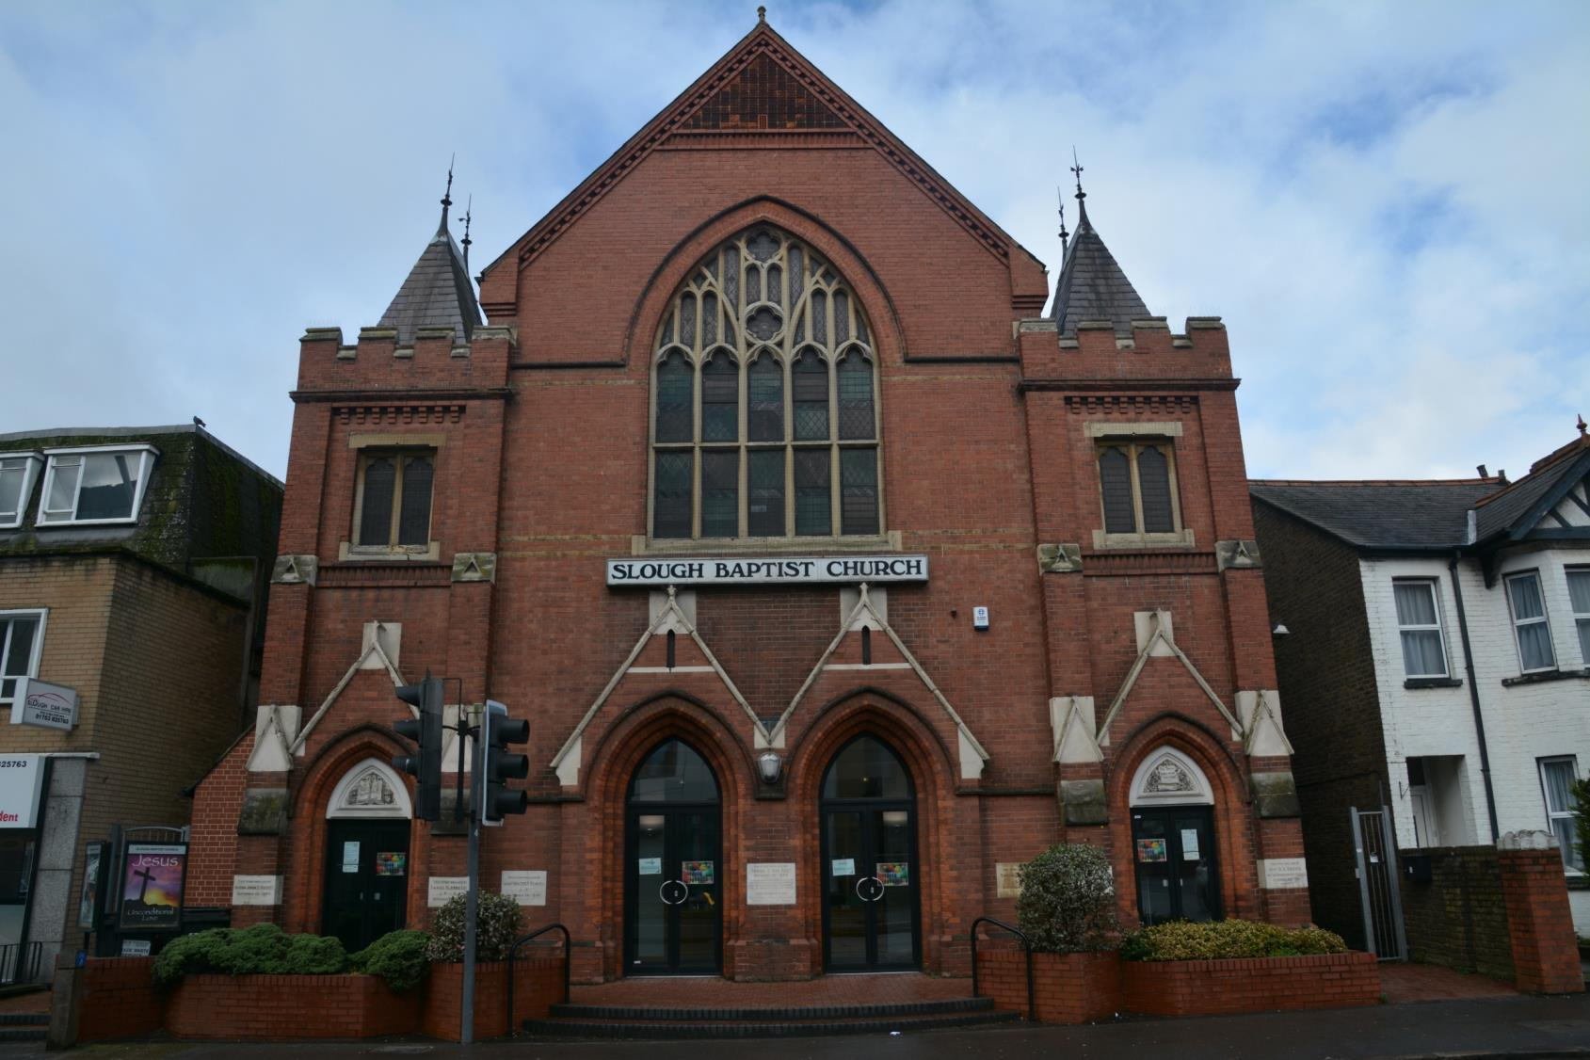
Slough Baptist Church

Slide 3
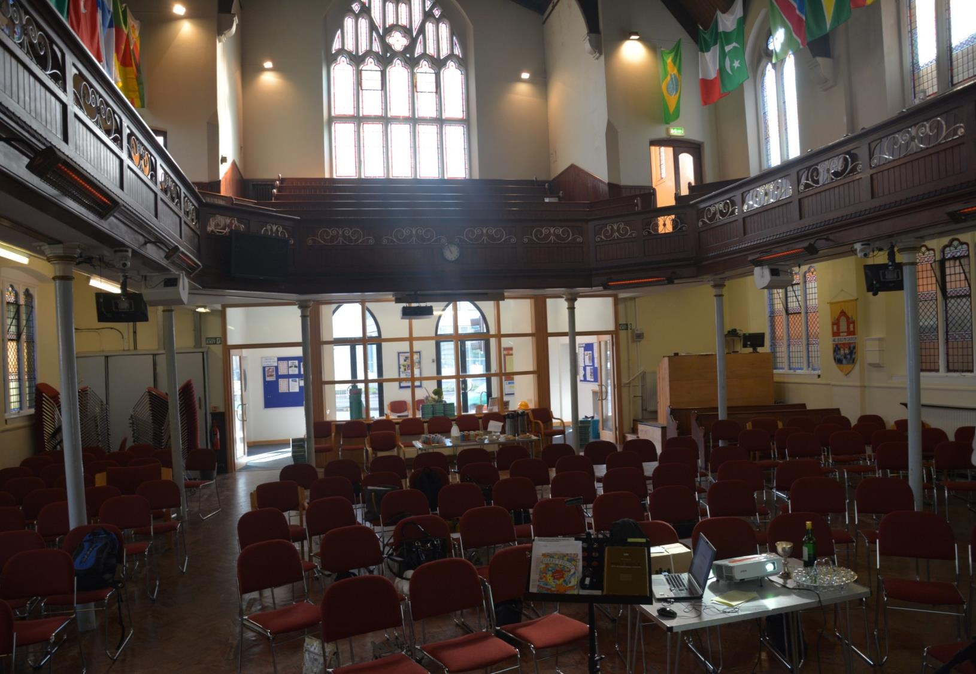
Inside this Baptist church there are modern seats which can be moved.
This allows many different activities to take place like school visits

Slide 4
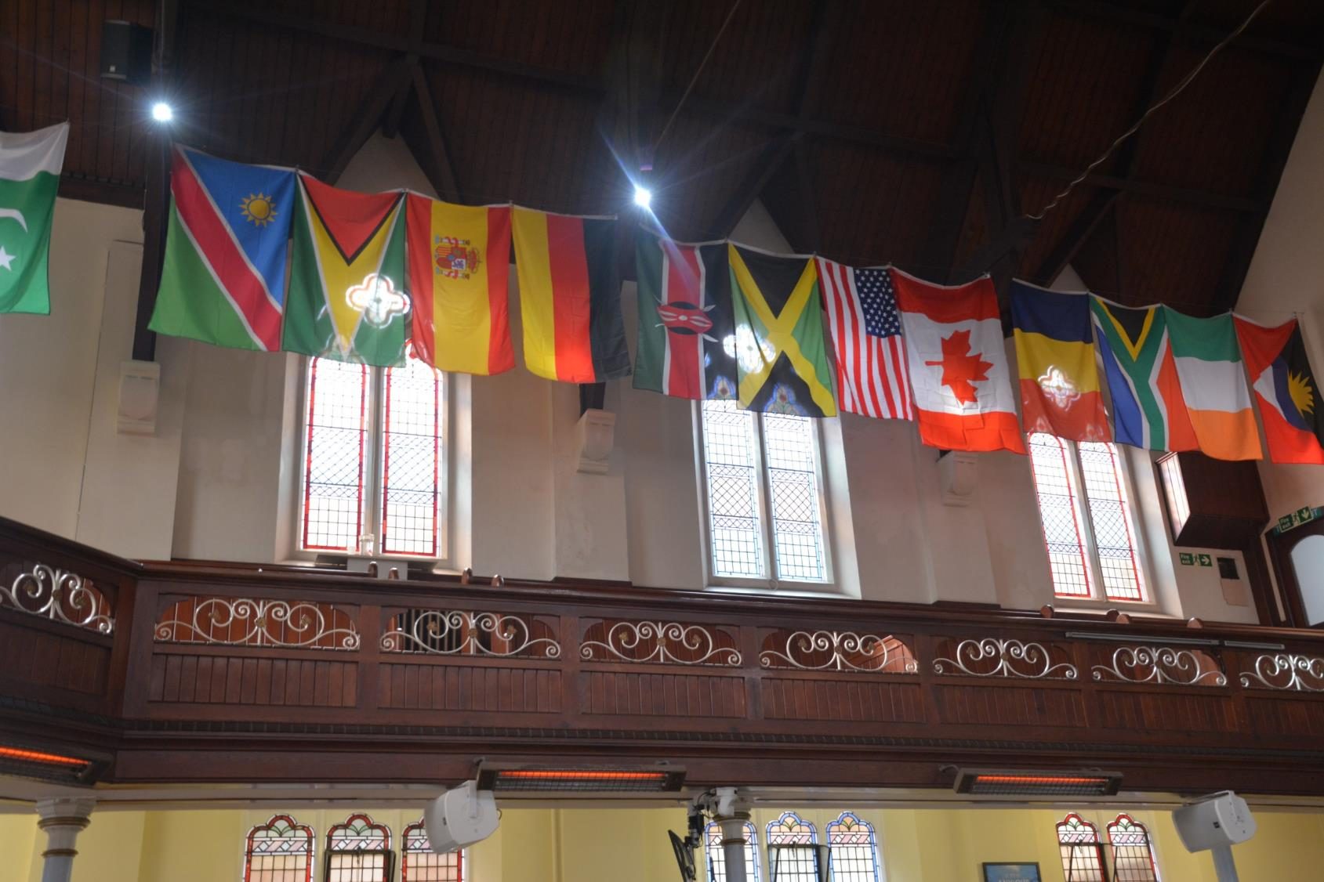
The flags show some of the home countries of people who worship there.

Slide 5
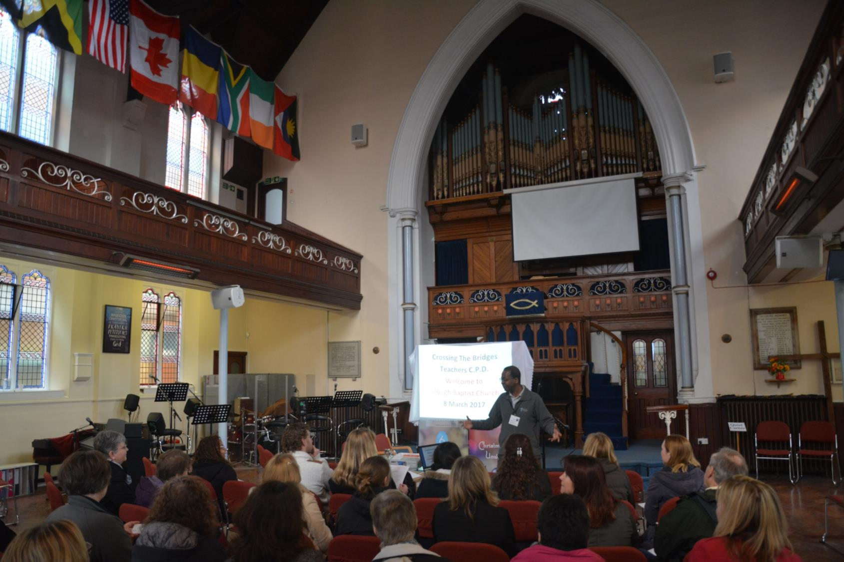
There is a musical area for modern instruments as well as a traditional organ

Slide 6
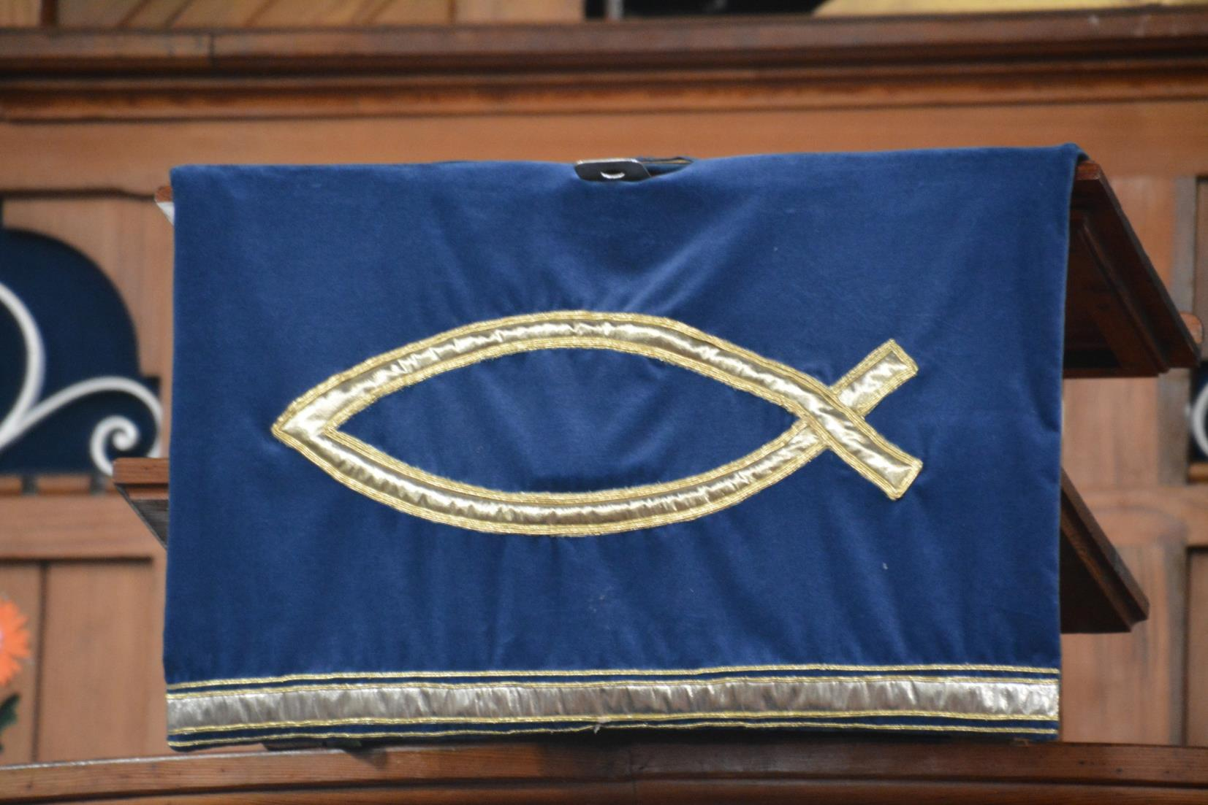
Many Christian symbols are present – for example this ICTHUS fish
Each letter in the Greek word ICTHUS stands for a word that explains what most Christians believe. All together the words read
‘Jesus Christ, Son of God, Saviour’

Slide 7
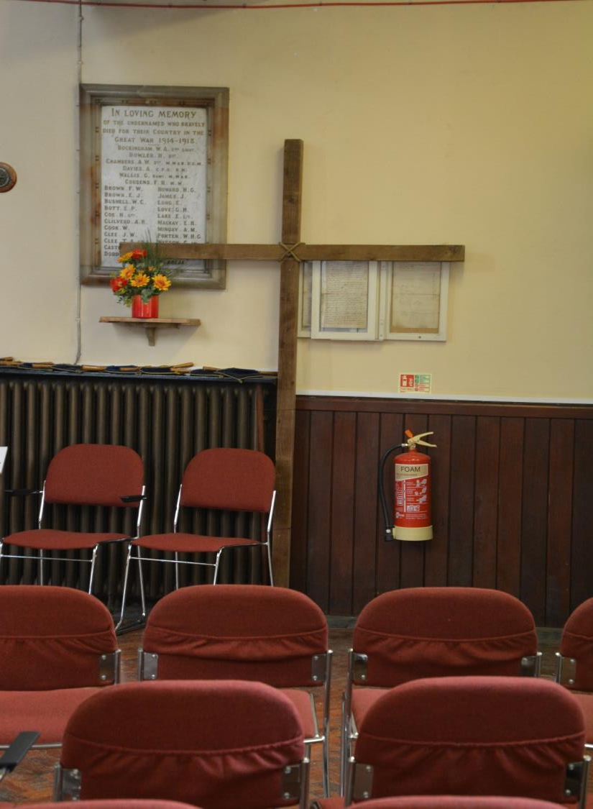
The cross is a reminder of Jesus’ death and resurrection

Slide 8
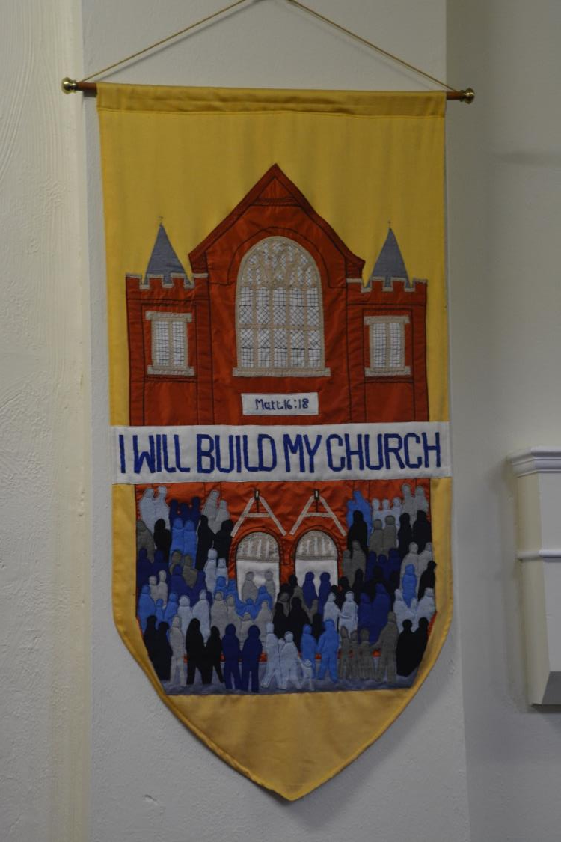
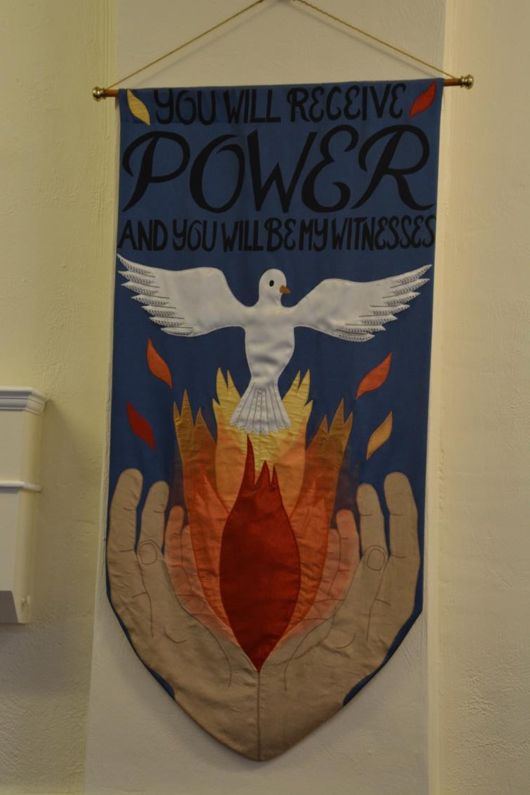
There are pennants hanging up in the church
They have supportive messages written on them
What do these mean?

Slide 9
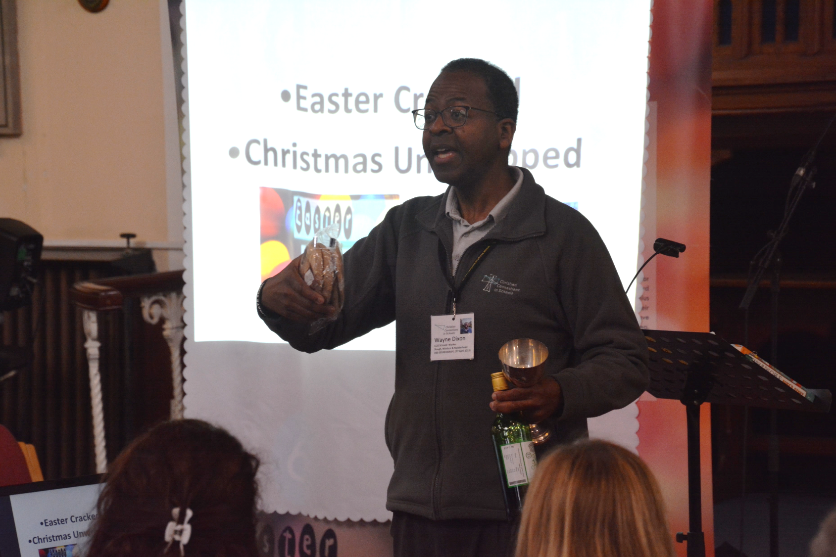
The bread and wine symbolise Jesus’ body and blood, his death and resurrection, and remember the Last Supper before Jesus was arrested.
In this Baptist church a non alcoholic drink replaces wine

Slide 10
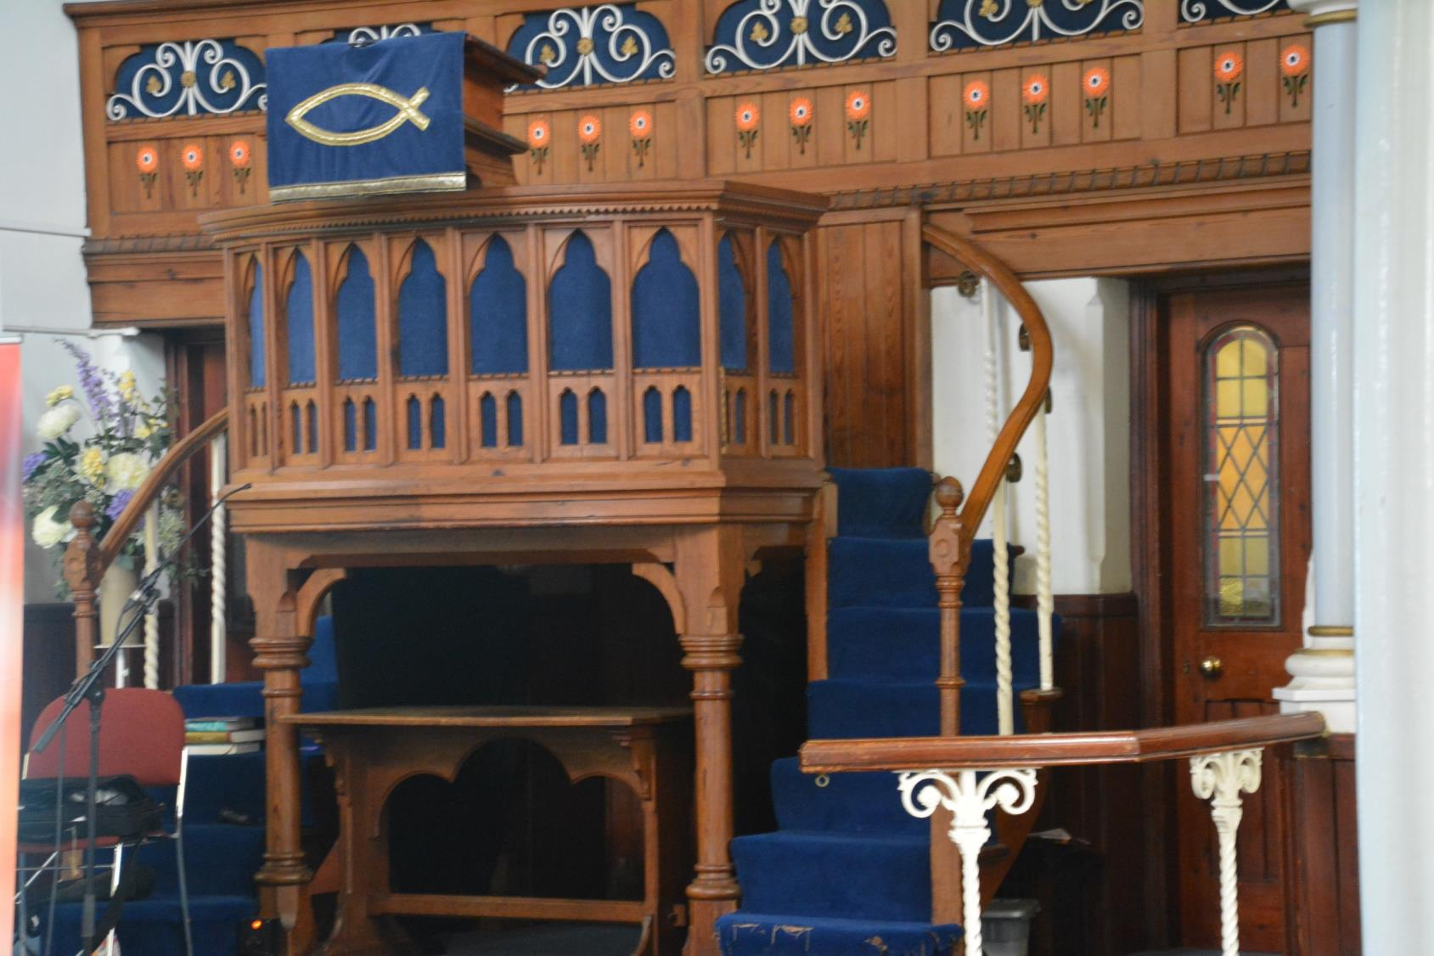
At the front of the church is a raised area called a pulpit.
This is so the speaker can be seen and heard by all

Slide 11
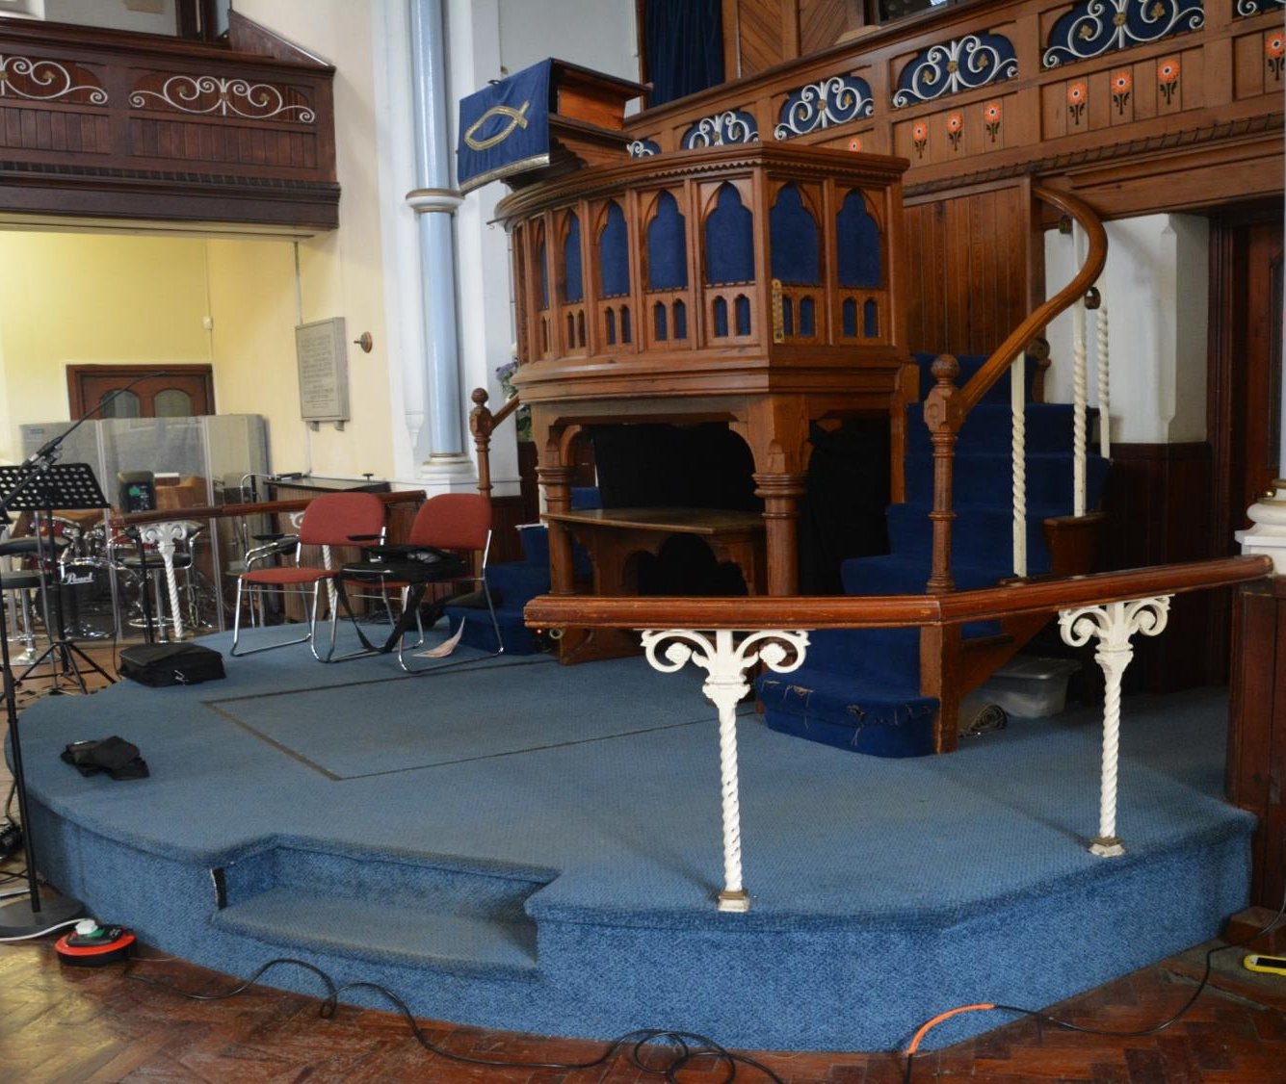
Adult Baptism
When people join the Baptist church they can choose to be baptised, being fully immersed in water. Jesus was baptised by John the Baptist.
Baptism under water is a way of showing you are having a fresh start with God.
Under the blue carpet is a large area for the baptism water

Slide 12
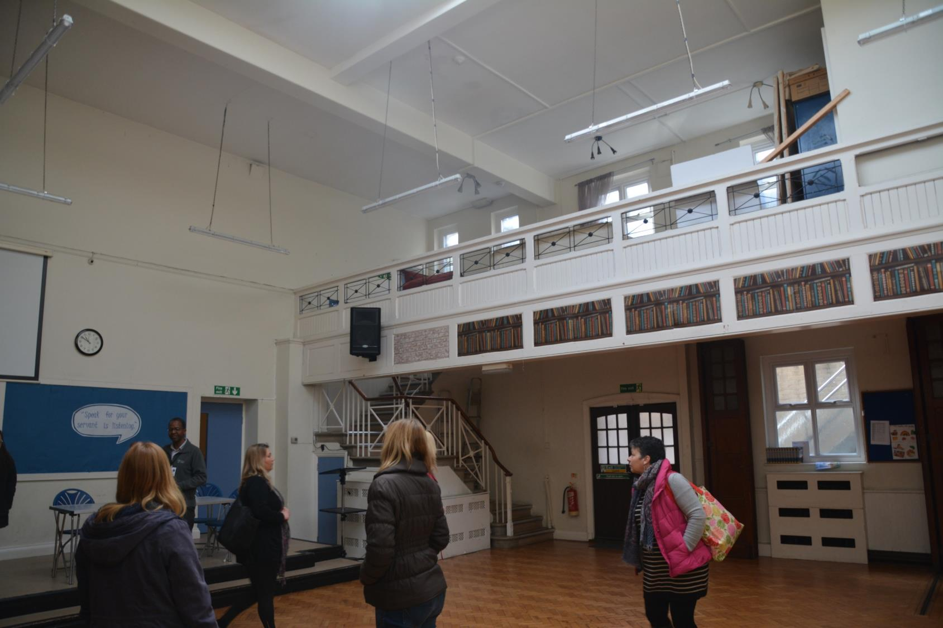
The church is very active in the local community. They host many different groups in a community room at the back of the church.
A food bank is run from a building next door.

Slide 13
Crossing the Bridges Project
Schools, SACREs and Places of Worship
working together
to enhance Religious Education
Pan-Berkshire
2017

