Slide 1
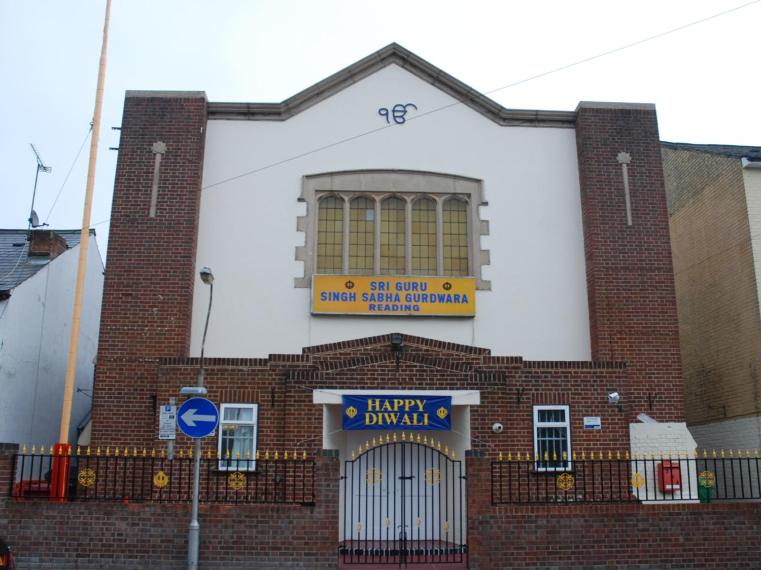
The Sikh Gurdwara in Reading

Slide 2
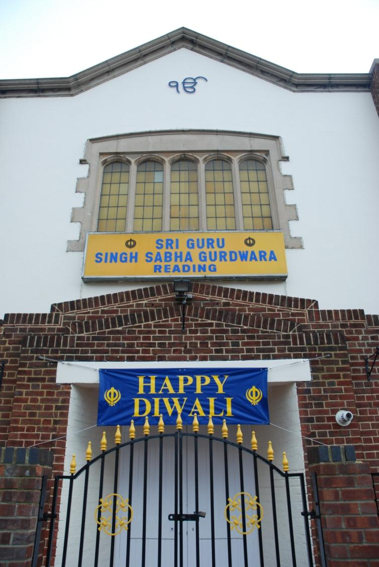
Symbols of Sikhism
Ik Onkar
is a symbol which appears at the beginning the Sikh scripture and means, "One With Everything".
The symbol Ik Onkar gives the idea of one creative being, or
one God.

Slide 3
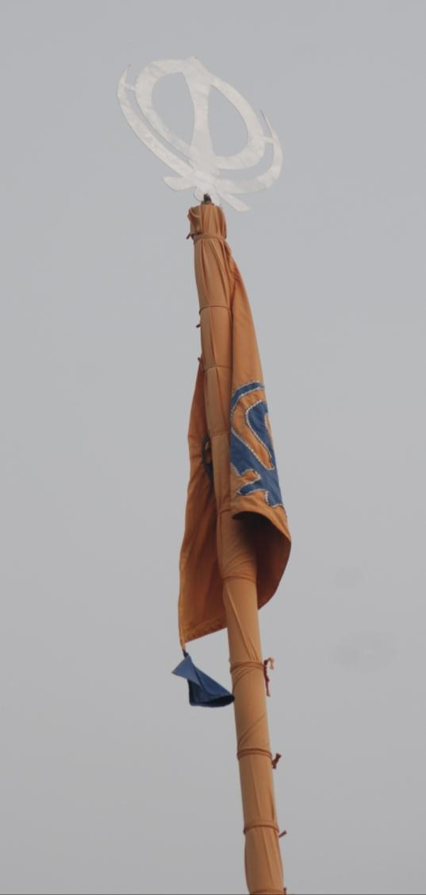
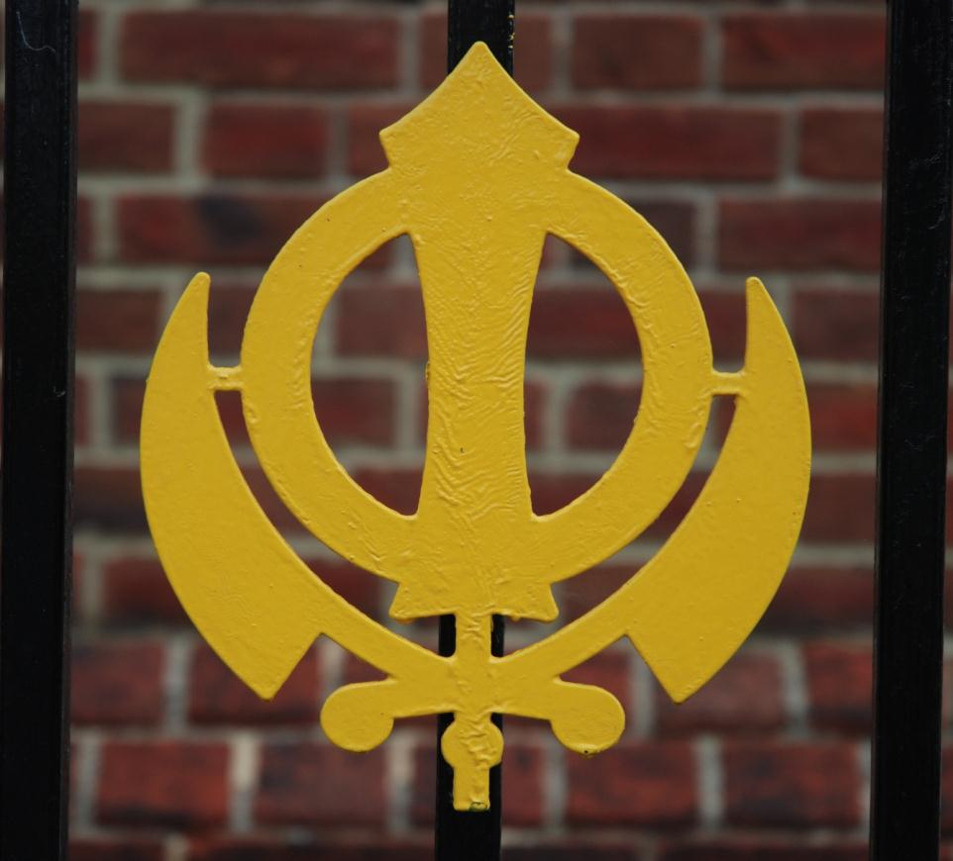
Nishan Sahib
Khanda

Slide 4
The Khanda is a symbol in 3 parts – it stands for God being eternal and also for truth.
Khanda
Nishan Sahib
It reminds Sikhs of their duty to God as well as to the community.

Slide 5
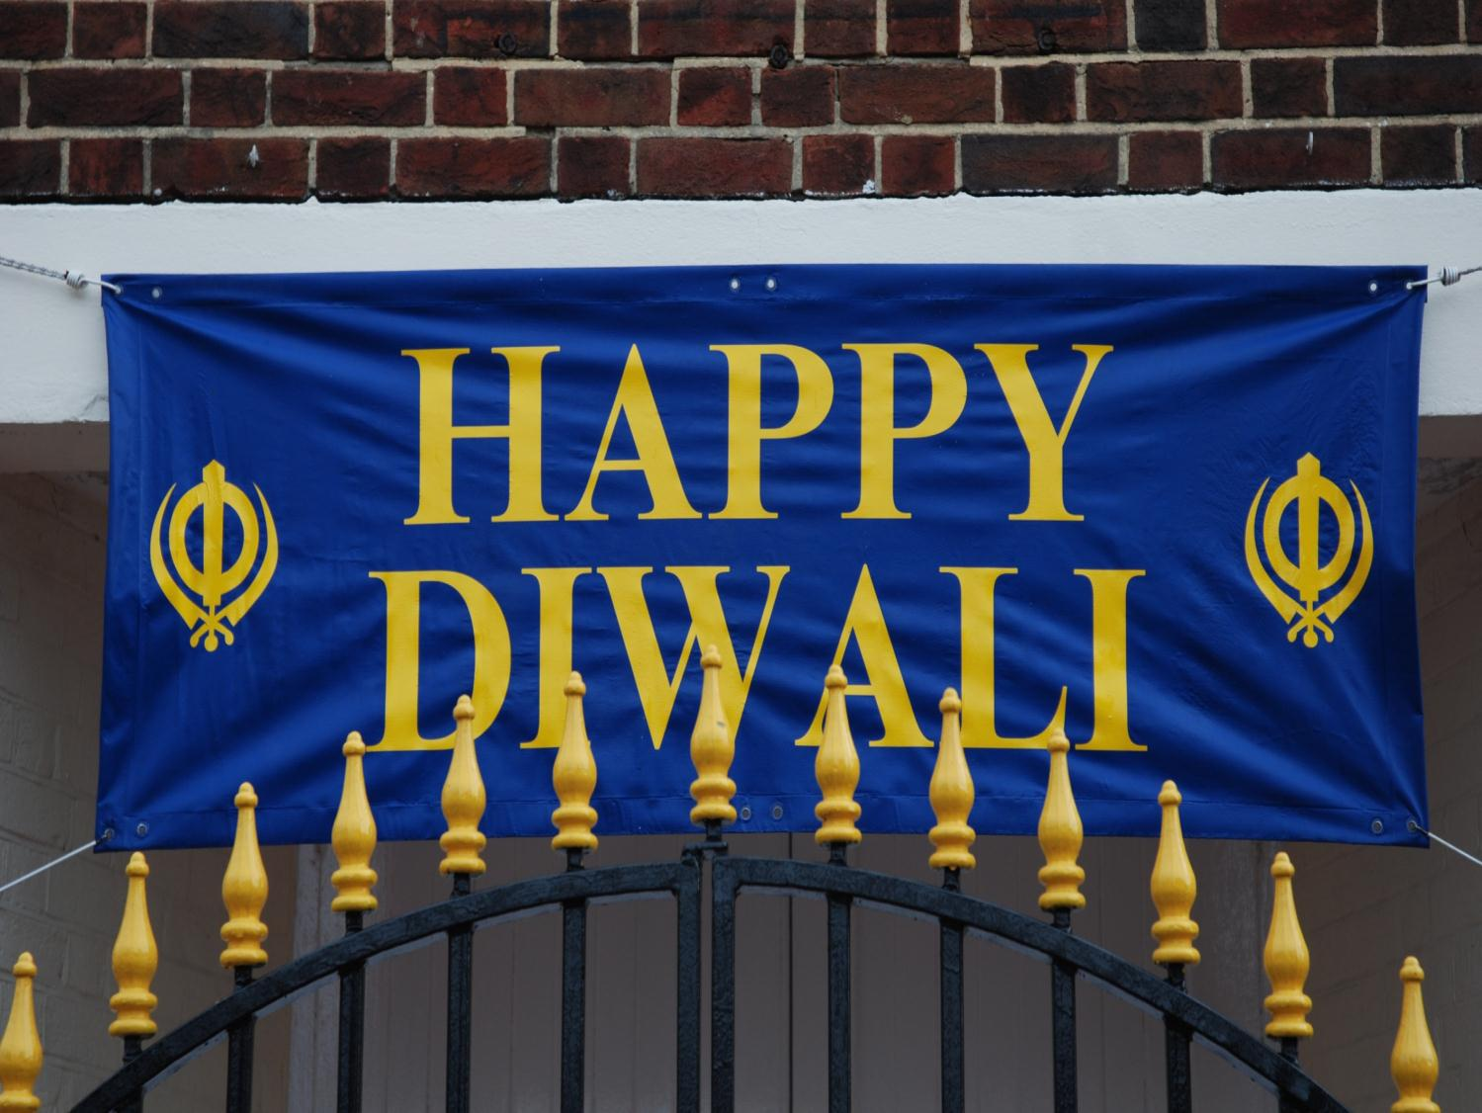
Festival banners are put up to help celebrate

Slide 6
As a sign of respect, Sikhs take off their shoes inside the Gurdwara and put them in a shoe rack

Slide 7
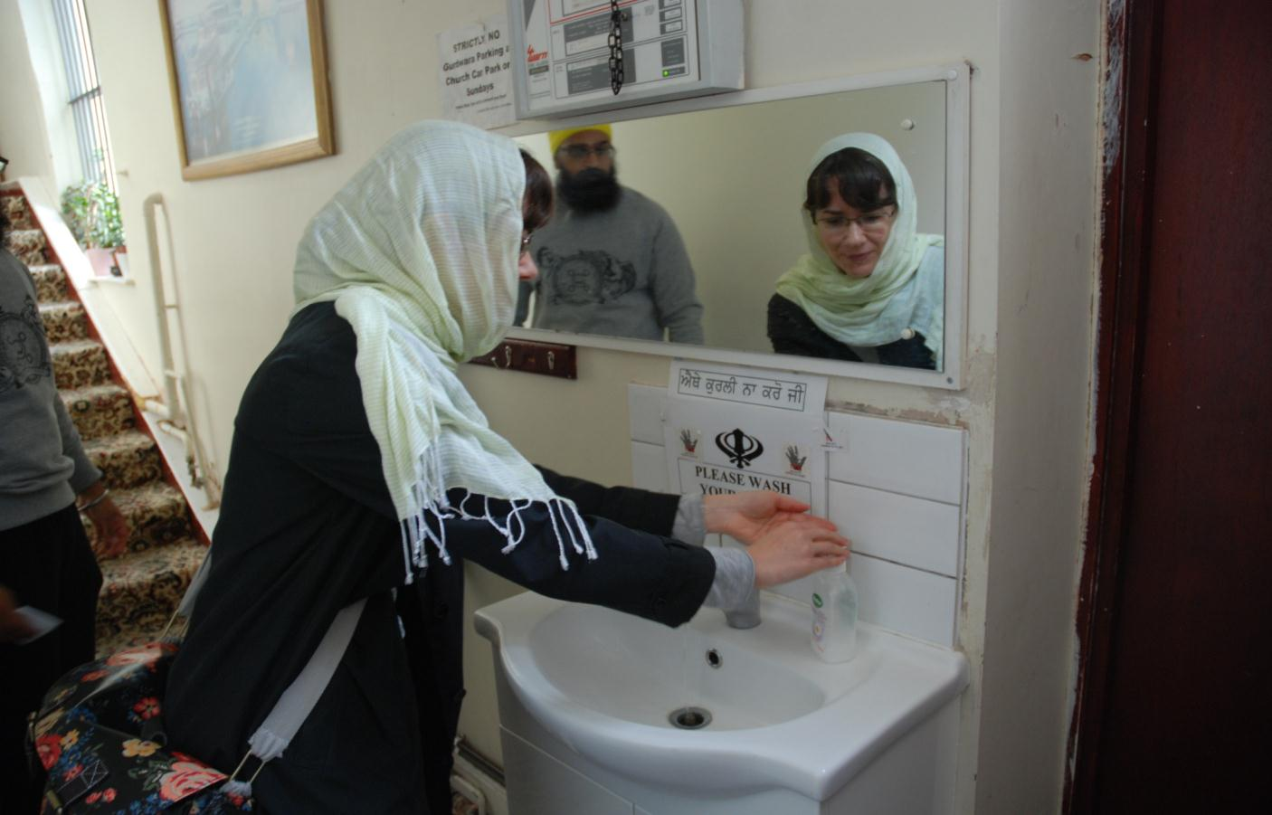
Sikhs also cover their heads and wash their hands before worship

Slide 8
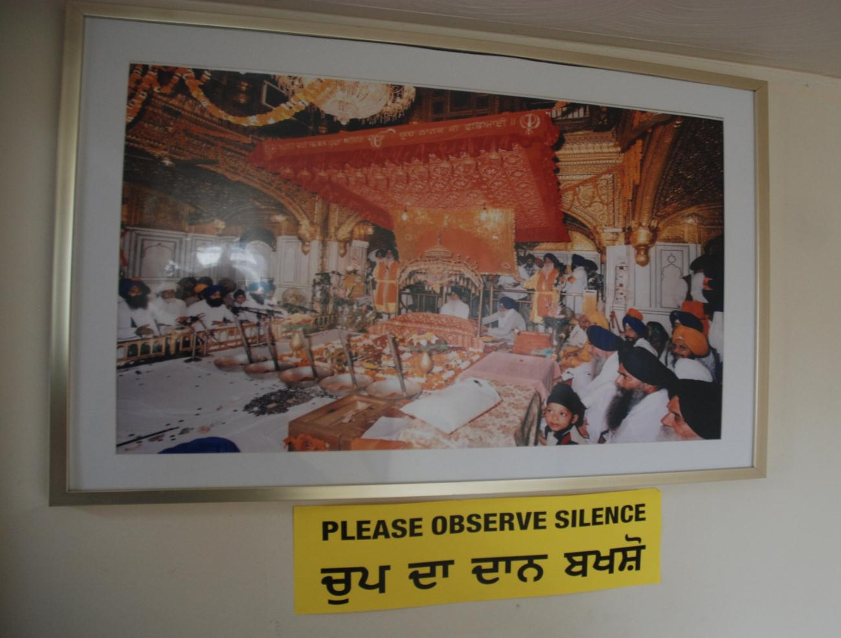

Slide 9
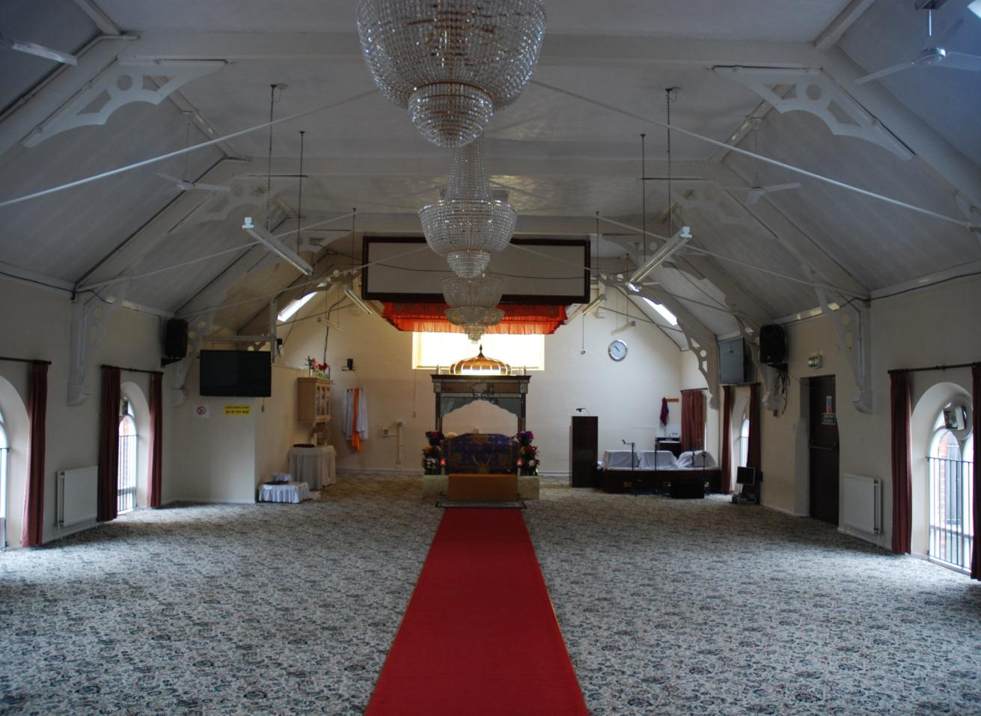
Inside the prayer room

Slide 10
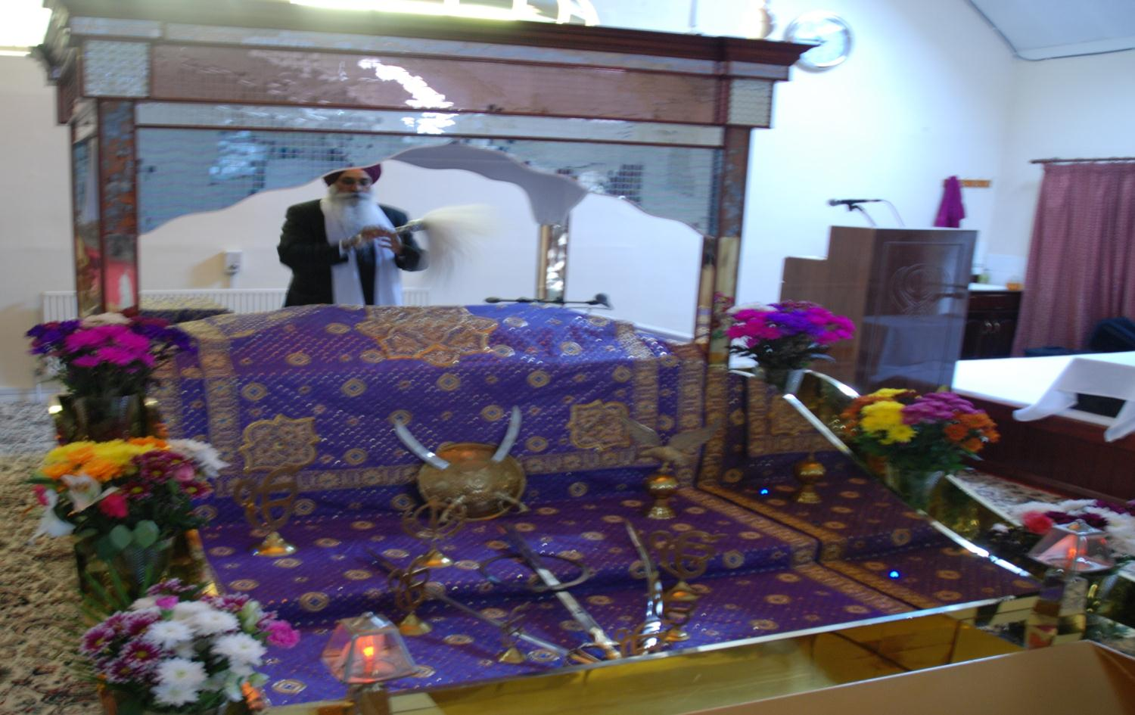
The Holy Book, The Guru Granth Sahib is treated
with great respect

Slide 11
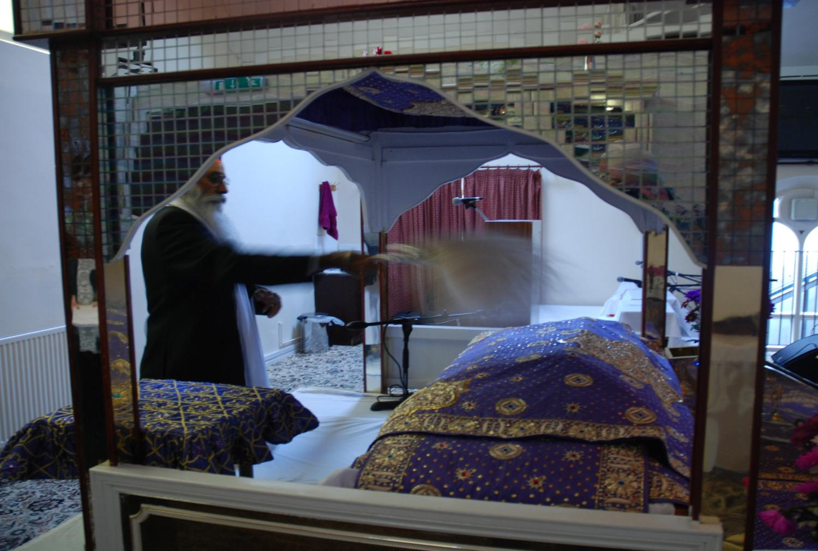
The Guru Granth Sahib is covered when not being read

Slide 12
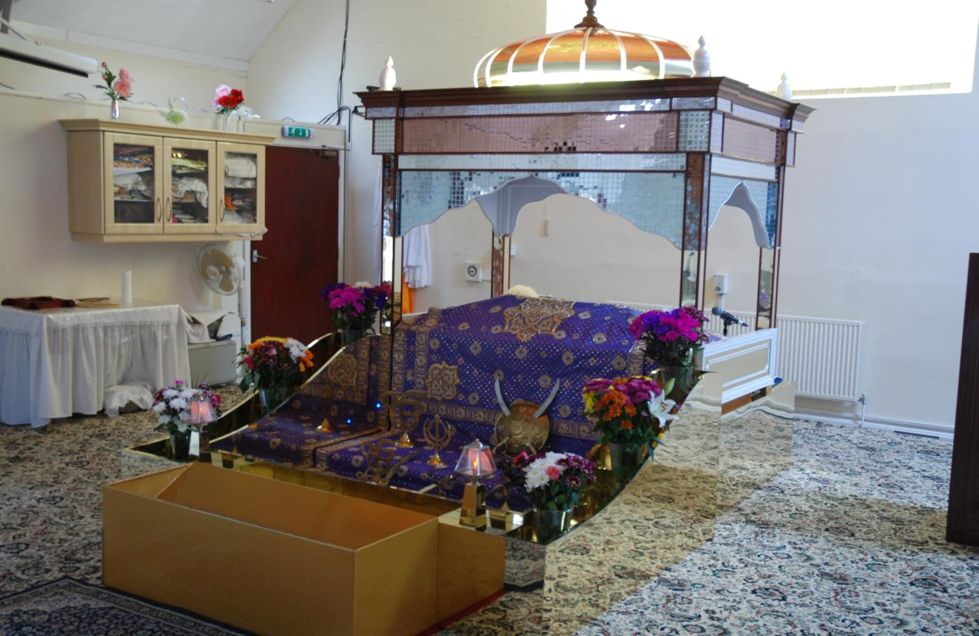
canopy
The Guru Granth Sahib has a canopy over it to show that it is important

Slide 13
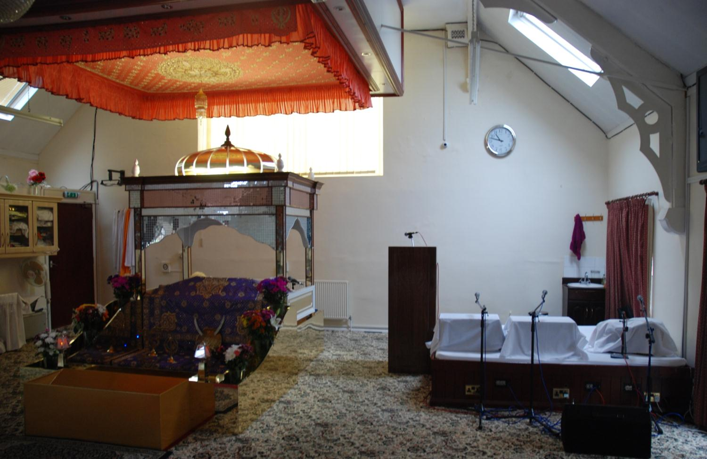
There is also a special place for the musicians to sit

Slide 14
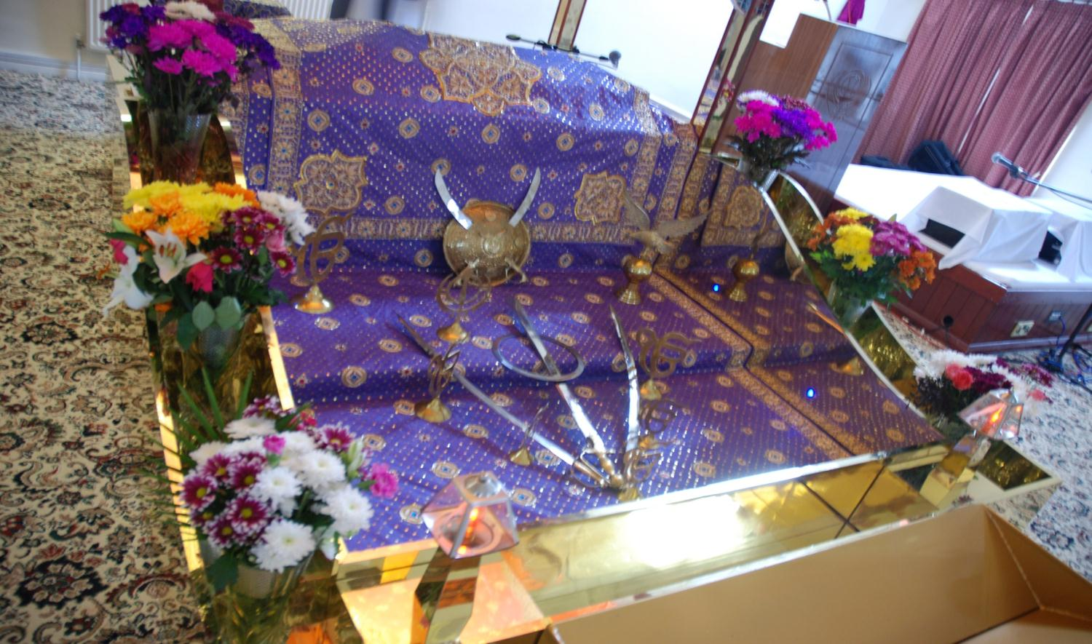
There are symbols and offerings in front of the
Holy Book

Slide 15
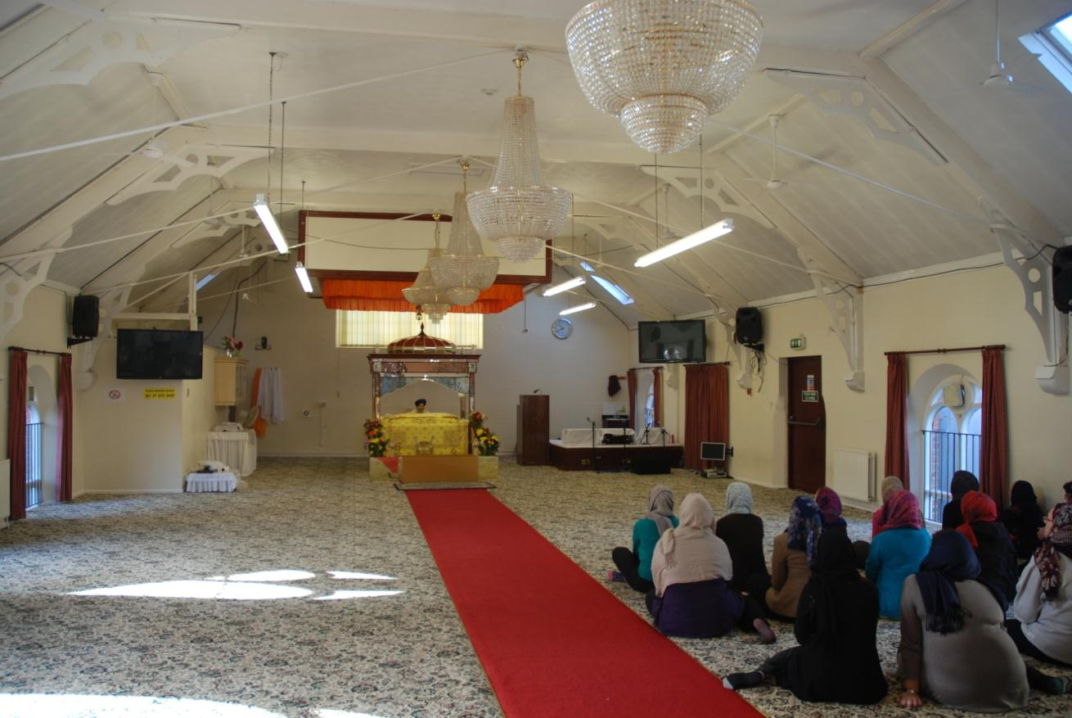
Everyone sits on the floor to show that all are equal

Slide 16
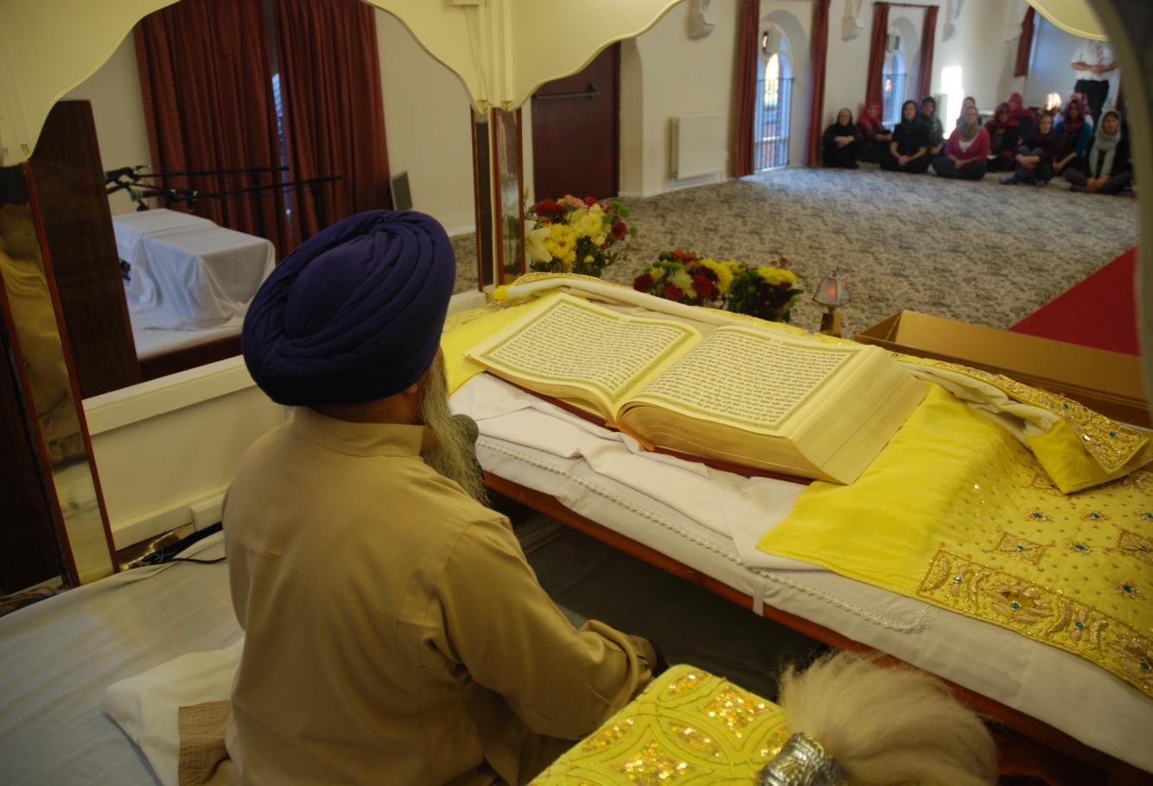
The Guru Granth Sahib is read during worship.
It is a collection of poems praising God

Slide 17
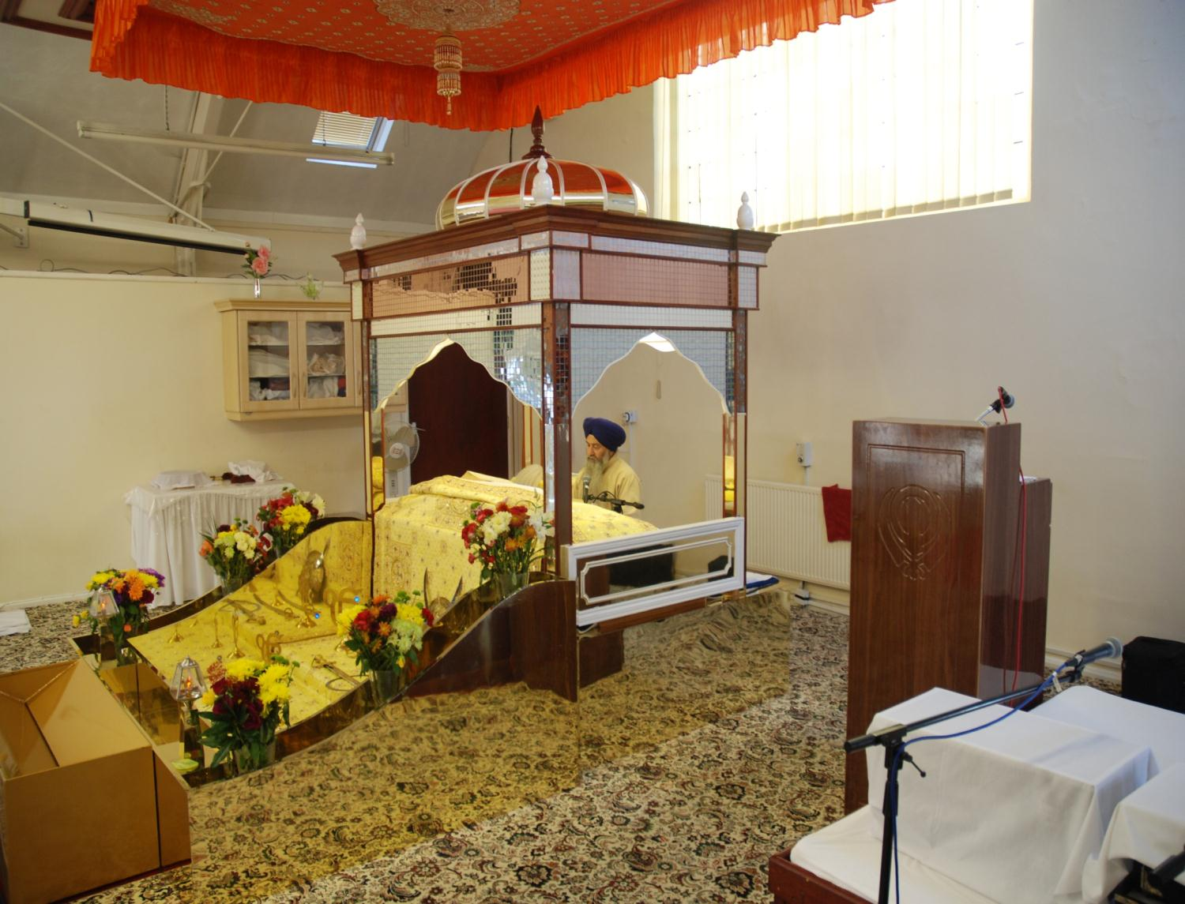

Slide 18
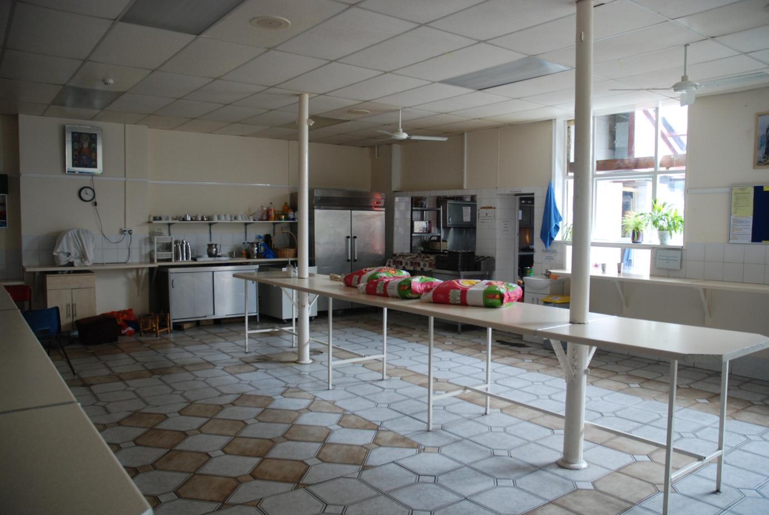
Sikhs believe in sharing. At the end of every service a meal is prepared for the community in special kitchens at the Gurdwara

Slide 19
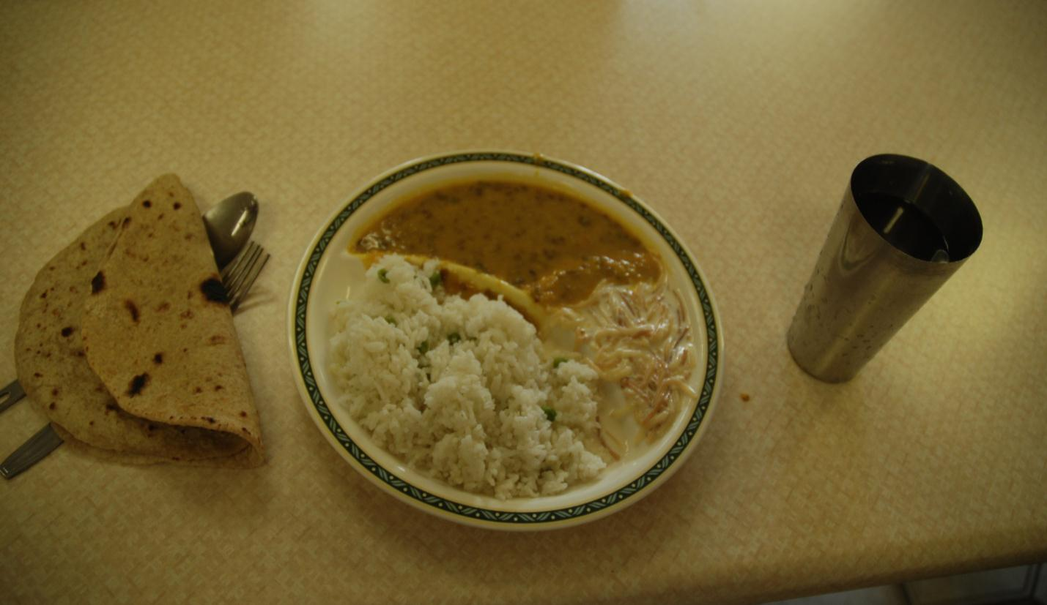
The food is always vegetarian and includes rice

Slide 20
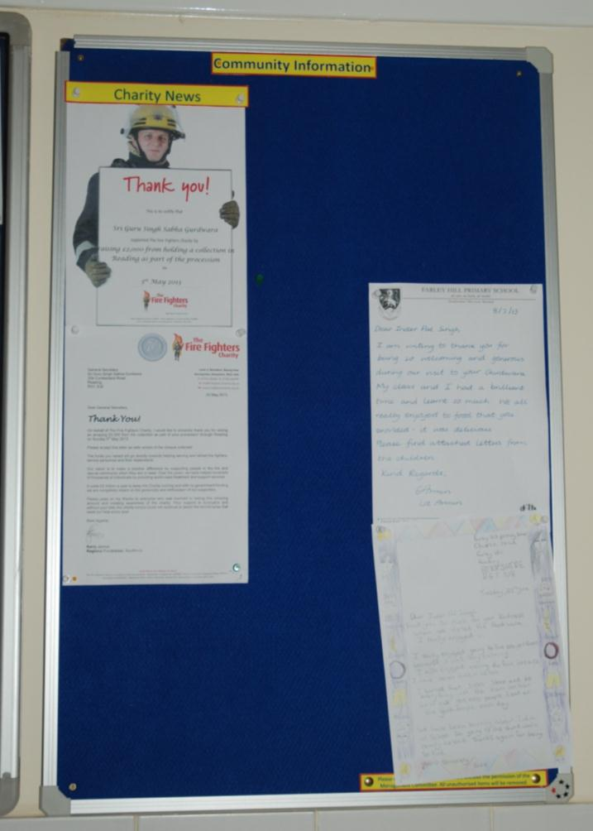
The Gurdwara is also a place for the Sikh community to meet together.
There are notice boards where community information can be shared

