Slide 1
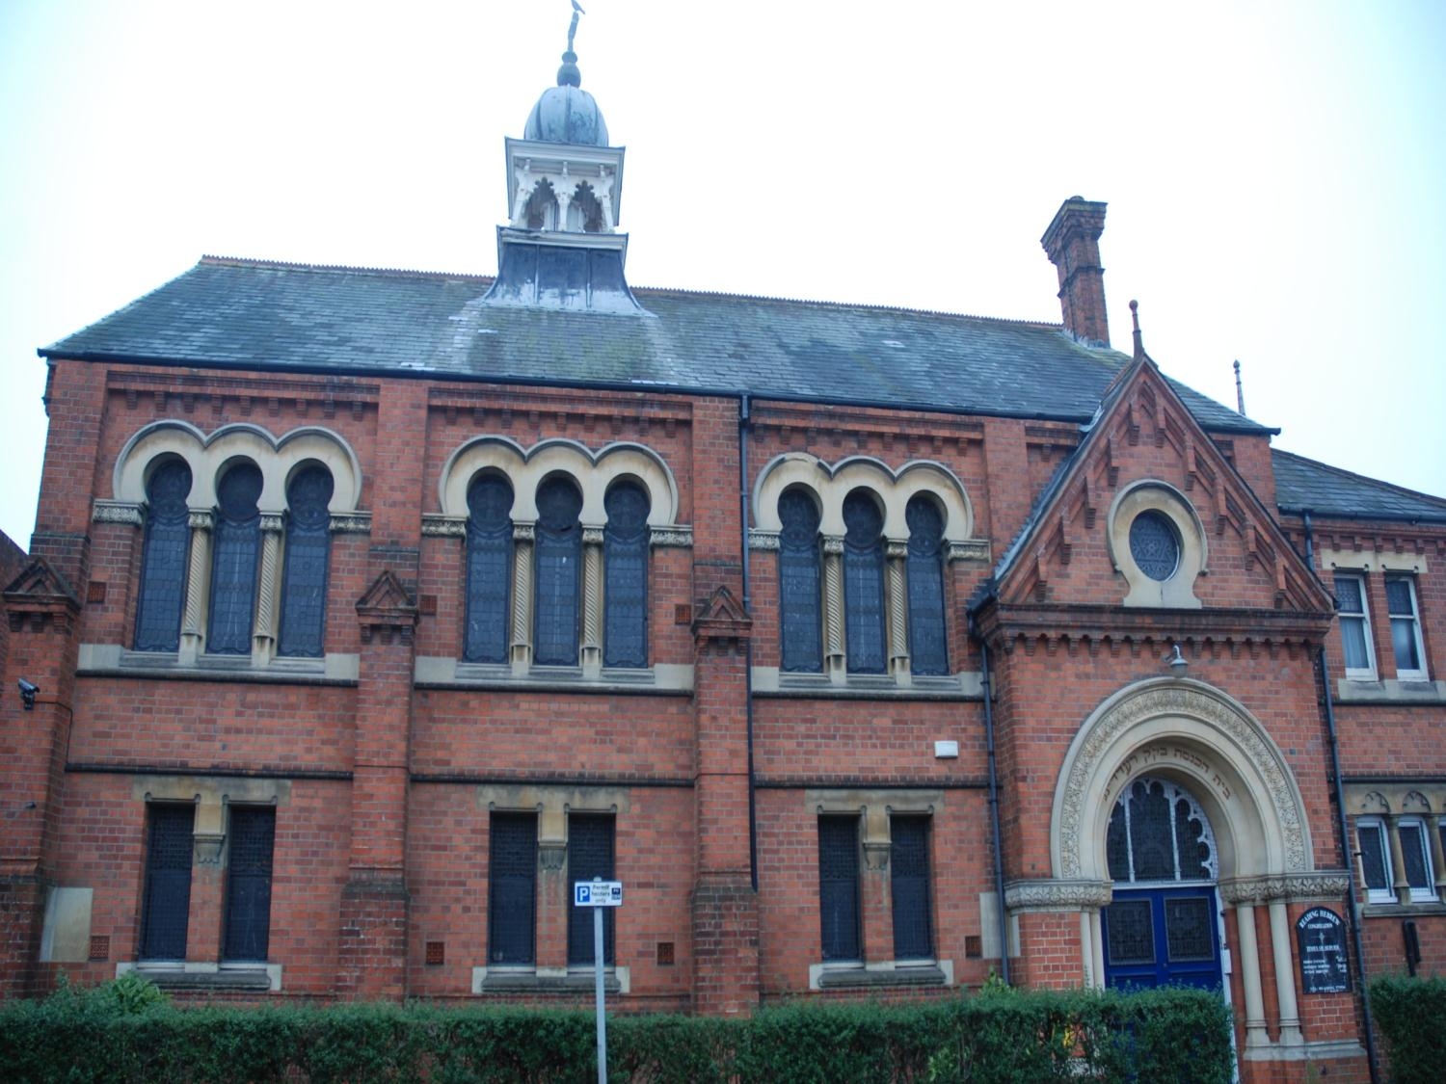
The Synagogue in Reading

Slide 2
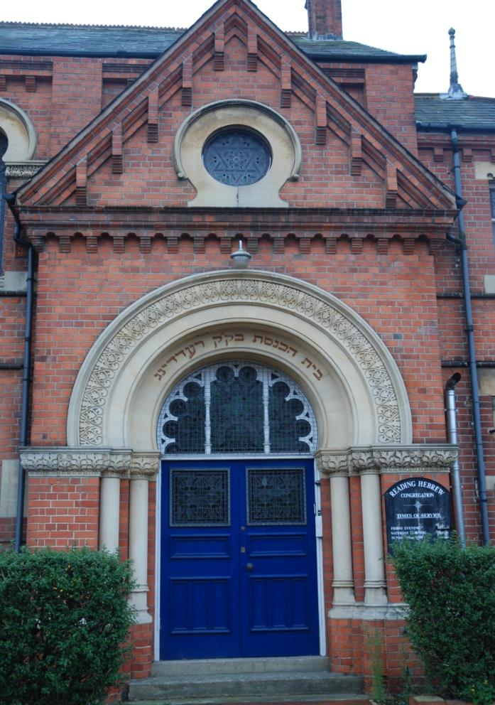
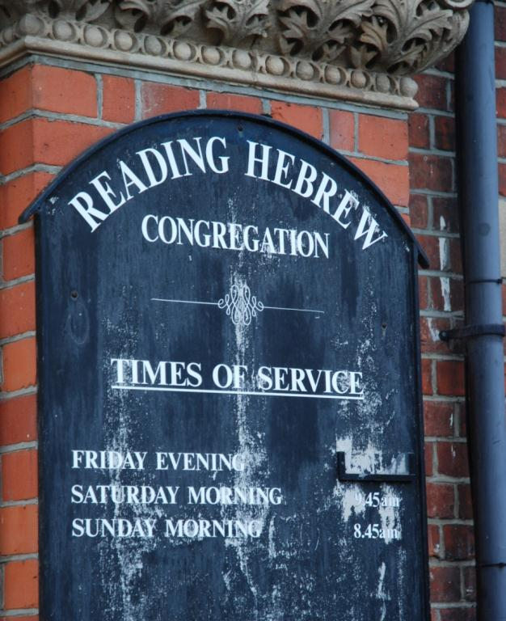
How can you tell it’s a synagogue?

Slide 3
The Star of David
Hebrew
writing

Slide 4
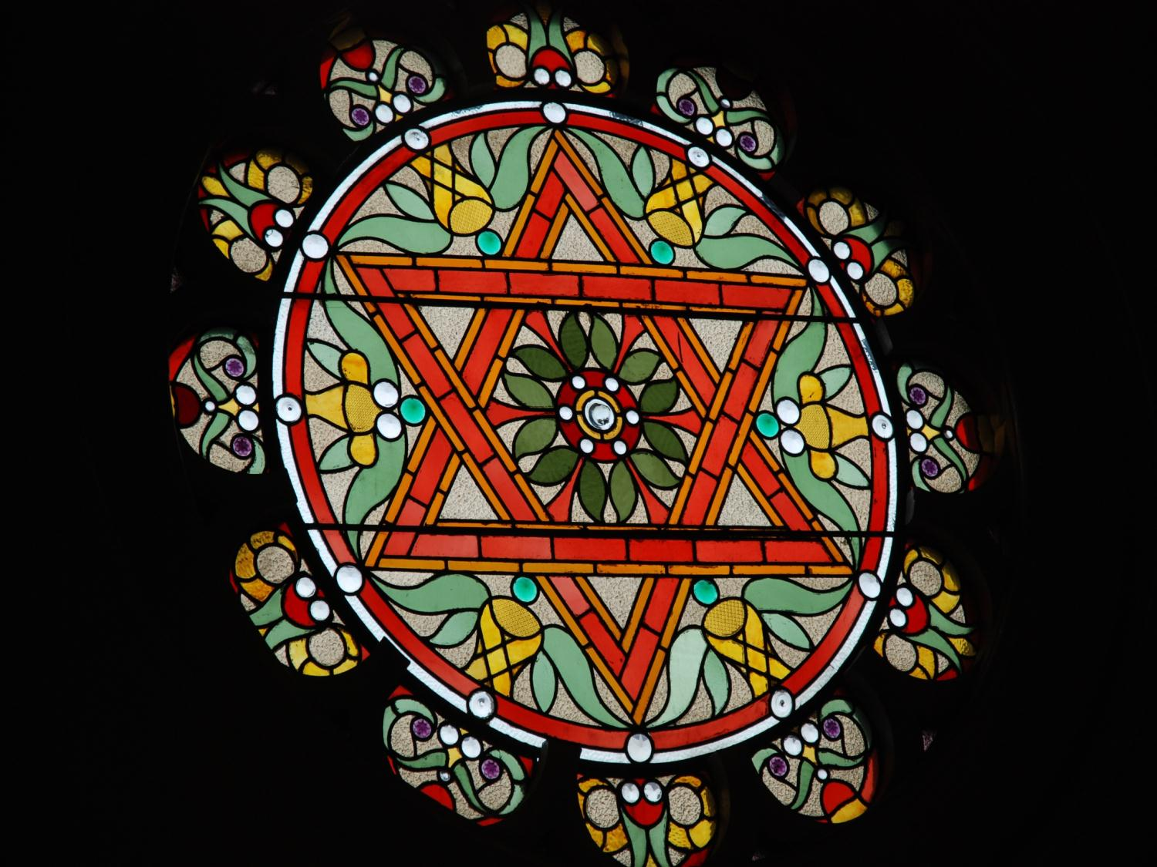
The Star of David

Slide 5
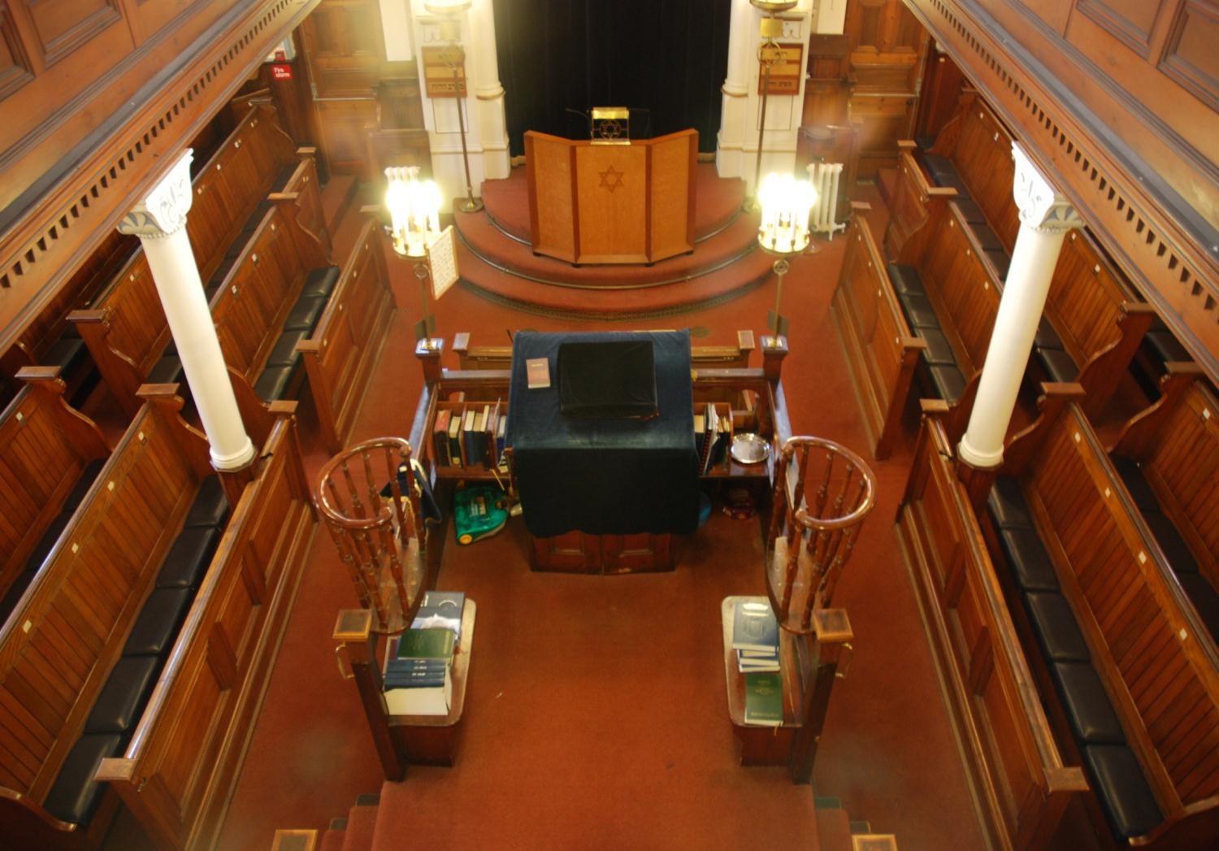
Inside the synagogue

Slide 6
Ark
Seats
Seats
Bimah (platform)
This is where the
Rabbi stands

Slide 7
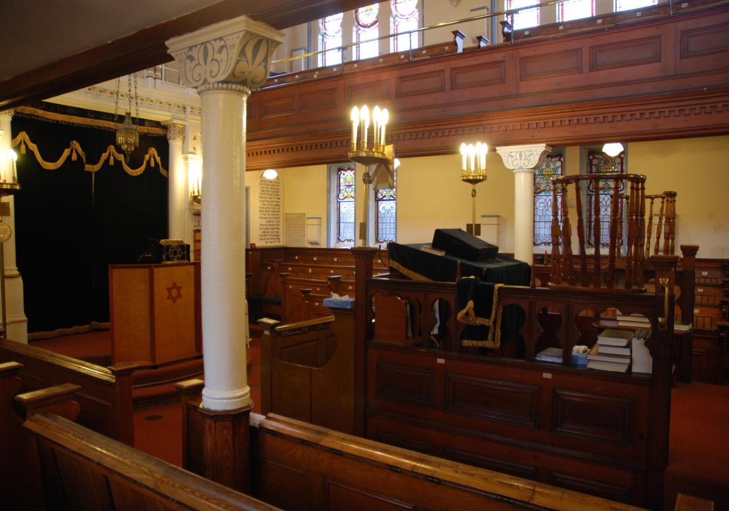
Women sit upstairs
Men sit downstairs
Children under 12 sit wherever they like

Slide 8
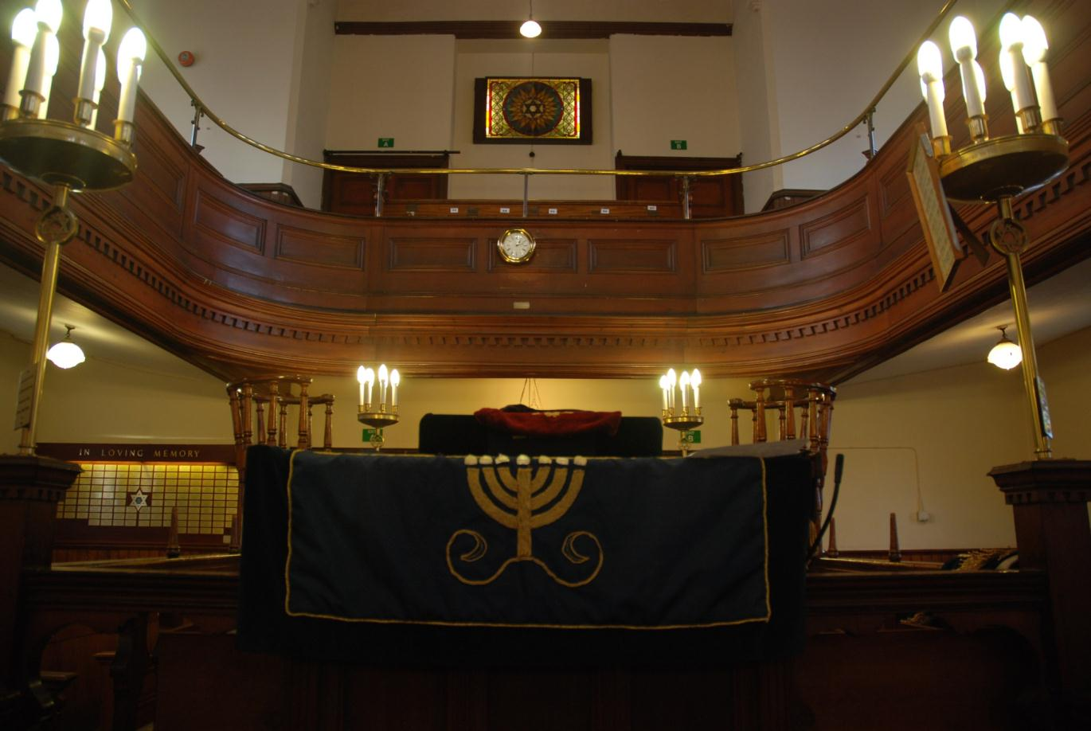
The Menorah is a Jewish symbol

Slide 9
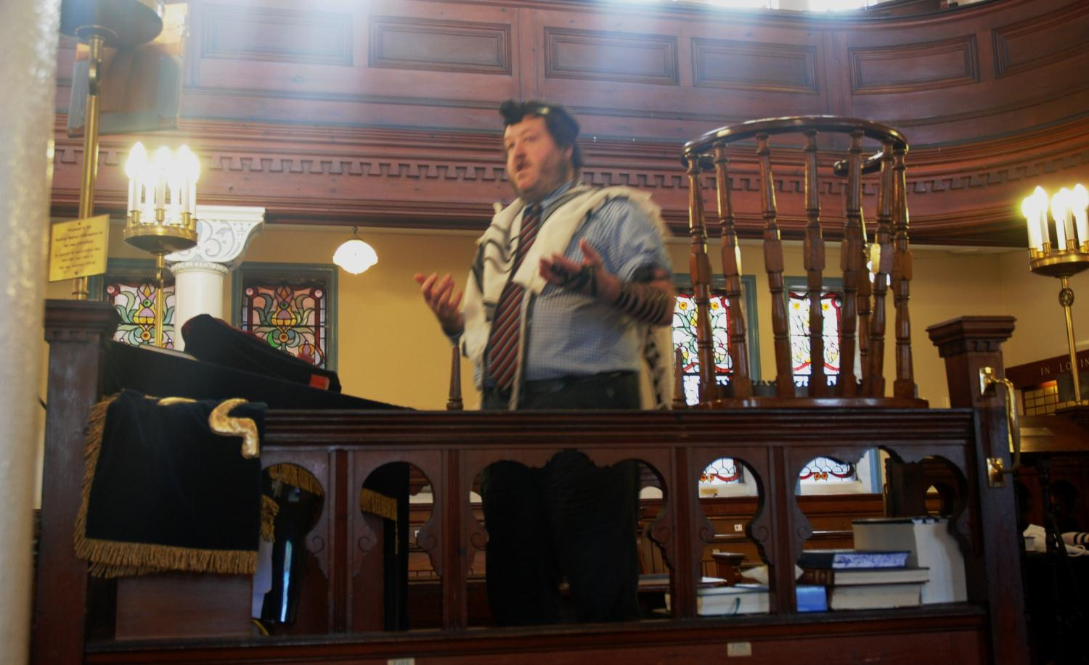
The Rabbi wears special clothes and stands on the Bimah to speak

Slide 10
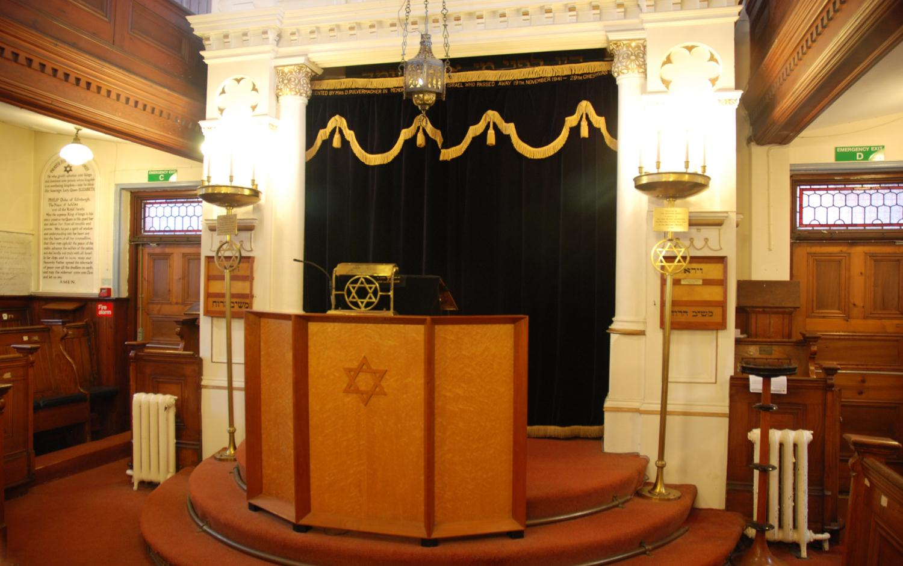
The holiest place in the synagogue is the Ark.
It is behind a curtain and contains the Holy books

Slide 11
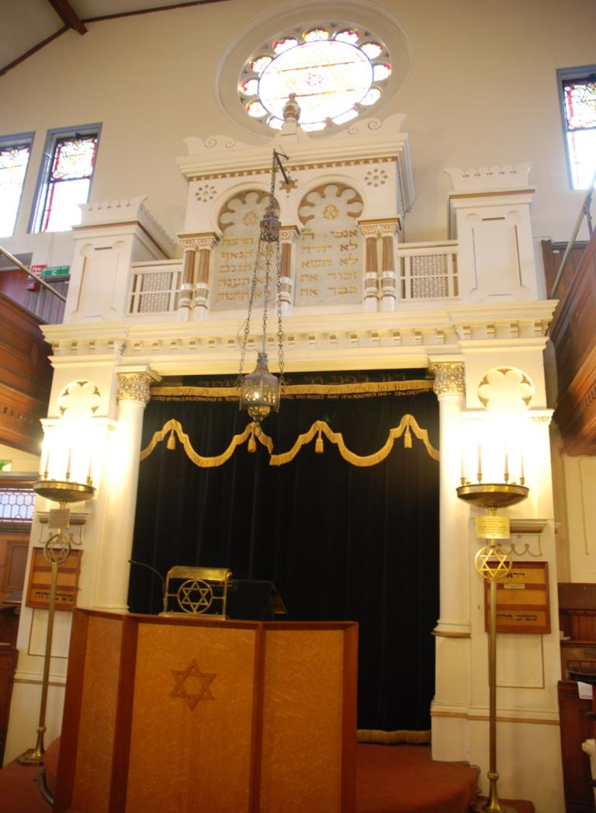
Above the Ark
are
2 stone tablets that stand for the
10 commandments that God
gave to Moses

Slide 12
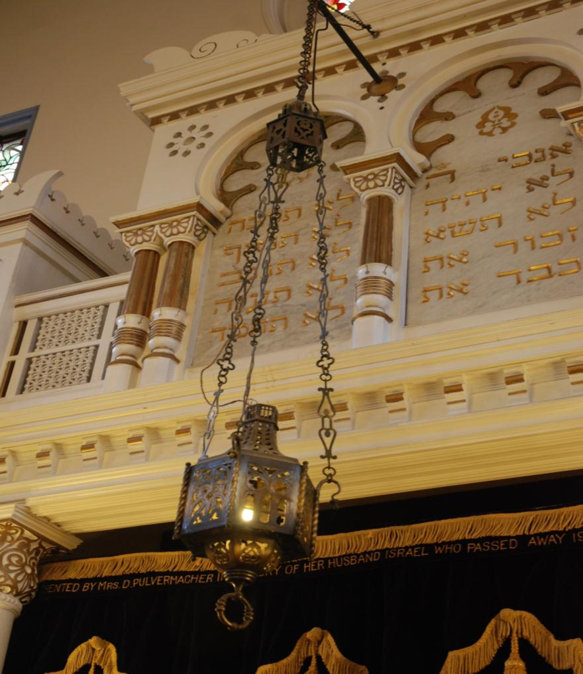
The Ner Tamid (ever- burning lamp) is a symbol that God is always present

Slide 13
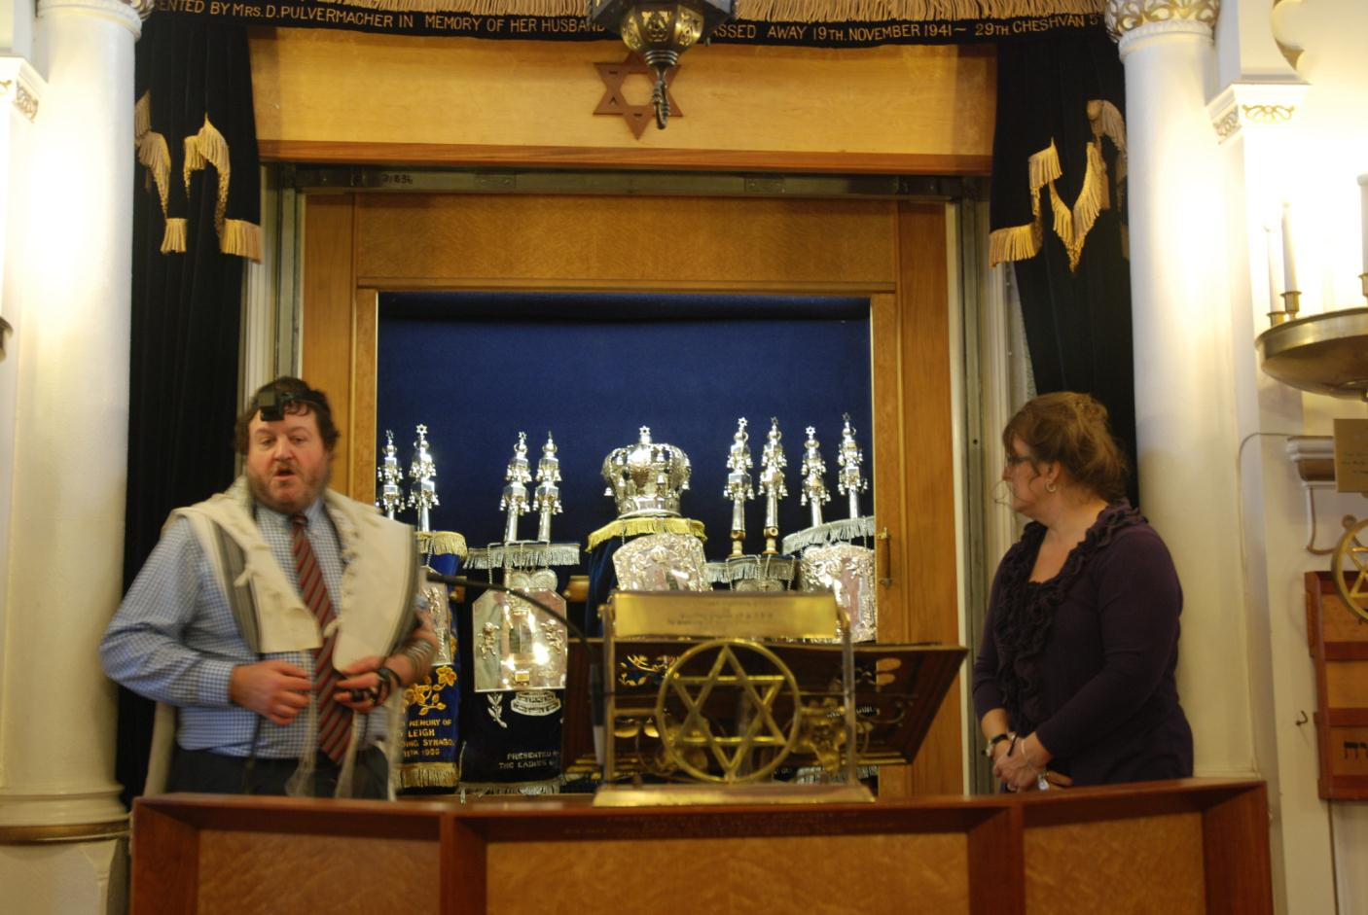
Inside the Ark are several copies of the Torah scrolls

Slide 14
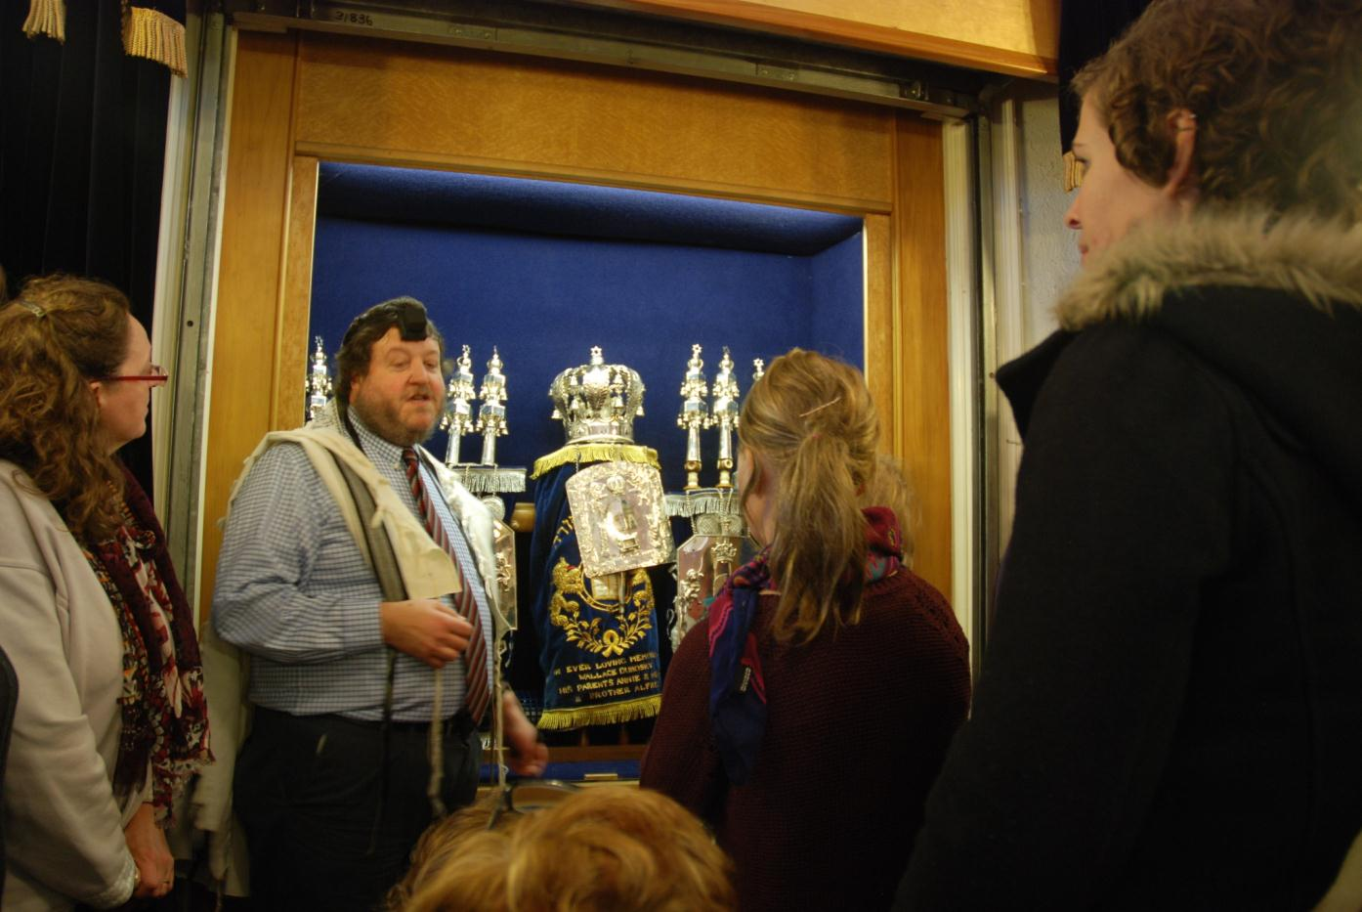
The scrolls contain the word of God so they are treated with great respect

Slide 15
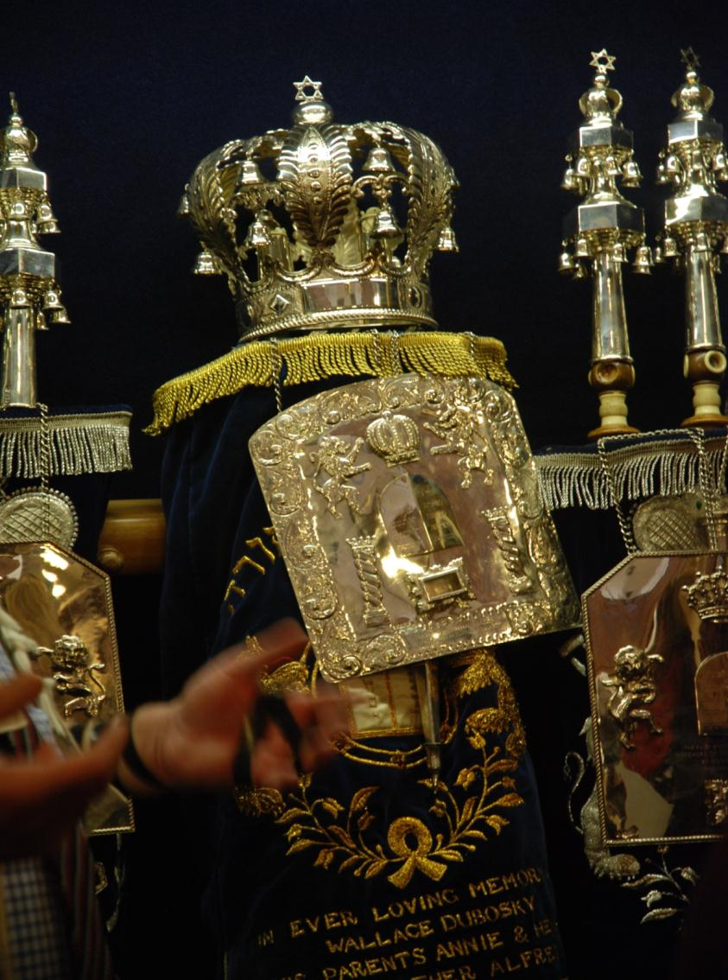
Each scroll has a special covering called a mantle.
When unrolled the scrolls are read but not touched by hand as this would damage them

Slide 16
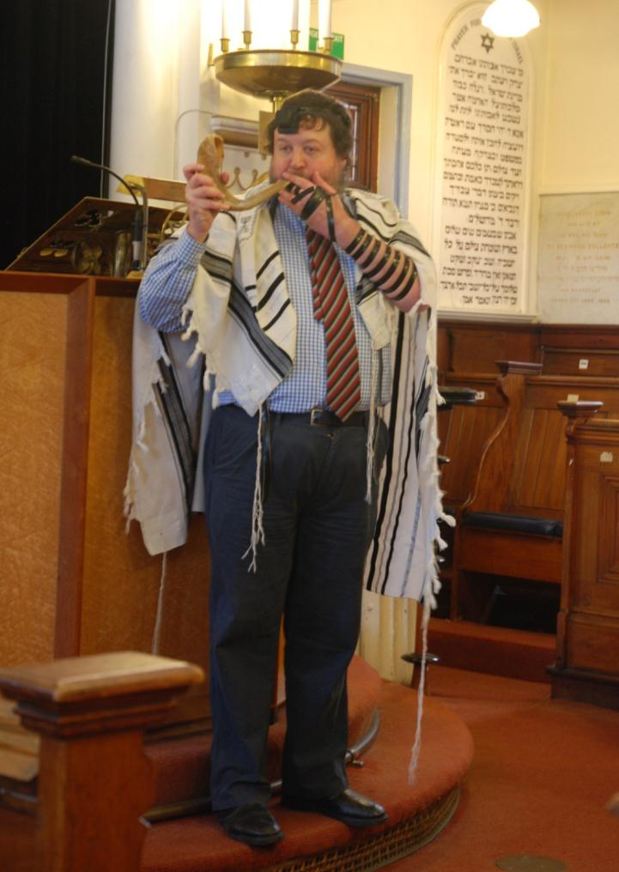
The rabbi sometimes blows a special horn called a Shofar
He is wearing a special
prayer shawl called
a Tallit

Slide 17
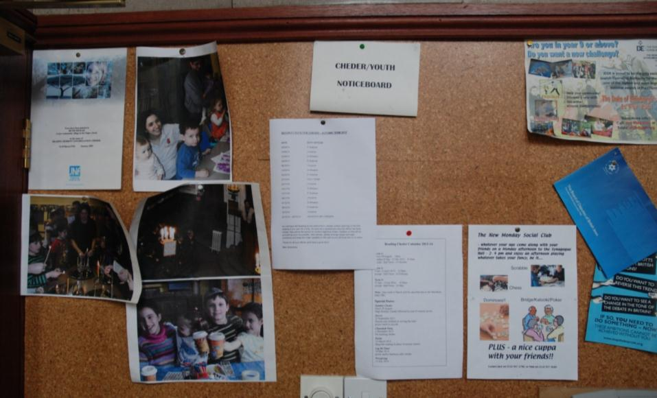
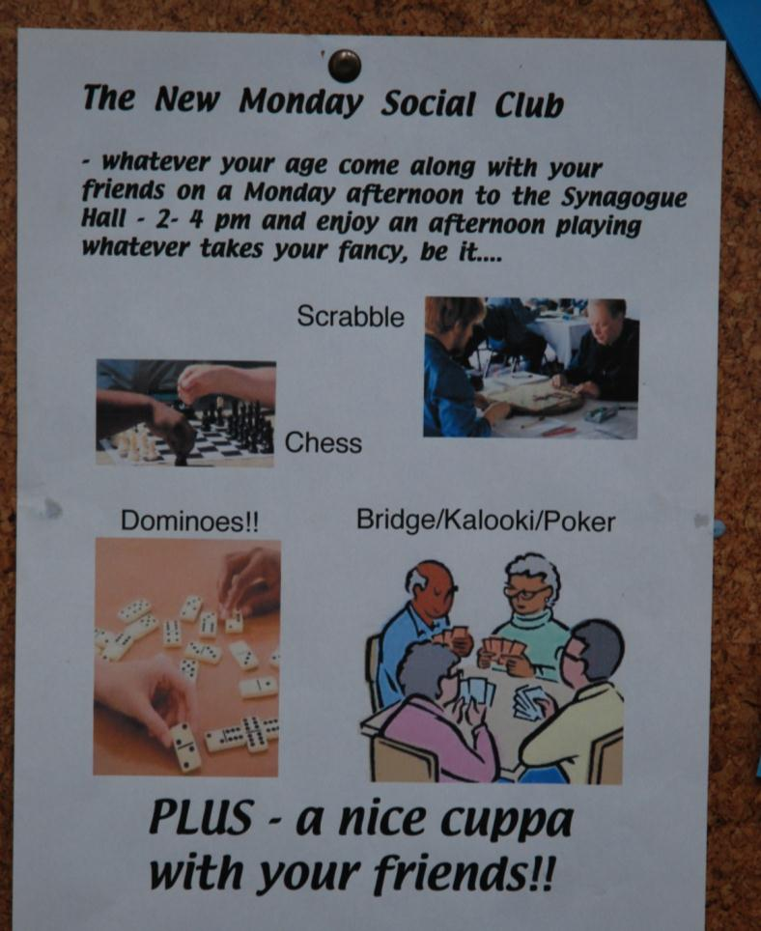
The Synagogue is also a place for the community to meet, there are notice boards with activities advertised

