Slide 1
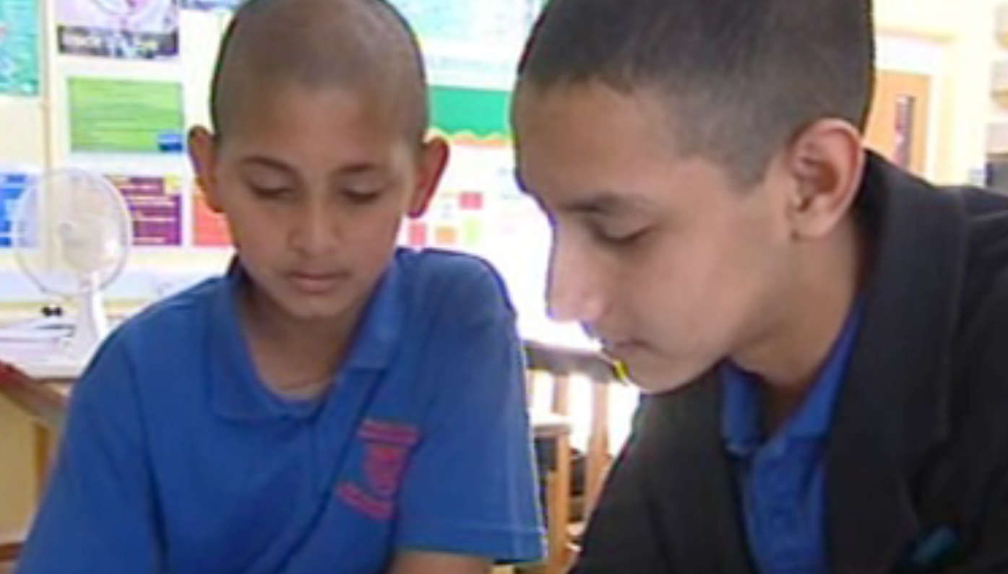
The sequence for teaching writing
Wokingham
21th May 2012

Slide 2
Aims
To engage with the sequence for teaching writing
To explore the use of success criteria, modelling and peer- and self-assessment in developing writing

Slide 3
Issues to consider
Knowledge, skills and understanding are ultimately measured through writing
Discrepancy between writing demands at Key Stage 3 and 4
Pupils may not transfer their learning about writing from one subject to another
Some teachers need to develop confidence in teaching writing explicitly

Slide 4
Weaknesses in writing – what the research tells us
Knowledge of genre inconsistent
Poor paragraphing
Lack of detail/inability to express ideas clearly
Incorrect usage at word and phrase level, for example, modal verbs to indicate probability or possibility, e.g. may/might/must
Narrow range of vocabulary
Punctuation errors
Subject-verb agreements

Slide 5
Text types in subject areas
Activity:
Consider the text types and identify the those that:
pupils are required to engage with in your subject area
pupils find most difficult
will ensure pupils achieve at the highest levels in your subject area.

Slide 6
The sequence for teaching writing
Activity:
Sequence the cards to show the process for teaching writing.

Slide 7
The sequence for teaching writing
1. Establish clear aims
2. Provide example(s)
3. Explore the features of the text
4. Define the conventions
5. Demonstrate how it is written
6. Compose together
7. Scaffold the first attempts
8. Independent writing
9. Draw out key learning
10. Review

Slide 8
Steps 1
Aim:
To write an analytical text in response to the question:
Which was more important as a reason for the failure of the League of Nations:
• its handling of the Manchurian Crisis 1931-33;
• its handling of the Abyssinian Crisis 1935-36?
You must refer to both reasons when explaining your answer.

Slide 9
Steps 2 & 3: provide examples and explore features of the text
Activity:
Read the text in front of you in pairs. What makes it an effective answer?
Consider:
structure & organisation
content
language used (e.g. tense, complexity of sentences, use of modal verbs, etc.)
use of evidence

Slide 10
Step 4: define the conventions

Slide 11
Step 5: Demonstrate how it is written

Slide 12
A sequence for teaching writing
Establish clear aims
Define the conventions
Demonstrate how it is written
Provide example(s)
Explore features of text

Slide 13
Sequence for teaching writing: steps 5 - 10
Year 9 unit on sound and hearing
End of unit assessment: ‘The Mosquito Device’
Task: write a leaflet
Audience: independent shop keepers
Purpose: to persuade them to buy the Mosquito Device
Already covered how sound travels, pitch, how the ear works…
Shared a model ‘Happy Home Security Device’
Success criteria set

Slide 15
A sequence for teaching writing
Compose together
Draw out key learning
Review
Scaffold first attempts
Independent writing

