Slide 1
Energy Contracts
DEC Certificates
Solar PV
Budget Forecasting

Slide 2
Energy Contracts
Current Monthly Batches Status
EDF HH – 11 Jan – 5 Feb (Jan invoice)
EDF NHH – 19 Dec -17 Jan (Dec invoice)
TGP – 13 Jan – 13 Feb (Jan invoice)
FBW – Dec invoice
EDF+TGP+FBW = WBC/BWO/Wiser Invoice
Energy Contracts DEC Certificates Solar PV Budget Forecasting

Slide 3
Energy Contracts
Framework Transfer Status
EDF to nPower: Account Lists handed over
TGP: Account List no change
FBW: Not part of framework yet
Opportunity to transfer missing accounts
Energy Contracts DEC Certificates Solar PV Budget Forecasting

Slide 4
DEC Certificates
DEC Expiry Refresh
Delay to include energy saving measures
Centrally managed pool of surveyors
Surveyor-1 – 12 (11 expired, 1 expiring)
Surveyor-2 – 10 (10 expired, 0 expiring)
Surveyor-3 – 11 (0 expired, 11 expiring)
Surveyor-4 – 13 (13 expired, 0 expiring)
Other – 10 (7 expired, 3 expiring)
Energy Display replacing laminated poster

Slide 5
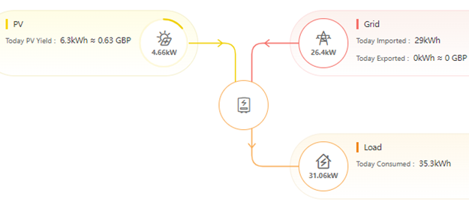
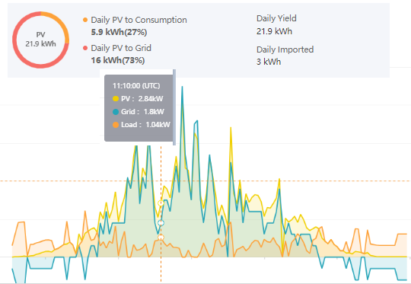
Solar PV
Solar PV
Inverter
EPM
Generation
Generation Meter
Storage
SurplusBat
SelfUseLive
Bat exp
PV exp
SelfUseBat
Export MPAN
Import
Site
Billable Meter
Import MPAN
Grid

Slide 6
Solar PV
Solar PV Billing Status
Contract Signing completion
One year transition
30% Cheaper compared to grid electricity
Linked to framework tariff
Grid 24p (28p), PV 17p (19p)

Slide 7
Budget Forecasting
Regular Budget Reporting Proposal
Headline figure Energy (gas/elec/fuel) & Water
Breakdown per supply type
Three times per year
October (YYYY07): six month review; past and future spend
January (YYYY10): three month forecast; to end of financial year
March (YYYY12): forecast next financial year; prev kWh usage * new tariff forecast

Slide 8
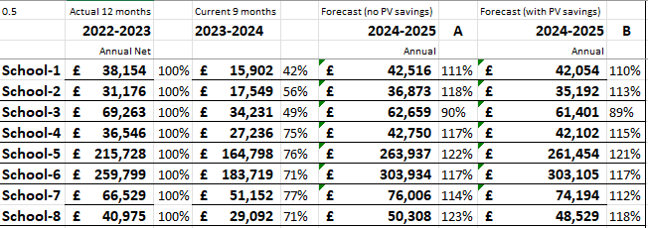
Budget Forecasting

