Slide 1
A short film (6 minutes) from Wokingham Film Project
Ruby's Corner - YouTube

Slide 2
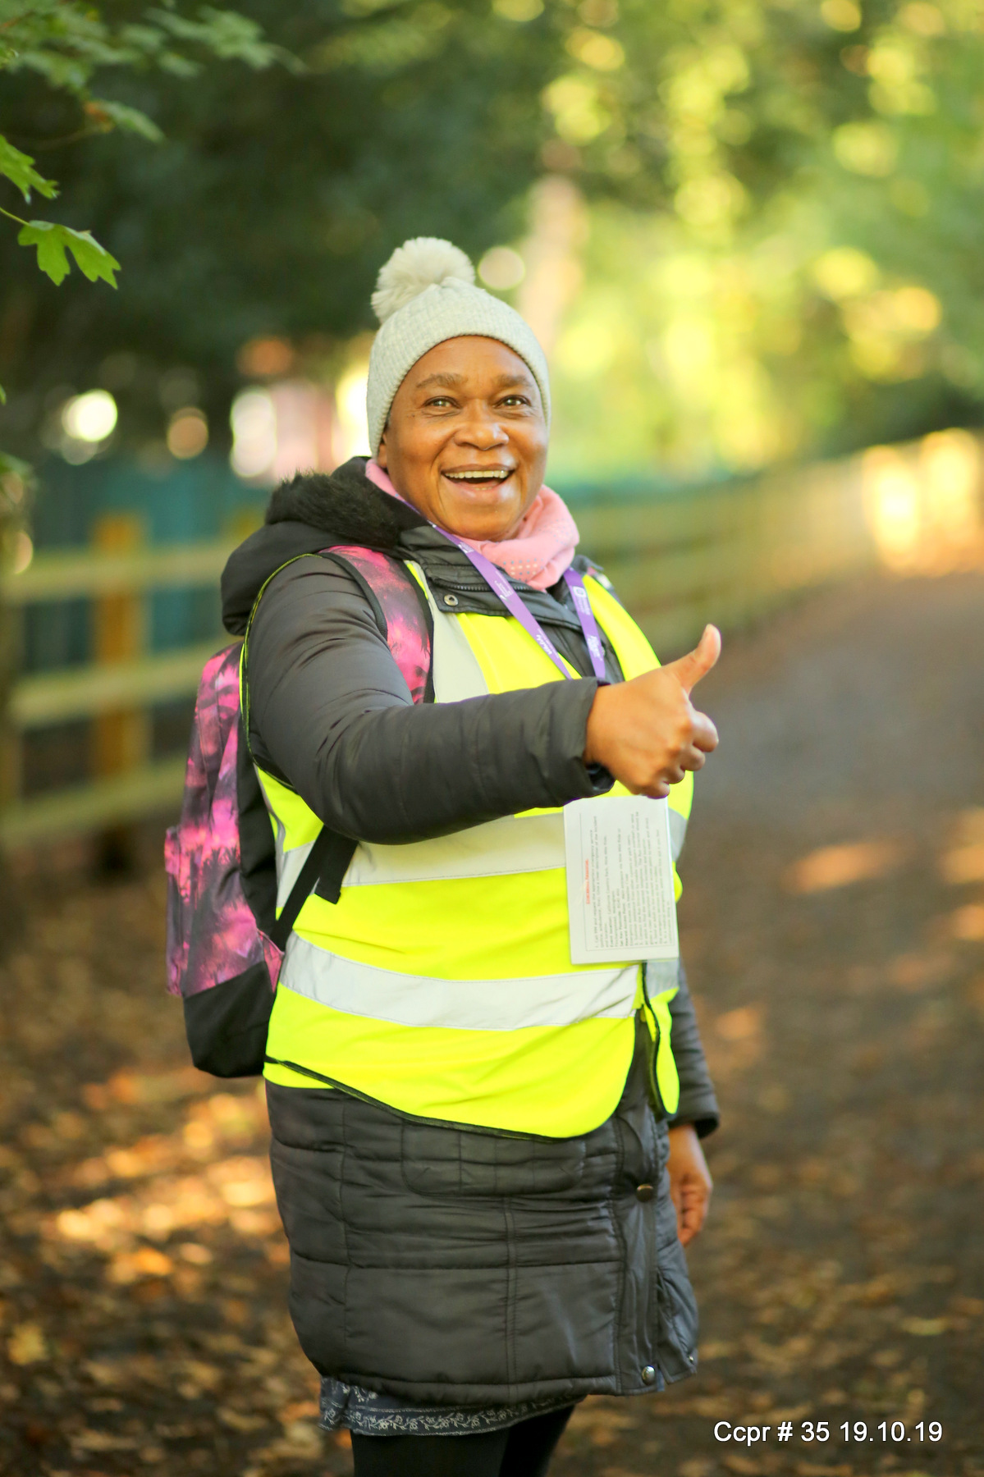
Ruby’s Corner
Ruby Lee was a runner and volunteer who lived in Wokingham. She volunteered at California Country parkrun and was also a member of Reading Roadrunners. Runners at Cali were all hugely appreciative of her encouragement as she cheered them on at her corner, which became known as ‘Ruby’s Corner’.
Unfortunately, Ruby became ill and passed away from cancer in December 2022. The community at Cali raised money and installed a bench to remember Ruby. Every week, runners acknowledge her when they pass her bench at Ruby’s corner. To remember Ruby, the first parkrun in December will be known as Ruby’s Run, where there will also be a collection for the local foodbank.

Slide 3
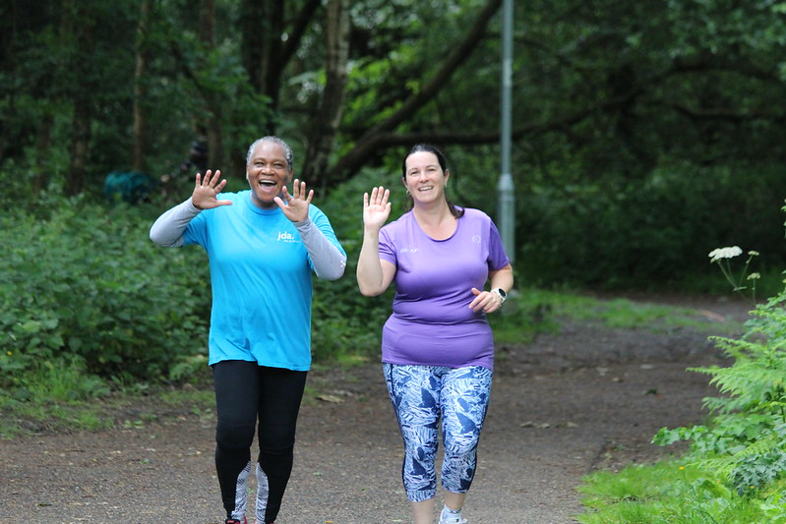
Teacher notes
We would like you to share this film and resource so that people can learn about Ruby’s story because she was from the local area. Please use the link to the quiz below to check the understanding of your students.
https://quizizz.com/embed/quiz/655b36ff050cfffa80e85901
Key Themes:
parkrun – a free, inclusive weekly running/walking event for all
Volunteering – Ruby Lee was a volunteer at California Country parkrun. She embodied the parkrun ethos of including and motivating all runners.
Belonging – through volunteering Ruby helped to create a sense of belonging for runners and other volunteers at parkrun.
Positive Representation – Ruby was a role model for volunteering. She also showed people of colour that running in the countryside was for them too.
Grief & Remembrance – deep emotions are expressed, and participants explain how they remember Ruby and keep her memory alive as a community

Slide 4
Activities
Use a search engine to find images of ‘cross country’ or ‘trail running’. How many of these images include people of colour?
How important do you think it is for people to see themselves represented before they decide to take up a new activity? Why?
Further Exploration:
Why might it be difficult to go running on the streets or in the countryside as a person of colour?
What could be done to combat this? Explore the work of Black Trail Runners
Notes:
(See hide slide)

Slide 5
Key concepts – notes for teachers
There is a lack of representation for people of colour in running in the UK that is not track/athletics based
In particular, black men can fear other people’s perceptions of them due to systemic racism. For example, Black men have been mistaken as being part of a crime when out jogging or running and subsequently they have been stopped by the police.
Running is often stereotyped as a white, middle-class sport.
Ruby defied that categorisation and proved that it was flawed.
All runners were hugely appreciative of her volunteering and the way that she encouraged them

Slide 6
Wokingham film project
Wokingham Film Project is a collaboration that seeks to give young people experiences of working in film through short projects.
In Ruby’s Corner, young people from across Wokingham Borough conducted film interviews with Ruby Lee’s family and friends. The project was co-ordinated by Holme Grange School and edited by Silk Purse Videos. The project was also funded by Windrush Generations Wokingham.
If your school/organisation would like to take part in a similar project to capture more Wokingham Stories, please contact Caroline Saynor at c.saynor@holmegrange.org

