Slide 1

SENCO Network Meeting
2nd July 2024
Private: Information that contains a small amount of sensitive data which is essential to communicate with an individual but doesn’t require to be sent via secure methods.

Slide 2


Welcome
Introductions – SEND Service
Housekeeping
Agenda
Why are we here?
Consultation 'Shout Out'
SEND & Inclusion Strategy / All Age Autism Strategy

Slide 3
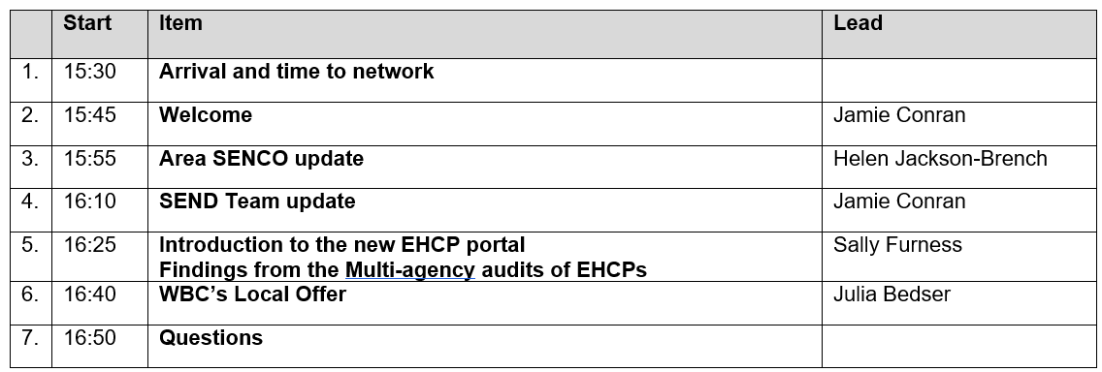
Agenda

Slide 4
Area SENCO update
Area SENCO role
Findings from school visits
OAP project
The coming year

Slide 5
Area SENCO role
Area SENCO Team:
An advisory service offered by Wokingham's Education and SEND team which provides advice and support to SENCOs and other school staff across Wokingham ensuring that children and young people with SEND have their needs met at the earliest opportunity, as close to home as possible.
School visits
Liaising with outreach services
Developing understanding of all of the services available in Wokingham
Attending panels
SENCO surgeries
Liaising with SEND Team
Began the Ordinarily Available Provision project
Recruited a Deputy Area SENCO

Slide 6



Area SENCO update – School visits
Higher numbers of pupils with SEND
More complexity of need
EYFS/Years 7s and 8s
SEMH
Care and compassion | Adaptations and adjustments | Sensory Circuits | Outdoor classrooms
Nurture spaces | Learning Support Centres | Internal AP | EBSA spaces
Animals | Sensory rooms | Carefully designed classroom environments | Quiet spaces
Bespoke spaces and curriculum | Acceptance | Lunch clubs | EEF 5 a day

Slide 7

Ordinarily Available Provision Guidance
Objective:
There will be a consistent Ordinarily Available Provision offer across mainstream schools in Wokingham leading to a higher proportion of pupils getting their needs met earlier at SEN Support.
Phase | Key actions | Timeline
1. Preparation | Establish working parties ensuring that all stakeholders are represented and have input | April 24
2. Review | Review existing guidance and agree scope and layout of new OAP | June 24
3. Publish | Publish a new Wokingham guidance | Dec 24
4. Launch | Launch of the new OAP | Jan 25
5. Sustainability | Support and training to schools to ensure that OAP is delivered effectively | Ongoing

Slide 8
Area SENCO update – What next?
Regular SENCO network meetings
SENCO Induction Programme
Training offer
SENCO Hub
SENCO newsletter
SENCO surgeries
Launch of the new Ordinarily Available Provision guidance
Transition project

Slide 9
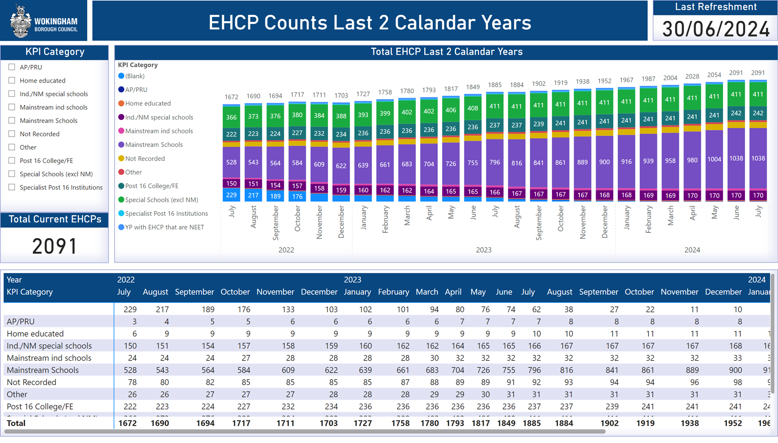
SEND Team
One part of SEND Service
Statutory function:
Decisions to assess
Decisions to issue
Annual reviews
Increasing demand year on year
Over 2090 EHCPs
EHCNA requests (see next slide)

Slide 10
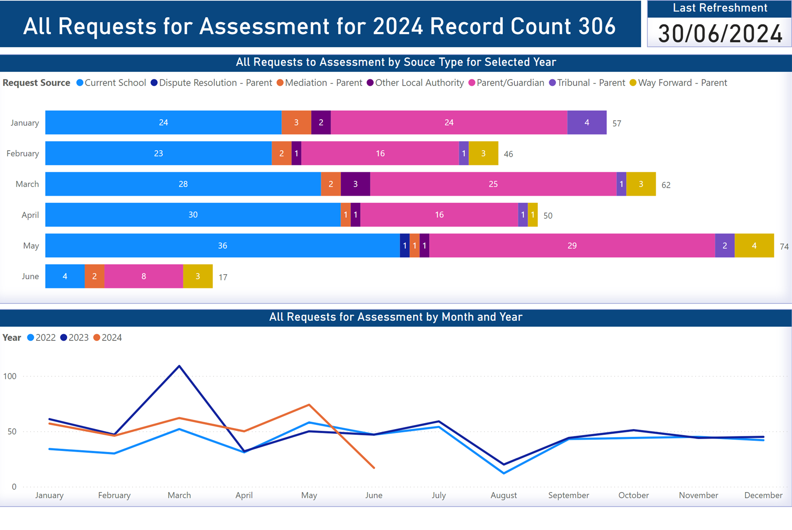
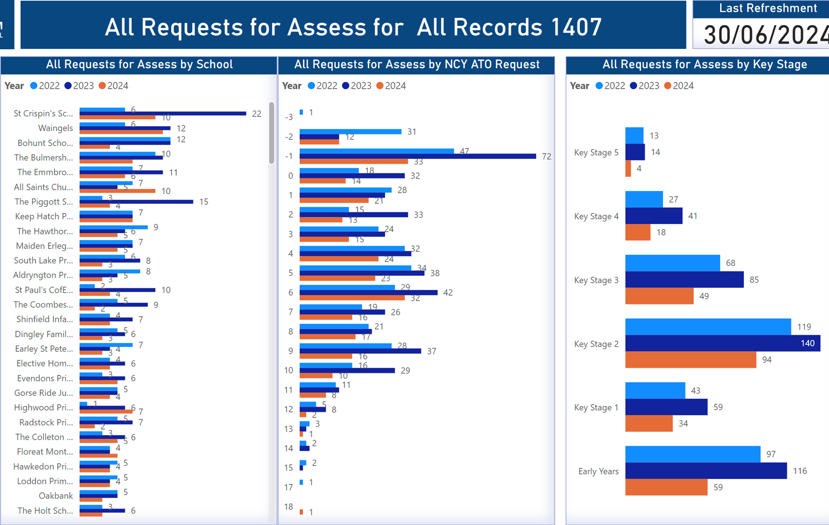
SEND Team - Development of PowerBI

Slide 11
SEND Team – A Different Way of Working
Current structure - Assessment / Annual Review Teams
Interim / Permanent Workforce
Staff vacancies / capacity
Communication
Attendance at key meetings
More to come at next SENCO Network!

Slide 12
ECHNA Capita Portal
BY the End of September, a EHCNA request portal should be open and requests will be able to be received into Capita directly. This is currently still being built and we will notify professionals if there is to be a delay.
This is being set up for schools initially and we will trial it with around 5 schools during September. Parent requests for EHCNA will follow during the summer.
Schools will be able to submit attachments with their request, such as provision maps, professional advice and school reports.
All letters and templates are being amended for the portal and we are working with business change to create detailed process maps so case officers will know what needs to be done at each step.
This work is planned in 5 phases, with the requests for advice from professionals and annual reviews being added to the portals capability over the next 6 months.

Slide 13
Benefits of the Capita Portal
All requests will go through and be held in the portal- easy to find- single front door.
Instant acknowledgement of request sent to the referrer
The Portal can be used to request advice from professionals, who will submit responses via the portal
Portal will chase professional information to try and keep within timelines of the assessment process
Parents can access the portal to see what stage the EHCP is in the assessment process
Parents can see the advice submitted from professionals
Information from the assessment process can populate the EHCP draft- which will save time for the SEND Team
Plans can be sent out via the portal- don’t need to use the secure email. And parent comments can come back through the portal
All CYP Documentation will be saved in Capita in the chronology for the child- one place to save all child information.

Slide 14
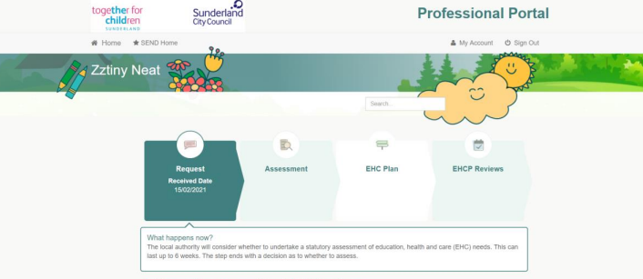
What will the Portal Look Like?
Whilst the Wokingham portal is under development, we have an example from another LA of what the portal will look like for a professional making a request for assessment-

Slide 15
What does this mean for SENCO’s?
All EHCP requests will be submitted through the Capita Portal when it is open, no more sending requests as an email
SENCO’s will need to register to join the portal so they can make requests
Before the portal goes live, SENCO’s will be sent details of how to register for the portal and information and templates will be updated on the Local Offer webpage and the Schools Hub
As the portal is developed, SENCO’s can access the portal to see where the EHCNA is in the request and assessment process.

Slide 16
EHCP Multi Agency Audit Activity
26 EHCP’s were audited in total
Audits have been held monthly and generally well attended by SEND, health and social care.
This included 4 audits held with professionals from health, social care and SEND and one audit held jointly with other LA’s which included Family Voices parent/carer forum
EHCP’s were graded 1-4 as follows-
Of the 26 plans audited, the outcomes were as follows-
Each EHCP was given an overall grade following the audit and to ensure Wokingham were holding themselves to a high standard, it was agreed that more than 70% of the EHCP needed to be scored at 1 or 2 for them to be considered as meeting expectations or higher.
The process was continually developed and improved throughout the Spring term. Once the process is finalised and agreed, we will invite schools and parent carer forums to take part in the Wokingham audits

Slide 17
Audit Findings
Have the Health provisions and support made a difference and improved outcomes for children and young people? | Have the Social Care provisions and support made a difference and improved outcomes for children and young people?
3 | 3
3 | 2
3 | 2
3 | 3
3 | N/A
4 | N/A
4 | N/A
2 | N/A
N/A | N/A
N/A | N/A
N/A | N/A
N/A | 4
In the annual review paperwork, there was a significant evidence of a lack of discussion around the health and social care needs of CYP and the impact of any provision given
One CYP whose EHCP was audited had ‘Not Applicable’ written into their annual review paperwork. Upon further investigation, at the time the annual review was taking place, the CYP was under a Child In Need plan and the family were being supported by Social Care.
When attendance at Annual Reviews was looked into, health and social care professionals were not always in attendance even when the CYP had involvement from either service written into their EHCP.

Slide 18
Recommendations
Can SENCO’s ensure health and social care colleagues are invited to annual reviews where appropriate. We acknowledge this may be difficult at times due to staffing capacity.
If health or social care are unable to attend the review, they can be asked to submit up to date advice regarding the CYP. Eventually, this will be possible via the Capita Portal.
If there is no known health or social care involvement for a CYP, can it be captured at annual review that the question was asked at the meeting. For example, “Attendees of the annual review were asked if here was any known health/ social care support being provided for the child and attendees confirmed there was not”.
When additional health or social care advice is discovered at the annual review meeting but there is no further information available at the time, log this and make a request that the SEND Team ask the services for updated advice for sections C,D,G or H of the EHCP.

Slide 19
Julia: SEND Local Offer Co-Ordinator
The SEND Local Offer is information about the support available locally for children and young people with special educational needs and disabilities, and their families.
Julia’s role is to:
Improve our online Local Offer so that families can find information and support more easily
Promote the Local Offer so that families feel well-informed about what support is available
Gather feedback from young people and their families, and use this feedback to make further improvements to the Local Offer
We publish this information online via our SEND Local Offer webpages and our SEND Local Offer Directory: SEND Local Offer (wokingham.gov.uk)

Slide 20



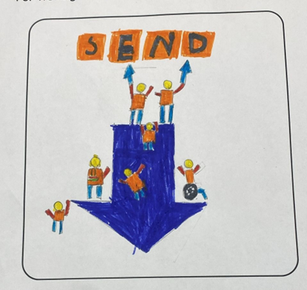

Progress so far and next steps:
Rewritten and reorganised the information on our Local Offer webpages
Developed a half-termly Local Offer newsletter
Set up a contact form and email address:
localoffer@wokingham.gov.uk
Hosted an in-person event to support families with post-16 options
Local Offer logo competition open to all children and young people in Wokingham Borough
What’s next?
Develop the look and content of the Local Offer further, in collaboration with young people
Host more in-person events next academic year, in response to feedback from families
Continue to promote the Local Offer so that families and schools are well-informed about it

Slide 21
Questions?

