Slide 1
Multi-Agency Safeguarding Hub (MASH) Safeguarding children is everyone’s responsibility
WOKINGHAM CHILDREN’S SERVICES
SHUTE END, WOKINGHAM
Telephone: 0118 908 8002
triage@wokingham.gov.uk

Slide 2
The Team
The MASH Team is the single ‘front-door’ for Children’s Services.
‘set up to identify risks to children at the earliest possible point and respond with the most effective interventions’
The Team consists of:
1 x Team Manager; Jennifer Vanderheyden
2 x Assistant Team Managers; Olivia Casey and Carlene Butcher. Victoria Gater (maternity cover for Carlene)
2 x Senior Social Workers; Judith Ihenacho and Roxanne Talbot
2 x Social Workers; Becky Aston and Imogen Wilson
3 x Referral Co-ordinators; Jess Gill, Abby Russell & Penny Walker
The purpose of the MASH Team is to gather further information from the professional network and parents / carers to make a decision in relation to threshold and next steps.

Slide 3
Legislation and Policy that underpin our work
Children Act 1989
Statutory guidance; Working Together to Safeguard Children
Keeping Children Safe in Education 2023
Berkshire West Safeguarding Children Partnership https://www.berkshirewestsafeguardingchildrenpartnership.org.uk/scp/threshold-guidance/wokingham-threshold-guidance
Local Service Level Agreements between agencies; including MASH Information Sharing Agreement
All Social Workers are registered with Social Work England

Slide 4
Sources of contacts / referrals
Education settings
NHS ; mental health services, ambulance reports, 111 calls, hospitals reports, and Multi-Agency Referral Forms (MARF’s) from midwives, health visitors and GP surgeries
Police ; when parent/carers have contact with the police (which would be considered a safeguarding concern) and have children under the age of 18.
Probation services
CAFCASS (Children and Family Court Advisory and Support Service)
Anonymous calls and calls from members of public
Self-referrals
…Anyone!

Slide 5
Volume of Contacts and Referrals
In a typical month, we receive approximately;
850 – 920 contacts straight into the MASH Team (this does not include contacts where a child already has a named social worker).
100 – 120 of these go through for discussion at the Early Help Hub
125 – 150 of these go through for a Child and Family Assessment
Strategy meetings; on average five a week
50 of these go through for MASH checks to gather more information to determine threshold and next steps (details in a later slide)

Slide 6
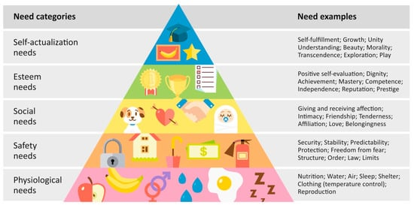
Why is this important in education settings?

Slide 7
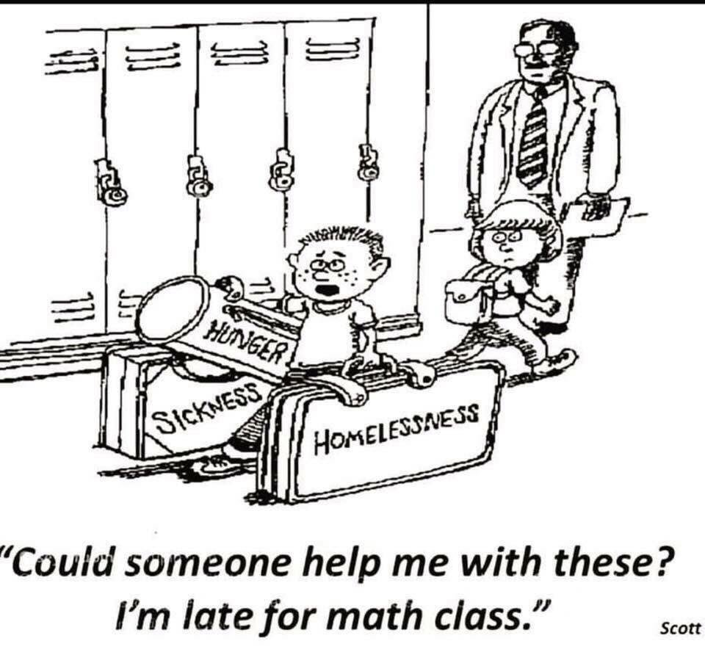
Why is this important in education settings?

Slide 8
Referral Process
Professionals can contact the MASH Team for advice on 0118 908 8002. Calls are recorded, and information is logged on our database. If it is generic advice on procedure, we do not log this.
You can pass this number to families if they’re concerned.
Professionals with concerns or identifying a support need, must complete a MARF (Multi-Agency Referral Form) and send it to Triage@wokingham.gov.uk (even if referrer has already spoken to a duty worker)
If there are immediate safeguarding concerns for a child, or a child is believed to be at risk of significant harm, the referrer should always contact the MASH Team in the first instance followed by a MARF (this will be explored in a later slide)
The Emergency Duty Team (EDT) should be contacted if it is out-of-hours (01344 351999)

Slide 9
Information on the MARF
The MARF should have as much information recorded as possible. This assist us in our decision making and next steps
Include: Personal details for families
Full names of all children and adults living in the family home
Dates of birth – for children AND parents/carers
Ethnicity
Religious beliefs
Contact details for the family; address, phone numbers (for both parents) and email (if known)
Referrers contact details (including phone number and email)
Any details of professionals working with the family that you are aware of
Include the parents/carers & children’s views (when possible)
Include academic information about child
It is good practice to complete the MARF with parents and show them the completed copy

Slide 10
Consent and Information Sharing
‘Wherever possible, you should seek consent and be open and honest with the individual from the outset as to why, what, how and with whom, their information will be shared’*
Consent isn’t the same as asking permission
Consent is an ethical requirement; we work transparently with families for the benefit of children and to maintain good working relationships
ONLY when seeking consent increases the risk to the child should you make a referral without consent
If consent is not sought and deemed required, then MARF’s may be returned with us requesting this is provided
*https://www.gov.uk/government/publications/safeguarding-practitioners-information-sharing-advice

Slide 11
Being specific…
When completing a MARF please be specific. Your professional judgement is important but please stick to the factual information
We need to know what you are worried about and why?
Body language and presentation of a child
Use understandable terminology
what does “mental health issues” mean for this person? Is there a diagnosis/are they on a pathway? What is the treatment plan? What are the potential risks to the children? What are the protective factors?
What does alcohol misuse look like? What are they drinking, how much, how often? What substances/drugs are being used – how often, where are they being sourced?
For domestic abuse – you may be the first person that the victim has disclosed to – what does the domestic abuse look like specifically? When was the first incident? When was the last? What was the worst incident? Where were the children? Is there a safety plan?

Slide 12
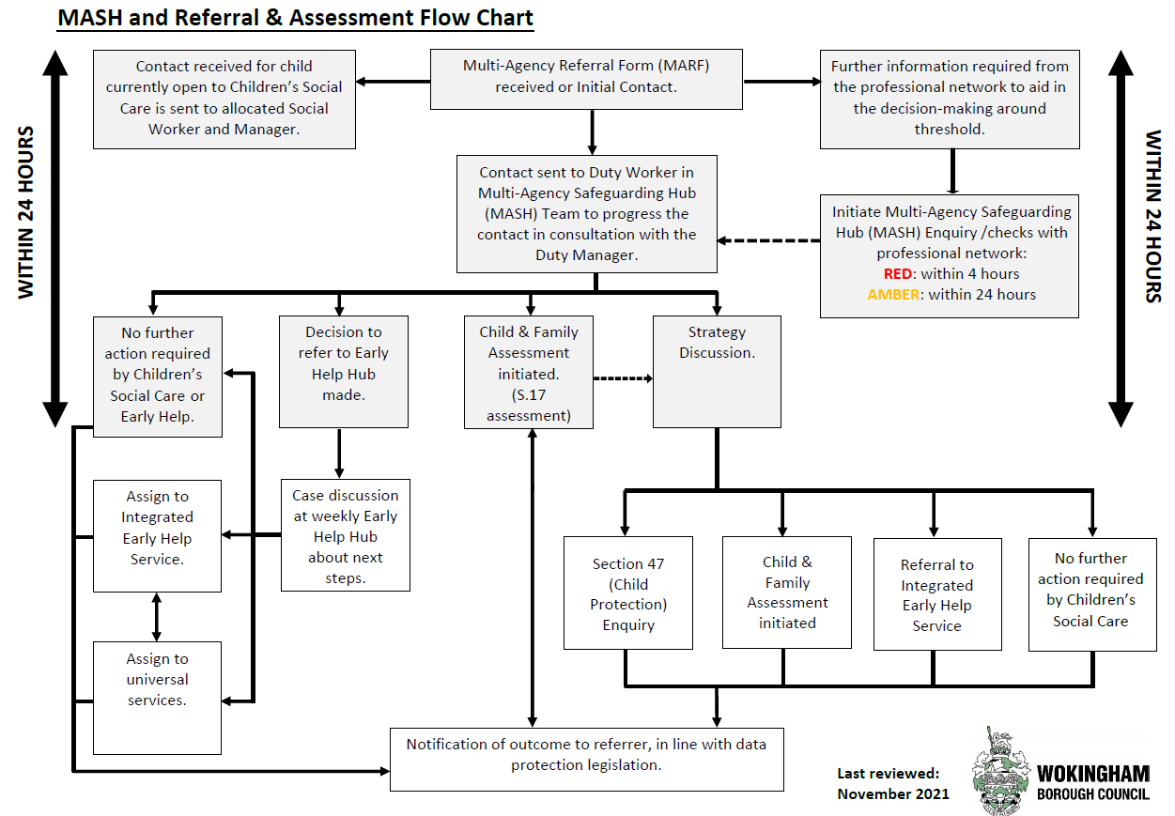

Slide 13
MASH Checks
If we are unable to make a decision around threshold – then full MASH checks may need to be completed, as information from the professional network can aid in the decision-making.
MASH checks include (but are not limited to):
Police
Education Provisions (School, College, Nursery, and Elective Home Education Team)
Housing
Probation
Cranstoun – Domestic Abuse and Substance Misuse
Health Services
Other Local Authorities (if required)
Consent for checks should be sought from parents in most cases
Information obtained via MASH checks is held confidentially.
As professionals who work face to face with the family, your insight is invaluable

Slide 14
Threshold of Intervention
When a referral is received the MASH team have 24-hours to make a decision in relation to threshold and next steps.
Outcomes:
No Further Action
Family to be discussed at the Early Help Hub (parental consent is required)
Child & Family Assessment (Section 17) (parental consent is required)
Multi-Agency Strategy Meeting when there is reasonable cause to suspect that a child is suffering, or likely to be suffering, significant harm
Decisions are made based upon the Wokingham Threshold Document - it can be viewed below:
https://www.berkshirewestsafeguardingchildrenpartnership.org.uk/scp/threshold-guidance/wokingham-threshold-guidance

Slide 15
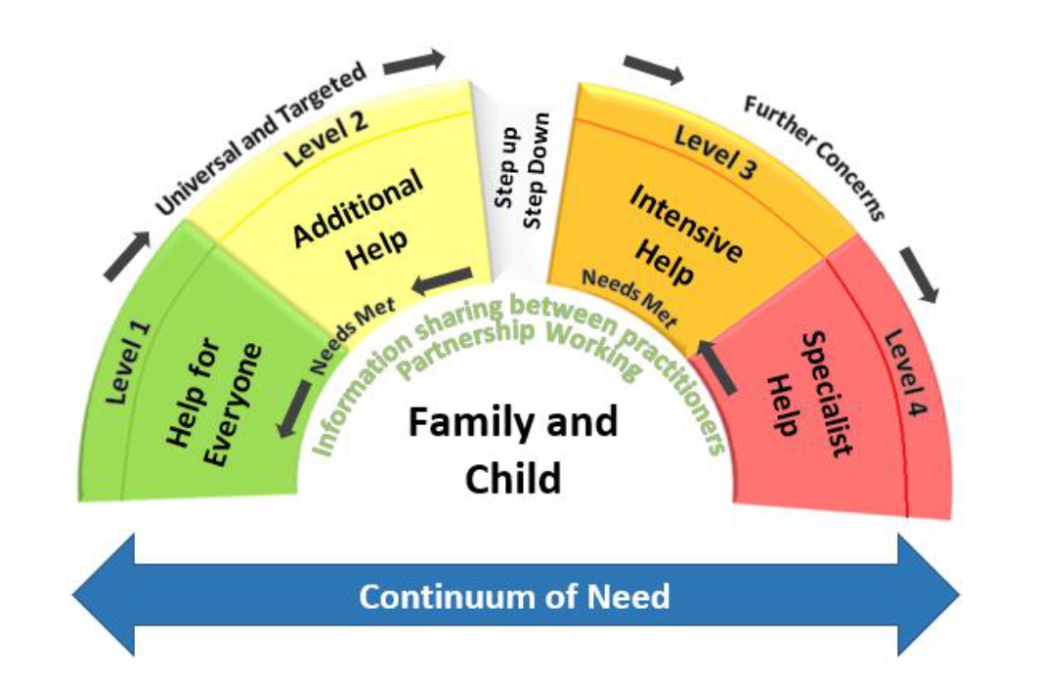

Slide 16
If a child makes a disclosure
Schools should have systems in place to record any safeguarding concerns. It’s important any concerns are escalated to safeguarding leads as soon as possible.
Write down exactly what was said – by both the child AND the adult – as soon as possible after the event
We recognise it’s difficult to know exactly what to say. It is very easy to ask leading questions and we understand that these conversations are tricky
Record factual information
It’s important to not make promises around confidentiality or next steps (it’s okay to reassure and say I don’t know, or I’m going to ask for advice)
https://learning.nspcc.org.uk/news/2019/february/equipping-teachers-better-respond-disclosures-abuse-neglect/
https://www.youtube.com/watch?v=bvJ5uBlGYgE

Slide 17
Harm Outside the Home Definitions
Our definition of “Harm Outside the Home” encompasses:
Child Sexual Exploitation
Child Criminal Exploitation
The contexts in which Harm Outside the Home take place could include;
online and in the digital world
peer groups within schools and places of learning
county lines
on and around public transport
wider community settings
…anywhere outside of their home!

Slide 18
Harm outside the Home Referring concerns
If this is the specific concern, there is an expectation of the Criminal Exploitation toolkit being completed in full
https://www.berkshirewestsafeguardingchildrenpartnership.org.uk/assets/1/pan_berks_child_exploitation_and_youth_violence_indicator_and_analysis_tool_-_updated_october_2021.docx
However, we consider harm outside the home in every contact for a child over 8 where appropriate, using prompts on next slide.
If concerns are raised we will explore this further as part of our work

Slide 19
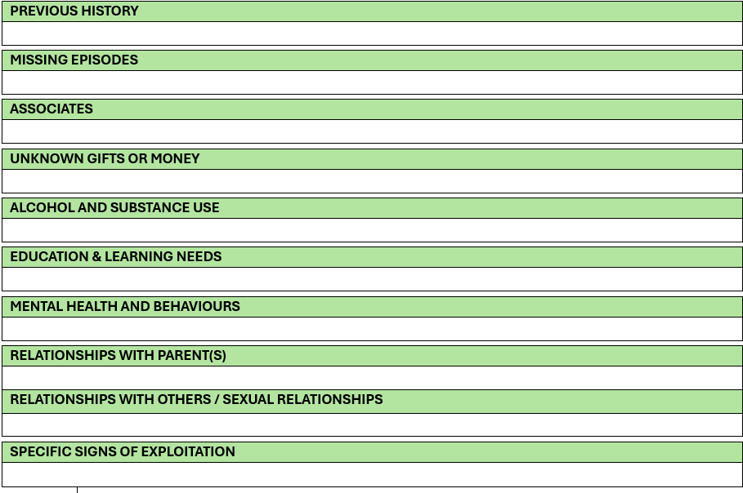

Slide 20
References
Working Together to Safeguard Children: https://assets.publishing.service.gov.uk/media/65803fe31c0c2a000d18cf40/Working_together_to_safeguard_children_2023_-_statutory_guidance.pdf
Children Act 1989: https://www.legislation.gov.uk/ukpga/1989/41/contents
Keeping Children Safe in Education
https://assets.publishing.service.gov.uk/media/64f0a68ea78c5f000dc6f3b2/Keeping_children_safe_in_education_2023.pdf
Berkshire Safeguarding Guidance: http://berks.proceduresonline.com/wokingham/index.html
Information sharing advice for safeguarding practitioners
https://www.gov.uk/government/publications/safeguarding-practitioners-information-sharing-advice
Wokingham Threshold Guidance: https://www.berkshirewestsafeguardingchildrenpartnership.org.uk/assets/1/wokingham_threshold_guidance_booklet_-_autumn_2020.pdf
https://www.gov.uk/government/publications/safeguarding-practitioners-information-sharing-advice
https://proceduresonline.com/trixcms2/media/16274/harm-outside-the-home-strategy.pdf

Slide 21
Any questions?
triage@wokingham.gov.uk

