Slide 1
Energy Updates
Framework Transfer
Energy Brokers
VAT exemptions
Meter Reading
Energy certificates
Budget Review & forecasting
Solar pv invoicing

Slide 2
Framework Transfer update
Framework:
CCS → LASER
Electricity:
EDF → NPOWER (NPO)
Handful of EDF accounts have yet to transfer due to different contracts, historical balance clearing etc. We are working to resolve this ASAP
NPO PDF SharePoint issue resolved
Gas:
Remaining with TOTAL (TGP)
Water:
Remaining with First Business Water (FBW)

Slide 3
Energy Brokers
Be aware of energy brokers
No supplier or company should show up unannounced, asking for meter or billing information
A broker can only make money from adding charges to the supplier cost
Thus, are by definition always more expensive
The WBC Energy Team are unable to engage with academy energy brokers

Slide 4
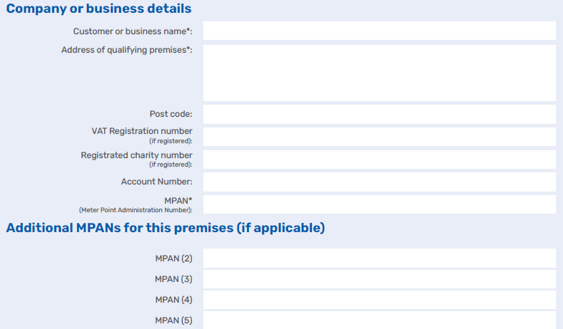
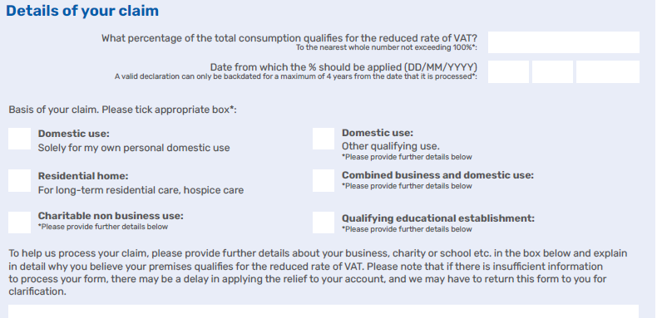
VAT Exemptions
TGP VAT Exemptions in place as before
Please review your current exemption status as you may be entitled to a lower VAT
NPO did not take VAT Exemptions from EDF
Currently is a mix of 5% and 20% across the accounts
If you believe you are a 5% site, we can provide a form
We will send them to Npower on your behalf, so once complete send them to energyteam@wokingham.gov.uk
For multi-site academies, these will need to be done on a per site basis

Slide 5
Meter reading efforts
All meter reads to be sent to energyteam@wokingham.gov.uk
Even if on Automatic Meter Reads (AMR), please continue to send as it provides a backup
If you would like help reading your meters, please get in touch
Stepping up efforts to complete Meter Location Data through site meter surveys
We are now accelerating the NHH AMR/Smart Meter rollout
Prioritised based on usage and PV
POLL QUESTION: Are you aware of where your meters are located (Elec, PV, EV, Gas, Water)?
energyteam@wokingham.gov.uk

Slide 6
DEC/EPC/TM44 Certificate Management
DEC (Display Energy Certificate) – Required on all public buildings (inc schools) that are over 250m^2. Liability of this falls to the tenant of said building.
EPC (Energy Performance Certificate) – Required on all buildings over 50m^2 at point of sale, new lease etc. Liability for this falls on the owner of the building.
TM44 – Required for any building with air conditioning. Liability of this falls to the building operator.
When a maintained school academises, the liability for the certificate's changes from WBC to the academy. WBC therefore needs to recharge for any certificates it then procures for that site.
We are able to provide a service to manage and procure these certificates on your behalf. As we procure certificates for the whole WBC Estate, we are able to buy them at a cheaper rate through bulk purchasing.
A recent quote for DECs was £115 (+£40 lodgement fee) – £200 (+£40 lodgement fee) per certificate, depending on building size
POLL QUESTION: Once academised would you join our central certificate procurement program?

Slide 7
Budget review & forecast
Currently developing automation tool
Expecting to publish P6 (P1 for Sep-Sep budgeting) review sometime in October
As shown during our site visits, the report will show both progress in the current financial year as well as forecast for the next financial year based on the most current data.
POLL: (Academies) Would you prefer: per site, or per academy, financial reporting?

Slide 8
Solar PV Invoicing
First 6-month PV invoicing will take place in October
This applies to the SEG PV installation, not FIT Installations
Current recharging is based on 50% self-use, pending installation of Smart Meters and Surplus Export MPANs
Not all sites have signed the PV Supply Contract yet
The contract guarantees a 30% discounted electricity tariff
If you need more information before signing, please contact us
If you're not in a PV supply contract, be aware we have the option to look at selling the energy elsewhere

Slide 9
Thank you
All correspondence through energyteam@wokingham.gov.uk

