Slide 1
Welcome to the Autumn SBM Briefing!
Please add your name and school in the Teams chat once you have joined

Slide 2
Agenda
10am – 10:10am | Welcome
10:10am – 10:25am | Apprenticeships presentation Gemma Lenton Workforce Development Specialist
10:25am – 10:35am | Fraud presentation Sharon Egan Corporate Investigation Officer
10:35am – 10:45am | Pupil Forecasts presentation Oliver Gill and Piers Brunning Head of Education Access and Sufficiency and School Organisation and Place Planning Manager
10:45am – 11:05am | Energy Update Tom Quinlan and Hoyte Swager Energy Officer and Energy and Utilities Manager
11:05am – 11:15am | Schools Finance Update Angela Blogg Schools Finance Manager
11:15am – 11:25am | Grants Update Diana Hollis Schools Finance Management Accountant
11:25am – 11:35am | Schools Finance Website Period 6 Budget Monitoring Asset Leasing Victoria Sarson Senior Schools Finance Officer
11:35am – 12pm | Any other business

Slide 3
Welcome
Kenneth Chan – SEND Finance
Alex Potter – Schools Finance Helpdesk Officer
Nicole Wallace – Gorse Ride Schools
Vikki Burt – The Colleton
Lisa Lainsbury – Lambs Lane
SBM Briefing future format
We would like to understand your preference for future SBM Briefings.

Slide 4
Schools Finance Update
APT Modelling
HNB Pressures
Deficit Schools

Slide 5
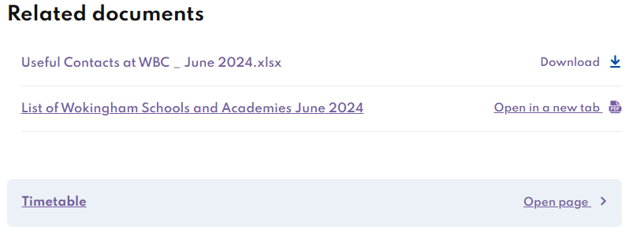
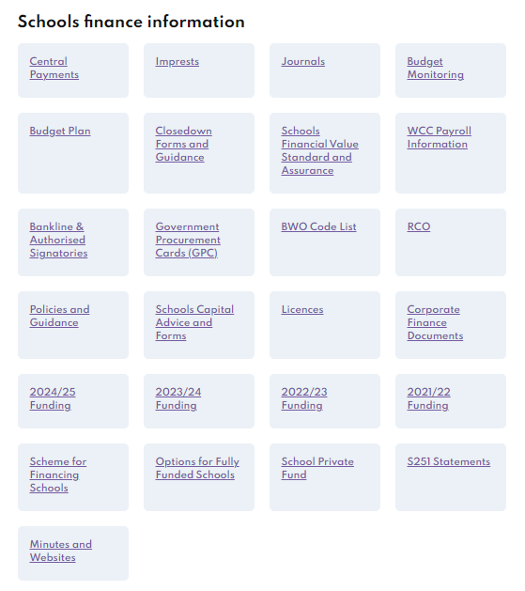
SCHOOLS FINANCE WEBSITE
Please bear with us whilst we making changes to the Schools Finance website.
Schools Finance (wokingham.gov.uk)
Current Updates
School Year Timetable with dates for BM, BWO reports & imprest deadlines, Census, provisional close down etc.
BM guidance notes have been reviewed and updated.
Useful Contacts at WBC
Imprest template
https://wsh.wokingham.gov.uk/leadership-management-and-governance/schools-finance.gov.uk)

Slide 6
BUDGET MONITORING P6 submissions:
The deadline for BM6 is Friday 18th October 2024
Please complete the Header Tab and columns O and S* on the detailed tab (tab with school cost centre).
* A variance on any CFR line exceeding 5%, please provide an explanation in column S.
Each submission should contain the BM P6 Template alongside a dummy imprest (if applicable) and the relevant school system reports (all printed on the same day) as follows:
FMS reports required
Fund Review
Proposed CFR
I&E Report (to month 13)
ACCESS reports required - Excel format
Income and Expenditure by CFR Code Report
Balance Sheet report
Trial Balance report
Management report
Interim CFR – if you are able to provide this

Slide 7
Asset Leasing
Due to some changes in the way we account for leased assets, we are now required to ask the schools to provide the value / cost of each asset on a lease as if purchased on the day the lease was signed.
If you have a lease with multiple items we would need to know the cost of each single asset.
As a result, I will be sending the lease asset register to you all this week, I would be grateful if you could please complete the asset costs and return back to me as soon as possible.
Additionally, a reminder that all new leases should be submitted to Schools Finance (along with each individual asset cost), prior to signing for Finance can review and approve.

Slide 8
Questions?

