Slide 1
High Needs Block update
27 February 2025

Slide 2
HNB Key Financials Update – 2024-25
Financials |  | 2023-24 |  | 2024-25
 |  | Actuals <A> |  | Forecast <B> | Diff <B>-<A> | Diff %
Total Expenditure |  | 41,163 |  | 47,603 | 6,440 | 15.6%
Total Income |  | (28,225) |  | (28,052) | 173 | -
HNB In Year Deficit |  | 12,938 |  | 19,551 | 6,613 | 51.1%
No. of EHCP plan |  | 1,953 |  | 2,220 | 267 | 13.7%
No. of EHCP plans increased by 14% from 1,953 in year 23/24 to an estimated 2,220 in year 24/25 with half of the growth from Special Schools and Independent Non-Maintained Special Schools (“INMSS”)
Average cost per EHCP plan is at £22,000. Cost per EHCP plan at Special Schools and INMSS are £34,000 and £58,000 which are significantly higher than the average provision
Increasing demand for Education Other Than At School (“EOTAS”) and Alternative Provision also drive up the total expenditure
HNB In Year Deficit is expected to increase by £6,613k or an equivalent 51% hike
High Needs Block

Slide 3
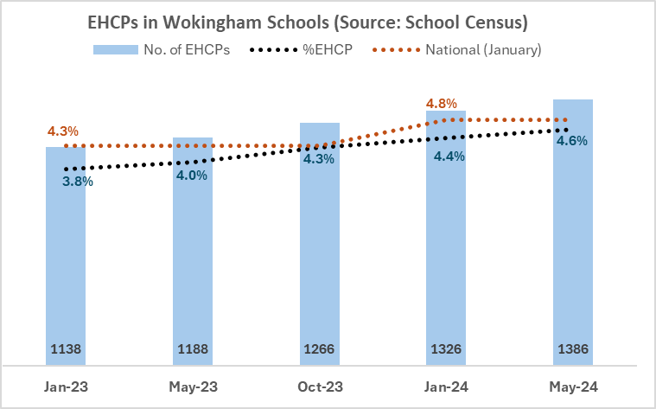
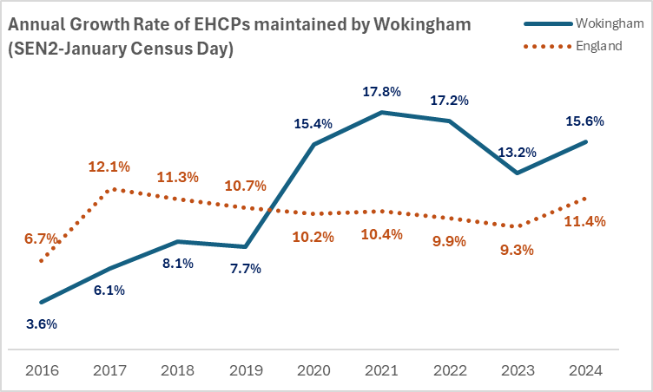
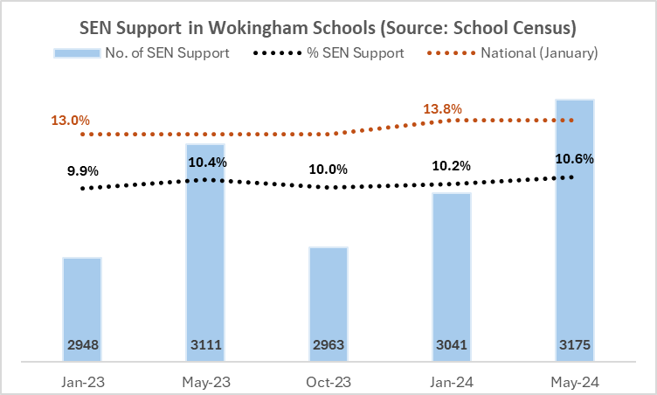
May 2024 School Census:
EHCP in Wokingham Schools – 1386, an annual increase of 0.6%, similar to national increase of 0.5%.
SEN Support in Wokingham schools – 3175, an annual increase of 0.2%, lower than national increase of 0.8%.
Q2 2024-25:
At the end of Sept-24, there were 2181 plans maintained by
Wokingham, a 14% annual increase from Sept-23, lower than 15.6% in Jan-24 on the census day.
HNB EHCP Numbers – Locally & Nationally

Slide 4
HNB In Year Deficit and Increase %
Steep increase in deficit over period
Mainly driven by increase in EHCP numbers, unit cost and profile of plans
Encouragingly, reduced growth in annual % increase in 2024-25
HNB Deficit

Slide 5
HNB Key Financials Update – 2025-26
Financials |  | 2023-24 |  | 2024-25 | 2025-26
 |  | Actuals |  | Forecast <A> | Budget <B> | Diff <B>-<A> | Diff %
Total Expenditure |  | 41,163 |  | 47,603 | 53,284 | 5,681 | 11.9%
Total Income |  | (28,225) |  | (28,052) | (28,784) | (732) | 2.6%
HNB In Year Deficit |  | 12,938 |  | 19,551 | 24,500 | 4,949 | 25.3%
No. of EHCP plan |  | 1,953 |  | 2,220 | 2,443 | 223 | 10.0%
No. of EHCP plans is expected to increase by 223 year-on-year. Growth rate probably would slow down but still at a double digit %
WBC is exploring ways to increase supply of Resource Base and Special School places, but in year 25-26 and short term, increasing demand for Special Schools and INMSS places would still be the key driving force for increase in expenditure
HNB In Year Deficit is expected to increase by £4,949k or an equivalent 25% hike
Note : Year 25-26 budget expenditure and income lines reduced by £3,200k as Addington places will be funded directly by ESFA
High Needs Block

Slide 6
HNB – Project Programme
Early Intervention & Prevention
Local Offer
Early Years Strategy
New SEN Support Service
Sufficiency & New Provision
Resource Base Reconfiguration & New SEND units
Special Schools
AP & EOTAS Review
Post 16 Strategy
Commissioning
Therapies Review / CAMHS / Health Financial Contributions
System and Operations
Revise Banding Framework
Digital Improvement
Placement Planning
HNB Model – Zero Growth & Reprofiling EHCP’s
High Needs Block – Project Programme

Slide 7
There is no new money in the total budgets available. There will be winners and losers BUT overall this will achieve a more equitable and fairer system.
We can only achieve this in partnership with schools – changes may be dramatic and impact needs to be carefully modelled (dry run allocations). Proposal will fundamentally change how we appraise cost/need.
Simplify the process and framework – currently close to 50 levels of banding being employed
Top up funding across the board seems to be very ad-hoc – some schools are in strong position to negotiate special terms for individual cases.
Uneven distribution of EHCPs between schools – whole system is heavily reliant on small number of schools with high proportion of EHCPs. Whilst these schools are very inclusive this creates system-wide vulnerabilities
Focus on reducing spend in INMSS and divert expenditure to local provisions, early intervention, SEND support etc
Banding Framework - Summary

Slide 8
The highest proportion (41%) of all mainstream EHCPs are in the middle bracket of 26-30 funded hours per week.
26% of mainstream placements are funded within the top funding bracket (more than 30 hours per week).
80% of mainstream spend incurred in the middle & top funding brackets
In terms of overall distribution, 244 (21%) are funded at precisely 25 hours and 307 (26%) are funded at precisely 30 hours.
4 schools account for almost 40% of all EHCPs in the 30+ hours bracket
High Needs Block – Mainstream Profile

Slide 9
 | Compared to…..
2021/22 Expenditure | Statistical neighbours | Regional average | National average
Total top-up funding (maintained) | Higher | In-line | Lower
Top-up finding – maintained early years | Higher | Higher | Higher
Top-up funding – maintained primary school | Lower | Lower | Lower
Top-up funding – maintained secondary school | Higher | Higher | Higher
Top-up funding – maintained Special School | Higher | Lower | Lower
Top-up funding - maintained AP | Higher | Higher | In-line
Non-maintained special school (“INMSS”) | Higher | Higher | Higher
Therapies/other health-related services | Higher | Higher | Higher
SEN Support and inclusion services | Lower | Lower | Lower
Use of HNB Benchmarking Tool
Data based on spend per head of population, aged 2-18 yrs old rather than EHCP’s
Data is slightly outdated, updated tool in progress to renew figures
WBC generally higher than neighbouring LA’s and regional average
Important note: the colour coding does not reflect a judgement about whether higher/lower/in-line spend is good or bad. For instance, higher spend on “SEN Support and inclusion” could be viewed as a positive. The red/amber/green colour coding is solely to indicate higher/in-line/lower.
High Needs Block – Benchmarking Data

