Slide 1
SBM Briefing –2025
27th February 2025
Please ensure your microphone is muted during the meeting unless you are asking a question.
If you have any questions, please write them down in the chat or ask these in the Q&A section at the end of the meeting.

Slide 2
AGENDA
10:00 – 10:05 | Introduction and welcome
10:05 – 10:25 | Energy Update Ian & Hoyte, Tom Quinlan - Energy Officer
10:25 – 10:40 | Procurement act Clare Priest – Head of Procurement
10:40 – 10:50 | Traded Services Gemma Plowright – Commercialisation Manager
10:50 – 11:05 | High Needs Block Kenneth Chan – Management Accountant
11:05 – 11:30 | Schools Finance Update Victoria Sarson – Senior Schools Finance Officer Angela Blogg – Schools Finance Manager Diana Hollis- Management Accountant
11:30 – 11:45 | Questions and any other business

Slide 3
Academisation
The LA has four months from the date of conversion in which to close off the converting school’s accounts.
The closing position is calculated by way of a “Determination”, or conversion statement, which sets out all the elements of the school’s budget allocation.
The determination accounts for the proportion of allocations, retained by the school and recouped by the LA. It is calculated in line with academisation guidelines, and dependant on the date the payment is taken over by the ESFA.
If you are preparing for academisation, shortly, please read the guidance (via the link below) and advise schools finance if you have any queries.
Policies and Guidance
Queries please contact: schoolsfinancehelpdesk@wokingham.gov.uk

Slide 4
SFVS
Please use the checklist form (link below) - do not use an old template – each year the Government make slight changes.
Please submit the related party transactions form (link below) – even if this is not applicable to your school.
Gov web links below:
https://www.gov.uk/government/publications/schools-financial-value-standard
Schools financial value standard (SFVS): checklist guidance
Schools financial value standard (SFVS) additional resources
Template for recording related party transactions
Schools financial value standard (SFVS) checklist
Deadline for submissions to Schools Finance:
31st March 2025

Slide 5
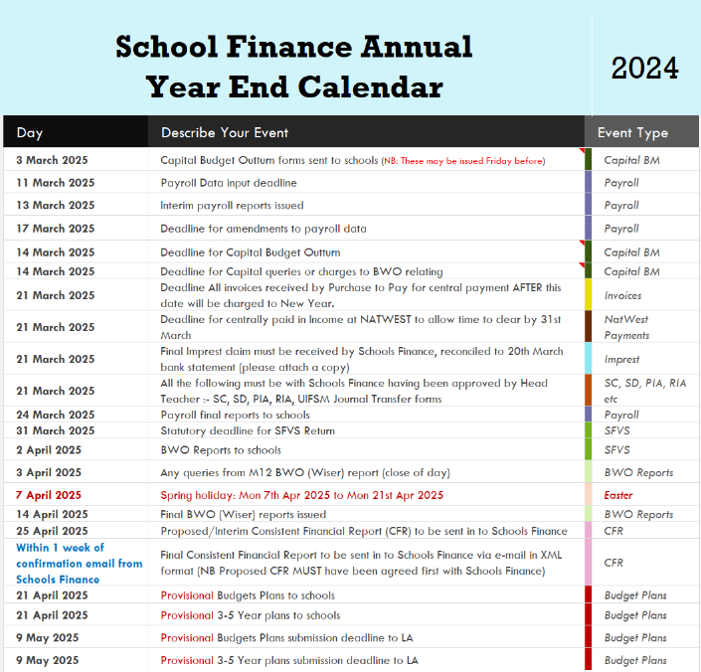
YEAR END
The Timetable is available on the website:
Timetable

Slide 6
Closedown 2024-25
Key Dates:
Reminder: Any adjustments – should be replicated from FMS/Access and BWO.
Accruals:
Energy accruals can be under £1,000. Energy colleagues can advise on values if required. If schools have transferred over to FBW, this also applies to water.
PPG and CSBG payment due with WBC 31st March 2025.
PE Grant payment due with WBC 30th April 2025
SMHL Grant – if you have made an application you may need to accrue if the training occurred before YE.
TPAG & TPECG – if eligible payments were May and October.
Accrual forms and UIFSM calculator can be located on the below link on the Schools Finance Closedown page:
21st March 2025:
Deadline for centrally paid invoices
Final imprest
Approved accruals journals (SC, SD, PIA, RIA, UIFSM)
Deadline for Asset Leasing
31st March 2025:
SFVS to schools
2nd April 2025:
BWO reports to schools
3rd April 2025:
Queries on BWO reports to SFH
Closedown Forms and Guidance
Spring Holiday: Mon 7th Apr 2025 to Mon 21st Apr 2025

Slide 7
Budget Plans
Guidance for completion
As part of your SFVS commitments you are required to submit a 3-year budget plan to the LA.
We will send out a 5-year plan template from BWO, or, submit your own template.
INCOME:
Key changes to the schools NFF in 2025-2026 are the incorporation of TPAG, TPECG and CSBG.
APT now available on the Schools Finance Website
3-4 indicative budgets were sent 25/2/25
2y & 9mths - 2y is under review
EXPENDITURE:
NI no change – remaining at 13.8%
Teachers Pension no change – remaining at 23.68%
LGPS currently 26.3%. Diptesh will advise as soon as details received
Support Staff (NJC) Pay – Unions have asked for increase of RPI + 2% on all spinal points and additional claims e.g. an additional day annual leave. WBC have assumed 4% increase corporately
Teachers Pay – DfE is recommending 2.8%
Deadline for submissions to Schools Finance:
9th May 2025

Slide 8
GRANTS
Changes for 2025-2026
Rolled into Schools Block Funding
TPECG
CSBG
TPAG
Expecting but unconfirmed for 2025-2026
Updated information is available on the Grants SharePoint hub.
Pupil Premium
UIFSM
SMHL
PE & Sports Grant

Slide 9
Pupil Premium
Expect the payment to LA’s to mirror last year as follows:
28th June 2025
30th September 2025
31st December 2025
31st March 2026
As soon as we have notification from the DfE we will advise the schools of the rates
UIFSM
We would expect the payment to LA’s to mirror last year as follows:
7/12 of the funding allocation on June 2025
5/12 of the funding allocation on June2026
As soon as we have notification from the DfE we will advise the schools of the rates
SMHL
From October 2021 to December 2024, schools could apply for a senior mental health lead training grant. The deadline to apply for the grant was 31st December 2024. Therefore, it may be possible we received residual payments from current financial years applications.
PE & Sports Grant
If DfE run this grant for 2025/2026 we would expect the payment to LA’s to mirror last year as follows:
7/12 of the funding allocation on 31st October 2025
5/12 of the funding allocation on 30th April 2026
As soon as we have notification from the DfE we will advise the schools of the rates

Slide 10
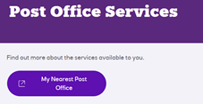
Post Office | Natwest
Banking at the Post Office
Contacts and Useful Information
What can we do at the Post Office?
We’ve increased the number of services available at thousands of Post Office outlets across the UK.
As a NatWest customer, you can:
Deposit cash with a barcoded paying-in slip or using your debit card and PIN.
Deposit cheques with a paying-in slip.
Exchange cash for coin using the Post Office Change Giving service - you must register for this service.
Withdraw cash using your debit card and PIN.
Get your balance using your debit card and PIN.
Contact the service team to order your barcoded paying in slips on:
Please use the below link and watch the “How To Videos”.
Points to note: We have been advised the Post Office will only accept full cash bags.
publicsectorandcharitiesservicingteam@natwest.com
Post Office | NatWest Business

Slide 11
AOB
Any Questions?
Feedback form

