Slide 1
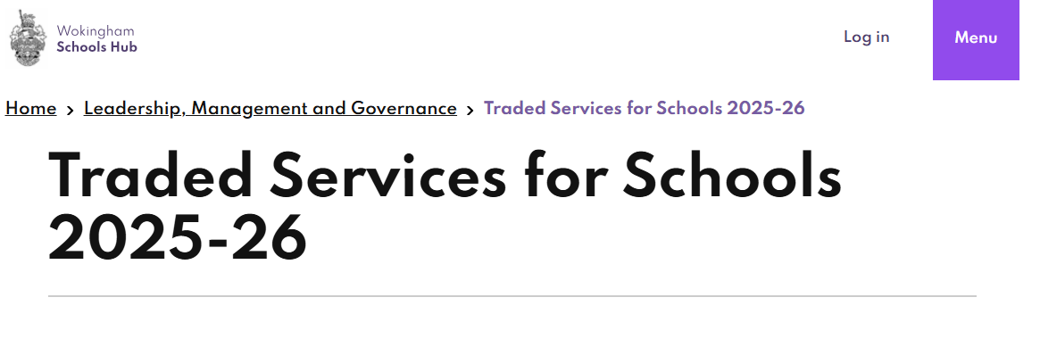
Traded Services for Children’s services & Select Business Services now together in a single point of entry – the Schools Hub
https://wsh.wokingham.gov.uk/leadership-management-and-governance/traded-services-schools-2025-26
Everyone should designated school personnel with access:
Any problems with access please contact Business services on business.services@wokingham.gov.uk

Slide 2
Traded Services
Changes have been made to some services (those affected will have already been informed) including:
School Meals Contract
Schools Maintenance Contract
Schools Finance
Smaller changes to inclusions / structure of the offering have been made to other services including:
- Health & Safety
- Forestry

Slide 3
Traded Services
All services can be booked via an online order form on the schools portal.
A PO will be required for each contract ordered so schools can be invoiced/charged accordingly.
Deadline for submission of order form is 28th March 2025

