Slide 1
VAPING TOOLKIT
FOR SCHOOLS
This toolkit includes useful resources and information around vaping.

Slide 2
Contents
This toolkit provides schools with useful resources, important information, guidance, and relevant legislation to help tackle youth vaping. It serves as a handy reference, giving educators the tools they need to raise awareness, act, and create a vape-free environment for students.
4-8
Essential Guidance
9-11
Resources for Teachers
12-13
Resources for Parents and Carers
13
Tools and Support for Parents and Carers
14-18
Information and Support for Young People
20
Useful Contacts and Recommended Websites

Slide 3
National context
According to the NHS England, 2023 Smoking, Drinking and Drug Use among Young People in England Survey, 5% of 11–15-year-olds reported vaping at least once a week, while 4% said they vape occasionally (less than once per week). Vaping was more prevalent among girls, with 6% reporting regular use, and even higher among young people who identify as another gender, at 11%. Overall, one in four young people (25%) said they had ever used a vape, this increases significantly by age, with 42% of 15-year-olds reporting they had ever used a vape. Among young people that regularly use vapes, 61% reported using vapes for over a year, and 54% said they buy their vapes from shops. Nearly half (47%) of 15-year-olds believed it was acceptable to try vaping out of curiosity, while 34% said it was okay to vape once a week.
Local context
There is no reliable local data on the prevalence of youth vaping, however the 2023 OxWell student survey included tobacco and vaping related questions. Among 698 respondents from three local secondary schools, 10 students (1.4%) reported vaping daily, while 9 students (1.3%) said they vaped often or sometimes. It is important to highlight that the OxWell survey is not completed by all schools (and not all pupils within a participating school choose to respond), this means that the results from the survey may not be representative of all young people; however, it is the only source of local data on vaping rates.

Slide 4
KEY GUIDANCE

Slide 5
The Southeast Association of Directors of Public Health (ADPH) position statement on vaping
The South East ADPH 2024 position statement on vaping provides a regional public health consensus, offering valuable guidance to help organisations shape their policies and practices. It reflects the most recent evidence, best practice guidelines, and relevant regulations, while also summarising key communication messages:​
​
Vapes are less harmful than smoking and can be an effective quit aid for adults who smoke. ​
If you smoke, vaping is safer than smoking. Vaping has minimal serious side effects when used for a short time to stop smoking.
​
People who want to quit smoking using a vape should be encourage to quit smoking and switch to vaping. ​
People who do not smoke, should not vape. ​
We must prevent children from using vapes due to the unknown longer-term harms of vaping and the risk of nicotine addiction

Slide 6
Guidance for managing vapes in schools
The South East Association of Directors of Public Health has produced advice and guidance for managing vapes in schools, targeted at Headteachers, school staff, safeguarding leads, and governing bodies. This document provides practical advice on how to address vaping within the school environment. You can access this guidance here: Managing Vaping in Schools_links v2.pdf
The public health charity Action on Smoking and Health (ASH) has also published guidance to help schools develop comprehensive policies for managing vaping. This guidance assists schools in addressing vaping issues in a way that promotes the health and safety of students.

Slide 7
Vapes & the law
It is illegal to sell vaping products containing nicotine, or tobacco products, to individuals under the age of 18. To be legally sold in the UK, nicotine-containing vapes must meet the following requirements:
Contain 20 mg/ml or less of nicotine (equivalent to 2% or less).
Carry the health warning: "This product contains nicotine, which is a highly addictive substance."
Be notified to the MHRA (Medicines and Healthcare products Regulatory Agency) and listed on its website.
Enforcement of laws related to underage sales, illegal products, and point-of-sale advertising is the responsibility of Trading Standards. Complaints regarding these issues can be made through the Citizens Advice online portal.
The Trading Standards service is provided by West Berkshire Council in partnership with Wokingham Borough Council.
You can contact them via:
Telephone
0345 404 0506 (Citizens Advice Consumer Service)
01635 519930 (Trading Standards)
Email
tsadvice@westberks.gov.uk
Contact Us Form: Contact Form

Slide 8
Creating a smokefree generation & tackling youth vaping
c
On Tuesday 5 November 2024, the government introduced the Tobacco and Vapes Bill into Parliament to put the UK on track to becoming smoke-free. It includes:
Create a Smoke-Free Generation ​
Makes it an offence to sell tobacco products to anyone born on or after 1 January 2009​​
This will not criminalise smoking nor will it mean anyone who can buy cigarettes now will be prevented from doing so in the future ​​
Smoke-free places​
Powers to extend smoke-free places restrictions to specific outdoor settings ​​
Powers to create vape free places and heated tobacco free places​​
Youth Vaping ​
Provides powers to regulate the flavours and descriptions of vapes and nicotine products and displays in retail outlets ​​
Provides powers to regulate vape and nicotine product packaging and product presentation​​
Bans the advertising and promotion of vapes and nicotine products​​
Bans free samples of vapes and nicotine products and bans the sale of non-nicotine vapes and nicotine products to under 18s​​
4. Enforcement ​
Provides powers to introduce licensing for sales of tobacco, vapes and nicotine products ​​
Introduces £200 fixed penalty notices to retailers who sell tobacco products or vapes to people underage​​
Provides powers to introduce a new registration scheme for tobacco, vapes and nicotine products on the UK market
The ban on disposable vapes was brought forward by DEFRA under separate environmental legislation - if passed, the ban will come into force on 1 June 2025 across all four UK nations

Slide 9
RESOURCES
For Teachers

Slide 10
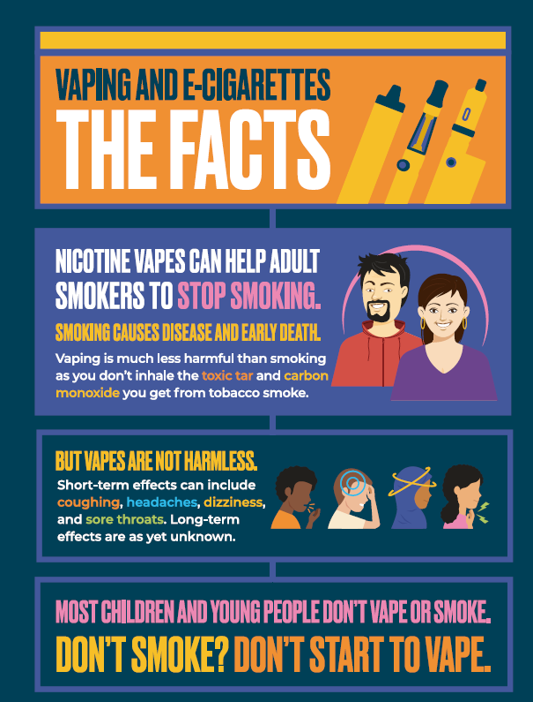
A range of resources are available to help communicate the facts about vaping to children and young people. These resources also support carers and educators, including PSHE and safeguarding leads, in having evidence-based discussions that empower young people to make informed choices about smoking and vaping.
Available resources for schools include:
Posters: Displayable in key areas such as school toilets, classrooms, canteens, and noticeboards, these posters provide clear messaging on vaping.
A4 Vaping Poster A (digital)
A4 Vaping Poster A (Print)
A4 Vaping Poster B (digital)
A4 Vaping Poster B (Print)
Animated Film; A short animated film that can be used in PSHE lessons, form times, and assemblies to initiate discussions.
PowerPoint Slides for Classroom Use; Ready-to-use PowerPoint slides for teachers to guide classroom discussions alongside the animated film.
Vaping the Facts Presentation
Detailed Teachers’ Slide Set; A more comprehensive slide set for teachers, providing additional information to support educators, answer questions, and signpost additional support resources.
Teachers Toolkit Presentation

Slide 11
Vaping - Key Stage 3 Form Time Activities
These resources, provided by the Department of Health & Social Care, are designed to help students understand social pressures around vaping, the impact factors, and the effects of nicotine on the adolescent brain. The activities support the PSHE curriculum.
Included Resources:
Three Bitesize PowerPoint Sessions; These sessions provide concise, digestible content for students, introducing key topics related to vaping.
Three Films to Support Activities; Short films to engage students and reinforce learning in a dynamic way.
Guidance for Teaching About Vaping; Provides structured advice and practical tips for educators on how to approach the topic of vaping in the classroom.
Teacher Training:
Training Module from GOV.UK; This training module supports teachers and subject leads in understanding and delivering the drugs, alcohol, and tobacco section of the statutory Relationships, Sex, and Health Education curriculum.

Slide 12
RESOURCES
For Parents/carers

Slide 13
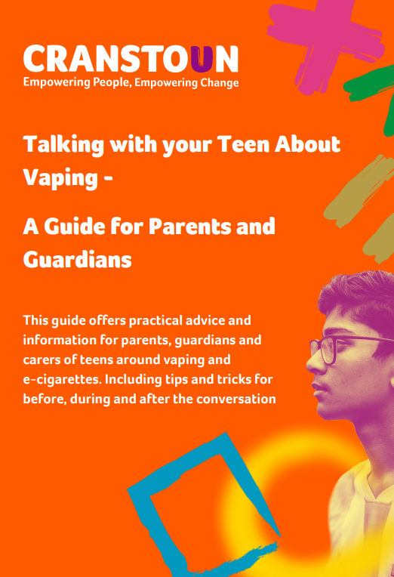
The below guides provide valuable tools and information to support parents and carers in understanding and addressing vaping concerns.
1. Illegal Vapes: Parents & Carers Guide Learn how to spot illegal vape products with practical advice and visual cues.
2. A5 Vaping Leaflets (Digital) This leaflet is to support parents and carers to have conversations with their children about vaping
3. Cranstoun "Talking to Teens About Vaping" Pack A comprehensive guide for parents and carers with:
Practical advice for conversations
Myth-busting facts
Support to promote healthier choices

Slide 14
Information & support for young people

Slide 15
The resources below are designed to support young people in quitting vaping, offering guidance, tips, and goal-setting strategies.
Self-Help Guide to Quit Vaping
Step-by-step strategies and practical tips to help quit vaping.
2. Youth Vaping Workbook
Interactive exercises to build awareness of vaping risks, personal goal-setting, and coping strategies

Slide 16
Support for Students and Parents
Chat Health: Confidential Texting Service. Chat Health provides a confidential texting service that connects students and parents with experienced school nurses. It offers advice on a variety of topics, including:
Mental Health
Vaping and Smoking
Relationships
Stress and Anxiety
Nutrition and Fitness
For students aged 11-19:
Text 07312 263266
For parents and carers:
Text 07312 263194
Please note: This is not a live chat session, but the nurse will aim to respond to all messages within 24 hours.

Slide 17
Talk to FRANK: Confidential Advice for Young People
Young people can get friendly, confidential advice on smoking, vaping, and other topics from Talk to FRANK.
FRANK Support:
Call: 0300 123 6600 (24 hours a day, 7 days a week)
Text: 82111 (Text your question, and FRANK will respond)
Live Chat: Available from 2pm – 6pm, 7 days a week
Email: Send an email to FRANK for a response
https://www.talktofrank.com/

Slide 18
Support to quit smoking
If a young person aged 12 or over is smoking and wants support to quit, they can be referred to their local Stop Smoking Service. These services offer specialised, friendly support to help anyone quit smoking. With treatment and support, the likelihood of success is three times greater.
They offer:
One-to-one or group sessions over 12 weeks
A free weekly supply of Nicotine Replacement Therapy (NRT)
Drop-in clinics in local community settings, GP surgeries, supermarkets and other venues
A selection of clinics operating by appointment only
Support via Quitline, text or Face-to-Face video chat
Home visits for people with mobility problems
SmokeFreeLife Berkshire:
Phone: 0800 622 6360
Text QUIT to 66777
Smoke free life Berkshire

Slide 19
USEFUL WEBSITES

Slide 20
Vaping and E-cigarettes: Websites
E-cigarettes: Just the Facts - Health for Teens
A resource to help teens understand e-cigarettes, their effects, and related health risks.
How to quit vaping - Better Health – NHS
Tips and advice on quitting vaping
Vaping - Childline
Information and support for young people around vaping, its risks, and how to get help.
What is Vaping and What Are the Risks? - The Mix
An informative article explaining what vaping is and the associated risks and side effects.
Information on Vapes - FRANK
Trusted, confidential advice on vaping and how it affects health, provided by FRANK.
Vaping Myths and the Facts - Better Health
Debunking common myths about vaping, providing evidence-based facts to clear up misconceptions.
ASH Resources on Youth Vaping
Action on Smoking and Health (ASH) offers resources focused on the impact of vaping among young people.

Slide 21
Acknowledgements
Wokingham Borough Council extends its appreciation to all those who contributed to the development of this Vaping Toolkit for schools.
Special thanks to Nicola Owens (Project Officer) for coordinating the collection of resources and information. We also thank Jennifer Gallacher (Health Promotion Officer) for her assistance with the design elements of the toolkit. We also acknowledge the contributions of Smokefree Sheffield in collaboration with Action on Smoking and Health (ASH) for the development of school resources and Cranstoun for the creation of the resources to support young people.
Finally, we thank the colleagues, health professionals, services and partners that have provided resources to ensure this toolkit meets the needs of schools and young people.
We’d love to hear your thoughts! Your feedback is invaluable in helping us improve and tailor the content to better meet the needs children and young people.
Please let us know if you found this toolkit useful, any changes you’d like to see, and what additional resources would be helpful.
You can share your feedback or contact us at public.health@wokingham.gov.uk.
Feedback

