Slide 1


School Business Manager Meeting
25 September 2025

Slide 2


Agenda
Time | Topic | Presenter
10:00 - 10:05 | Welcome
10:05 – 10:25 | Utilities Update | Tom/ Matthew/ Paul
10:25 – 10:35 | Capital | Nisar
10:35 – 10:50 | School Organisation Plan | Oliver/Piers
10:50 – 11:05 | SRMA | Angela
11:05 – 11:20 | High Needs Block Update | Al / Kenneth
11:20 – 11:30 | Budget Monitoring | Vicki
11:30 – 11:50 | Looking ahead – P9 BM; APT; Budget Planning | Angela
11:50 – 12:00 | Questions & AOB

Slide 3

Academisation
The LA has a four-month period from the date of school conversion to finalise the accounts of the converting school.
The closing position is calculated via the “Determination” statement and outlines all components of the school’s budget allocation.
The Determination reflects the proportion of allocations retained by the school and amounts recouped by the LA. It is calculated in accordance with DfE guidelines, and is dependant on the date the DfE assumes responsibility for payments.
If you are preparing for academisation:
Ensure that a new bank account has been opened and that all direct debits (DDs) and standing order payments (STOs) are transferred accordingly.
Notify Wokingham Borough Council, parents, lettings customers, any other income sources of your new account details (WBC will need to create a new supplier for the school - so advance notice is required)
Aim to process as many bank transactions as possible before conversion, however, a final imprest, post conversion but before final settlement can be processed.
Please review the guidance (via the link below), and contact schools finance with any questions: schoolsfinancehelpdesk@wokingham.gov.uk
Policies and Guidance

Slide 4

School Resource Management Advisers (SRMA) programme
Angela Blogg

Slide 5


SRMA programme
Peer to peer support – experienced school finance professionals
Critical friend approach
Free to access, funded by the DfE
6-8 week timeline
Provide recommendations for deficit management

Slide 6

Budget Monitoring

Slide 7


Agenda
P6 Considerations
Preparation
System Reports
BM Template
Grants
P9 – Planning

Slide 8

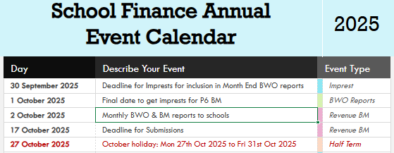
P6 Considerations
P6: Does not constitute enough of the school year to reliably assume that half of the budget has been utilised.
Teachers Pay: 4% uplift confirmed from September 2025.
Non-Teaching Staff: 3.2% uplift confirmed and backdated to April 2025
Utilities: We anticipate more than 50% of your budget is remaining. This will increase during winter months.
Income: Check received what was expected

Slide 9

Preparation
Procedure note are available on the Schools Finance website
Regular Monitoring: We expect you have conducted regular monitoring against agreed budgets and reconciled FMS / ACCESS to your monthly BWO Reports.
Cash Flow: Ensure your imprests are up to date and you have copies of monthly bank statements
Budget Plans: Have a copy of the original budget plans to locate any variances (please ensure you have explanations for any significant variances)
Contact SFH with any anomalies

Slide 10
Download all FMS and ACCESS reports simultaneously
System Reports
FMS Reports
Fund Review
ACCESS Reports
Interim CFR report
Proposed CFR
I&E Report (to month 13)
Balance Sheet Report
Trial Balance Report
Management report (please tick to include commitments)
I&E Report (to month 13)

Slide 11
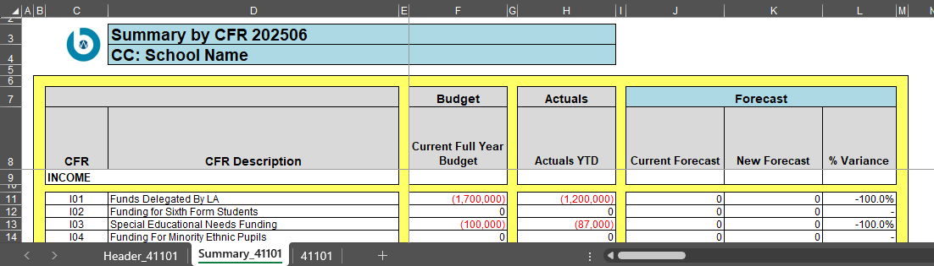
BM Template
Do’s & Don’ts
BM Workbook
DO follow the guidance on the website.
DO complete your forecast at either CFR or account/ledger code level.
DO ensure you use the comments column for significant over or under spends
DON’T alter the template by adding or deleting any rows/columns.
DON’T override the Grey formulae cells
Header tab: Reconciliation and Sign-Off Sheet
Summary tab: Summary by CFR Code
Cost Centre(Details) tab: Summary by account/ledger Code

Slide 12

Grants
2025
Nic Grant
PE & Sports Grant
Pupil Premium Grant
Schools Budget Support Grant
Universal Infant Free Schools Meals Grant

Slide 13
Expected dates of payment to LA
All eligible schools need to complete the digital expenditure reporting return for the PE and sport premium, for the 24/25 academic year, by 5pm on Tuesday 30 September 2025.
GRANT PAYMENTS | PAYMENT 1 | PAYMENT 2 | PAYMENT 3 | PAYMENT 4 | GOV WEBSITE LINK
NIC | September 25 | March 26 |  |  | National Insurance contributions (NICs) grant for 2025 to 2026 - GOV.UK
PE & Sports (Dates not yet published) | October 25 | April 26 |  |  | Grant has been confirmed but there is no official Gov information available
PPG | June 25 | September 25 | December 25 | March 26 | Pupil premium: overview - GOV.UK
SBSG | October 25 |  |  |  | Schools budget support grant (SBSG) - GOV.UK
UIFSM | June 25 | June 26 |  |  | Universal infant free school meals (UIFSM): conditions of grant 2025 to 2026 - GOV.UK
Beyond 25/26, funding will be incorporated into core budget allocations by being rolled into the schools block of the schools national funding formula (NFF) for 26/27.
UIFSM: June 25 = Final allocation 24/25 and 7/12ths provisional allocation 25/26 & June 26 = Final allocation 25/26 and 7/12ths provisional allocation 26/27

Slide 14
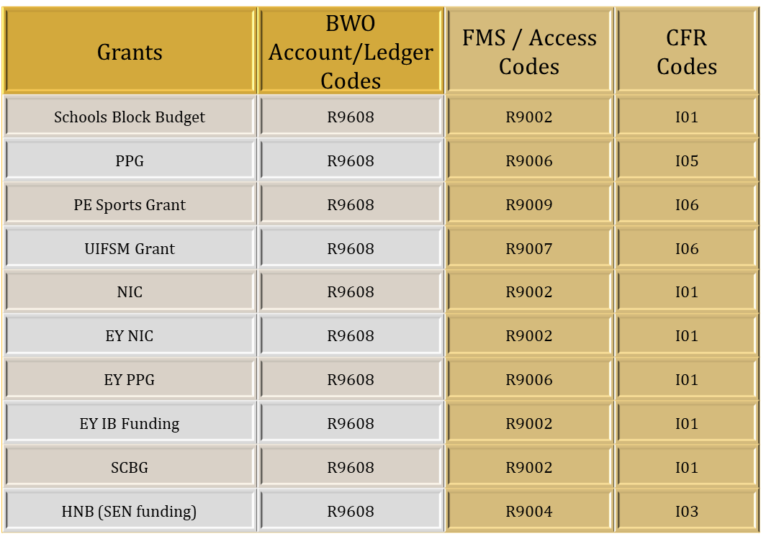
Coding
Consistent financial reporting framework 2025 to 2026 - Income - Guidance - GOV.UK

Slide 15

P9 – Planning
P9: Should provide a clearer picture of where you are with budget vs actuals.
Expecting a Year End deficit?
Use BM to identify where savings can be made or revenue can be generated.
Revenue: Renting rooms, car parks, holiday clubs / second-hand uniforms / PTA fundraising, local business to sponsor school events, Supermarket charity tokens.
Savings: Staffing adjustments (consider roll numbers for upcoming FY—review & implement changes proactively), are there any modifications to your energy consumption or other resources.
Surplus funds
Review School Development Plan and identify any costed projects not yet under way.

Slide 16

APT and Budget Setting for 26/27
APT
discussion with the Task and Finish Group, consultation with schools and Schools Forum
moving to the NFF, impact of the HNB contribution, growth fund proposals
Budget Setting
Guidance in the new year for budget setting
3-5 year plans

Slide 17



Thank you
Email: Schoolsfinancehelpdesk@wokingham.gov.uk
Timetable: Schools Finance Calendar 2025
Budget Monitoring: Budget Monitoring
BWO Codes: CFR to Account Code Mapping
Grants: Grants

