Slide 1


CAPITAL

Slide 2
Additional content
Capital project Considerations
A capital project can also be plant or equipment that will either acquire or enhance an asset that will see benefit for more than one year.
One Capital Project Notification(CPN) form per project
Is the project identified in your school development/asset management plan?
Does the Project only involve ICT Equipment?
Do you require WBC's Buildings Unit to project manage the works?
Is the need for the work outlined in the schools latest Ofsted Report?
Approvals
Do you have the approval of the Head Teacher?
Do you have approval of the Chair of Governors
Do you have a copy of the meeting minutes the project was discussed and agreed on?
The project cannot commence until the Local Authority approval has been obtained.

Slide 3



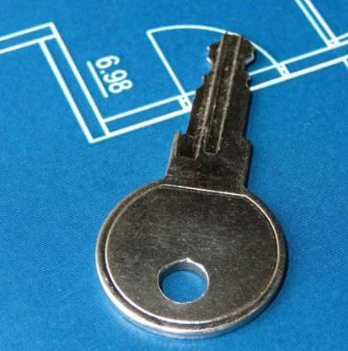


Thank you
Schools Capital Advice and Forms
Business.Services@wokingham.gov.uk

