Slide 1
High Needs Block update
25 Sep 2025

Slide 2


HNB Key Financials Update : 2025-26
Financials | 2024-25 |  | 2025-26 | 2025-26
£’K | Actuals |  | Budget <A> | Forecast <B> | Diff <B>-<A> | Diff %
Total Expenditure | 46,253 |  | 53,145 | 49,052 | (4,093) | (7.7%)
Total Income | (28,056) |  | (28,645) | (28,644) | 1 | -
HNB In Year Deficit | 18,197 |  | 24,500 | 20,408 | (4,092) | (16.7%)
No. of EHCP plan | 2,194 |  | 2,565 | 2,487 | (78) | (3.0%)
Provision type | Budget | Forecast | Diff
£’K
Mainstream | 9,055 | 8,147 | (908)
Resource Base | 2,209 | 1,878 | (331)
Special Schools | 12,488 | 11,924 | (564)
INMSS | 18,904 | 17,177 | (1,727)
PRU | 2,157 | 2,368 | 210
Post 16 | 2,755 | 2,708 | (47)
Others | 5,577 | 4,850 | (726)
Total | 53,145 | 49,052 | (4,093)
No. of EHCP plans is expected to increase by 13% from 2,194 in year 24/25 to an estimated 2,487 in year 25/26 with two third of the growth from Mainstream and remaining from Special Schools and others
Growth of Independent Non-Maintained Special Schools (“INMSS”), Education Other Than At School (“EOTAS”) and others are slowing down when we are consolidating our provisions under Mainstream and Resource Base, this is also a key contributor to the saving compared to the original budget
Average cost per EHCP plan is at £19,700. Cost per EHCP plan at INMSS and Special Schools are £71,000 and £23,800 which are significantly higher than the average provision
HNB In Year Deficit is expected to increase by £2,211k YOY or an equivalent 12% annual increase
High Needs Block

Slide 3
HNB Key Financials Update : 2025-26
Financials | 2023-24 | 2024-25 | 2025-26
£’K | Actuals | Actuals <A> | Forecast <B> | Diff <B>-<A> | Diff %
Total Expenditure | 41,163 | 46,253 | 49,052 | 2,799 | 6.1%
Total Income | (28,225) | (28,056) | (28,644) | (588) | (2.1%)
HNB In Year Deficit | 12,938 | 18,197 | 20,408 | 2,211 | 12.2%
No. of EHCP plan | 1,953 | 2,194 | 2,487 | 293 | 13.3%
Cost per EHCP plan | 21.1 | 21.1 | 19.7 | (1.3) | (6.6%)
Steep increase in in-year deficit in early years which were mainly driven by increase in number of EHCP plans, unit cost and profile of plans
Year-on-year growth slowed down from 79% in year 23/24 to 41% in year 24/25 and to estimated 12% in year 25/26
Cost per EHCP plan recorded a first year drop in recent 3 years
When additional resource unit and new special school places are available, a further decline in cost per EHCP plan is expected
High Needs Block

Slide 4
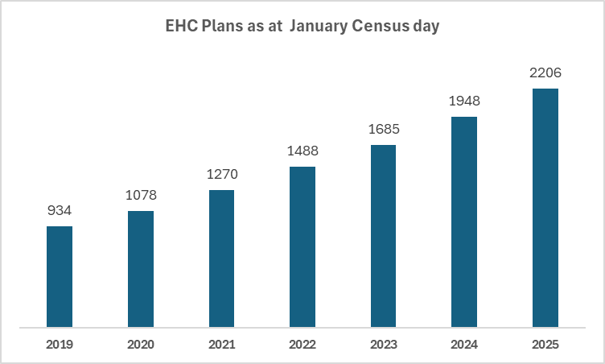
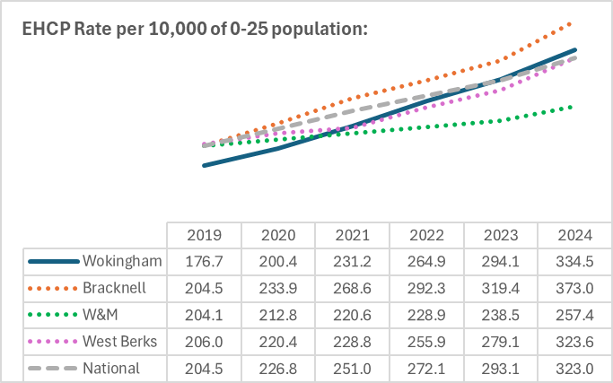
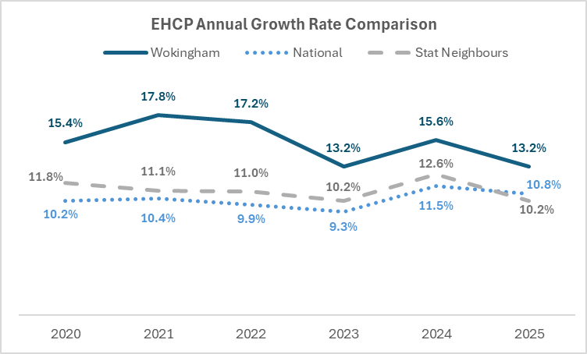
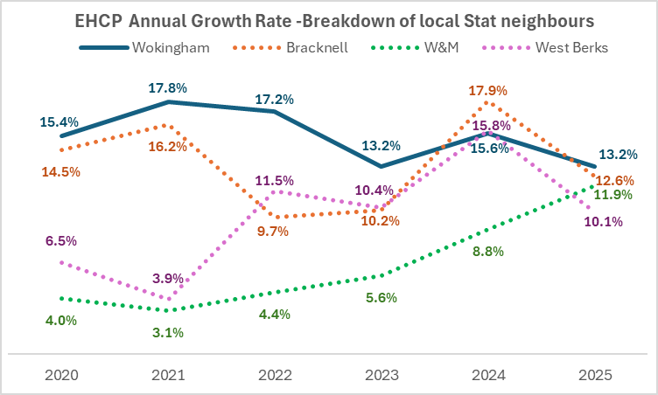
EHC Plans and Growth Rate:
Wokingham’s EHCP rate per 10,000 population remained below the national average until 2022 and is now broadly in line.
In 2019 and 2020, geographically close statistical neighbours recorded higher EHCP rates than Wokingham.
From 2022 onwards, Bracknell Forest has consistently maintained a higher rate than Wokingham. West Berkshire's rate has been slightly lower.
Windsor & Maidenhead has consistently reported significantly lower growth rates than other neighbouring authorities and the national average until 2025.
Wokingham’s annual growth rate of EHC plans is slightly above national average but has declined by 2.4% compared to the previous year.
All local authorities, with the exception of Windsor & Maidenhead (W&M), experienced a spike in growth in 2024, followed by a decrease in 2025.
Notably, W&M has shown a steady increase in growth since 2022, surpassing the national rate by 2025.

Slide 5
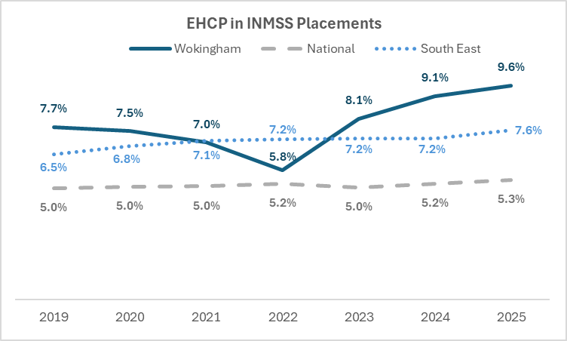
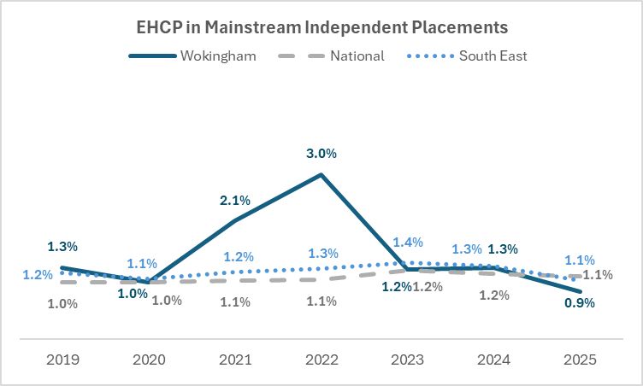
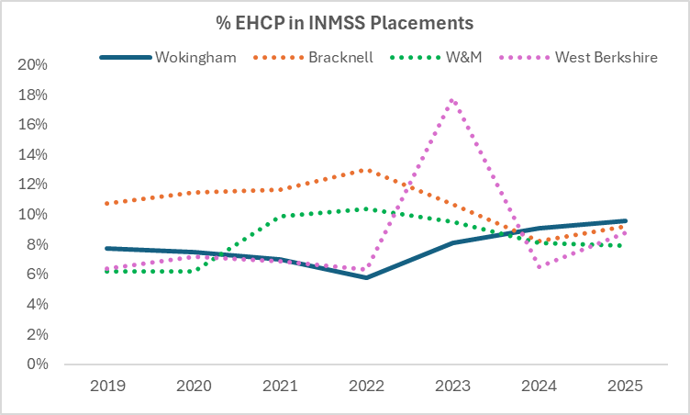
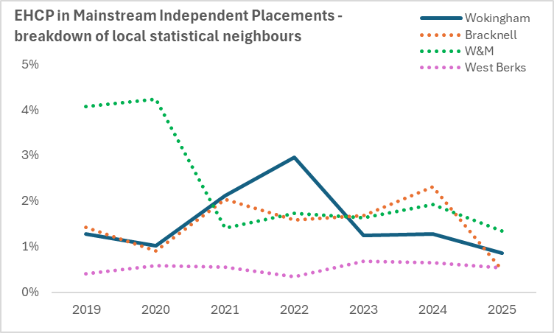
Independent & Non-maintained Placements as at SEN2 2025
Proportion of INMSS placements by Wokingham is higher than national & South East region and has grown for the past 3 years, BUT is broadly comparable with regional stat neighbours.
Wokingham and Bracknell have a similar proportion of INMSS placements, with West Berkshire (8.8%) being the lowest of all four.

Slide 6
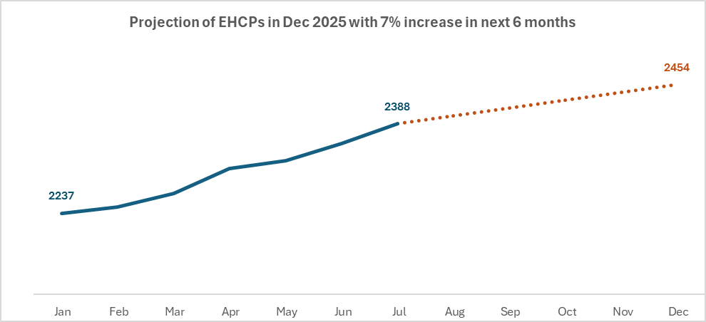
Projection of EHCPs at end of 2025:
From January to July 2025, 151 EHC plans were issued, with a growth rate of 7% in 6 months.
In the last two years, average of 70% plans were issued in the first 6 months of the year. If a similar growth trajectory is sustained through the remainder of this year (August to December 2025), the total number of EHC plans is projected to reach 2454 by the end of December 2025.
Between January and July 2025, 36 plans were ceased.
If the cessation rate increases (as planned) by January 2026 the projected number of active EHCPs by the end
of the calendar year will be 2,426 with an annual growth of 8%, a significant improvement on the 13.2% seen
last year.

