Slide 1

Wokingham Borough’s
Ordinarily Available Provision
Information for settings
September 2025
Notes:
This presentation is about Wokingham’s new Ordinarily Available Provision guidance that was launched in September 2025

Slide 2


What is Ordinarily Available Provision?
Ordinarily available provision is the inclusive provision and support available for all learners in mainstream schools
Notes:
Local authorities are required to set out what educational and training provision they expect to be made available by settings for children and young people with SEN.
Each local authorities' OAP should reflect the context of that particular area. Wokingham did have a guide but everybody agreed that it was time for a new one
Ordinarily Available Provision is the inclusive provision and support available for all learners in mainstream schools.
It is the support that schools put into place from their own resources without the need for an EHCP. It benefits all pupils but particularly those with SEND. Pupils with an EHCP will also benefit from the support laid out alongside the provision set out in section F of their EHCPs

Slide 3
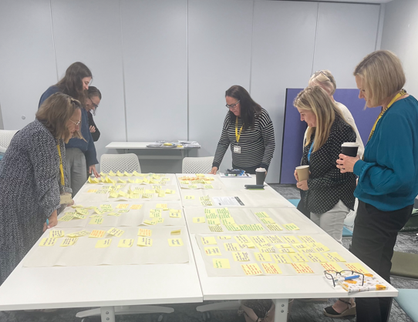
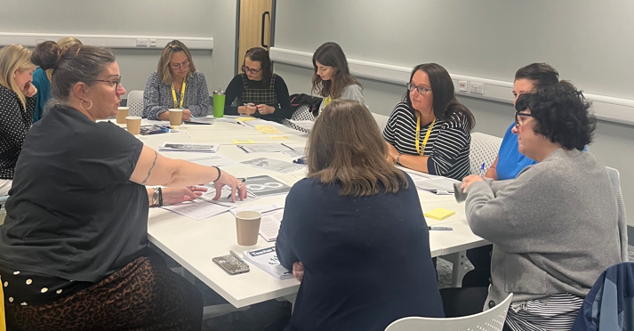
Co-production of the guidance
Active working party with representatives from different stakeholders
Workshops to ensure local context of Wokingham is captured
Contributions from specialist services
Informed by learners’ views on the support and adjustments needed
Draws on existing resources e.g. NASEN, EEF
Reflects the good practice seen in visits to local settings
Notes:
The reason this document has taken 18 months to produce is that there was a commitment to ensuring that it was co-produced in a meaningful way.
A working party was established with representatives from all different stakeholders including SENCOs, headteachers, EPs, outreach services, Wokingham staff, a parent representative. The working party was very active and responsive. They took part in workshops, attended many meetings, read drafts and provided feedback every step of the way
Another integral part of creating this guidance was the Area SENCOs visits to schools. She visited almost every school. Everything in this document reflects good practice that has been observed.
This document is also informed by the views of our learners. Some of our schools carried out pupil voice surveys with their pupils about the support and adjustments that they need. We also used information that schools had already gleaned from young people in their settings.
The guidance also draws on existing resources. In particular the NASEN teacher handbook and the EEF reports

Slide 4

How to access the guidance
You can access the guidance here:
Local Offer: Help with learning
Notes:
Anyone can access the document through the local offer.
School staff can also access the information on the Wokingham Hub
If you have downloaded the document onto to your school system, add the location to this slide

Slide 5

Introduction: pages 4 - 7
‘Wokingham is a borough where all children and young people are visible, valued, and included in their communities, are safe and cared for, achieve their potential, are healthy and feel happy, hopeful, and loved.’
Needs led, not diagnosis driven
Draws on evidence-based research (EEF)
Consistency across mainstream settings
Inclusion embedded in everyday practice
Environments that make learners feel valued and supported
High quality adaptive teaching
Early intervention, inclusion and continuous improvement
Notes:
On the left is Wokingham’s vision. It underpins this document and others.
These are the principles that inform this guidance.
Draw people’s attention to ‘needs led not diagnosis driven’ – this means that children do not need a diagnosis to access support and a diagnosis does not necessarily tell you the support a child might need.

Slide 6
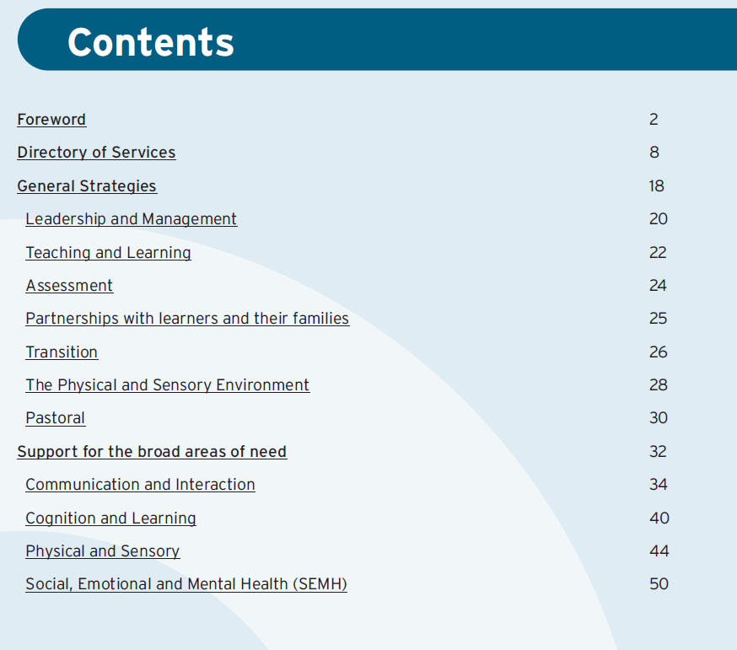
Format of the guidance
Notes:
Explain layout

Slide 7
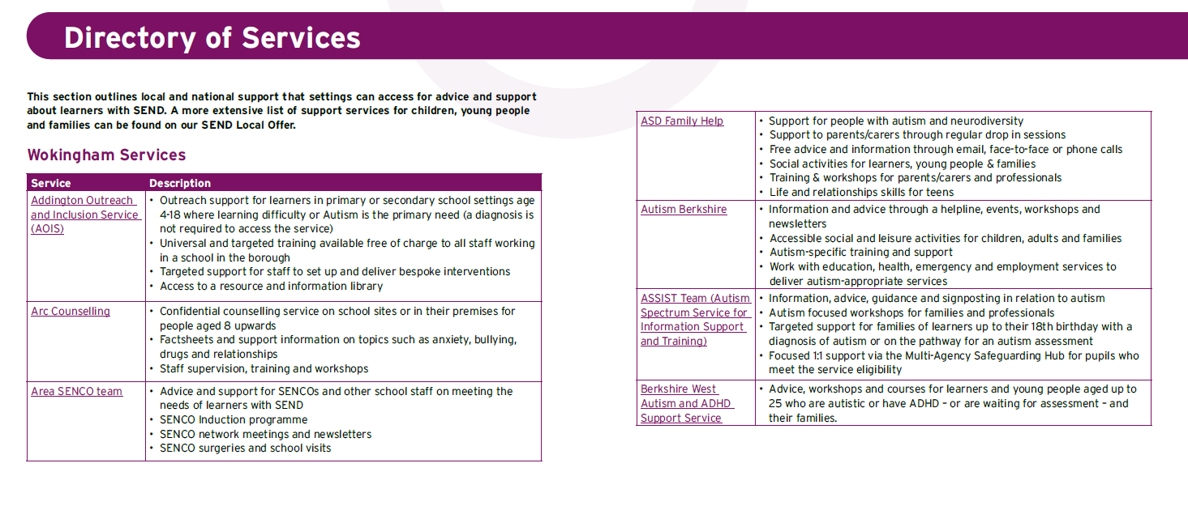
Local and national services: pages 8-17
Notes:
This section lists the different services that are available in the local area.
Some of them are services that schools can go to for support such as our outreach services, EP service, Area SENCO team or different departments within WBC.
Others are charities or organisations that families or young people can access such as ASSIST, the Me2Club,
On the online version, there is a link to more information about each service. Families are still encouraged to look at our local offer for a more extensive list.

Slide 8
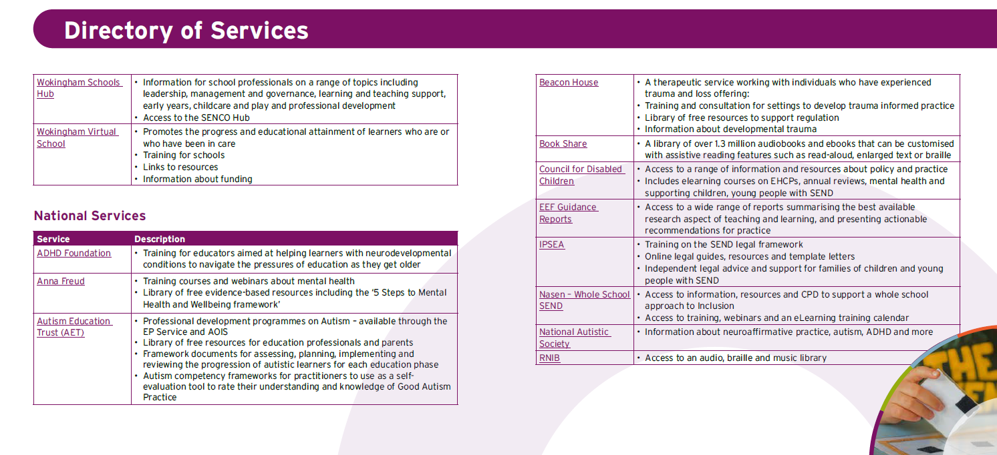
Local and national services: pages 8-17
Notes:
You can see that some of the national services that may support you in your roles have also been included.

Slide 9

General Strategies: pages 18 - 31
This section outlines the reasonable adjustments and general approaches that all settings should implement to support the inclusion of all learners including those with SEND.
This section is organised into the following key areas:
Leadership and management
Teaching and learning
Assessment
Partnership with learners and their families
Transition
The physical and sensory environment
Pastoral
Each section lists between 1 and 3 key expectations and describes the strategies schools need to implement in order to achieve the expectations.
Notes:
The next part of the guidance outlines the reasonable adjustments and general approaches that all settings should implement to support the inclusion of all learners including those with SEND.

Slide 10
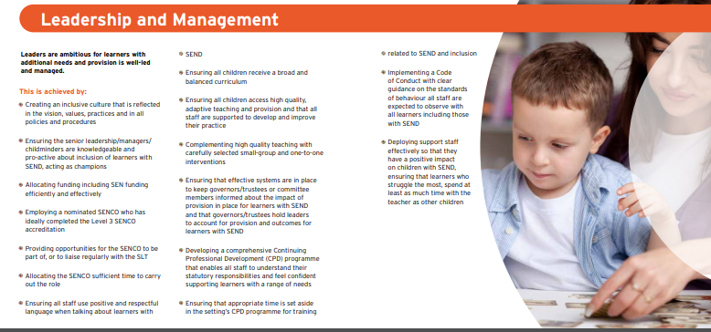
Notes:
The working party all agreed that a leadership and management section was vital
This section has one overarching expectation here in bold. Underneath here we then have the strategies that should be implemented to achieve this expectation (pick out a couple of examples).
It is important to read this section alongside others that might be more relevant to a learner’s specific needs

Slide 11
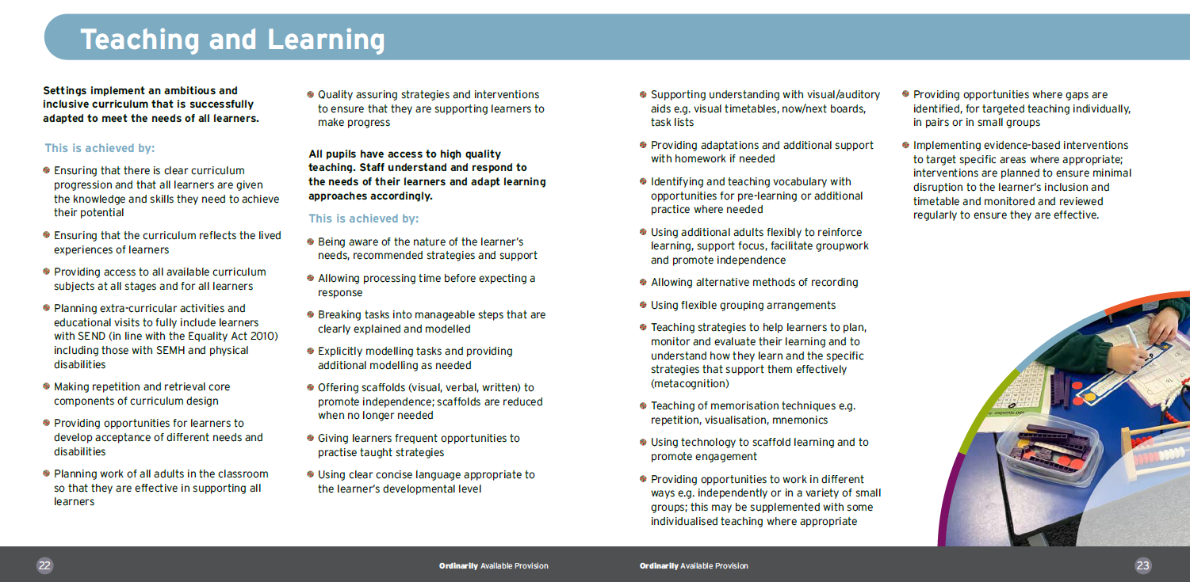
Notes:
This is the teaching and learning section. In this section there are two overarching expectations – one centred around an ambitious and inclusive curriculum and the other about adaptive learning approaches.
Give staff time to read through this page.
Any comments?
Can they think of learners who might benefit from some of these strategies?

Slide 12
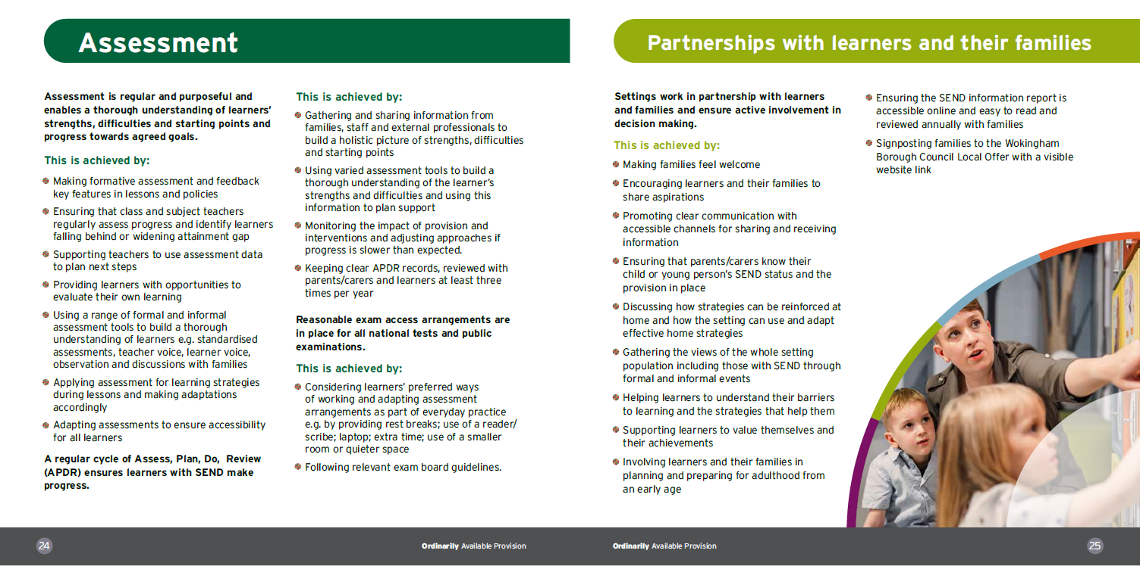
Notes:
The next two sections are on assessment and partnerships with learners and their families.
The assessment section has expectations around regular and purposeful assessment, the assess, plan, do, review cycle and exam access arrangements.
The partnerships with learners and their families section emphasises the importance of working in partnership with learners and their families.

Slide 13
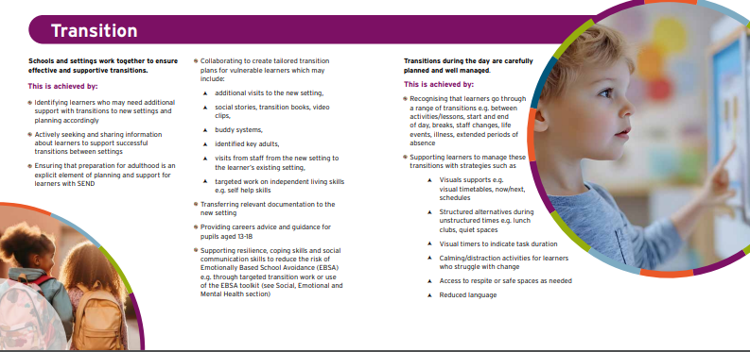
Notes:
This next section is all about transition. It covers transitions between settings and those that happen throughout the day.
Presenter may want to go through the ‘transitions during the day’ bullet points and ask ‘which of theses things are you already doing?

Slide 14

Notes:
The physical and sensory environment section lays out the reasonable adjustments that could be made to the physical environment and to the sensory environment.
This includes things such as ensuring access to supportive equipment or resources, using technology to support alternative recording methods and accommodating individual sensory sensitivities including uniform adjustments.

Slide 15
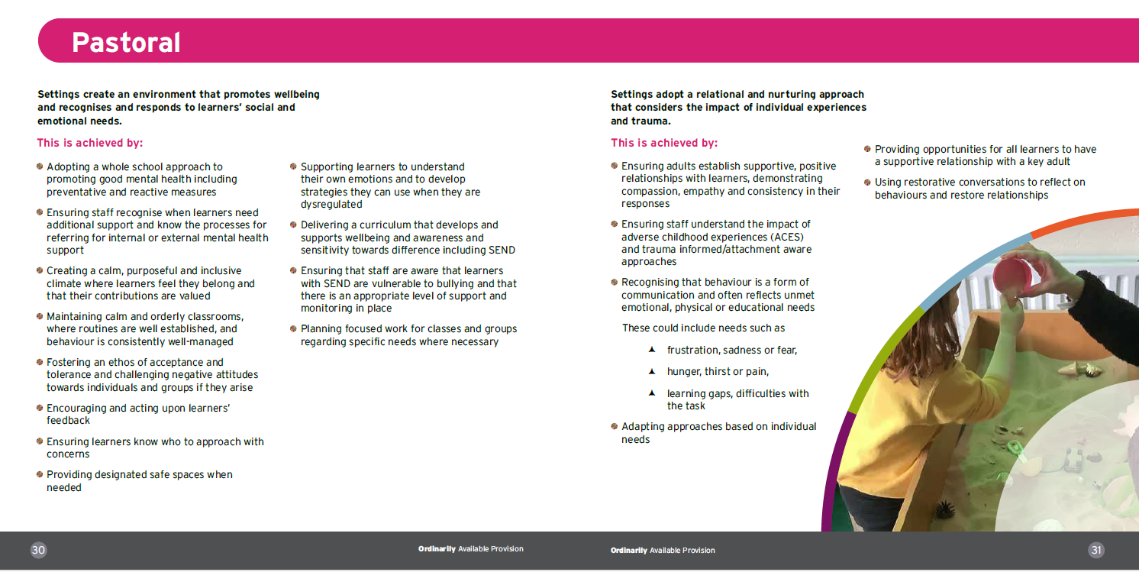
Notes:
The final section in the General Strategies section is the pastoral section. There are two overarching expectations.
Allow staff to look read this section. Can you think of any learners who would benefit from the strategies in this section?
Which of these strategies do we already do well? Are there any that we could do more consistently? Are there any that we are not yet doing?

Slide 16

Support for the broad areas of need: pages 32-55
This section details the support and provision that should be available for learners with SEND across the four broad areas of need:
Communication and interaction
Cognition and learning
Physical and sensory
Social, emotional and mental health
Strategies should be implemented alongside those in the General Strategies section.
These broad areas encompass a wide range of needs; effective support requires a detailed understanding of each individual learner.
Notes:
The next section is Support for the broad areas of need.
This includes more detail about some of the strategies you might use for pupils exhibiting difficulties in one of the four broad areas of needs.
It is important to remember that young people do not fit neatly into boxes and each child will have a unique profile of strengths and difficulties, but this helps to identify strategies for specific areas of need.
These strategies should be implemented alongside those in section 1.

Slide 17
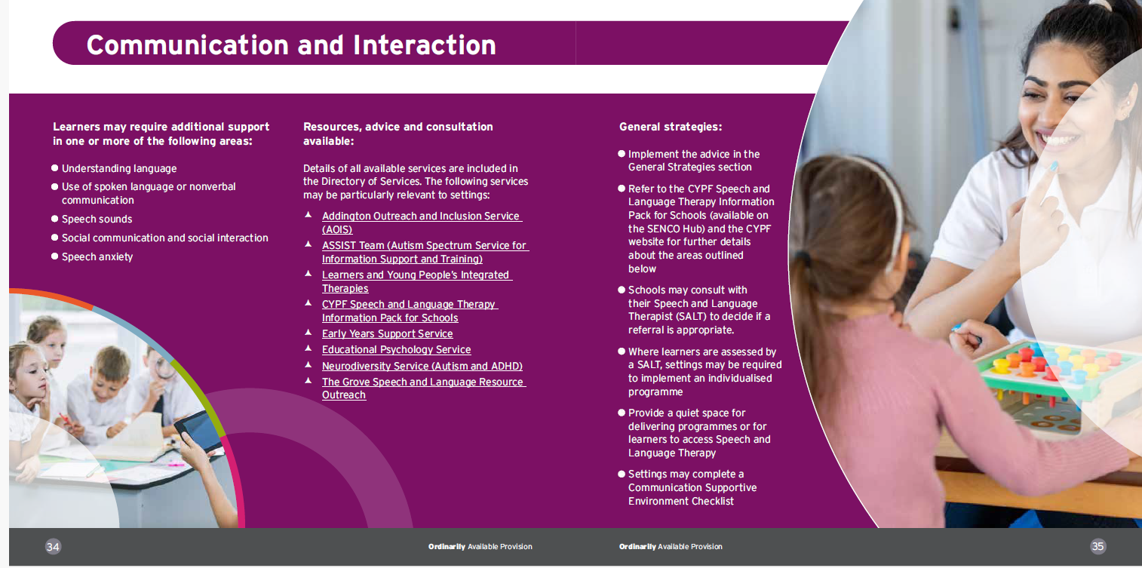
Notes:
Each of the four subsections are organised in the same way. This is the communication and interaction section. It starts by summarising the areas in which learners may require additional support.
It also lists some of the services from the directory that might be particularly pertinent for learners with needs in this area.
There are then some general strategies that might be appropriate for any learner with communication and interaction needs

Slide 18
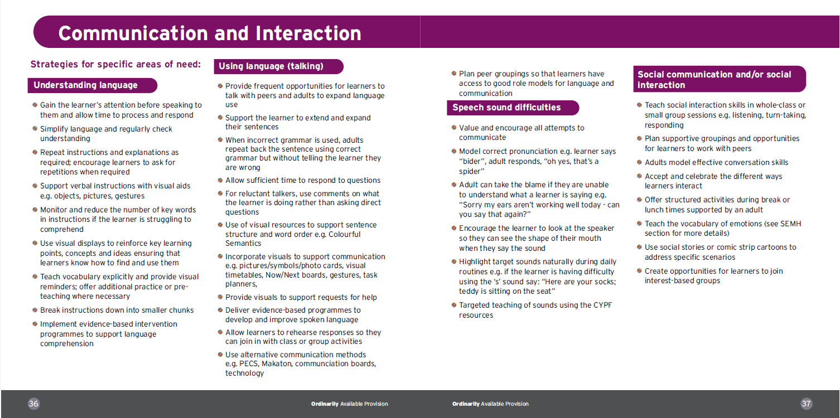
Notes:
The next part has the suggested strategies for each of the specific areas of need.
For instance if you have a child who has a difficulty with understanding language or talking etc you can find the specific difficulty and then will be able to see the suggested strategies.
Have a look the strategies you might use for a pupil who is having difficulty making speech sounds.

Slide 19
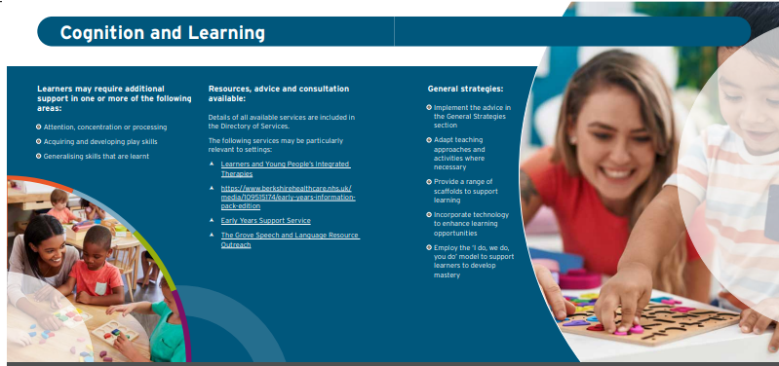
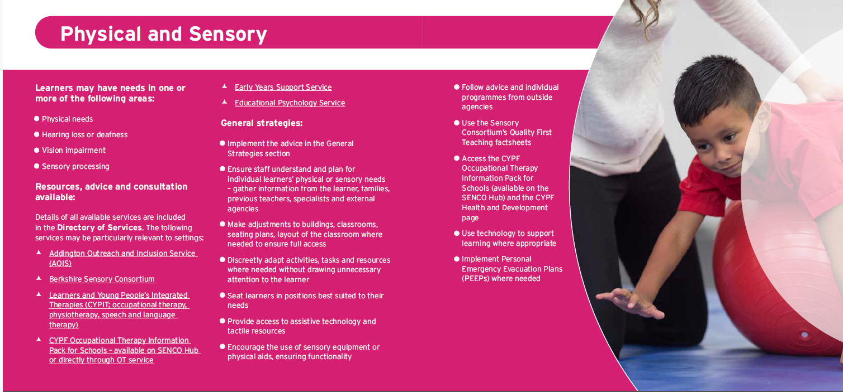
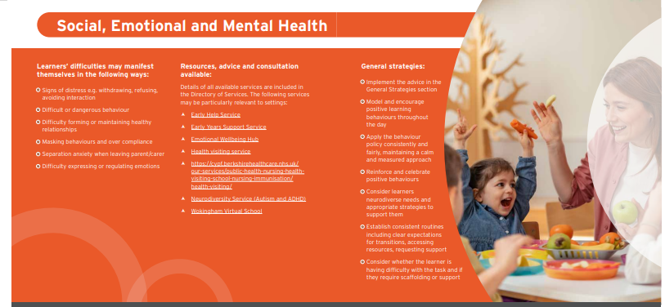
Notes:
Each of the remaining 3 sections are set out in the same way as the communication and interaction section.

Slide 20
Task
Find the sections in the guidance that might support one of the following pupils:
Child A is working below expected levels across all areas. He is pre verbal although will point and gesture. He will not engage in adult led activities but can be highly focussed on his own interests.
Child B has experienced some traumatic events. She often gets overwhelmed and will scream and push others away.
She will try and escape out of the room.
Notes:
Encourage staff to find the document online
Give them time to have a look through the guidance
Alternatively, ask them to think about a learner they work with. Consider the needs of the child (remember we think about needs not diagnoses). Which sections would be relevant to the learner you are thinking about?

Slide 21

Putting it into practice
Training offer
Panel responses may link recommendations to OAP
Possibility of a localised Inclusion Quality Mark
Guidance and resources uploaded to SENCO Hub
Offer of SEND reviews to mainstream settings to evaluate practice
SEND team training
Ongoing support from existing services e.g. EPs, Area SENCO, outreach
SENCO Induction Programme
Notes:
It is important that we all use the guidance in this document
These are some of the ways we are ensuring that everybody knows about it and understands how to use it.

Slide 22
Inclusion Champion Training
Book now
6 Practical sessions

Slide 23
Questions?
Queries?
Comments?

