Slide 1





SBM Briefing - 23rd February 2026
Please pop your name and school into the meeting chat
Please ensure your microphone is muted during the meeting unless you are asking a question.
If you have any questions, please use the “raise your hand” function on Teams or write them down in the chat.

Slide 2

Time | Topics | Presenter
10:00 -10:05 | Welcome
10:05 -10:15 | Utilities Update | Matthew, Jim, Tom and Paul
10:15 11:00 | Schools-financial-value-standard (SFVS) Register of Certified Officers (RCO) Asset Leasing Private fund account 25/26 Year End Close down Calendar/Closedown Accruals
11:00 -11:15 | Pupil Projection Update | Oliver
 | FY26/27 Budget Planning
 | Deficit School
 | 3 to 5 – Year Plan
 | DfE Financial Benchmarking Grants
11:50 12:00 | Questions & AOB

Slide 3


SFVS
Please use the checklist form available on the SFVS Gov.uk website - do not use an old template – the Government make changes to the form every year.
Question 16: Feedback from DfE
The related party transactions form is mandatory – even if this is a null return.
Schools should submit their SFVS checklist to their local authority no later than:
31st March 2026
https://www.gov.uk/government/publications/schools-financial-value-standard
Ensure your Register of Certified Officers (RCO) is up to date as the Chair of Governors will be signing YE submissions
Register of Certified Officers (RCO)
Spring holiday: Mon 30th Mar 2026 to Mon 10th Apr 2026

Slide 4

Asset Leasing Private Fund Accounts NatWest
Asset Leasing:
Please ensure you have completed: Friday, 6 March 2026
If you haven’t received the email, please do advise so we can resend it
Housekeeping:
All potential lease agreements should be submitted to WBC BEFORE they are agreed and signed
When sending the lease for approval, please confirm the individual cost price of each asset on the lease
You should submit your lease agreements to the Schools Finance Helpdesk
Please follow up with your lessor for a countersigned copy of the agreement
Private Fund Accounts:
Please ensure you have the schools private accounts audited annually
Please submit a copy of the audited accounts to the Schools Finance Helpdesk
NatWest:
Annual review of your signatories.
Videos to help you get the best out of Bankline | NatWest Business

Slide 5
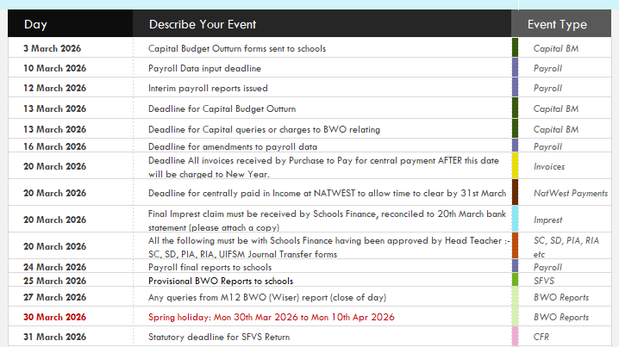
25-26 Year End Closedown Timetable
The Timetable is available on the website:
Timetable

Slide 6

25-26 Year end Closedown
Please ensure your P11 reports match to BWO.
Notify Schools Finance with any anomalies as soon as possible.
Key Dates:
20th March 2026:
Deadline for centrally paid invoices
Final imprest
Approved accruals journals (SC, SD, PIA, RIA, UIFSM)
25th March 2026:
BWO reports to schools
27th March 2026:
Queries on BWO reports to SFH
31st March 2026:
SFVS from schools to WBC
Spring holiday: Mon 30th Mar 2026 to Mon 10th Apr 2026

Slide 7
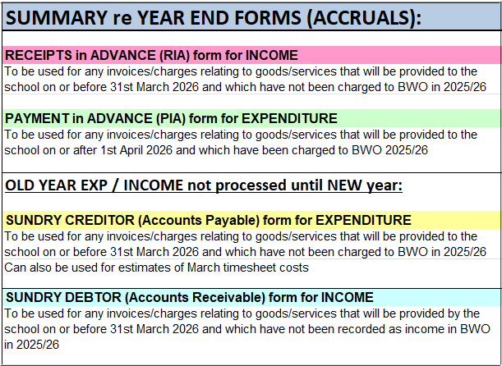

Accrual Forms
New Template
Submission process
Accruals:
Utilities (Gas, electricity & Water) accruals can be under £1,000. Utilities colleagues can advise on values if required. Include Feb & March.
Property repairs up to end of February – accrue for March only.
PPG payment due with WBC 31st March 2026.
PE Grant payment due with WBC 30th April 2026
Income from School lettings / other income
Expenditure
Accrual forms and UIFSM calculator can be located on the below link on the Schools Finance Closedown page:
All accruals should be replicated on FMS/Access if you are submitting to be uploaded onto BWO.
Closedown Forms and Guidance

Slide 8

Budget Plans
Guidance for completion
As part of your SFVS commitments you are required to submit a balanced 3-year budget plan to the LA.
We will send out a 5-year plan template from BWO, you may submit your own template.
INCOME:
Key changes to the schools NFF in 2026-27 are the incorporation of the NI grant and the Schools Budget Support Grant.
Due to changes in the Growth fund we were able to almost achieve the NFF. APT will soon be available on the Schools Finance Website
EXPENDITURE:
NI no change – remaining at 13.8%
Teachers Pension no change – remaining at 23.68%
LGPS due to reduce to 24.9% (currently 26.3%). Diptesh will advise schools in March confirming all rates from April
Support Staff (NJC) Pay – Unions have asked for increase of 10% or £3k. WBC have assumed 4% increase corporately
Teachers Pay – Government is proposing a cumulative 6.5% pay award over three years (26/27 – 28/29). Thie is not a flat annual rise – weighted with smaller increase in the first year to aid affordability
Deadline for submissions to Schools Finance:
Scheme for Financing Schools deadline - 9th May 2026
Schools in deficit will be asked to submit earlier

Slide 9
Deficit Schools & 3–5-year Budget Plans
3-5-year plans
- more scrutiny over the plans and the assumptions. Plans need to show balanced budgets while reflecting known changes.
- Link other school plans to the budget – SDP, Premises, staff
Deficit School framework - setting out the steps for schools and the Council.
Duties and responsibilities for schools
Role and responsibilities of WBC

Slide 10

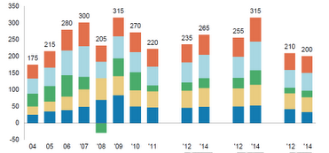
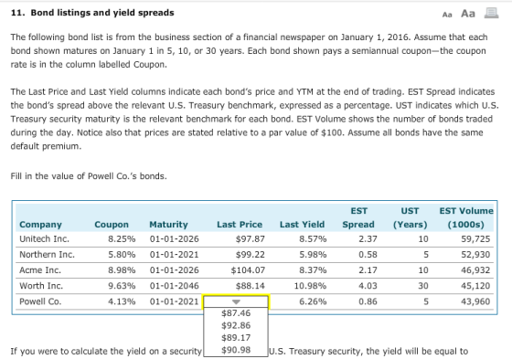
DfE Webinar: DfE Financial Benchmarking and Insights Tool (FBIT)
Benchmark your school’s spending against similar institutions
Identify areas for improvement and share best practice
Build a workforce deployment plan using the integrated curriculum and financial planning tool
Access commercial resources, frameworks, and guidance from the DfE
Generate reports to support conversations with leadership and governance teams
Power Hour: DfE Financial Benchmarking and Insights Tool (FBIT) Tickets, Thu, Feb 26, 2026 at 3:00 PM | Eventbrite
10

Slide 11

GRANTS
Latest grant changes for 2026-2027
Rolled into NFF for 2026 to 2027
NIC
SBSG
EYNTPG
Updated information will be available on the Grants SharePoint hub.
Expecting but unconfirmed for 2026-2027
Pupil Premium
UIFSM
PE & Sports Grant
ITTECF
ECTE

Slide 12
Pupil Premium
The pupil premium will continue in the 2026 to 2027 financial year. For 2026 to 2027 the October 2025 school census data will be used to allocate the pupil premium
28th June 2026 – in the P4 report
30th September 2026 – in the P7 report
31st December 2026 – in the P10 report
31st March 2027 – to be accrued at YE
As soon as we have notification from the DfE we will advise the schools of the rates
UIFSM
Schools will still receive funding for Universal Infant Free School Meals (UIFSM) in the 2026-27 academic year. The government has announced that free school meals will be extended to all children in households receiving Universal Credit starting from September 2026, and there are no proposed changes to the funding allocations for this expansion.
PE & Sports Grant
If DfE run this grant for 2026/2027 we would expect the payment to LA’s to mirror last year as follows:
7/12 of the funding allocation on 31st October 2026
5/12 of the funding allocation on 30th April 2027
As soon as we have notification from the DfE we will advise the schools of the rates.

Slide 13
Initial Teacher Training and Early Career Framework (ITTECF)
Covers the training and induction periods at the start of a teacher’s career and combines and replaces the previously separate Initial Teacher Training (ITT) Core Content Framework (CCF) and Early Career Framework (ECF)
Initial teacher training and early career framework - GOV.UK
Early career teacher entitlement (ECTE)
From September 2025 the term early career teacher entitlement (ECTE) replaces ECF-based training and induction. Settings do not need to make an application for this funding.
The DfE will collect evidence through their manage training for early career teachers service portal.
Early career teacher entitlement - GOV.UK

Slide 14




ANY QUESTIONS?
Feedback form

