Slide 1
Pedagogy and Practice
Ian Nicholson
Senior National RE Adviser
Wokingham primary teacher meeting - 14th January 2026

Slide 2

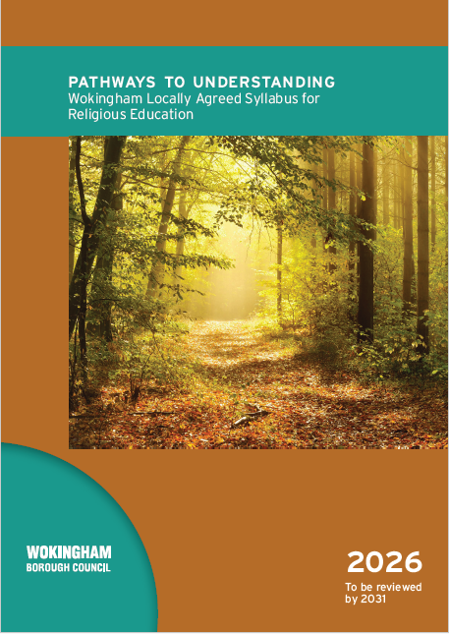
Aims for today
To increase understanding of the legal requirements of the Wokingham Agreed Syllabus for RE
To develop first stage planning for the implementation of the Wokingham Agreed Syllabus for RE
To work collaboratively on planning for the implementation of the Wokingham Agreed Syllabus for RE

Slide 3

Notes:
What can you remember about the pedagogy of RE?

Slide 4



3 Types of Knowledge Used in RE
Substantive
Disciplinary/Ways of knowing
Personal
Notes:
Those of you who have been keeping an eye on Ofsted will know there’s lots of talk about 3 kinds of knowledge. Getting better at RE comprises knowing and remembering more of each.
I’m going to talk about the first and third so briefly that I’m not going to do them justice, but a great place to start to find out more is Ofsted’s research review from May 2021.
Substantive: knowledge about various religious and non-religious traditions. In the May report, we have the stipulation that ways of knowing will be taught alongside this rather than being artificially separated out.
Personal: pupils build an awareness of their own presuppositions and values about the religious and non-religious traditions they study – there’s an emphasis on getting to know oneself.

Slide 5
Deep and Meaningful 2024
“Schools should be ambitious for pupils to develop all aspects of knowledge: substantive, ways of knowing and personal knowledge.”
These 3 types of knowledge are explained in Ofsted’s research review (May 2021). In the most recent subject report (April 2024), findings are put under these 3 areas.
They are also in the Statement of Entitlement and the RE Directory in a similar format.
Ofsted, April 2024

Slide 6
The role of ways of knowing in RE
In most of the schools we visited as part of the sample, pupils were taught generalisations, for example that all followers of a particular religion might worship in the same way. Misconceptions communicated to pupils through the curriculum demonstrated a lack of subject knowledge.
Most schools said that they had artefacts from different faiths. However, they were not always used in a way that developed pupils’ ways of knowing.
Although a few primary schools recognised the importance of laying foundations that would enable pupils to recognise different ways of knowing in RE, most did not. Most schools had not chosen to include this as part of their curriculums. Some did not see the relevance of this. Few schools considered different disciplinary aspects, such as discussing where, around the world, followers of different traditions lived in the past and live today.

Slide 7


Ofsted Toolkit 2025
Inspectors consider the extent to which:
The curriculum has subject specific rigour, so that pupils gain disciplinary knowledge and can answer subject-specific questions – page 21

Slide 8
What does the word Biblos mean?
It is rightly observed that the Bible is not a book, but a book of books. In the same way theology and religious studies is not a discipline but a discipline of disciplines.
The University of Cambridge

Slide 9
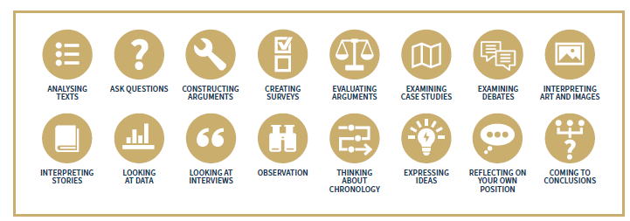
Which tools and methods with which discipline?

Slide 10
Disciplines
Sociology
Psychology
Philosophy
Theology
Methods
Surveys
Interviews
Comparing views
Analysing texts
Tools
Questionnaire
People
Debate
Literary criticism

Slide 11
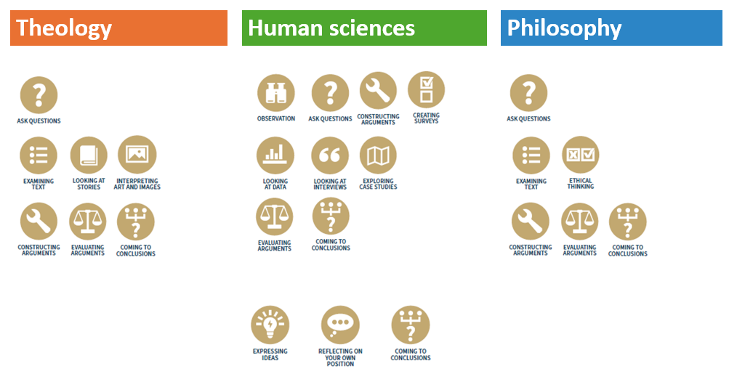

Slide 12
Personal Knowledge
The Qur’an is never placed on the floor. The words are holy, so the book is often read from a special wooden stand. | Muslims wash their hands before touching the Qur’an. The book is honoured and kept clean from dirty fingers. | Some Muslims learn the whole of the Qur’an by heart. This can take several years. People who have done this are called ‘Hafiz’.
When not in use, the Qur’an is kept wrapped in a clean cloth, on the highest shelf. The book is ‘above all other books’ and one way to show this is by keeping it above other books. | If a copy of the Qur’an is worn out, it is not thrown in the bin. It is buried. The old book would be wrapped in cloth and buried in a safe place – maybe next to the mosque. | Muslims do whatever the Qur’an tells them to do. To obey the teaching is hard, but perhaps it is the whole point of respecting the book.
The Qur’an is often bound in leather with golden letters on the front. These beautifully made copies of the Qur’an are treasured by those who own them. | The Qur’an is recited, or chanted. Crowds at the mosque listen carefully to what it says. Friday prayers at the mosque are the time for listening to the Qur’an. The first chapter is part of the five daily prayers too. | The Qur’an is written in Arabic. Muslims learn Arabic, to read it. Mosques often have classes to teach children this language, so they can recite the Qur’an themselves.

Slide 13
But which why of knowledge is this?
Your local library has been thinking about how we show respect for all people in our communities, including people from different religions.
Some people say: ‘Libraries should not have holy books in them, in case people are not respectful.’
But your library has decided to have copies of holy books from all different religions. They ask you to make a poster that will help people to respect the Qur’an. There is an example on the next page.
Think of 4–6 points your poster might include. Design it carefully.
Call the poster: ‘The Muslim Qur’an: how to show respect’.

Slide 14
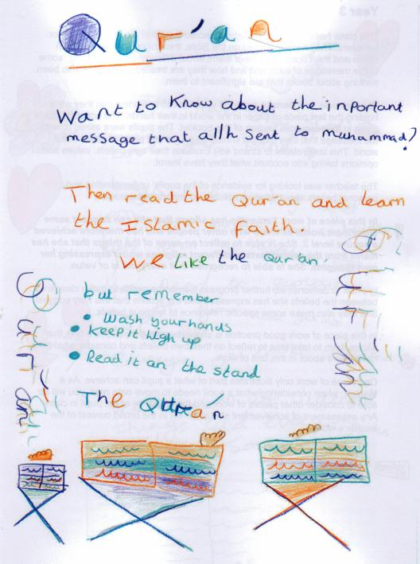
Iman
Sociological
Sociological
Akhlaq

Slide 15
Using the Wokingham Agreed Syllabus for RE
EYFS | KS1 | Lower KS2 | Upper KS2
Christianity School Choice Non-religious worldviews | Christianity Hindu Dharma Judaism Non-religious worldviews | Christianity Islam Non-religious worldviews including Humanism Sikhi | Christianity Hindu Dharma Judaism Sikhi and/or Buddhism and/or Islam and/or Humanism
Page 10

Slide 16
Three types of units
Core
Two lessons at the beginning of each year
Compulsory
Christianity in every year
Specified religions and NRWV
Optional
School decision over ‘other’
UKS2 choice of religions to supplement compulsory

Slide 17
EYFS
School Choice and Decision
Christianity, An Abrahamic religion and a Dharmic religion
NRWV
Fit into the EY curriculum or discrete RE
Core Questions
What does it mean to be kind? Why are some people remembered by others? Why are some places special? Why are some occasions special? What can we learn from stories? Why are some items and actions special?

Slide 18
Key Stage 1
CHRISTAINITY | HINDU DHARMA | JUDAISM | NRWV | OTHER IF YOU WANT
Compulsory in Year 1 and Year 2 | Place in Year 1 OR Year 2 | Place in Year 1 OR Year 2 | Place in Year 1 OR Year
Specific questions are on page 11 of the Agreed Syllabus
Core questions and material pages 36 to 38
Exemplar activities are on pages 18 to 21

Slide 19
Lower Key Stage 2
CHRISTIANITY | ISLAM | NRWV INCLUDING HUMANISM | SIKHI | OTHER
Compulsory in Years 3 and 4 | Place in Year 3 OR Year 4 | Place in Year 3 or Year 4 | Place in Year 3 or Year 4
Specific questions are on page 22 of the Agreed Syllabus
Core questions and material pages 38 to 40
Exemplar activities are on pages 22 to 25

Slide 20
Upper Key Stage 2
CHRISTIANITY | HINDU DHARMA | JUDAISM | ISLAM BUDDHISM SIKHI HUMANISM | ISLAM BUDDHISM SIKHI HUMANISM | OTHER
Compulsory in Year 5 and Year 6 | Place in Year 5 OR Year 6 | Place in Year 5 OR Year 6 | Choose 1 and place in Year 5 OR Year 6 | Choose 1 and place in Year 5 OR Year 6
Specific questions are on page 25 of the Agreed Syllabus
Core questions and material pages 40 to 42
Exemplar activities are on pages 25 to 30

Slide 21
Humanism guidance – Clare Walsha, Wokingham SACRE member
Clare Walsha - A certified school speaker for Humanists UK
https://understandinghumanism.org.uk/ - resources grouped by topic, and then by age range (5+, 7+, 11+, 14+, 16+) and type (overview, presentation, information, activities, other resources)
Teacher training — regular webinars plus bespoke training:
https://understandinghumanism.org.uk/training/
FREE Humanist school speakers:
https://understandinghumanism.org.uk/school-speakers/
FREE online course:
https://understandinghumanism.org.uk/online-courses/

Slide 22
Additional Humanism materials
Guide to the website: https://understandinghumanism.org.uk/teaching-about-humanism/how-to-use-understanding-humanism/
Conway Hall virtual tour: https://understandinghumanism.org.uk/conway-hall-virtual-tour/
Humanist perspectives for GCSE: https://understandinghumanism.org.uk/perspectives/
Articles: https://understandinghumanism.org.uk/articles/

Slide 23






VOCO Hotel, Solihull
31st January 2026
Follow @NATREupdate
Join in on the conversations using #StrictlyRE
Notes:
23

Slide 24
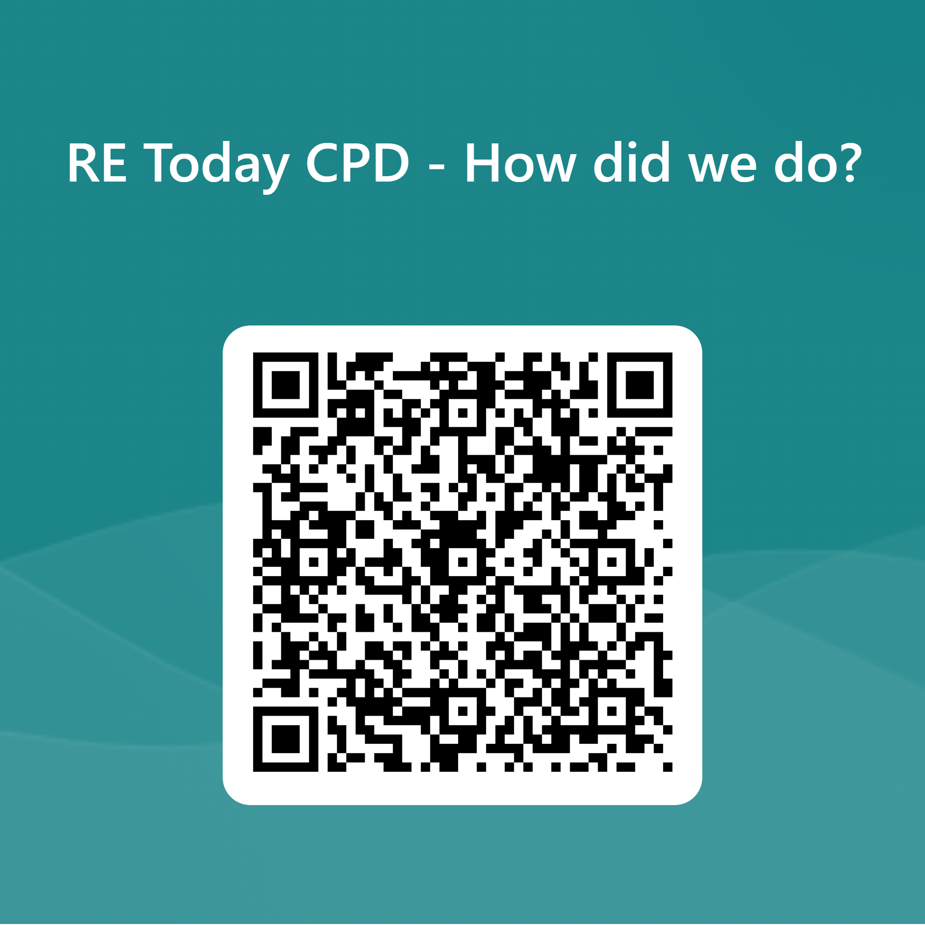
Your feedback is essential in shaping our courses to ensure they meet your expectations and requirements.
By sharing your feedback, you help teachers select the most effective and high-quality courses for teaching Religious Education.

