Slide 1
DATE | ACTIVITY | Notes
Monday 11th May 2026 | Deadline for expressions of interest to be submitted to ChildrensCommissioningTeam@wokingham.gov.uk (FAO: Laura Mackenzie) | This doesn’t need to be the full application – include a brief overview of the provision and intended outcome, the name of the key contact leading the project and their contact details.
Tuesday 19th May 2026 | SENDAP Working Group - Expressions of interest to be shared with the SENDAP group for discussion and coordination of bids to be negotiated (i.e. Are they complementary? Do they address the right needs?) | Representation from any bidding schools should be present at this meeting.
Monday 15th June 2026 | Deadline for full applications to be submitted by this date. Please send a completed application form to ChildrensCommissioningTeam@wokingham.gov.uk (FAO: Laura Mackenzie) | Applications will be accepted before this date. Note: schemes with trust/school capital contribution may be prioritised if funds are oversubscribed
Tuesday 16th June 2026– Tuesday 23rd June 2026 | Applications will be shared with members of the SENDAP working group. | Should any clarifications be needed, they will be circulated to the applicant.
Tuesday 30th June 2026 | All applications will be discussed at the SENDAP working group. SENDAP to reach a decision as to which applications to recommend for approval. | Applicants will present a summary of their application and answer any further questions. Applicants will not be present for other applications.
9th July 2026 | WBC’s Commissioning and Insights Board - Finalise decision & approve funding release. | Confirmation of whether a bid was successful will be received via email by 24th July 2026
23rd July 2026 | WBC’s Education Sufficiency Board - Ratify SENDAP decision

Slide 2
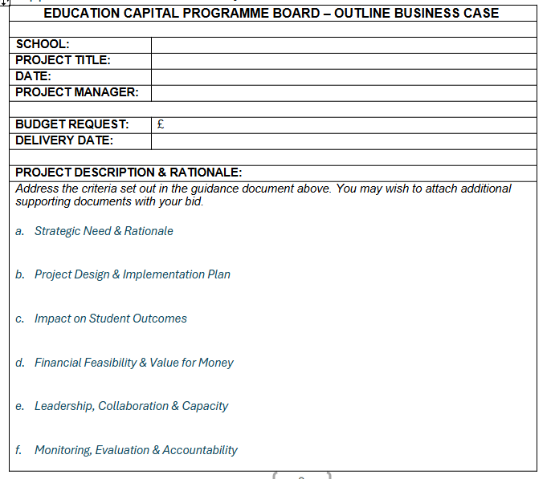
Each of these elements should address the criteria outlined on the application form. However, please ensure the following points are highlighted explicitly:
How does the rationale for your provision address the challenges currently addressed by external AP and how will this change your school AP data, as well as the data outlined in the application form ? Link this to the impact on both financial and pupil outcomes data.
If your provision is to focus on a smaller cohort, ensure you have outlined how this may change and develop to address the needs of pupils from other schools / phases over time (include timescales).

Slide 3
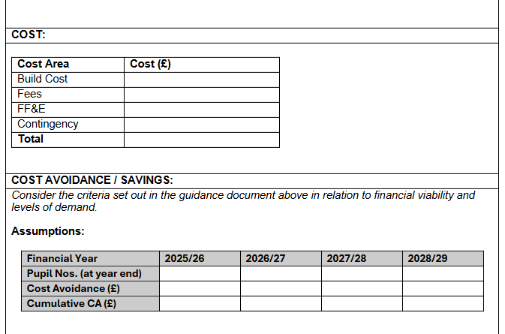
Cost:
Outline how the capital costs will be divided between each category.
(FF&E = Fittings, Fixtures and Electrical)
Cost Avoidance:
This section should outline how the provision will save money compared to the current spend on AP year-on-year. This can be linked to your in-school spend on AP, and/or the wider cost saving to WBC.
It would be helpful to think about the unit costs (average impact per pupil) as well as the total cost so projections can be made regarding the savings to WBC as a whole, as well as individual school budgets.
Please provide explanatory information in your own format, underneath the table, should you feel it necessary.

Slide 4
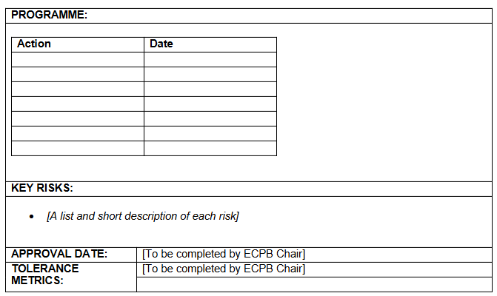
Programme:
Please outline the timeline of actions that will be undertaken to set up the provision.
Please also include actions that will be undertaken as the provision develops.
Please ignore the approval date and tolerance metrics.
This application will be scored using the scoring matrix and recommendations will be taken to the Sufficiency Board following the scoring process as outlined on the next slide.

Slide 5
Evaluation Process and Timeline
11th May 2026
19th May 2026
15th June 2026
Full application to be submitted
EOI to be submitted
ChildrensCommissioningTeam@wokingham.gov.uk
16th-23rd June 2026
Applicants present their bids to the SENDAP group
Scores and feedback collated by Strategy, Transformation and Commissioning team
9th July 2026
Recommendations and funding approval is sought at EBC Commissioning and Insights Board
All EOIs to be shared at SENDAP working group
Those who have expressed an interest to attend this meeting
Send to ChildrensCommissioningTeam@wokingham.gov.uk
Applications will be circulated to members of the SENDAP working group
30th June 2026
23rd July 2026
Outcome decision shared with applicants and SENDAP group at the earliest opportunity.
Decisions ratified at WBC Sufficiency Board

